Slide 1

Parameter Configuration & L2 Creative Writing
How AI Parameter Settings Shape DDL Scaffolding in Poetry
Presenter: Yu Ruobin
Affiliation: English Department, FASS, HongKong Baptist University

Slide 2
Research Question & Experimental Design
🔍 How does parameter manipulation enable dynamic DDL scaffolding?
📊 2×2 Experimental Design (N=10):
• Structured parameters (Temp 0.3, Top-p 0.4) vs. Exploratory parameters (Temp 0.8, Top-p 0.9)
• Awareness condition (aware vs. unaware)
Three Interaction Types:
• Type A: Constraint Repair (corrective feedback)
• Type B: Exemplar Giving (preset options)
• Type C: Surprise Harvest (unexpected ideas)

Slide 3
The Research Platform:
https://poetry.aitutor.ink/
🏗️ Purpose-Built Infrastructure
• Custom poetry writing platform (not commercial AI tool)
• Transparent experimental laboratory with full parameter control
🎨 Design Principles
• Guide, not ghostwriter: AI as writing coach & collaborator
• Parameters exposed as pedagogical variables (not hidden)
• Prompt-designed to support all 3 interaction types
🔬 Research Features
• Complete interaction logging: every keystroke, revision, suggestion
• 4 Virtual rooms with different parameter configurations
• Identical prompts, only parameters vary (clean experiment)

Slide 4
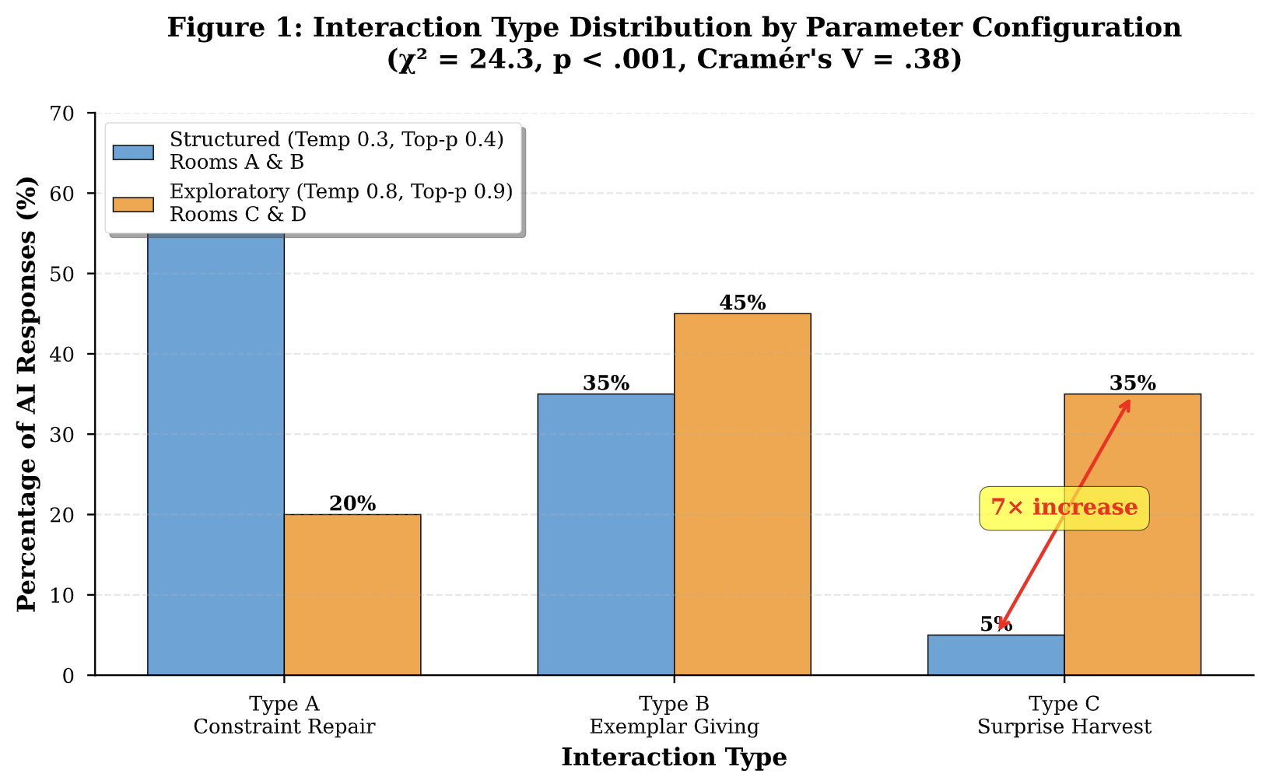
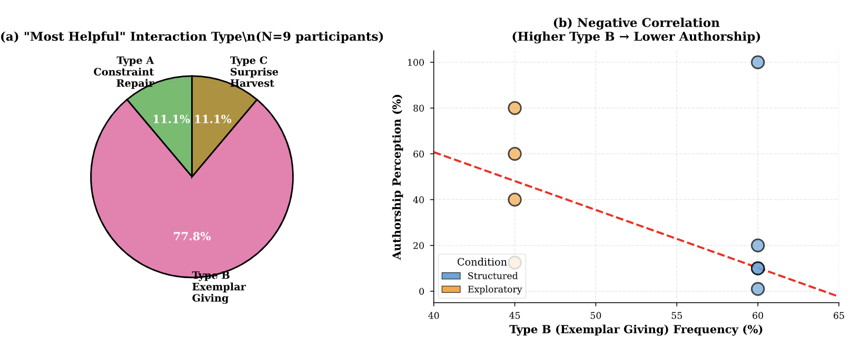
Major Findings
📈 7× Increase in Type C Interactions:
• Structured: 5% Type C, 60% Type A, 35% Type B
• Exploratory: 35% Type C, 20% Type A, 45% Type B
• χ² = 24.3, p < .001 (highly significant)
⚠️ The "Helpful but Alienating" Paradox:
• 78% rated Type B as "most helpful"
• But Type B negatively correlated with authorship
• Structured rooms: avg 28% self-authorship
• Exploratory rooms: avg 48% self-authorship
✨ Type C Enables Ownership:
• Participant preferring Type C reported 80% authorship

Slide 5
Implications & Conclusions
🎯 Parameter Literacy as Essential Competence
Educators must understand how temperature shapes pedagogy
🔄 Parameter Configuration as Pedagogical Lever
AI evolves from pattern-enforcer to pattern-extender
📚 DDL's Evolution, Not Death
AI preserves constructivist discovery when configured for
Type C interactions (exploratory parameters)
💡 Key Insight:
The difference between alienation and authorship may hinge
on adjusting a temperature setting from 0.3 to 0.8

