Slide 1
BACK FACE DETECTION
back-face detection Determination of whether a face of an object is facing backward and therefore invisible. The usual test is whether the surface normal points into the screen or not. Special attention is needed for faces on the silhouette of the object
back-face detection Determination of whether a face of an object is facing backward and therefore invisible.

Slide 2
Back-Face Detection
In a solid object, there are surfaces which are facing the viewer (front faces) and there are surfaces
which are opposite to the viewer (back faces).
These back faces contribute to approximately half of the total number of surfaces. Since we cannot
see these surfaces anyway, to save processing time, we can remove them before the clipping process
with a simple test.
Each surface has a normal vector. If this vector is pointing in the direction of the center of projection,
it is a front face and can be seen by the viewer. If it is pointing away from the center of projection, it
is a back face and cannot be seen by the viewer.
The test is very simple, if the z component of the normal vector is positive, then, it is a back face. If
the z component of the vector is negative, it is a front face.

Slide 3
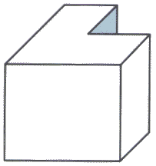
BACK FACE DETECTION

Slide 4
Two Main Approaches
Visible surface detection algorithms are broadly classified as:
  Object Space Methods: Compares objects and parts of objects to each other within the scene definition to determine which surfaces are visible
  Image Space Methods: Visibility is decided point-by-point at each pixel position on the projection plane
Image space methods are by far the more

Slide 5
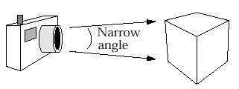
Back-Face Detection
The simplest thing we can do is find the faces on the backs of polyhedra and discard them

Slide 6
Back-Face Detection
We know from before that a point (x, y, z) is behind a polygon surface if:
where A, B, C & D are the plane parameters for the surface
This can actually be made even easier if we organise things to suit ourselves

Slide 7
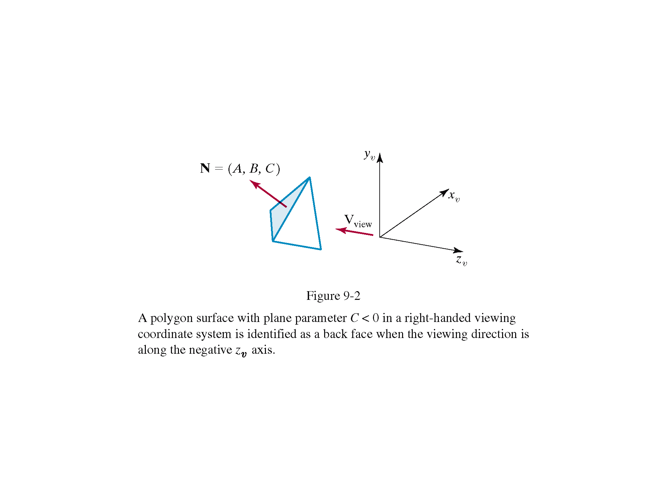
Back-Face Detection
Ensure we have a right handed system with the viewing direction along the negative z-axis
Now we can simply say that if the z component of the polygon’s normal is less than zero the surface cannot be seen

Slide 8
Back-Face Detection
In general back-face detection can be expected to eliminate about half of the polygon surfaces in a scene from further visibility tests
More complicated surfaces
though scupper us!
We need better techniques
to handle these kind of
situations

Slide 9
Back-Face Detection
Visibility : Back-Face Detection
Visibility : Back-Face Detection
Fast and simple object-based system
A point (x,y,z) is “inside” a polygon surface with plane parameters A, B, C, D if :
Ax + By + Cz + D < 0
When an inside point is along the line of sight to the surface, the polygon must be a back face and so cannot be seen

