Slide 1

Exploratory Data Analysis
Project name : Bank Marketing Campain prediction
Using Machine Learning
Team name : Data Scientist Geeks
29 decembre2021

Slide 2

Agenda
Project Details
Executive Summary
Problem Statement
Approach
EDA
EDA Summary

Slide 3
Project details
Team Members Informations
Name of Group : Data Scientist Geeks
Member 1:Refka Mejri - Tunisia/National Engineering School of Tunis
Member 2 :Tasnime Hamdeni - Tunisia/National Engineering School of Tunis
Project Roadmap and Process:
This process is prepared according to the needs of the company and the submission of each week.
Week7
Business understanding and problem description
Week8
Data Analysis and descriptive data study
Week9
Data Preprocessing
Week10
Week11
Week12
Presentation
Preparing the presentation
Preparing the report
Exploratory Data Analysis
Preparing Report
Preparing presenation for EDA and Data Preprocessing
Bulding the machine Learning model for prediction
Week13
Prepare presentation with final results and recommandation for clients.

Slide 4
Executive Summary

Slide 5
Company :
ABC Bank wants to sell it’s term deposit product to customers and before launching the product they want to develop a model which help them in understanding whether a particular customer will buy their product or not (based on customer’s past interaction with bank and other financial Institution)
In order to achieve their goal and need they demand to Data Glacier Company to help them with a AI model for prediction.
Goal :
The Data Glacier company give us as a data scientist team this mission.
We will develop a Ml Model to shortlist customer whose chances of buying the product is more so that their marketing channel can focus only on those customers whose chances of buying the product is more.

Slide 6
Data Understanding

Slide 7
Dataset details :
Bank_additional_full_data details:
Total number of observations | 41188
Total number of files | 1
Total number of features | 21
Base format of the file | .csv
Size of the data | 6.6 MB

Slide 8
Exploratory Data Analysis

Slide 9
Exploratory Data Analysis :
Missing values : After verifiying missing values I conclude that we don’t have missing values in our dataset.
Duplication rows : The dataset contain 12 rows duplicated, I droped them using drop function

Slide 10
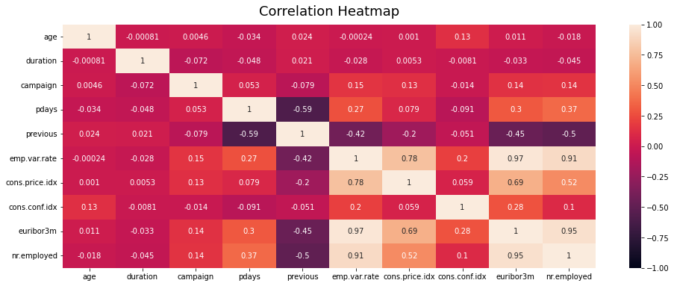
Features correlations
The emp.var.rate, euriborn3m, nr.employed and cons.price.index are the 3 highly correlated attributes.

Slide 11
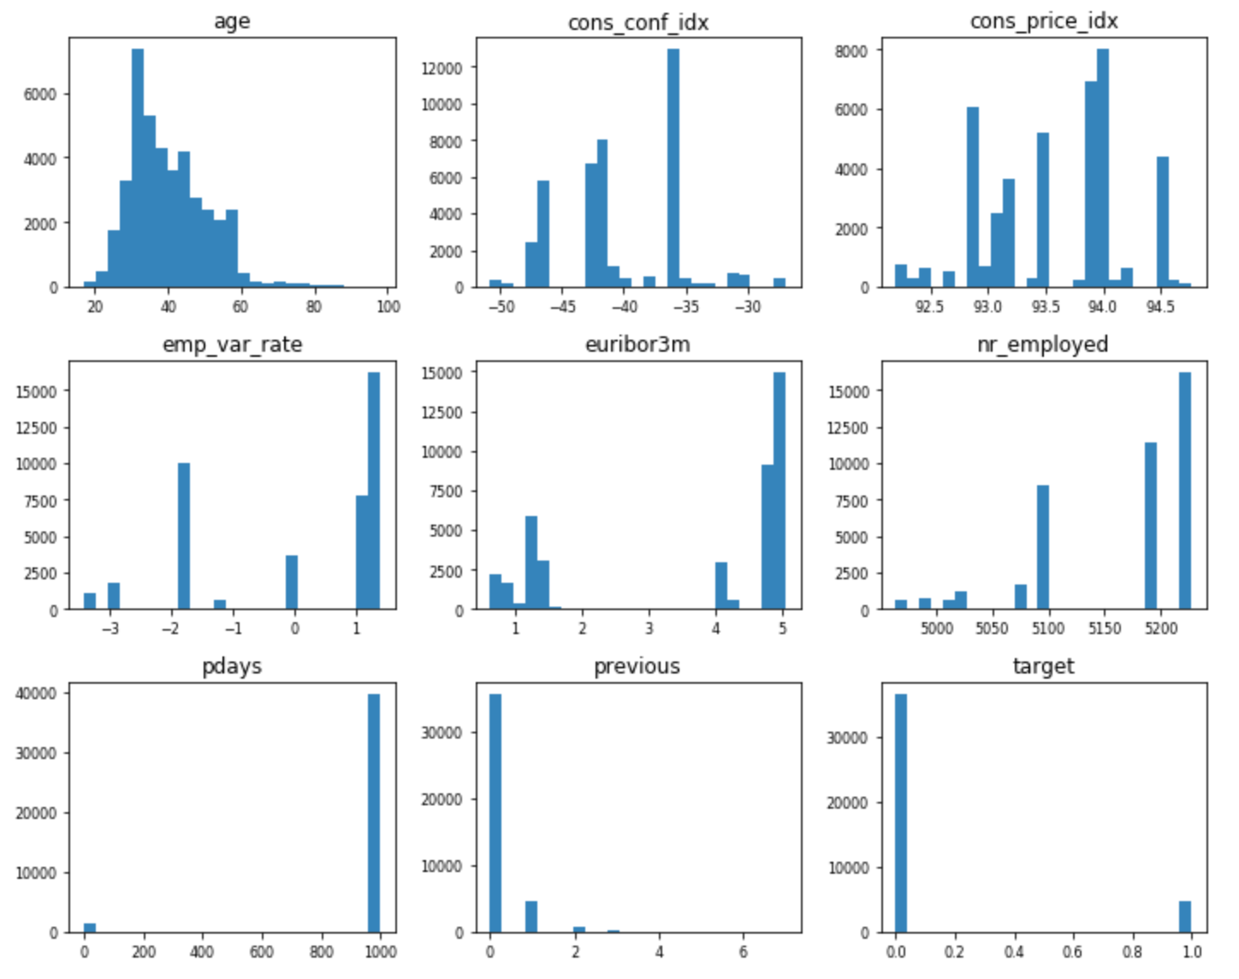
Statistic description
Numerical Attributes Analysis:

Slide 12
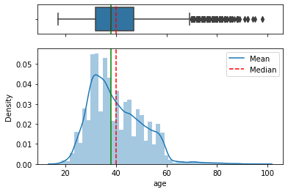
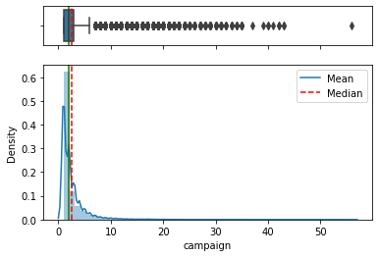
Outlier detection
From boxplot and histogram of numerical variables plotted using univariate analysis, we can see that our data have outlier on age and campain attributes.
We can observe that we have dispersion in our data, specially in the age and campaign attributes.We handle them using percentile and z-score method but, actually we will not drop them.In fact we can see that they have a normal behavior as we work with a real world dataset.

Slide 13
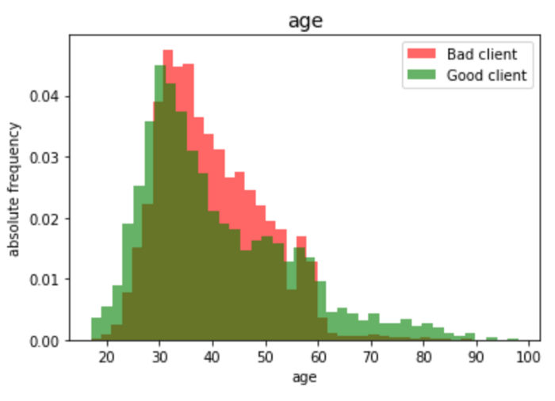
Distribution of customers’age per target
There are more subscribers aged between less than 30 and more than 60 years old than between those from 30 to 60 years old.

Slide 14
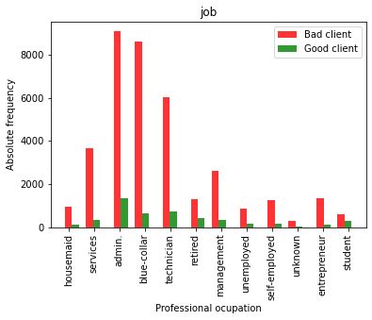
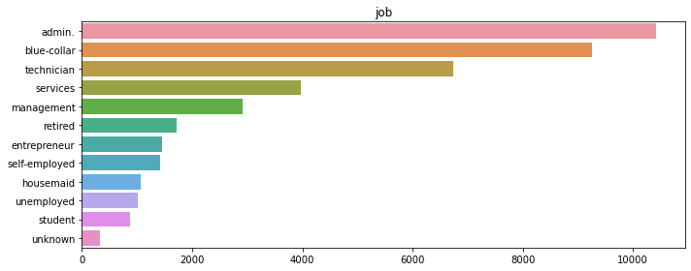
From the second graph, we can conclude that people with admin, blue_collar and technician jobs are more contacted by the bank.It can be explained by their social situation and the bank expectation.
From the first plot, we see student and retired are the more subscribed according to the total numbers of people by job category.

Slide 15
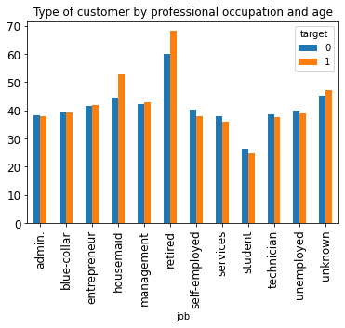
We can observe that retired and housemaid are the oldest customers and the more classe that accepted to subscribe to the term deposit.

Slide 16
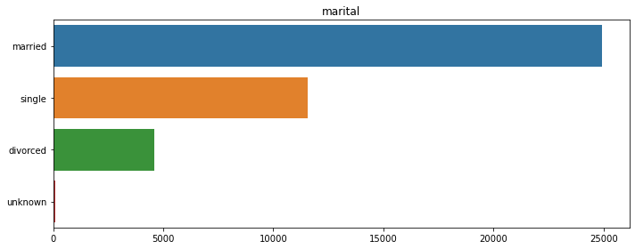
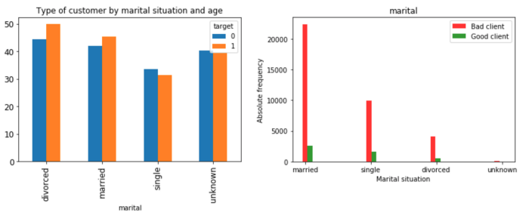
Customer repartition per marital situation and age analysis
The married classe are the dominated classe contacted and subscribed to the term deposit

Slide 17
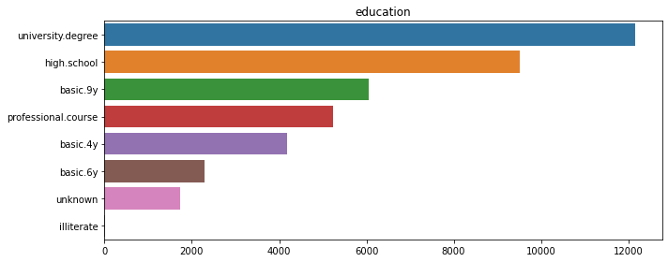
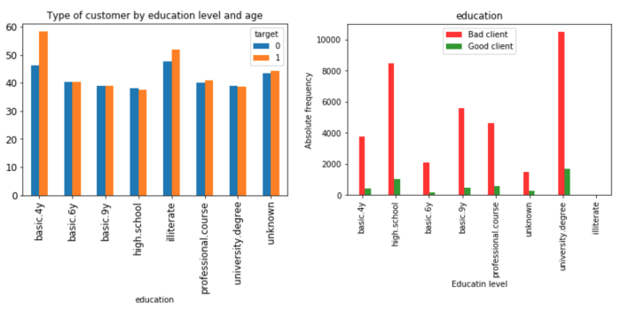
Customer repartition per education and age analysis
The more educated class are the dominated class in term of bank contact and also for deposit subscription.

Slide 18
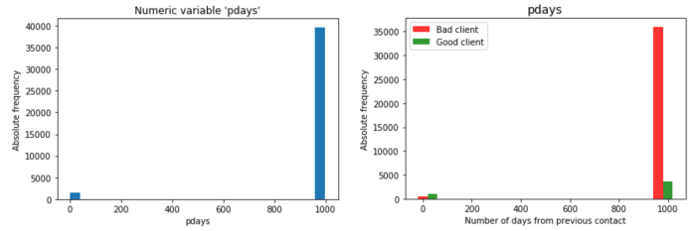
Distribution of Day and also the variable against the target.

Slide 19
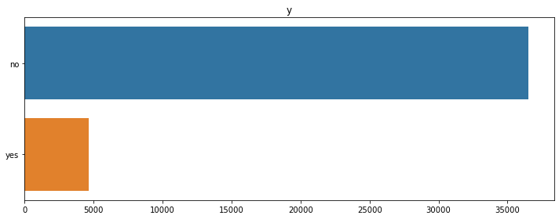
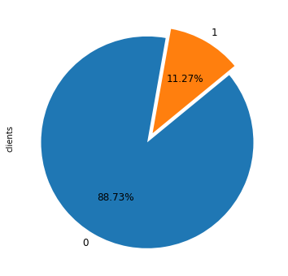
Target repartition and data balencement
The dataset is imbalanced with the class no is higher than the class yes

Slide 20
EDA Summary

Slide 21
EDA summary:
In this section we worked on 3 important steps:
Data Cleaning: where we clean data, verify duplication, missing values and outliers
Data description analysis : We extract information from analyzing visualisation for numerical and categorical attributes.We used univariates and bivariates analysis to extract insight from some attributes.
It’s recommanded to take more time to work and analyze all attributes in order to inderstand well our data and to be able to give more pertinent advice to our client

Slide 22
Thank You

