Slide 1

G2M insight for Cab Investment firm
Virtual Internship
Tasnime HAMDENI
25-Oct-2021

Slide 2
Background –G2M(cab industry) case study
XYZ is a private equity firm in US. Due to remarkable growth in the Cab Industry in last few years and multiple key players in the market, it is planning for an investment in Cab industry.
Objective : Provide actionable insights to help XYZ firm in identifying the right company for making investment.
The analysis has been divided into four parts:
Data Understanding
Forecasting profit and number of rides for each cab type
Finding the most profitable Cab company
Recommendations for investment

Slide 3
Data Exploration
Assumptions:
Seasonality in number of transactions using the cab service.
Did the total number of transactions increase or decrease with time? How about for each company?
Which company has maximum cab users at a particular time period?
Yellow cabs company makes more profit than Pink cabs company.
More female than males grab pink cabs.
Most Yellow cab users pay with cash.
Is there an obvious increase or decrease in the number of transactions as time goes by?
Does the profit increase when the distance travelled is longer ?
Cab_Data.csv
Customer_ID.csv
Transaction_ID.csv
City.csv
Final cab data

Slide 4
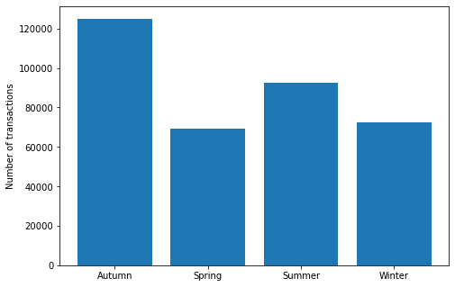
Profit Analysis
Hypothesis 1: Seasonality in number of transactions using the cab service

Slide 5
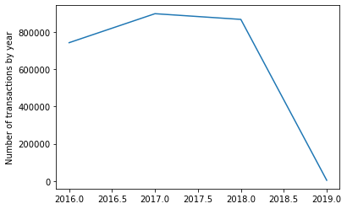
Hypothesis 2: Did the total number of transactions increase or decrease with time? How about for each company?
Total number of transaction by year (2016 to 2019)

Slide 6
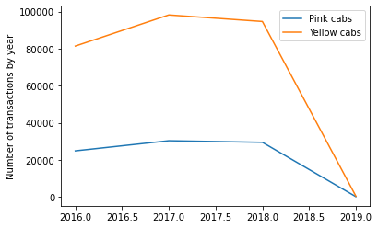
Number of transaction by year according to the company
Hypothesis 2: Did the total number of transactions increase or decrease with time? How about for each company?

Slide 7
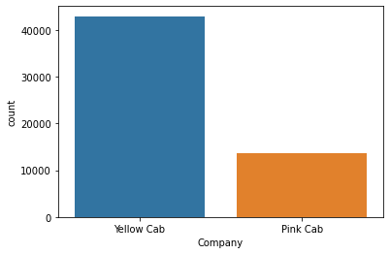
For the time period between "2016-05-1“ and "2016-10-31"
Hypothesis 3: Which company has maximum cab users at a particular time period?

Slide 8
Hypothesis 4: Yellow cabs company makes more profit than Pink cabs company
Yellow cabs | Pink cabs
count 274681.000000 mean 160.259986 std 171.823833 min -176.930800 25% 37.180000 50% 102.000000 75% 228.670400 max 1463.966000 Name: Profit, dtype: float64 | count 84711.000000 mean 62.652174 std 77.590378 min -220.060000 25% 11.206000 50% 41.500000 75% 93.965000 max 1119.480000 Name: Profit, dtype: float64

Slide 9
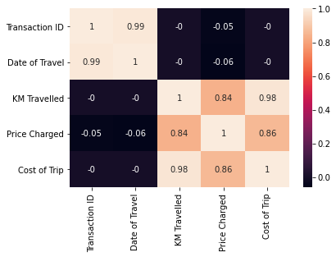
Correlation between attributes

Slide 10
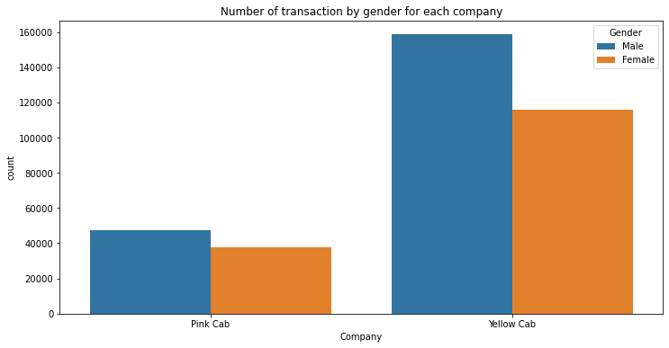
Hypothesis 5: More female than males grab pink cabs

Slide 11
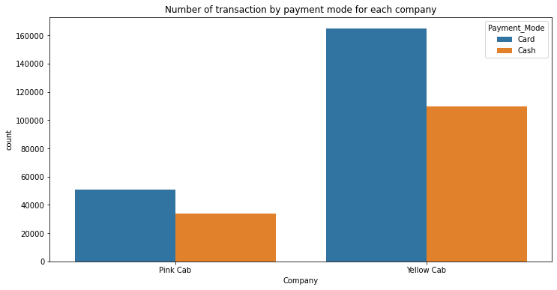
Hypothesis 6: Most of Yellow cab users pay with cash

Slide 12
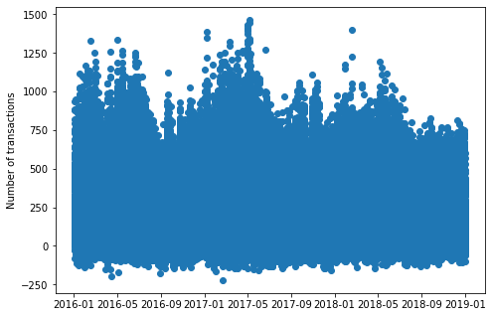
Hypothesis 7: Is there an obvious increase or decrease in the number of transactions as time goes by?

Slide 13
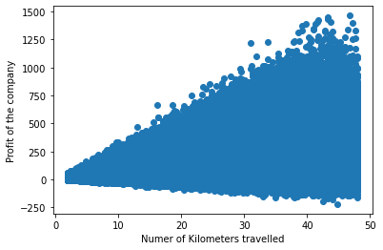
Hypothesis 8: Does the profit increase when the distance travelled is longer ?

Slide 14
Recommendations
We have evaluated both the cab companies on following points and found Yellow cab better than Pink cab:
The number of transactions tends to be higher in Autumn than in the other seasons.
The total number of transactions is higher in 2017 and 2018 than in 2016.
Yellow cabs have a higher number of transactions from 2016 to 2018.
For the specific period chosen to be from “2016-05-1“ and "2016-10-31, the total number of transactions in Yellow cabs company is three time the total number of transactions in Pink cabs company
The mean amount of Profit for Yellow cabs’ company is around three times the mean amount of Profit for Pink cabs company
The date of travel and the transaction ID are highly correlated which indicates that the transaction ID’s include the dates,
The cost of the trip and the price charged are evidently highly correlated
The number of kilometers traveled is highly correlated with the cost of the trip and the price charged
Both companies have more male clients than female. But the difference is more obvious with Yellow cabs’ company
In both companies, most of the clients pay with their credit cards rather than cash.
There is no obvious increase nor decrease in the number of transactions as time goes by.
The profit of the cab companies increase when the distance travelled by the client is longer.
On the basis of above point , we will recommend Yellow cab for investment.

Slide 15
Thank You

