Slide 1
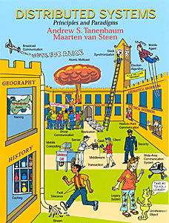
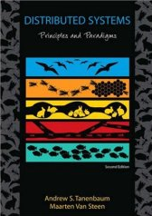
Distributed Object-based Systems CORBA
Md Shafiqul Islam
Department of Electrical and Computer Engineering
Iowa State University

Slide 2
Outline for Today’s Talk
Role of CORBA and need for object oriented distributed computing
Overview of CORBA architecture and its various components
CORBA client-server example
Coding with IDL

Slide 3
Readings for Today’s Lecture
Chapter 10 of “Distributed Systems: Principles and Paradigms”
References
http://www.corba.org/
http://www.omg.org/gettingstarted/
http://www.omg.org/gettingstarted/readingroom.htm
“Understanding CORBA”
“Examples of Writing CORBA Applications”, http://www.cs.wustl.edu/~schmidt/PDF/corba-apps4.pdf
“Introduction to Distributed Object Programming with CORBA ”, http://www.cs.wustl.edu/~schmidt/PDF/corba4.pdf
Real life examples, http://www.dre.vanderbilt.edu/~schmidt/TAO-users.html

Slide 4
CORBA and OMG
CORBA (Common Object Request Broker Architecture) is a standard for distributed objects being developed by the Object Management Group (OMG)
that provides the mechanisms by which objects transparently make requests and receive responses.
CORBA provides interoperability between applications
built in (possibly) different languages,
running on (possibly) different machines in heterogeneous distributed environments.
The OMG is a consortium of software vendors and end users.
develops and maintains standards for distributed computing, modeling, and middleware technologies.

Slide 5
Key Features of CORBA
Applications written in different languages (C++, Java, Python, etc.) can communicate with each other.
Enables remote method invocation,
allowing different applications to work together over a network.
Provides seamless integration between
different systems, regardless of OS or hardware.
ORB is the core component of CORBA, which enables clients
to invoke methods on remote objects as if they were local.
handles object registration, location, method invocation, and data transfer.
IDL defines object interfaces in a way
that is independent of implementation language.
Supports security mechanisms and distributed transactions.

Slide 6
CORBA and Distributed Computing
Access distributed information and resources from within popular desktop applications
Make existing business data and systems available as network resources
CORBA’s model of object oriented computing makes reuse of software components and application development easier
CORBA enables applications in a heterogeneous distributed environment to access and share each other’s objects

Slide 7
Simple CORBA Architecture
Client
Servant
ORB
ORB
Method request
Method response
Internet Inter-ORB Protocol (IIO)
TCP/IP stack

Slide 8
ORB (Object Request Broker)
Uses Object Reference to identify and locate objects
Object Reference is a unique handle that allows the client
to access a remote object without knowing its physical location.
This abstraction enables location transparency
client does not need to worry about where the object is hosted.
ORB acts as a middleware that routes
method invocation requests from the client to the correct remote object.
The client only sees a local proxy representation
while ORB manages the actual request processing.
ORB facilitates bidirectional communication
responses from remote objects are sent back to the client.
Services necessary to accomplish the tasks are completely transparent to the client

Slide 9
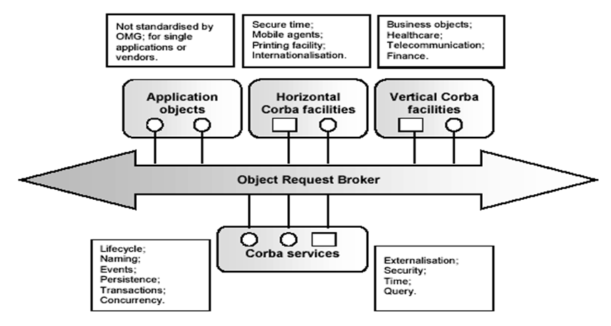
The Object Management Architecture

Slide 10
CORBA Components
Interface
Repository
IDL Compiler
Implementation
Repository
Client
Servant
Skeleton
DSI
Stub
DII
ORB
Interface
ORB
Interface
Object Adapter
ORB core
ORB core

Slide 11
CORBA Client-side Components
Stub
A client-side proxy that represents the remote object.
Generated from IDL that helps in invoking methods on the remote object.
Dynamic Invocation Interface (DII)
Allows clients to invoke remote methods dynamically (without using stubs).
Useful when the client does not have prior knowledge of the remote object.
ORB Interface
provides basic functions for object communication
Managing requests, responses, object lifecycle.
ORB Core
The central component that routes method calls from the client to the server.
Hides the underlying network details.

Slide 12
CORBA Server-side Components
Skeleton
Generated from IDL and acts as the server-side equivalent of the stub.
Unmarshals incoming requests and forwards them to the actual object implementation.
Dynamic Skeleton Interface (DSI)
Allows servers to process requests dynamically
Used when the server does not have a statically generated skeleton.
Object Adapter
Bridges the ORB with the actual implementation of objects.
Helps in object activation, request dispatching, and reference management.
ORB Core
routes requests from the client to the appropriate object.
Handles protocol communication (like IIOP – Internet Inter-ORB Protocol)

Slide 13
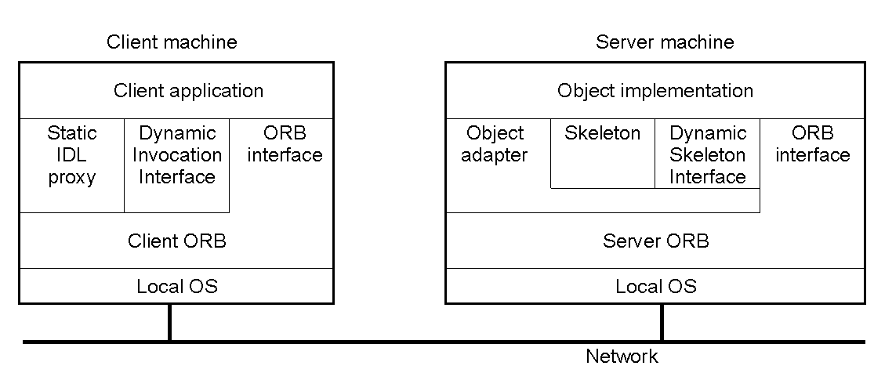
Object Model
The general organization of a CORBA system.

Slide 14
CORBA Services
Service | Description
Collection | Facilities for grouping objects into lists, queue, sets, etc.
Query | Facilities for querying collections of objects in a declarative manner
Concurrency | Facilities to allow concurrent access to shared objects
Transaction | Flat and nested transactions on method calls over multiple objects
Event | Facilities for asynchronous communication through events
Notification | Advanced facilities for event-based asynchronous communication
Externalization | Facilities for marshaling and unmarshaling of objects
Life cycle | Facilities for creation, deletion, copying, and moving of objects
Licensing | Facilities for attaching a license to an object
Naming | Facilities for systemwide name of objects
Property | Facilities for associating (attribute, value) pairs with objects
Trading | Facilities to publish and find the services on object has to offer
Persistence | Facilities for persistently storing objects
Relationship | Facilities for expressing relationships between objects
Security | Mechanisms for secure channels, authorization, and auditing
Time | Provides the current time within specified error margins
Overview of CORBA services.

Slide 15
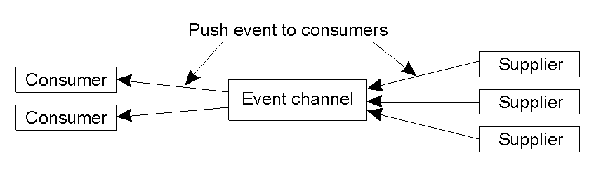
Event and Notification Services (1)
The logical organization of suppliers and consumers of events, following the push-style model.
Notes:
Event channel
Standard CORBA object
Communication with event channel is through standard CORBA requests
3) broadcast repeater

Slide 16
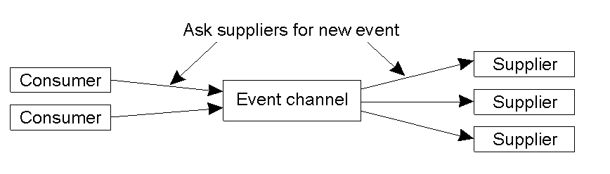
Event and Notification Services (2)
The pull-style model for event delivery in CORBA.

Slide 17
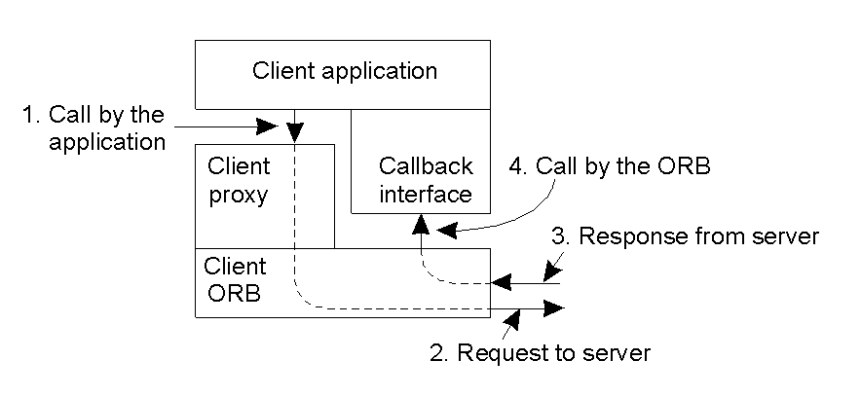
Messaging – Callback Model
CORBA's callback model for asynchronous method invocation.

Slide 18
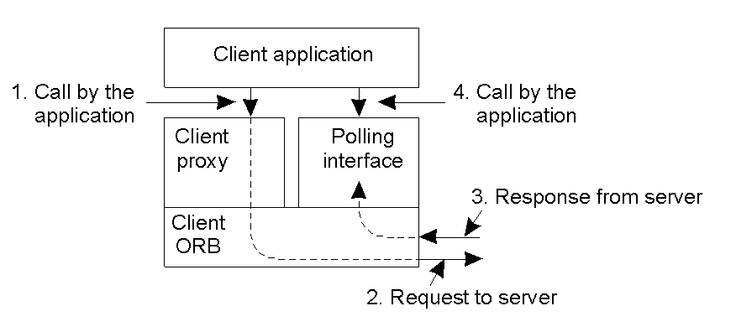
Messaging – Polling Model
CORBA'S polling model for asynchronous method invocation.

Slide 19
Static and Dynamic Invocation Interface – client side
Static Invocation Interface (SII)
Client knows interface operations in advance
Client is compiled with the relevant stub generated by IDL compiler
During invocation, the proxy object understands the parameters in an operation and marshals them into the request
Faster and optimized execution.
Reliable because everything is defined at compile-time.
Dynamic Invocation Interface (DII)
A client may not always have the stub available at compile time
application example: automated testing system
Allows clients to discover operation parameters using Interface Repository and create requests dynamically
Can adapt to changing or unknown interfaces.
Useful for automated testing and dynamic service discovery.
Notes:
http://docs.oracle.com/cd/E13203_01/tuxedo/tux80/creclien/dii.htm
One of the major differences between static invocation and dynamic invocation is that, while both support synchronous and one-way communication, only dynamic invocation supports deferred synchronous communication.
DII is often used when deferred synchronous communication is needed. However, DII is more difficult to program (your code has to do the work of a client stub).

Slide 20
Interface Repository (IFR)
IFR is a distributed service in CORBA
stores and manages persistent objects representing IDL information
It provides runtime access to IDL descriptions for clients and servers.
Provides type information necessary to issue requests using the DII
allows clients to invoke methods dynamically without precompiled stubs
Also stores additional information like
debugging info
libraries of stubs or skeletons etc.

Slide 21
Static and Dynamic Skeleton Interface – server side
Static Skeleton Interface (SSI)
Similar to SII, but on server side
Knows the operation types at compile time
Performs request demarshaling and dispatching
Dynamic Skeleton Interface (DSI)
Similar to DII, but on server side
Generic skeleton interface for all objects

Slide 22
Object Invocation Models
Request type | Failure semantics | Description
Synchronous | At-most-once | Caller blocks until a response is returned or an exception is raised
One-way | Best effort delivery | Caller continues immediately after sending out the request; there is no response.
Deferred synchronous | At-most-once | Caller continues immediately; later poll to see if response is returned or block to wait for response
Invocation models supported in CORBA.

Slide 23
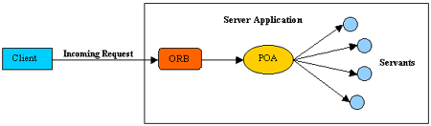
Object Adaptor (OA)
Manage server-side resources
Implementations of objects must be registered with the OA
OA maps a client request (specified by object reference) to the implementation of the object
Activate and deactivate objects
Allowing varied methods of implementation facilitates integration of legacy applications
Two types – BOA (basic, deprecated) and POA (portable)
Notes:
OA is a CORBA object.
object adapter is the mechanism that connects a request using an object reference with the proper code to service that request.
A servant is the invocation target containing methods for handling the remote method invocations. In the newer CORBA versions, the remote object on the server side is split into the object (that is exposed to remote invocations) and servant (to which the former part delegates the method calls). It can be one servant per remote object, or the same servant can support several (possibly all) objects, associated with the given Portable Object Adapter.

Slide 24
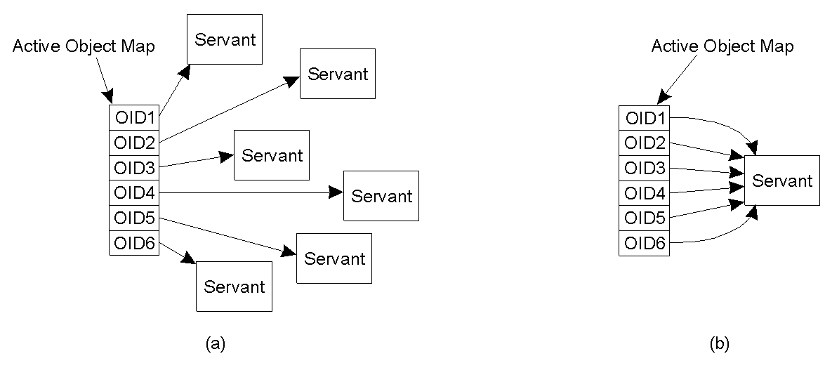
Portable Object Adaptor
Mapping of CORBA object identifiers to servants.
The POA supports multiple servants.
The POA supports a single servant.
Notes:
Every POA has an Active Object Map that is an abstract implementation that map CORBA Object IDs with servants. Every CORBA Object ID must be unique for some given POA. Requests on an interface are first passed from the remote ORB(may be local) to the Local ORB. The Local ORB passes the request on to the appropriate POA. Using the Active Object Map, the POA finds the appropriate servant to service the request.

Slide 25
Portable Object Adaptor (2)
My_servant *my_object; // Declare a reference to a C++ object CORBA::Objectid_var oid; // Declare a CORBA object identifier
my_object = new MyServant; // Create a new C++ object oid = poa ->activate_object (my_object); // Register C++ object as CORBA OBJECT
Code: Changing a C++ object into a CORBA object.
NOTE: CORBA object is a “virtual” entity

Slide 26
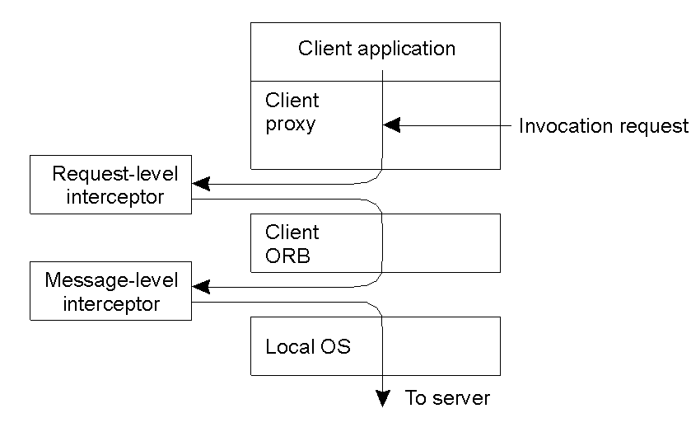
Interceptors
Figure: logical placement of interceptors in CORBA.
Interceptor: code inserted by users into the ORB invocation flow.

Slide 27
Interoperability
GIOP (General Interoperability Protocol)
Abstract protocol for communication between different ORB products
Specifies message types
Request, Reply, LocateRequest, LocateReply, CancelRequest, CloseConnection, MessageError
Specifies data format
CDR (common data representations
IIOP (Internet Inter-ORB Protocol)
Mapping of GIOP over TCP/IP
IIOP - IOR contains a host name and port number as endpoint info

Slide 28
Interoperability (2)
Message type | Originator | Description
Request | Client | Contains an invocation request
Reply | Server | Contains the response to an invocation
LocateRequest | Client | Contains a request on the exact location of an object
LocateReply | Server | Contains location information on an object
CancelRequest | Client | Indicates client no longer expects a reply
CloseConnection | Both | Indication that connection will be closed
MessageError | Both | Contains information on an error
Fragment | Both | Part (fragment) of a larger message
GIOP message types.

Slide 29
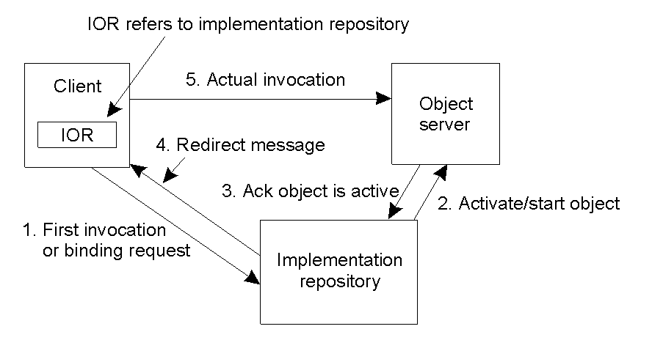
Object References
Indirect binding in CORBA.

Slide 30
CORBA Application Development
Steps in developing a CORBA server and client
Design your application interface and specify them in OMG IDL (Interface Definition Language)
Run the IDL specs through IDL compiler of language of your choice, say C++, to generate client-side stub and server-side skeleton
Implement server side interfaces using C++ classes (called servants)
Implement the server program that instantiates the servants
Compile the server program along with the skeleton code using a C++ compiler
Implement the client program
Compile the client program along with the stub code

Slide 31
Interface and Servant
module HelloApp
{
interface Hello
{
string sayHello();
};
};
idlj -fall Hello.idl
Generates:
HelloPOA.java: server skeleton
_HelloStub.java: client stub
HelloOperations.java: contains the method sayHello()
Hello.java, HelloHelper.java, HelloHolder.java,
Servent code
import HelloApp.*;
import org.omg.CosNaming.*;
import org.omg.CosNaming.NamingContextPackage.*;
import org.omg.CORBA.*;
import org.omg.PortableServer.*;
import org.omg.PortableServer.POA;
import java.util.Properties;
class HelloImpl extends HelloPOA {
private ORB orb;
public void setORB(ORB orb_val) {
orb = orb_val;
}
// implement sayHello() method
public String sayHello() {
return "\nHello world !!\n";
}
}

Slide 32
Server
public class HelloServer {
public static void main(String args[]) {
// create and initialize the ORB
ORB orb = ORB.init(args, null);
// get reference to rootPOA & activate the POAManager
POA rootpoa = POAHelper.narrow(orb.resolve_initial_references("RootPOA"));
rootpoa.the_POAManager().activate();
// create servant and register it with the ORB
HelloImpl helloImpl = new HelloImpl();
helloImpl.setORB(orb);
// get object reference from the servant
org.omg.CORBA.Object ref = rootpoa.servant_to_reference(helloImpl);
Hello href = HelloHelper.narrow(ref);
// get the root naming context. NameService invokes the name service
org.omg.CORBA.Object objRef = orb.resolve_initial_references("NameService");
// Use NamingContextExt which is part of the Interoperable
// Naming Service (INS) specification.
NamingContextExt ncRef = NamingContextExtHelper.narrow(objRef);
// bind the Object Reference in Naming
String name = "Hello";
NameComponent path[] = ncRef.to_name( name );
ncRef.rebind(path, href);
System.out.println("HelloServer ready and waiting ...");
// wait for invocations from clients
orb.run();
}
}

Slide 33
Client
import HelloApp.*;
import org.omg.CosNaming.*;
import org.omg.CosNaming.NamingContextPackage.*;
import org.omg.CORBA.*;
public class HelloClient
{
static Hello helloImpl;
public static void main(String args[])
{
try{
// create and initialize the ORB
ORB orb = ORB.init(args, null);
// get the root naming context
org.omg.CORBA.Object objRef = orb.resolve_initial_references("NameService");
// Use NamingContextExt instead of NamingContext. This is
// part of the Interoperable naming Service.
NamingContextExt ncRef = NamingContextExtHelper.narrow(objRef);
// resolve the Object Reference in Naming
String name = "Hello";
helloImpl = HelloHelper.narrow(ncRef.resolve_str(name));
System.out.println("Obtained a handle on server object: " + helloImpl);
System.out.println(helloImpl.sayHello());
} catch (Exception e) {
System.out.println("ERROR : " + e) ;
e.printStackTrace(System.out);
}
}
}

Slide 34
Compilation and running
Connect to "research-4.ece.iastate.edu". If you are off campus, please use a VPN
0) Compile the idl file:
idlj -fall Hello.idl
1) Compile the source files:
javac *.java HelloApp/*.java
2) To start orbd from a UNIX command shell, enter:
orbd -ORBInitialPort 1050&
3) To start the Hello server from a UNIX command shell, enter:
java HelloServer -ORBInitialPort 1050 -ORBInitialHost localhost&
4) Run the client application:
java HelloClient -ORBInitialPort 1050 -ORBInitialHost localhost

Slide 35
Interface definition Language (IDL)
Separates object implementation from interface
Basically a declarative language, similar in appearance to C++
A means by which the object implementation tells clients what operations are available and how to invoke them.
Mapped to a particular programming language (C , C++, Java) by an IDL compiler
IDL compilation produces stubs/skeletons
stub - local function call for the client
skeleton - server side of the object implementation
Client - Server communication is facilitated by stubs & Skeletons
Stub
IDL Specs
IDL Compiler
Skeleton

Slide 36
Coding with IDL
CORP.IDL
Interface
Repository
OMG IDL Compiler
CORP_cstub.c
Client Stub
CORP.h
Header file
CORP_sskel.c
Server Skeleton
Client Application
Server Application

Slide 37
Coding with IDL (cont.)
//File CORP.IDL
Module CORP
{
typedef long BadgeNum;
typedef long DeptNum;
enum DismissalCode {DISMISS_FIRED, DISMISS_QUIT}
Interface Employee
{
void promote(in char newjobclass);
void dismiss(in DismissalCode reason,
in string description);
}
……
}

Slide 38
Coding with IDL (cont.)
//File CORP.IDL ---- Defining an object attribute in ODL
Module CORP
{
typedef long BadgeNum;
typedef long DeptNum;
enum DismissalCode {DISMISS_FIRED, DISMISS_QUIT}
struct DeptInfo
{
DeptNum id;
string name;
}
Interface Department
{
atttribute DeptInfo DeptID;
}
……
}

Slide 39
Coding with IDL (cont.)
//File CORP.IDL ---- Defining an read-only object attribute in ODL
Module CORP
{
Interface Employee;
struct DeptInfo
{
DeptNum id;
string name;
}
Interface Department
{
atttribute DeptInfo DeptID;
readonly attribute Employee manager_obj;
}
Interface Employee
{
attribute EmpData personal_data;
readonly attribute Department department_obj;
}
……
}

Slide 40
Coding with IDL (cont.)
//File CORP.IDL ---- Defining inheritance in ODL: single inheritance
Module CORP
{
struct PersonalData {
string lastname;
string firstname;
string phone;
}
typedef PersonalData EmpPersonalData;
struct EmpData {
BadgeNum id;
char job_class;
float hourly_rate;
}
Interface Employee
{
attribute EmpData personal_data;
readonly attribute Department department_obj;
void promote(in char new_job_class);
void dismiss(……);
void transfer(……);
}
Interface Manager: Employee
{
void approve_transfer(……);
}
}

Slide 41
Coding with IDL (cont.)
//File CORP.IDL ---- Defining inheritance in ODL: multiple inheritance
Module CORP
{
Interface Employee
{
……
}
Interface Manager: Employee
{
……
}
Interface Peronnel: Employee
{
……
}
Interface PeronellManager: Personnel, Employee
{
……
}
……
}

Slide 42
Coding with IDL (cont.)
//File CORP.IDL ---- Defining inheritance in ODL: inheritance across modules
Module CORP
{
Interface PeronellManager: Personnel, Employee
{
……
}
……
}
Module ENGINEERING
{
Interface EmployeeLocator
{
void FindEngineer(in CORP::BadgeNum id,
out CORP::PersonalData info);
}
Interface PersonnelManager: CORP::PersonnelManger
{
}
}

Slide 43
Questions?
Thanks and See you next time

