Slide 1

The Miners

Slide 2
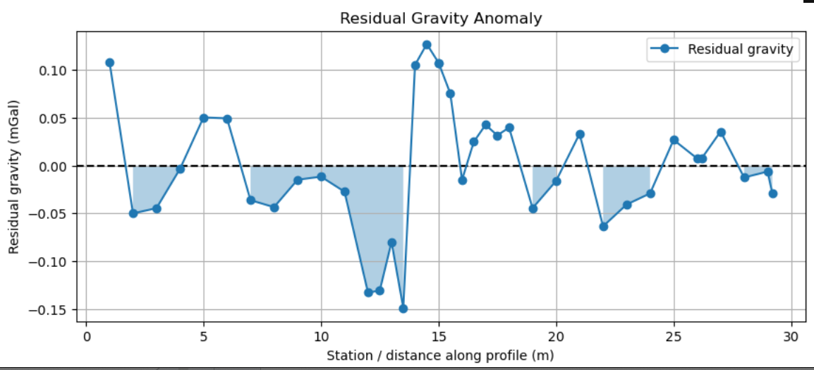
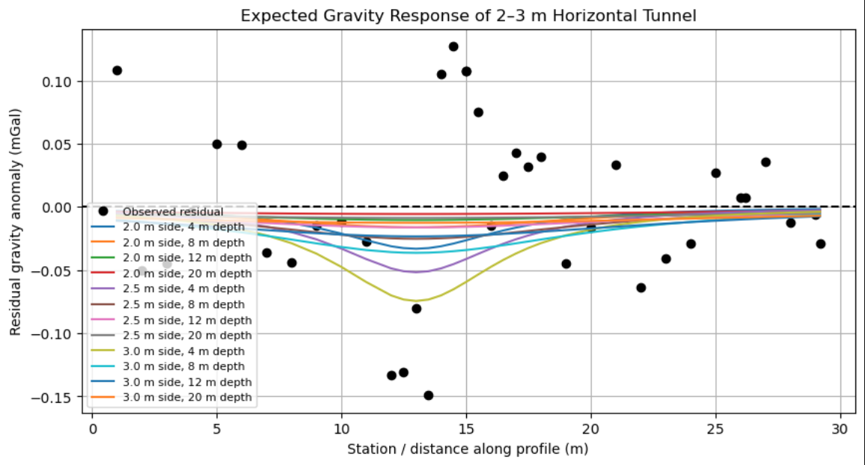
Gravity
There is a high amplitude negative residual gravity anomaly centered at 12.5 m along line
We know the mine shafts extends 200 ft at 2 m by 2 m, around the center of our line
Model assumes a clean tunnel, but it was built a while ago- its likely collapsed
Collapsed shafts and fractured sandstones create more irregular negative anomalies

Slide 3
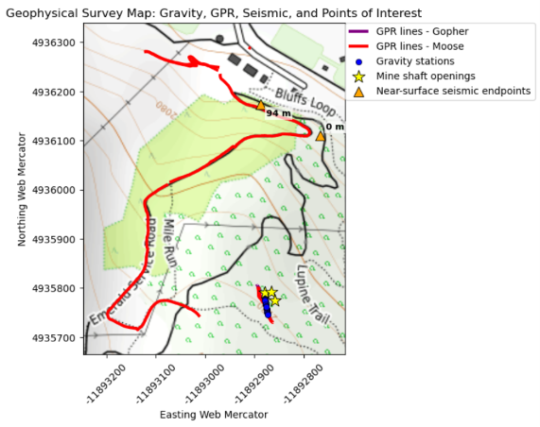
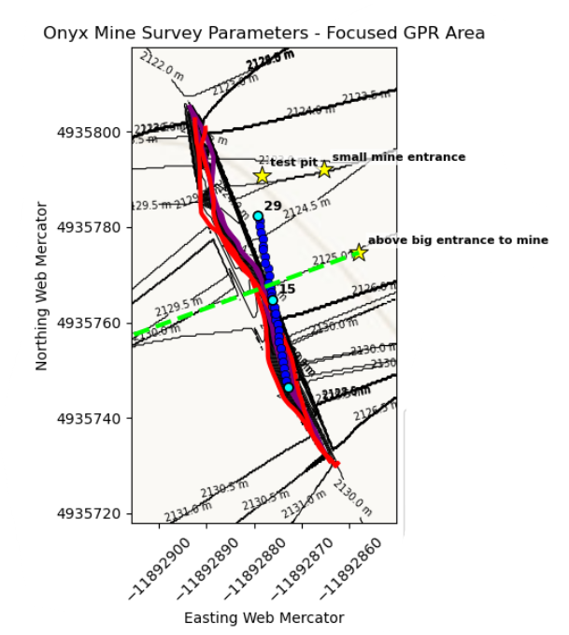
Tested adding topo layers to the zoomed survey map, but the elevation change is only 9m so topo lines were cluttering the survey map and taking away from the message of the figure.

Slide 4
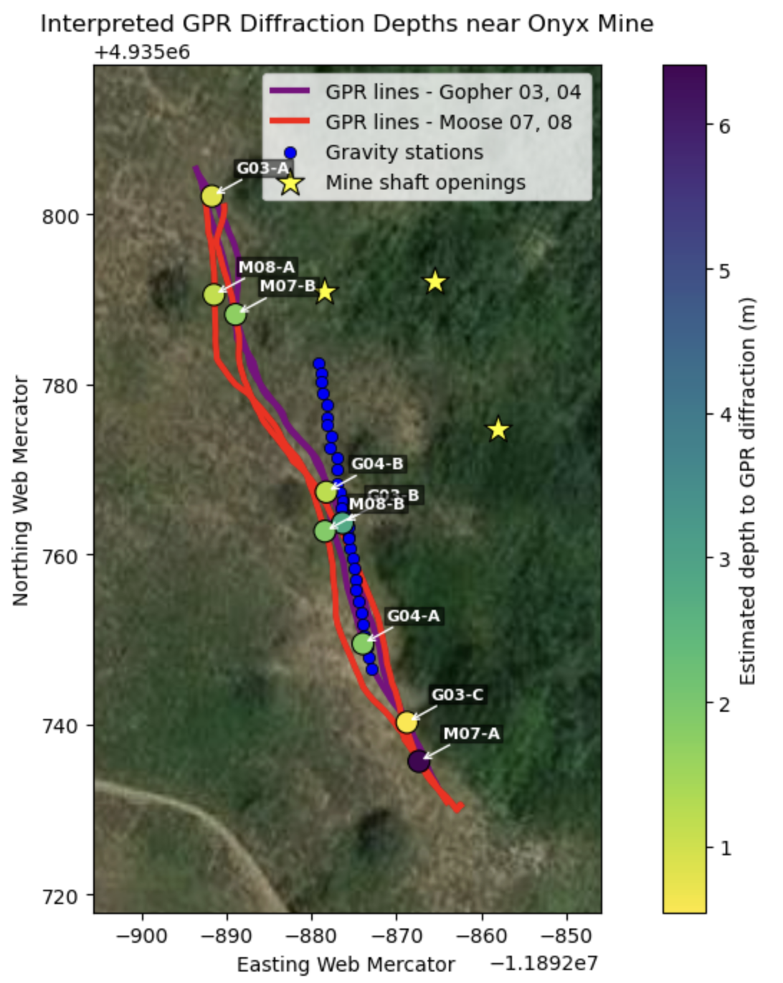
GPR Anomalies
Added GPR anomalies on top of our survey lines
Several points lined up with anomalies on gravity line
Similar anomalies between different frequencies and survey lines
Weird anomalies towards the south end of our line that could indicate collapsed portion of the mine shaft, or continued portion of it
ex: G03, M for moose, G for gopher

Slide 5
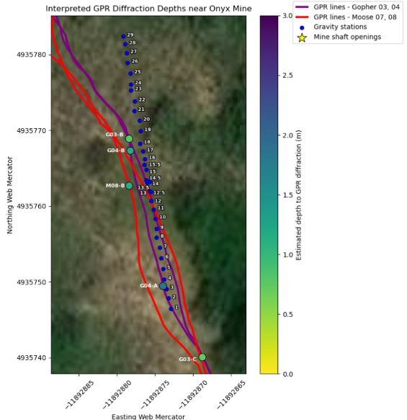

Slide 6
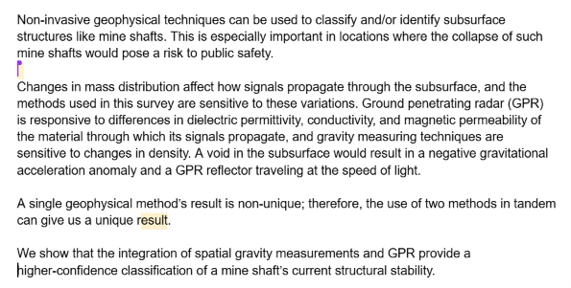
Abstract is in the works!!
Used the Nature Abstract guidelines.

Slide 7

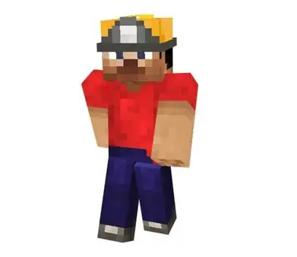

To do:
Overlay GPR with Gravity and see if they have coinciding anomalies
Begin to characterize the mine shaft (stable or collapsed)
Look more into refraction data and decide if not useful
Finish abstract
GET PROFESSIONAL HELP
Eat ASSSSSSSSSSSSSSSSSSSSSSSSSSSS (looking for volunteers)
WITH AN EEEEEEEE NO O!!

