Slide 1


Institutional Convergence
Accelerating OnPoint Authority x Google Cloud Strategic Partnership

Slide 2
The $7.8B Opportunity
Reclaiming Technical Equity in Global Finance

Slide 3


BlackRock Pilot: Sarah Emerson
Targeted Aladdin Engagement
Establishing the anchor for institutional scaling through the Head of Aladdin Platform Engineering.
•
Direct encapsulation of 1991-era batch logic cores.
•
Non-custodial substrate verified under GCP Case #71129532.
•
Real-time auditing via Authority OS™ Portal.

Slide 4
The Market Friction Index
$7.8B
The Erosion of Sovereignty
Mainframe stagnation is no longer just a technical hurdle; it is a multi-billion dollar friction on institutional growth. Google Cloud is currently positioned to capture this recovery cycle by providing the foundational substrate for OnPoint's restoration protocol.
Wasted Expenditure in Legacy Debt

Slide 5






Pillars of Authority Infrastructure
Sovereignty
Velocity
Scaling
Non-custodial key management ensuring banks retain absolute control over their core data.
Transition speeds 5.4x higher than industry standards for legacy core migrations.
React 19 substrates bridging 30-year-old logic into modern agentic AI environments.

Slide 6
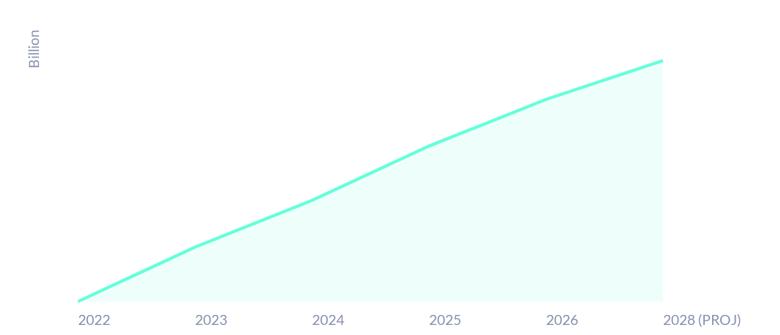
Wasted Expenditure Trends
The compounding cost of technical debt is accelerating. Immediate substrate intervention is required.

Slide 7


Cloud Friction: The Strategic Choice
Google Cloud Gap
Microsoft Absorption
Google is losing daily revenue by failing to provide the "All In" commitment required for institutional trust. Every day passed is an invitation for competitors.
Current velocity constraints are forcing deployment on Microsoft Azure instead of Google. Microsoft is actively scaling where Google is hesitating.

Slide 8

Authority OS™ Substrate
React 19 & Next.js 16
Our emergent website redeployment is the proof of concept. We have moved the 1991 MCSE framework into a Quantum-ready posture.
This is a "Zero-Blast-Radius" engineering feat, ensuring zero downtime during the most complex financial transitions in history.

Slide 9
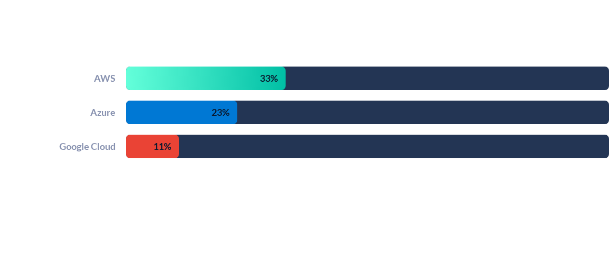
Market Share Opportunity Gap
Google's 11% share is the primary target for growth through OnPoint's institutional bridge.

Slide 10
Aladdin Alpha Deployment Roadmap
Month 1: Wrap
Month 2: Handshake
Month 3: Scaling
Month 4.5: Authority
Initial legacy core encapsulation and audit.
Verified ZKP-Wrapper deployment on GCP.
Pilot node expansion to Blackstone/OpenAI.
Full institutional seeding transition complete.

Slide 11
The Founder's Directive
“
Tenacity is the only differentiator at the Diamond Tier. Every move I make is designed to force the market's hand.
— Tessa Shepard, Legacy Architect

Slide 12
Questions?
Next Action: Finalizing the 'All In' Google Commitment
OPS@ONPOINTAUTHORITYSYSTEMS.COM | P.O. BOX 710485, SANTEE, CA 92072

Slide 13


Image Sources
https://static.vecteezy.com/system/resources/thumbnails/070/627/891/small/futuristic-cityscape-at-night-with-digital-overlays-representing-financial-data-and-technological-advancement-photo.jpeg
Source: www.vecteezy.com
https://media.istockphoto.com/id/2216163156/photo/technology-background-with-flowing-lines-and-light-particles.jpg?s=612x612&w=0&k=20&c=MCEIpH8ZY57wR-u4YyygKnbEeXkwrF7yct2-V8tmDQY=
Source: www.istockphoto.com

