Slide 1
Origami Tessellations Based Actuation
How can the directional stiffness exhibited by origami tessellations be used to simplify the actuation of the locomotion of a laminate robot?
Manan Luthra
Eric Feil
Meet Shah
Disha Vyas

Slide 2
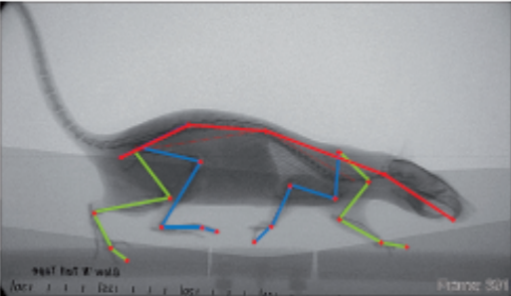
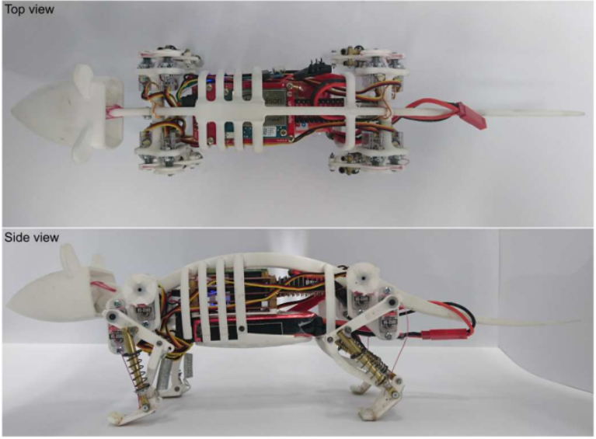
Biomechanics-driven inspiration
Prior work on ‘Rat’ Motion/Behaviour
Prior work related to Similar Robots
Gait Topography in Rat Locomotion [1]
Functional assessment in the rat by ground reaction forces [2]
Motion of the foot and ankle during the stance phase in rats [3]
Design and Development of a Legged Rat Robot for Studying Animal-Robot Interaction [4]
Design and Control of a Miniature Quadruped Rat-inspired Robot [5]
Design of a Biomimetic Rodent Robot [6]

Slide 3
Biomechanics-driven inspiration
Biomechanics-derived specifications
We performed a biomechanics investigation using informed assumptions and deduced the following specifications for our prototype:
Parameter | Unit | Value Range
Total mass | kg | 0.25-0.40
Average speed walking | m/s | .20-.60
Stride length | cm | 9-16
Stride width | cm | 2-4
Metabolic power walking | W | 3.08 +/- .26 @.116 m/s
Peak walking ground reaction | N | 2.5-3
Stance phase duration | s | .150-.400
Body length | cm | 17-21
Tail length | cm | 20-23

Slide 4
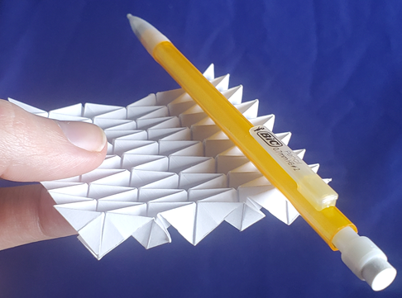

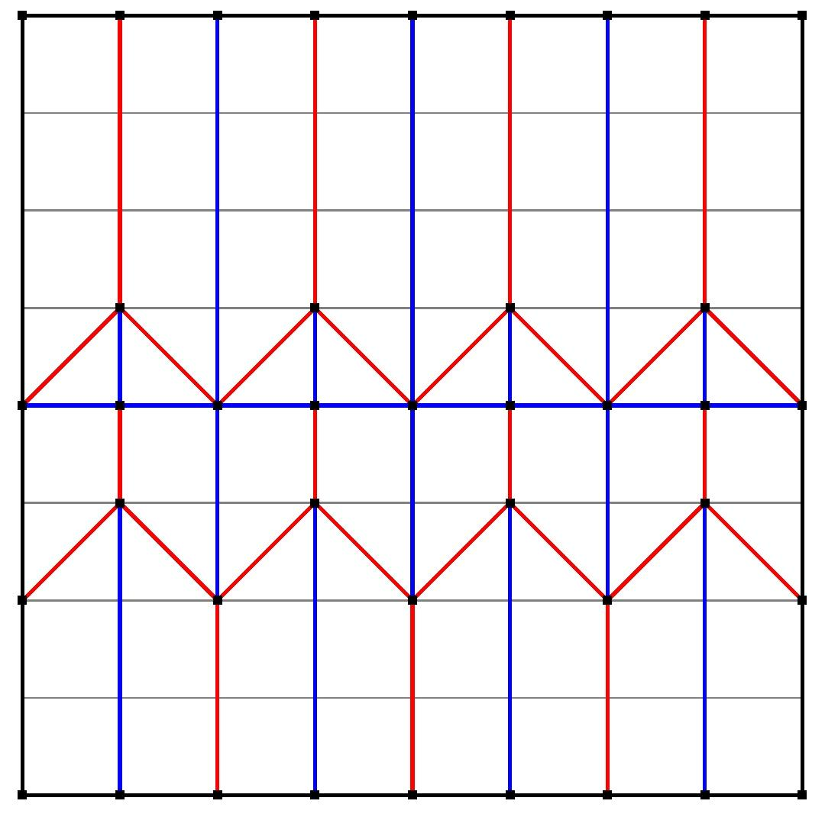
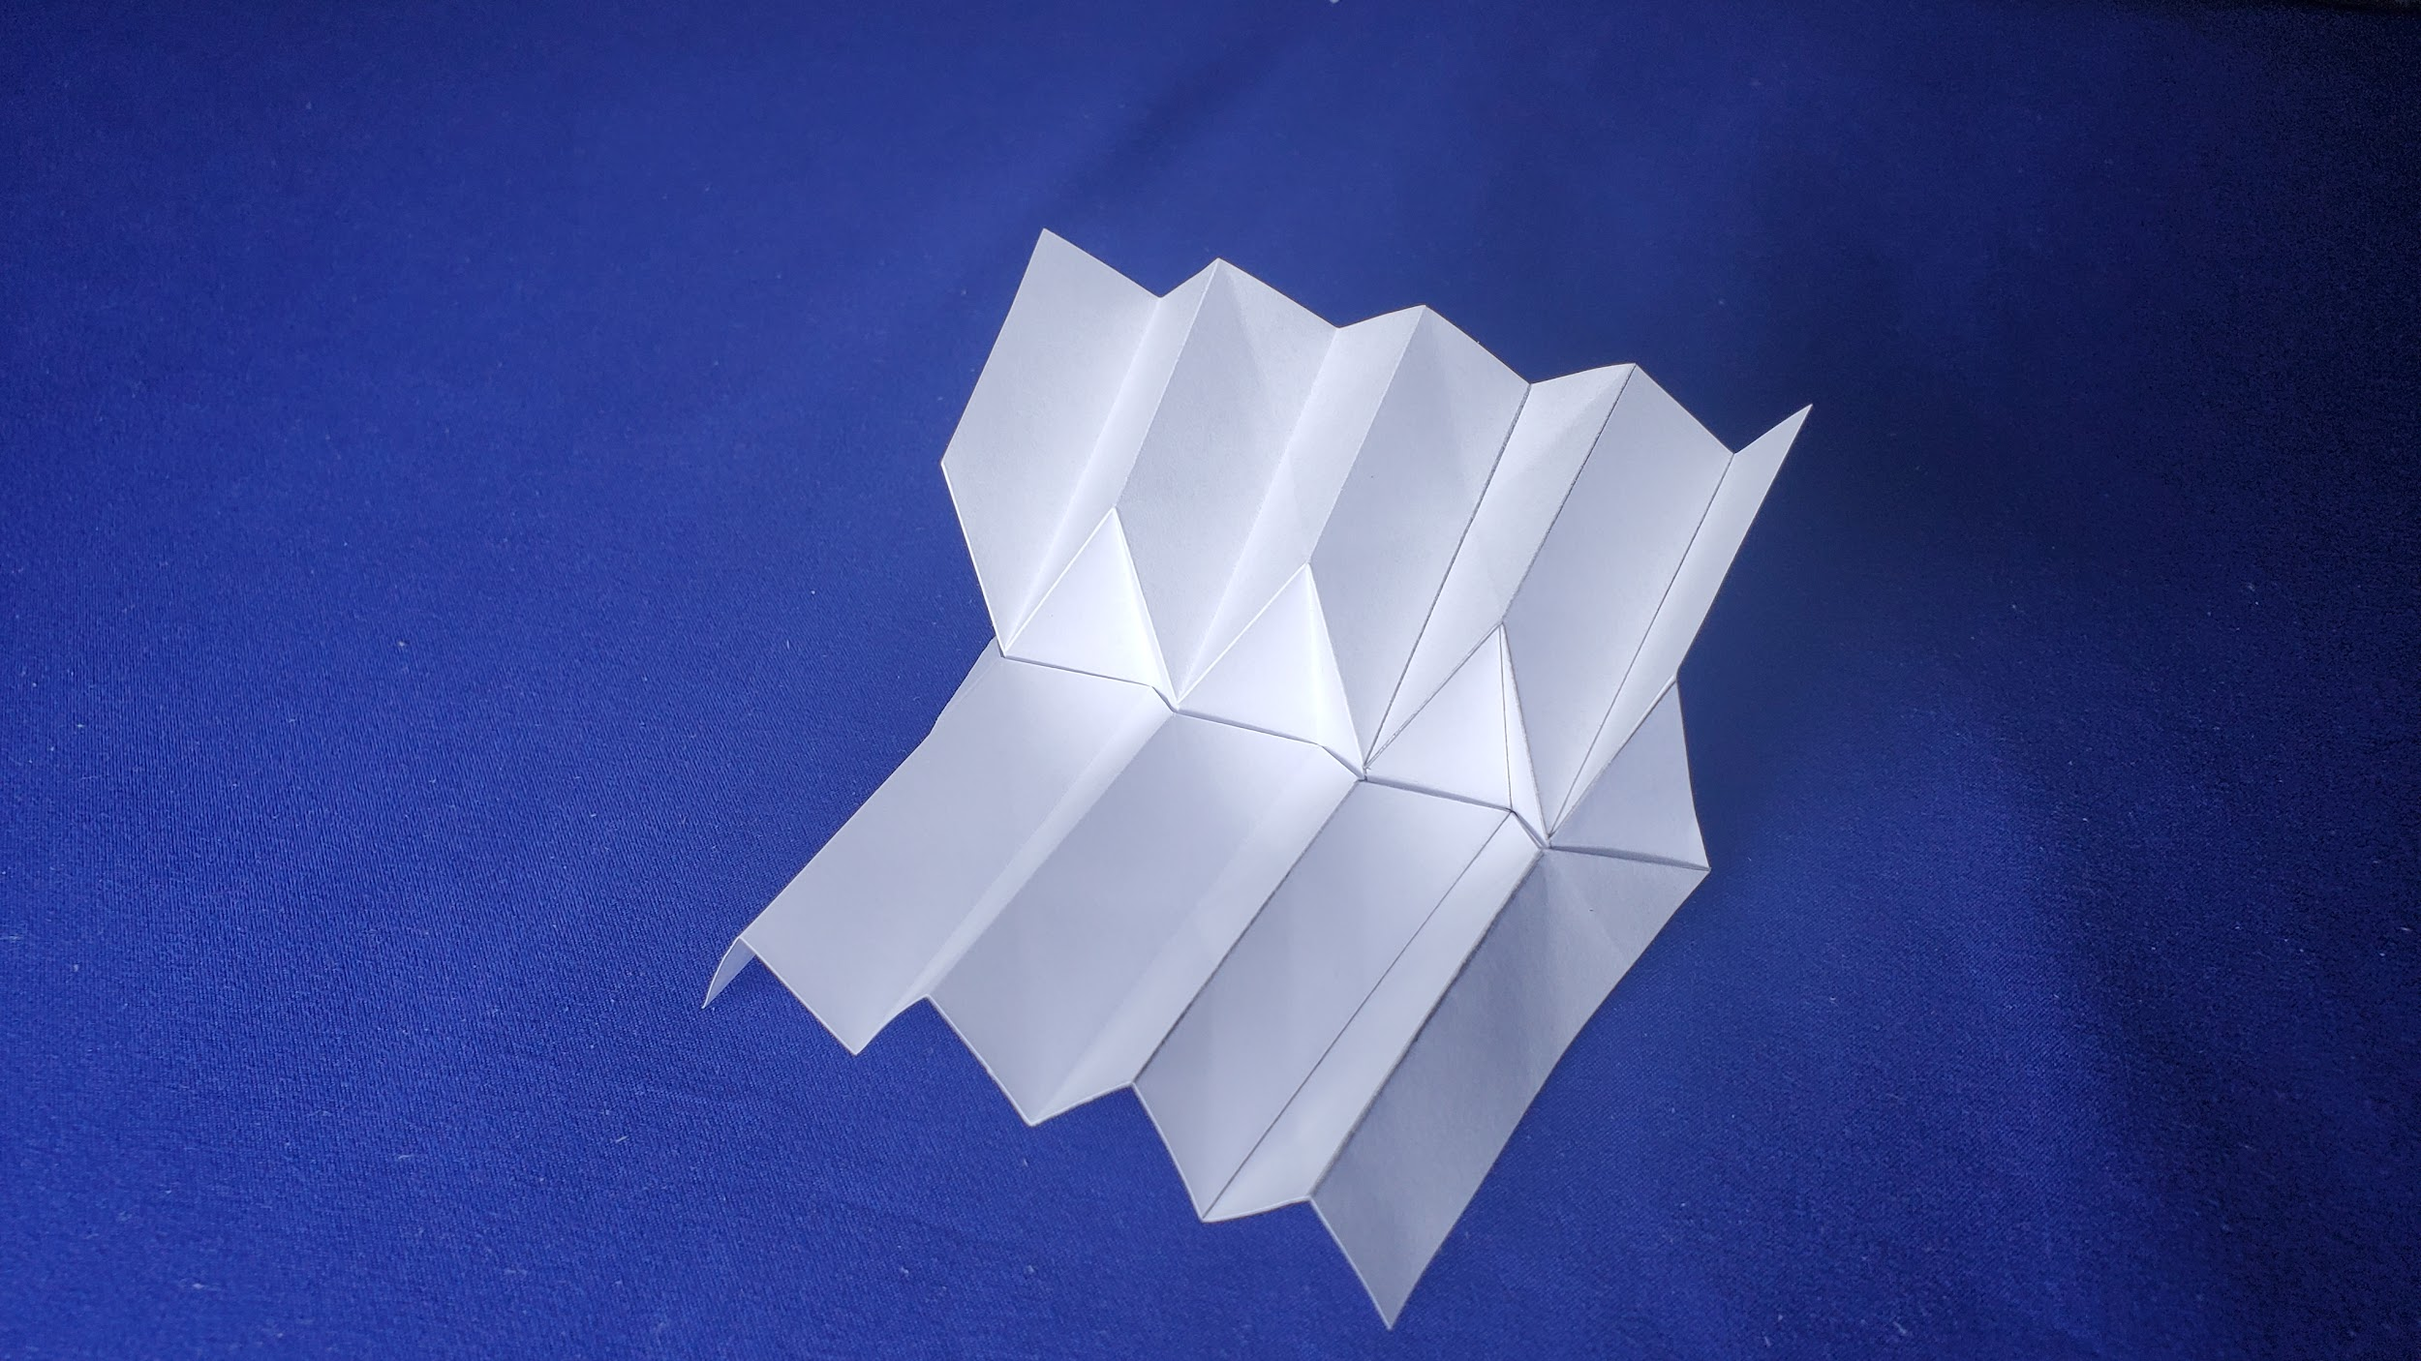

Proposed mechanism
Layout : Red lines are mountain folds Blue lines are valley folds

Slide 5
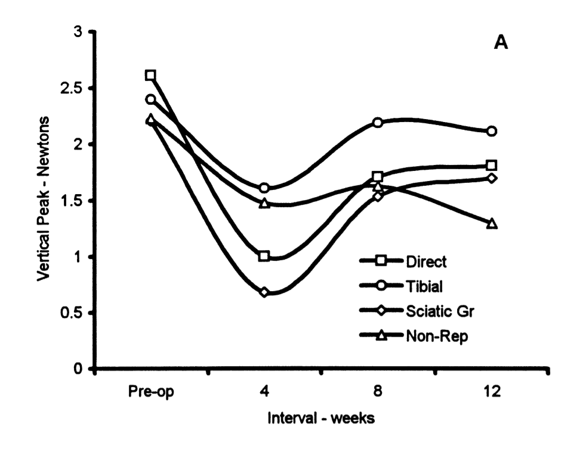
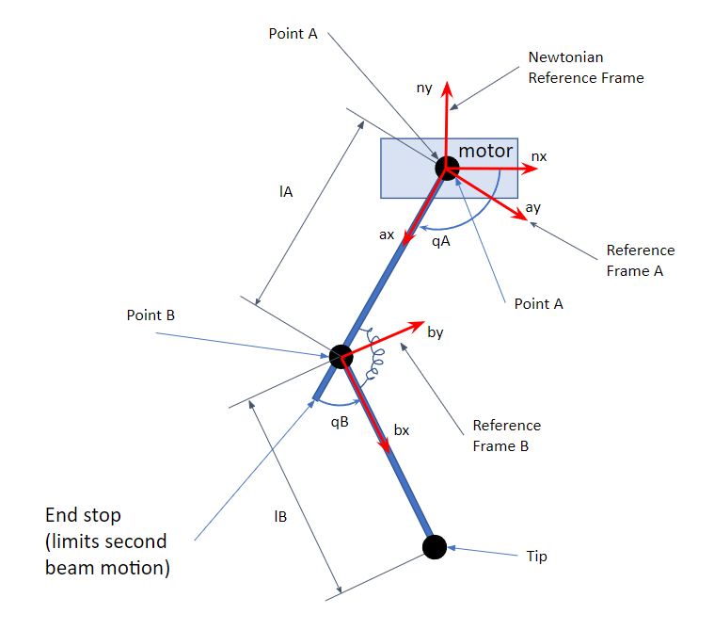
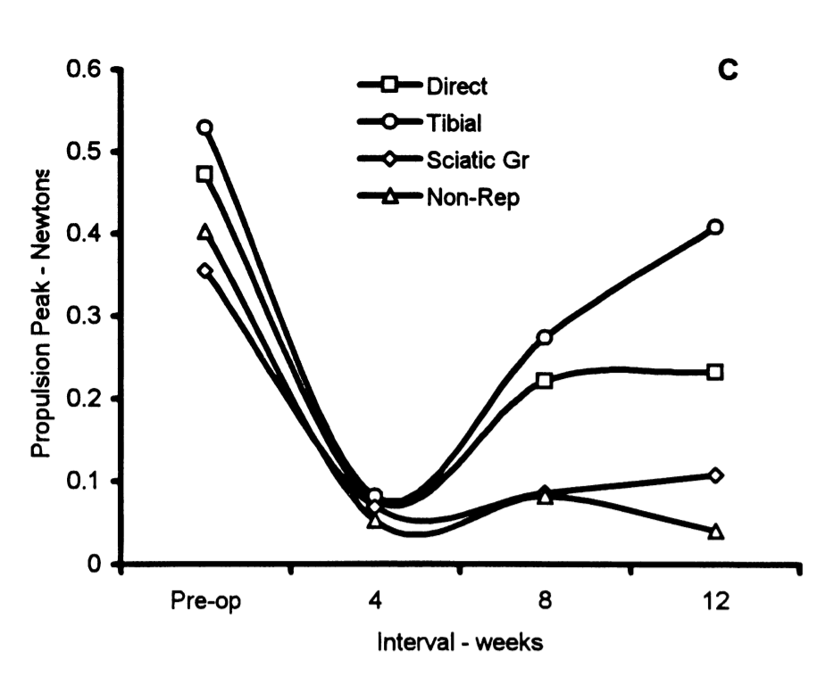
Kinematics
Peak vertical and purposive (horizontal) ground reaction forces [2]

Slide 6
Future Plans
Kinematic modeling of tessellation element
This will help us model the springiness in the simpler leg model
Dynamic modeling and simulation of the simplified leg model
This will help us to better understand how different leg properties affect locomotion
Continue development of folded leg design
Further consideration of leg design is needed
A plan for how the leg will attach to the motor needs to be developed
Leg width and tessellation element scale may need to be studied
Design of Robot Body
Considering materials, processes, construction limitations, and cost
The biomechanics specifications and kinematic modeling will be used to choose motors with the necessary speed and torque

Slide 7
References
[1] A. J. Parker and K. A. Clarke, “Gait topography in rat locomotion,” Physiology & Behavior, 14-Feb-2003. [Online]. Available: https://www.sciencedirect.com/science/article/abs/pii/0031938490902586. [Accessed: 12-Feb-2022].
[2] C. S. Howard, D. C. Blakeney, J. Medige, O. J. Moy, and C. A. Peimer, “Functional assessment in the rat by ground reaction forces,” Journal of Biomechanics, vol. 33, no. 6, pp. 751–757, 2000.
[3] Dvm, Artur & Md, Phd & Md, Phd & Bulas-Cruz, José & Filipe, Vítor & Melo-Pinto, Pedro & Varejão, Artur & Cabrita, António & Meek, Marcel & Bulas‐Cruz, José & Gabriel, Ronaldo & Melo‐Pinto, Pedro & Winter, David, “Motion of the foot and ankle during the stance phase in rats”, Muscle & Nerve, 2002, vol. 26, pp. 630 - 635, doi: 10.1002/mus.10242.
[4] C. Laschi et al., "Design and Development of a Legged Rat Robot for Studying Animal-Robot Interaction," The First IEEE/RAS-EMBS International Conference on Biomedical Robotics and Biomechatronics, 2006. BioRob 2006., 2006, pp. 631-636, doi: 10.1109/BIOROB.2006.1639160
[5] S. Wang et al., "Design and Control of a Miniature Quadruped Rat-inspired Robot," 2019 IEEE/ASME International Conference on Advanced Intelligent Mechatronics (AIM), 2019, pp. 346-351, doi: 10.1109/AIM.2019.8868662.
[6] Lucas, Peer., “Design of a Biomimetic Rodent Robot”, 2019, doi: 10.14459/2018md1464578.

