Slide 1
Power Bi From Scratch
<packt>: Microsoft Power Bi – The Complete Masterclass 2023

Slide 2
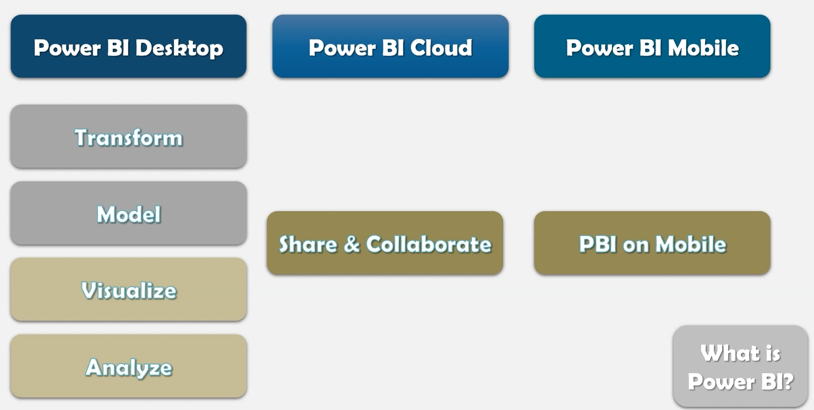
Introduction – What is Power BI?

Slide 3
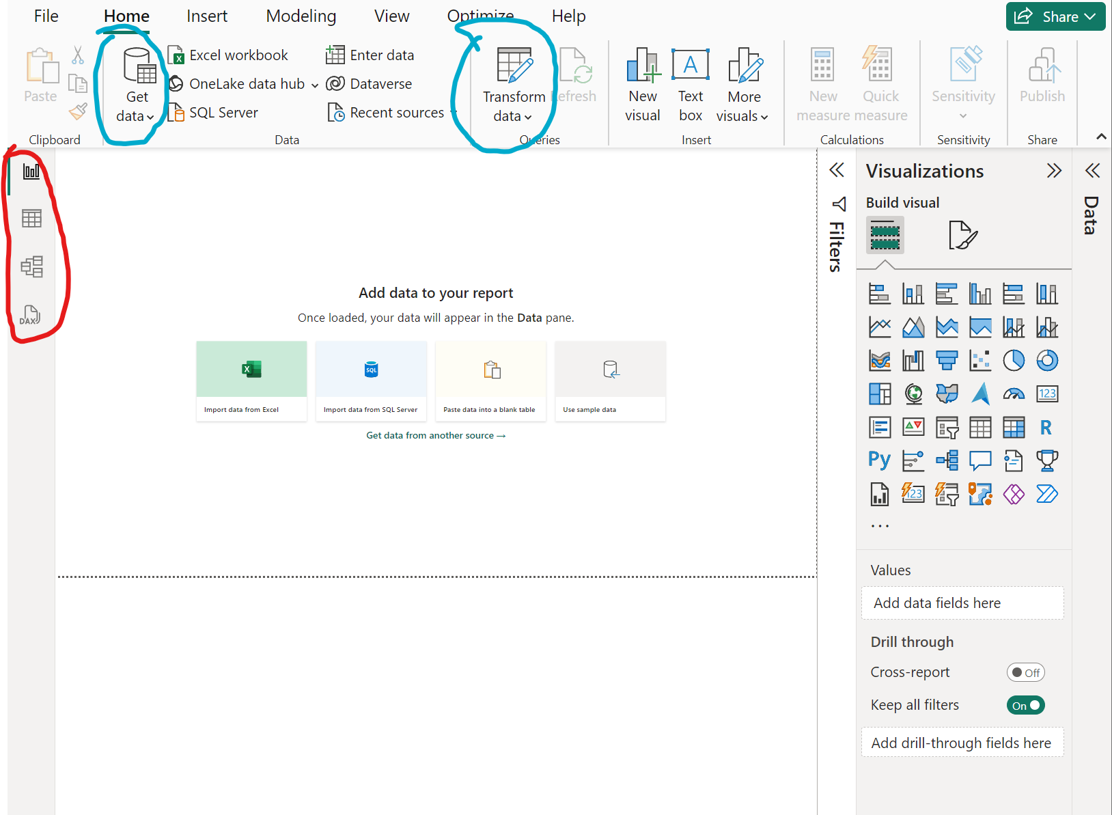
Introduction – Overview
Get and Transform Data (BLUE)
Different views: report, table, model, dax (RED)

Slide 4
01 Introduction – Mini Project – Part I
Click Get Data
Import excel filegdp_data.xls from C:\Users\Simon\packt_video_courses\pbi_complete_masterclass\Section 1 - Mini Project
Click on Transform Data
in the new window you can rename your query and your columns by using a double click
Click Use First Row as Header if the first row is actually your header
Remove null values: select your first colum -> click Reduce Rows -> Remove Rows -> Remove Blank Rows -> finally click Close & Apply
Remove unwanted columns: right click the unwanted column and click Remove
the report view offers Visualizations
Click the visualization you want and then drag and drop the data you want to visualize from Fields
Drop e.g. Year into the x-axis to see the development of the GDP over the years
Now drop Country into the legend field to visualize both Country and Year
Click slicer under visualizations to make a new chart (with e.g. drag and drop country) which allows you to select all the countries you want to show in your chart

Slide 5
01 Introduction – Mini Project – Part II
Better overview: select country and under visualizations select format your visual then select style under title
Now make a new chart the cluster chart -> drop GDP growth into the y-axis then Country as legend
To visualize the year into our country drop it into the x-axis field
Adding more tables to our visualization: we get our 2nd source file via Get data and load our life expectancy excel file and again click Transform Data -> then we click the Get first row as header as before
But we now have a wrong format so we right click our column and choose unpivot other columns in the drop down menu
But our column is still a text column shown by the ABC next to the column title -> right click that column and change the data type to a whole number
we should now change our column names to year and life exp then apply and exit
Now create a new clusterd column chart with life exp as values and year into the axis y and x
But: values have been summed up (people seemed to be more than 6k years old) -> click the small down arrow next to life exp under visualizations then choose average
Now drag country into the legend und visualizations
Problem: both country columns in both tables are equal but should be connect -> go to model view and drag and drop the tables to connect them -> click Save and return to the report view

Slide 6
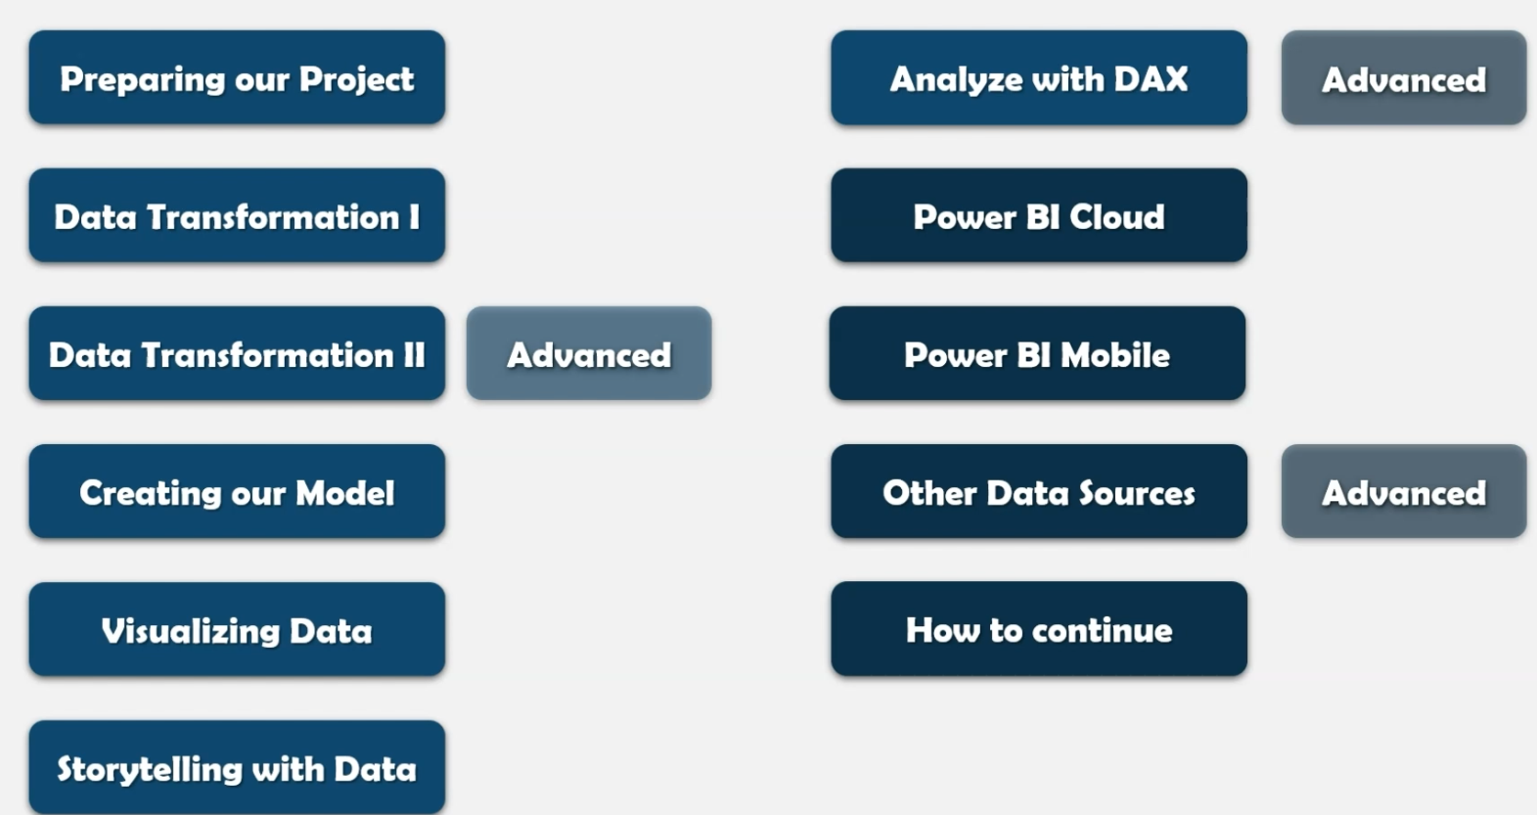
Next steps…

Slide 7
02 Preparing Our Project I
First of all go to File -> Options and Settings -> GLOBAL -> Regional Settings and select for both App Lang and Model Lang the English language as a default
Then go to CURRENT FILE (also under Options) and uncheck the box under Type Detection then uncheck the first and third box under Relationships <-> after that go to Regional Settings under CURRENT FILE and change your Locale to English (US)
Restart your program after applying all changes!
For the change of attaching files go to Transform data -> Data source settings -> change source

Slide 8
03 Data Transformation – The Query Editor I
Applied steps: navigator to your whole steps (what you have done so far) -> steps can be deleted clicking the X next to the step description OR you make just make changes to a step
CountriesWorld.xslx loaded: clicking APPLIED STEPS lets you modify the data source (e.g. csv)
Next click Reduce Rows -> Remove rows -> Remove top rows and enter the number 2
Then click Use First Row as a Header
Unter a column name you can sometimes find a red box -> do a mouse over and you‘ll see the number of errors in your column -> then select your columns and click under Remove rows directly at Remove Errors -> all rows containing errors will be deleted
If you click the gray arrow next to your column name you can choose Remove Empty which has the same effect as Reduce Rows -> Remove Rows -> Remove Blank Rows
Remove Duplicates under: Reduce Rows -> Remove Rows
Change data type manually: click on the symbol left of your column title
Change multiple data types the same time: shift + left click, then right click one of those marked columns -> choose Change Type -> select your type
Columns that contain percentage could be transformed to percentage and then clicking Transform in the main upper bar (next to Home) -> click Standard -> Divide -> Enter 100
Replace values: select column -> right click it -> click Replace values (attention: a comma in Europe is a dot in the US, so watch you local settings in the options!)

Slide 9
03 Data Transformation – The Query Editor II
Open CSV files: Get data -> CSV/Text file -> open formdate.csv -> select encoding and delimiter -> Transform data
Connect Power BI to a Website: type into google search „list of sovereign states by date of formation and open the wikipedia article -> copy and paste the URL of Wikipedia in our project file -> click New source in the Power BI Query Editor -> Web -> paste the URL -> a table overview will open -> select only Table 3 (which is about Africa) -> table now has been added to our Power BI file -> then we delete it again
In our formdate.csv we Use First Row as a Header
How to extract only the e.g. year from a column? – Mark you date column -> click Transform -> click Extract -> click Last Characters-> Enter 4 (for the max. length of the year) -> convert your column to a Whole Number now
To keep a column mark it -> right click it -> choose Duplicate
How to split columns? – mark your column -> click Transform -> Split Column -> Split Column by Delimiter -> Select Custom -> enter from and select Left-most delimiter
Merge columns -> mark 2 or more columns -> click Merge Columns -> choose separater (even custom is possible like re-entering „from“) and type a new column name

Slide 10
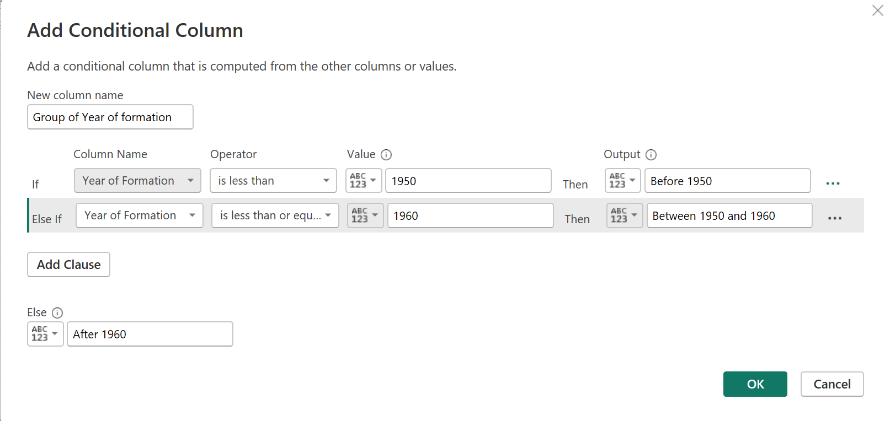
03 Data Transformation – The Query Editor III
Adding new columns based on the information that is already given -> mark e.g. Year of formation column -> click Add Column -> in the new window define one or more conditions

Slide 11
03 Data Transformation – The Query Editor IV
Creating new columns from existing columns -> in this example we want to combine Country and Year of formation so we select it -> click Column From Examples and choose Select columns -> we click the first column and enter Algeria has become independent in 1962 -> all other columns will be completed automatically after clicking Ok
To combine more columns just select them additionally to your already selected columns then enter the text in your newly created column -> after that the auto-completion should fill in the data according to your text -> if not: manually fill in the other lines until the autocompletion will work -> at the end: just click OK and here we are!
To extract only the year of a date -> select the Date column -> click Column From Examples and choose Select columns -> in the new column just enter the year only and it will fill out the missing values (blanks can be filled out manually)
Combining information in one query -> click New Source -> open in this example the file GDP by country 1960-2016 -> after that clean the first 3 rows then make the first row a header for each file -> go to Combine -> Merge Queries -> Merge New Queries -> now select all files and mark a base column that occurs in both files -> Join Kind can be ignored as is this case we have all countries available in all files -> a new table Merge1 will be created -> there delete all full null rows -> in the last column click the small symbol next to the column title and only select the years (this means de-selecting e.g. Country Name etc.) -> uncheck Column as Prefix -> do the same thing now with your Merge1 and the other file (in this case the GDP 2000-2016) -> repeat the thing with those prefixes as before
Pivot the table to only have one table of the year -> select columns 1960-2016 -> click Transform -> click Unpivot Columns -> a new column Attribute will appear (those were the column names from before), behind that we will find a new column Value that contains all the values attached to the year -> clicking the icon next to the column name lets you sort the current column in ascending or descending order -> ATTENTION: there is a much easier way doing all this by just selecting the first one or two columns and click only Unpivot Other Columns -> now we have the same result instead of marking dozens of columns
Before we saw the unpivoting, to pivot columns you only have to select exactly 2 columns -> click Pivot Columns -> then choose the name of the column that should pivot the values
How to combine different tables into one new table -> in this example we open just text files (groups 1-3) -> go to Home -> New Source -> Text/CSV -> we select first one of those files and import, then we do the same thing with the 2 remaining files -> next we click on Combine -> Append Queries -> Append Queries as New -> click the box Three or more tables and add the three new tables

Slide 12
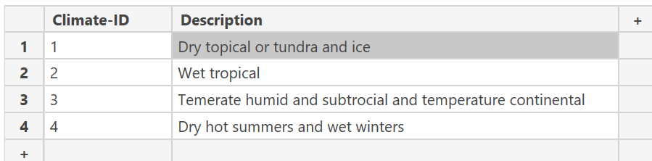
03 Data Transformation – The Query Editor V
Organizing queries in groups -> right click an empty space in the queries area and make an New Group -> drag & drop the Country Fact Table in the newly created group (or just right click the table and move it)
Entering data manually -> e.g. climate infomation represented by numbers -> click Enter Data to create a new table -> the example will look like this then:
Creating an index column -> click Add column -> Index Colum -> in our case we choose From 1
Program orientation: best way may always be to right click a column to perform a specific operation instead of searching in the menu bar

Slide 13
04 Data Transformation – Advanced I
Advanced Editor for Error Handling: Click Transform -> choose a table -> click Advanced Editor -> everything here is written in the M Language -> steps there are beginning with a label (e.g. the removed columns) -> purpose: if errors occered after e.g. renaming a column in our applied steps we can just use the advanced editor to rename the column in further steps manually, as the error depended on the renaming step
In the Advaned Editor you can also change the file name of your current file
Create references instead of duplicates -> right click your table then click Reference -> a reference will create a new source without the steps in between (which we have for the duplicate and will provide much better performance especially for large files) -> Attention: changes of our original tables will affect our reference, too, but not the other way
Duplicates can be quite good -> if you like to change your source (in the Applied Steps) e.g. to analyze only a part of the data (clicking the table you would like to work with) you can use a duplicate to experiment with it without changing the original file -> But: if you would like to do some different changes you can just open the Advanced Editor and change e.g. the date in your to the desired item #"GDP by Country_2000-2016_Sheet" = Source{[Item="GDP by Country_2000-2016",Kind="Sheet"]}[Data] which in this case is the span of the years -> by this you won’t lose all the changing steps instead of creating a new table from the source file
Improve the performance of our model I: models that you don’t need can be disabled (or better said you can prevent them from being loaded) -> right click the model then click the box next to Enable Load (disabled loads will be displayed in italic fonts)
Improve performance of our model II: for static models (that don’t get new data so often) -> right click the model name then de-select Include in report refresh
Improve performance of our model III: click your table -> click Transform -> click Group By -> there select e.g. REGION and let it count the rows (to see how many regions of your countries you have in your data) by creating a new column -> be advised that you can always modify this by step by clicking on the gear item in Applied Steps for another operation or another dependency -> click Advanced if you would like to analyze more rows

Slide 14
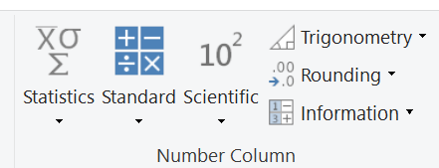
04 Data Transformation – Advanced II
Mathematical Operations: only works for numeric columns -> mark a column -> click Transform -> click Standard in the Number Column in the menu bar -> choose an operation e.g.:
percentage takes the percentage of all the values in the column)
information can check for even or odd numbers
scientific offers logarithms and many more

Slide 15
04 Data Transformation – Advanced III
Dealing with parameters -> Home -> Manage Parameters -> click on New -> under suggested values enter all countries you like to observe -> under Current value select anything -> now click the small arrow next to your column name of the original table and select -> Text Filter -> e.g. equals -> click the ABC icon after equals then select the Parameter -> after going back to our Parameter table we can select another country which will now be filtered in our original table
Make a new parameter as before -> but now name it e.g. taxrate -> select decimals -> enter a value of e.g. 0.2
Now make a custom column -> Add Column –> create Custom Column -> double click GDP (or click insert) -> enter a multiplication sign * -> enter taxrate -> now we get the new column -> Attention: changing values in our parameter table will automatically effect our newly created column

Slide 16
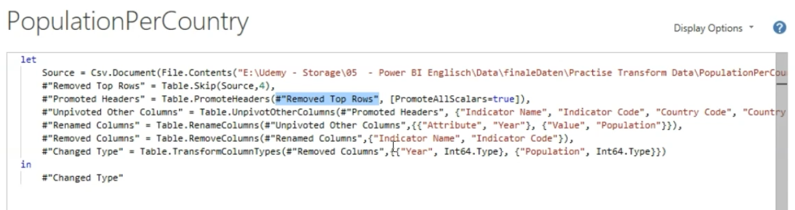
04 Data Transformation – Advanced IV
M language: can be found under Home -> Advanced Editor -> example:
First Line is the source of our file location
Following lines are the applied steps
Structure: name_of_the_step (as a variable) -> equal sign -> M language functions
Preceding variables will be used in the next step again
Each line ends with a comma
The final step is concluded by just repeating the last variable
Errors will be shown below the code

Slide 17
04 Data Transformation – Advanced V
Example: right click the left Queries space then create a New Query -> Blank Query -> open the Advanced Editor -> enter some text or numeric value in the “ “ -> in the upper left click To table
To create a list in M -> just write something into those brackets {} -> example: Variable = {"abc", "def"} -> note: you can also create a list of a list writing it like this {{}} e.g. Source = {{"abc", "def"},{2,3}} -> lists can be clicked within the table then (to see the full list click the icon next to the column title then click Expand to New Rows
To create a new table within the Advanced Editor: open your editor -> below the e.g. list variable type #“Variable“ = table access brackets (number of columns, list of lists with content list1 containing only the first rows‘ content and list2 containig only th second rows‘ content) like this:
let
Source = {{"abc", "def"},{2,3}},
#"Table creation" = #table(2, {{"abc",2}, {"cdef", 3}})
in
#"Table creation"

Slide 18
04 Data Transformation – Advanced VI
Using functions in M language -> e.g. upper case -> example: Source = "abc", UpperCase = Text.Upper(Source)
Applying a funtion on a table with its column names (first) and the lines (second curly brackets) -> in this case we try to apply the upper case -> line2 is our created table, line3 is a new table for the upper case, line4 lets us rename columns
More about functions on: https://learn.microsoft.com/en-us/powerquery-m/
let
#"Table creation" = #table({"TextColumn", "Numbers"}, {{"abc", 2}, {"cdef", 3}, {"xyz", 4}}),
#"Table in UpperCase" = Table.TransformColumns(#"Table creation", {"TextColumn", Text.Upper}),
#"RenameColumns" = Table.RenameColumns(#"Table in UpperCase", {{"TextColumn", "Text"}, {"Numbers", "NumbersColumn"}})
in
#"RenameColumns"

Slide 19
05 Creating a Data Model I
Visualizations:
from Countries drag & drop Country in the field and see world map with all geographical locations of the countries
Numerical data will be automatically show a bar chart
Alternative: select the chart und Visualizations first then drag & drop the data you want after that
Dependencies can be dragged into Axis, Legend AND/OR Values under Visualizations (e.g. GDP in Y-axis and Description in X-axis -> problem they all have the same length -> solution connect the tables according to their main field and the corresponding ID -> see the next step)
Create and edit relationships: go to the Model View Window -> if we have s.th. like e.g. Climate in one column and Climate-ID in the other column and intend to extablish a connection between those two aspects we just have to drag Climate (column A) over Climate-ID (column B)

Slide 20
05 Creating a Data Model II
File: Cross Filter and Many-to-many.pbix
Edit a connection in the Model View: double click or right click the connection line -> Cardinality
Many to one: many means there are multiple values, 1 means values in that table are unique
One to one: connecting a uniqe value form table A to a unique value from table B (e.g. IDs)
Many to many: cross filter directions -> choose the direction you want to examine e.g. Single (Country-Sales filters Country-Population) -> selecting Countries in the Sales table in the Report view now show us the values as far as they are available in the Population table
Cross-filter direction: shown by the sign of the two arrows (both direction) and the one arrow (single direction) on the link between the two tables -> you can change that by double clicking it -> Why not always use the both filter? Because it helps you to understand your model more properly (but you can always use both cause there is nothing wrong with it)

Slide 21
05 Creating a Data Model III
You can never have more than one active relationship -> to activate a specific relationship -> double click the connection line then click Make this relationship active -> note: always try to avoid more than one relationship
Manage relationships button can quickly make multiple changes to active relations or just delete them

Slide 22
06 Data Visualization I
First step: click the chart you want under Visualizations -> drag any table containing data into that chart, as here Country (it will then be automatically put into the y-axis but can be dragged in another axis, too) -> clicking the table in Fields we can see a new bar in the menu bar names Column tools which shows us the Data type of our table -> drag another table into our chart, e.g. like GDP (it will be automatically put into the x-axis)
Changing the order of elements: click the three dots (More options -> descending/ascending or Sort by column)
For a new chart: click into the empty space -> click another chart
Visualizations window -> Format your Visual ->
click Visual: Legend on/off, Title (change name of the legend), change the color/font/text size of the Legend -> note: you can Reset to default
Drag e.g. Country into the empty Legend spot to see more visualizations
Note: colors can be changed for each bar manually under Visual -> Slices -> Colors
Visualize a single bar: Visual -> Bars -> Categories (drop down e.g. USA) -> click the fx next to the color -> new window pops up -> under Format style select Gradient -> select the table the gradient color scheme should rely on
Data Labels: click Visual -> Data Labels then make your adjustments e.g. Options -> Position -> e.g. Inside end (recommendation: click Overflow text on); change Background transparency for a stronger visualization of the text inside the bars -> note: for the Pie Chart click Details labels (e.g. Postion, Label contents)

Slide 23
06 Data Visualization II
Understanding Tables:
Create the table: under Visualizations click Table -> drag the table you want into the Values field (e.g. Country) -> there is a small down arrow in this field click it to make math operations on that table which will be shown instantly on the left side -> additionally we can drag another table into the Values field and we will have a new two-column table
Adjustments under Visualizations: to change the name of a column just double click the name in the Columns field (where we have dragged our columns before)
Changing the design: click Format visual -> Visual -> change Style, Grid, Values color etc.
Conditional Formatting: click Visual -> Specific column -> under Series select a column -> change Background color, Text color
for advanced options click Cell elements and switch on e.g. Background color
if needed click fx for more options (for Grading there you can set a custom value under minimum AND/OR maximum) -> same thing can be done for the Font color
Under Cell elements you can also change the data visualization to Data bars and adjust some advanced settings via fx
Cell elements -> Icons -> icons show a range of the percentage where you can find the values

Slide 24
06 Data Visualization III
The Pie Chart – example01 - (only good for displaying percentage): under Visualizations
click Build visual -> Drag another table into Details for a broader information on your pie chart
click Build visual -> Drag another table into Details to see more details to your data via mouse-over a specific part of your pie chart
Click Format Visual -> Detail labels -> Label contents -> changes the information displayed of your tables
All about the filter visual – example02 - -> under Visualizations drag & drop a line chart ->
from Country Fact Table for x choose e.g. Year for y choose e.g. Sum of GDP for legend e.g. Country Name -> NOW EVERYTHING SEEMS TO BE A BIT MESSY ->
under Visualizations select Slicer -> there drag & drop e.g. Country Name which lets you select a specific country now ->
now drag & drop IncomeGroup (from MetaData Country tables collections) into the Slicer field to see the income groups of all countries ->
note if there is only a blank instead of the chart you should see if you can link the tables correctly in the Modle View ->
for an even better overview drag e.g. Region into an empty space then make it a Slicer and select your desired region according to its income ->
To find out a certain span of years -> drag Year into an empty space on the left -> change the chart to Slicer -> now you can slice through the whole span of all of the years you got -> note: to change the type of slice you just click the down arrow on the upper right within your chart
FILTERS FILTER EACH OTHER

Slide 25
06 Data Visualization IV
Filters pane (next to Visualizations):
to filter blanks click the down (right next to the table name) arrow under Filters -> Filters on this visual -> select all wanted categories -> the Filter type should be Basic filtering ->
to change the Filter type to Advanced filtering -> e.g. contains can filter all words that contain a “w“ ->
another option is Top N which allows you to filter countries by another value (drag & drop the table into the By value field) -> under Show items Top/Bottom you can enter a value for the amount of top values displayed
To define a general filter click into the blank then drag a table right into the Filters field -> filters can always be cleared by clicking the X next to the Filter type section
To make a table e.g. IncomeGroup to large buttons go to -> Visual -> Slicer settings -> Options-> style -> Tile -> note: to change the background color of your buttons (go to Visual -> Values -> Background)
Cross Filtering and Edit Interactions (example03) -> in the upper bar click Format -> click Edit Interactions (icons show up but won‘t appear on the selected chart but on the others) -> over those icons we can filter, hightlight or block interactions -> if we don‘t like interactions on a specific visual
Synching slicers – example04 -: in the lower part of the window right click Page 1 then click Duplicate -> mark your chart -> remove Sum of GDP then drag & drop the Population table -> main goal: all tabs below should affect one another (synchronized) -> to do that click the View panel in the main bar -> click Sync slicers -> mark your slicer table -> on the right under Sync slicers check all boxes -> note: THIS HAS TO BE DONE FOR EVERY TABLE MANUALLY -> Advanced options: lets us choose groups that can be affected by our filter

Slide 26
06 Data Visualization V
Creating Drilldowns: drag a second table to the X-axis -> drill down mode will appear below the chart (arrow up/down/two-arrows) ->
now just click on any region and you will see all information about this region according to the (in this case) GDP -> to go back click the arrow up icon
The two arrows show all countries (in unfolds all connections)
Dragging more tables to the Y-axis is even possible (hierarchy scheme: highest table first then going down to the lowest table which represents the lowest level)
The expand all icon shows all table data next to each other
Creating Drill-Throughs (example05): you would like to see how e.g. the IncomeGroup on page1 affects the other page (GDP) -> go to the GDP Page and drag the IncomeGroup into Drill through under Visualizations -> now go back to page1 and right click any bar in the IncomeGroup -> click DrillThrough -> for a new operation just click another bar or just do the same steps on a new page tab e.g. Population
The Treemap Visual: open a new page tab -> drag & drop the treemap chart -> drag & drop groups -> mouse -> over shows you more information -> now you create a new stacked bar chart with IncomeGroup and Average_of_GDP -> then create Slicer with the years in it and only allow one selection (Visual -> Slicer settings -> Selection -> Single select ON) -> values are changing by just clicking the Year radio button -> note: by just clicking other income bars it will also affect the Population chart according to the Income selection or vice versa

Slide 27
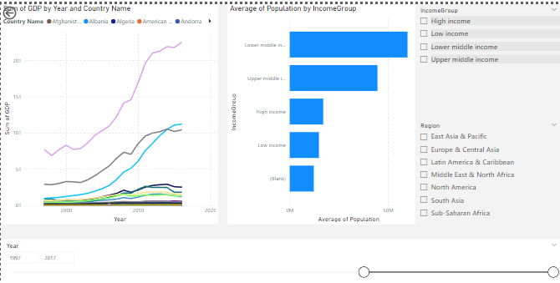
06 Data Visualization VI
Decomposition Tree: first create a new page tab -> click Decomposition tree -> drag on table into Analzye -> drag 1 or multiple tables into Explain by -> now click the little plus sign on your DT chart -> select e.g. Region and you see the sum (can be changed to every other operation like average etc.) -> from all branches you can make another branch by just clicking the plus sign on that -> if you then select another branch it will refresh the following information according to that branch -> note about the High/Low Value: clicking the plus sign and choosing High/Low Value will automatically find the best branch / best split to the highest/lowest value when choosing a certain math operation (e.g. average)
Understanding the Matrix Visual: make a new page tab -> drag Region to Rows, IncomeGroup and Country to Columns and Sum of Population to Values -> Columns can be accessed via arrows below the chart -> if you drag Country into Rows you can just expand them by clicking on the Region in the table -> to empasize important values on throughout the whole numeric columns click Visual under Visualizations then Cell elements and Background color fx -> optionally add a middle color
Editing Pages (example06): first delete Page1-> on View (main menu bar) click Synch slicers to see what you have synched so far -> drag Region into the IncomeGroup -> then remove Region again ->
Change the whole background: click into an empty space -> Visualizations -> Format your Report Page -> Canvas background -> choose a color or an image as background (you can play with the transparency on all of your visuals/charts)
Change the background of a visual: Visualizations -> General -> Effects -> Background -> note: you can always remove the background (set it to OFF) from your visuals it will be 100% transparent

Slide 28
06 Data Visualization VII
Buttons and Actions: click your Matrix Visual tab -> then go to Insert (main bar) -> Buttons -> Back Button -> we can set a title/color etc. -> under Action you can select e.g. the Page navigation and select a destination (e.g. the tab Treemap Visual) -> note: you can also add a URL under Page navigation -> then you can set the Drill through -> to do that select a Region in your Matrix Visual then a certain country e.g. Australia then just click the button to go to the specific tab with the tabel containing the data
Bookmarks to Customize Your Report: a bookmark always remembers a specified action -> for this just create any button (e.g. the bookmark button) -> go to View and select Bookmarks and Selection -> under Bookmarks add a new bookmark -> no matter if you go to another tab or make changes to some data on your bookmark tab it will always go back there to the its home and set values -> to update the bookmark to new adjustments just click the three dots next the the bookmark title (under Bookmarks) and click Update -> note: in the Slection pane you can customize what you would like to see (it will also be stored to our bookmark), this will work for filters (under Visualizations), too -> and: you can also make the data vanish and get it back by clicking the button making it more interactive

Slide 29
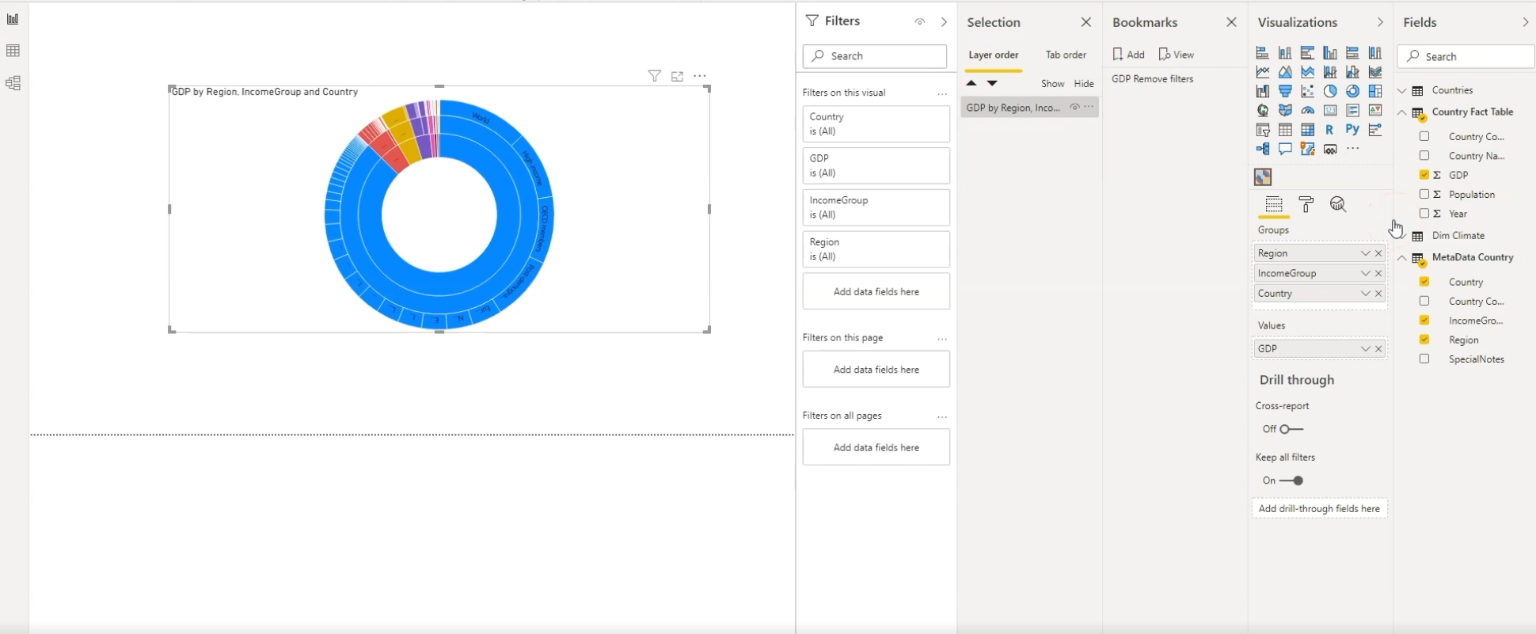
06 Data Visualization VIII
Analytics and Forcasts with Line Charts (example07):
drop date into the X-axis -> drop profit into the Y-axis -> now it doesn‘t look very clear -> so just drag the quantity into Secondary y-axis to make 2 axis for both Profit and Quantity -> now remove the Quantity to focus on the Profit
Insert a trend line: Visualizations -> Analytics Icon -> Trend line ON
Add a threshold line: Visualizations -> Analytics Icon -> X-Axis Constant Line
Percentiles: same as before but -> Percentile line
Forcecast: insert a number (in this case it‘s the number of days) -> Confidence interval (model is sure in such an amount that our values will lie within this range) -> ignore points to change the forcast -> Ignore the last lets us see how our model predition would have worked
Working with Custom Visuals (example08): open a new tab -> under Visualizations click the three dots -> Get more visuals -> create an account for Power BI -> choose the visual called Sunburst from the market place (see image above)

Slide 30
06 Data Visualization IX
Get Data Using R Script and R Script Visual: open the R file in the folder resources -> then copy & paste it via Get data into the R script window (eventually some libraries have to be installed in R) -> now you can drag & drop the new table into your Report view window -> note: to edit the R script files click the R und Visualizations and drag & drop the R tables you like to edit (e.g. petal.lenght, petal.width, species) -> code will be applied automatically in the R script editor below -> from your R script file now just copy the rest of the code (under Visual 1) into your R script editor -> just run your code by clicking on the play button in the upper right in the R script editor -> then create a new visual with all lengths, widths and species -> then copy & paste the Visual 2 from the text file
Asking Questions (Q&A Visual): go to Insert -> Q&A -> write a question like „how many countries do we have“ and press Enter -> the answer will be shown instantly -> OR: just try the preset questions -> in most cases Power BI will automatcially use visuals as the answer -> note: clicking the gear icon lets you choose which tables should be considered for this Q&A -> note2: you can also click Suggest questions

Slide 31
07 Power BI and Python I
Transforming Data Using Python (example01): import a csv file (e.g. indian_food.csv) -> problem: csv has many null values -> click Transform data -> filling data with python script -> click Transform (main menu bar) -> Run Python script -> click the gear icon to write the python script -> enter „import pandas as pd \n data = pd.DataFrame(dataset.loc[:, 'prep_time‘])“ -> then enter „final = data.fillna(method='ffill‘) “ in a new line in the Python script, alternatively you can write e.g. data.mean() in the brackets instead of the ffill method
Creating Visualizations Using Python: click the dataset (main) table -> under Visualizations click the Python visual -> into the values you can drag e.g. cook_time, prep_time and the course -> in the Python script editor you can see that all dropped tables will be automatically added to a Pandas dataframe -> in the Python script editor enter „import matplotlib.pyplot as plt \n plt.plot(dataset.course, dataset.cook_time, 'o') \n plt.show()“ and click the Run button -> in the Values filed click the down arrow and Don‘t summarize to show the true dispersion of the data

Slide 32
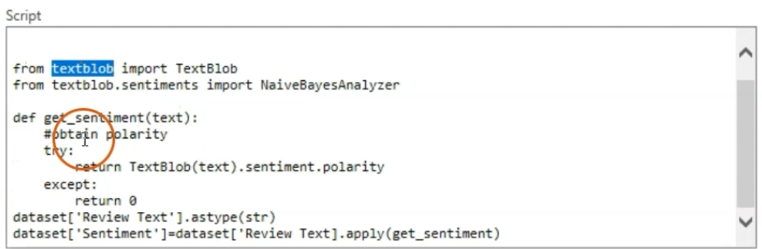
07 Power BI and Python II
Violin Plots, Pair Plots and Ridge Plots Using Python: in the Python script editor enter “import matplotlib.pyplot as plt \n import seaborn as sns \n sns.violinplot(x=dataset["region"], y=dataset["prep_time"], palette="Blues") \n plt.ylabel("prep_time") \n plt.show()” -> then make e.g. a pairplot “import matplotlib.pyplot as plt \n import seaborn as sns \n sns.pairplot(dataset) \n plt.show()“
Machine Learning (BayesTextAnalyzer) Using Python -> import the csv file Womens Clothing E-Commerce Reviews -> in the Query Editor go to Transform -> Run Python script code from the image above -> you will see a new column Sentiment at the end of your table -> note: negative sentiments close to -1, positive sentiments will be close to +1 -> now go back to your Report view and click the Scatter chart under Visualizations -> drag&drop Rating table to the x-axis and Sentiment to the y-axis -> click the down arrow then Don’t summarize the Rating and Average the Sentiment -> result: the higher the rating the more positive our sentiment is -> note: you can make a new table, sort your Clothing IDs by negative/positive sentiments and take a look at the Review Text according to that sentiment

Slide 33
08 DAX – The Essentials I
The Project Data: load the sales data.csv -> select all tables and click Load ->
Measures Versus Calculated Columns: on the left go to the Table View (example01) ->
Calculated column: a logic like a formula that is producing a new physical column in our table (that means for each row we have a new physical data point) -> create a new calculated column -> right click the table (e.g. sales) and create a new column or just mark the sales table and click New column in the main bar -> click in the formula field above your table and name it e.g. price -> for the formula type RELATED (price) and select products[price] for autocompletion -> press Enter and the price will be written into the price column
Calculating the revenue (quantity x price): select sales table -> click new column -> type the formula revenue = sale[quantity] * sales[price]
What are measures? – main difference: measure is only virutal not physical like the calculated columns -> measure means better performance -> now drop the revenue into your Report View -> click Column tools and select the dollar sign -> now drop the location id into the chart -> now right click the sales table and click New measure -> go to the formula bar and type Total = SUM (sales[quantity]) and press Enter -> our newly created measure will appear under the sales tables -> you can now drop Total into the Report View -> note: going to the Table View won‘t show the new measure Total in the table (which proves that it only has been calculated virtually)
Click the sales table again -> make a new measure called Revenue -> for the formula type Revenue Measure = SUMX(sales, sales[price]*sales[quantity]) -> note: SUMX means summing up a calculation within the chosen table) -> when now moving the location id into the Revenue Measure table the result will be the same as our table in the calculated columns section

Slide 34
08 DAX – The Essentials II
Automatically Creating a Date Table in DAX:
Go to https://learn.microsoft.com/en-us/dax/calendarauto-function-dax to see the code for the date function
In Power BI mark the sales table and click on New Table in the menu bar -> in the formula type DatesTables = CALENDARAUTO() -> a new table called Dates will be created in the new DatesTables -> now drag the Dates table into the Report View windows -> under Visualizations click the down arrow next to Date and select Date -> now dropping the date table from our sales table you can see that this one starts on May 1 unlike the auto table which start on January 1 -> into the formula of the DatesTables type the number 3 into the brackets and you can see that the year now starts on April 1 and ends on March 31
Calendar [function] -> see on https://learn.microsoft.com/en-us/dax/calendar-function-dax -> more manual way of creating a date table -> you can enter a start date and an end date -> on the dates table now change the formula form CALENDARAUTO to CALENDAR by typing DatesTables = CALENDAR (DATE(2018, 5, 1), DATE(2020, 5, 1)) -> the first date and the last date will be May 1 -> now change the formula again to DatesTables = CALENDAR (MINX (sales, sales[date]), DATE(2020, 5, 1)) and press Enter -> if new dates appear in that table it will always be updated automatically then thanks to our formula

Slide 35
08 DAX – The Essentials III
Creating a Complete Date Table with Features: create a New table under Table tools first -> then copy and paste the script into the new table -> under Table View you can see all relevant information about months and years -> now go to the Model View -> there you should connect the date in the sales table with the date column in the table DateTable for further operations
Creating a Key Measure Table: for a better overview it is recommended to create a key measure table -> for that in the main menu bar click Home -> click Enter data -> in the name field enter e.g. Key Measures Table -> click Load to see the new table on the right -> there go to the sales table and mark Revenue Measure table -> in the main menu bar go to Home table and click sales -> in the menu select Key Measures Table to move the Revenue Measure table to Key Measures Table -> do the same thing to the Total table -> from the Key Measures Table Column1 can now be deleted

Slide 36
08 DAX – The Essentials IV
Aggregation Functions (example02):
mark the Key Measures Table on the right and click New measure in the menu bar -> type Average sales quantity = AVERAGE (sales[quantity]) then move it to an open field in the Report View -> then click Table under Visualizations
now select the customer table on the right and insert the name below the Average sales quantity which now shows us the average sale quantity per customer -> you can do the same to the Revenue Measure by location_id chart by just moving the Average sale quantity table right into this chart -> remove the Revenu measure then to see the distribution of the average sales quantity across our location_id
To see the maximum of the sales quantity -> mark the Key Measures Table and create a New measure -> type in the formula Maximum of sales quantity = MAX (sales[quantity]) -> then move that new table into the Average sales quantity chart

Slide 37
08 DAX – The Essentials V
The Different Versions of COUNT (example03):
Under the Key Measures Table enter the formula Sample Measure 1 = SUM (sales[quantity]) -> drag and drop the chart into an empty space -> from products on the right drop the product table into the newly created chart from the step before
Count functions: COUNT, COUNTROWS, COUNTBLANK, DISTINCTCOUNT, COUNTA, COUNTX, COUNTAX
Create a new table SampleTable and create a new column in there (see example03) ->
now enter the formula Sample Column1 = IF(SampleTable[SampleColumn]="", BLANK(), SampleTable[SampleColumn])to create a new column with blanks ->
for Sample Column 2 enter the formula Sample Column 2 = IF (SampleTable[SampleColumn]="", FALSE(), TRUE()) ->
click the Key Measures Table and create a new measure Sample Measure then enter the formula Sample Measure COUNT = COUNT (SampleTable[Sample Column1]) -> drag and drop the Sample Measure COUNT table into an empty space -> under Visualizations click Card -> we see the count ->
for the real count enter the formula Sample Measure COUNT = COUNT (SampleTable[SampleColumn])
To count the rows enter Sample Measure COUNT = COUNTROWS (SampleTable)
How to count False/True values? -> use the COUNTA operator for that -> COUNTA works for ALL values
How to count the amount of different values? -> use DISTINCTCOUNT for that -> note: even empty values will be used as a value
To count the blanks simply use the COUNTBLANK function

Slide 38
08 DAX – The Essentials VI
SUMX – Row-Based Calculations (example04): first create a new measure in the Key Measures Table -> for the formula type Revenue Measure Fail = SUM (sales[quantity]) * SUM (products[price]) -> you can now see that the revenue has been calculated false (first the sum of columnA * the sum of columnB) -> TO AVOID SUCH A MISTAKE USE THE SUMX FUNCTION -> note this X function (the x at the end) will work for other functions e.g. AVERAGE, too

Slide 39
09 DAX – The CALCULATE Function I
CALCULATE – The Basics (example01):
first go to DateTable -> drag Date into the empty Report View space -> now click Date table on the left once -> under Format in the main menu bar select a suitable format e.g. 2001-01-13 -> from the Key Measures Table drag the Revenue Measure into the chart (or under Visualizations) -> now adapt the Revenue measure by changing the Format to currency (you can do that the same way as before) -> then set the number of decimals to 2
To create a new calculation measure right click the Key Measures Table on the right an create a New measure and type in the formula Revenue LastYear = CALCULATE( ‘Key Measures Table’[Revenue Measure] , SAMEPERIODLASTYEAR( DateTable[Date]) ) and press Enter -> drag&drop the new Table into the existing chart on the left -> again change the Format to Currency and 2 decimals
From the DateTable on the left (Data pane) now drag&drop the YearMonth table into the chart then remove the Date (under Visualizations)
Now make a new chart -> from location drag&drop state into an empty space -> click Table under Visualizations -> from the Key Measures Table drag&drop Revenue Measures into our new chart
For calculations for specific states mark the Key Measures Table and click New measure -> enter the formula Revenue filtered by a state = CALCULATE([Revenue Measure], location[state] = "Utah") -> drag&drop it and click Card under Visualizations

Slide 40
09 DAX – The CALCULATE Function II
Changing the Context with FILTER (example02) ->
edit the formula of the Revenue filtered by a state and change it to Revenue filtered by a state = CALCULATE([Revenue Measure], FILTER(location, location[state] = "Utah")) -> drag&drop into the state-RevenueMeasure-chart -> now we only see a value for Utah
Now create a new table -> just keep the Revenue filtered by a state selected -> click Table tools in the main menu bar then New table -> type in the formula SampleFilterTable = FILTER( products, products[price]>5) -> a new table will appear on the right (under Data) -> drag&drop price table and product table from there into a new chart -> when changing the filter to >6 it will change to all prices above 6
ALL (example03) ->
Click the Revenue filtered by a state table -> edit the formula to Revenue filtered by a state = [Revenue Measure]/CALCULATE([Revenue Measure], ALL (location[state])) -> note: this formula means the revenue of each state divided by the revenue of all states together -> in the main menu bar change the values to %
Then remove the state under Visualizations and drag&drop the product table from products -> change the formula to Revenue filtered by a state = [Revenue Measure]/CALCULATE([Revenue Measure], ALL (products))
Now select the price table under products and change its Format to Decimal number -> drag&drop the price table into an empty space on the left -> under Visualizations click the Slicer to see how the prices in the main chart change -> problem: the Total in the chart won’t show the 100% because it is affected by the slicer -> solution: use the ALLSELECT

Slide 41
09 DAX – The CALCULATE Function III
ALLSELECTED (example04): returns all the rows in a table or all the values in a column, ignoring any filters that might have been applied inside the query, but keeping filters that come frome outside -> replacing the ALL by ALLSELECTED in the formula of the Revenue filterd by a state table it will now keep the 100% for the total values
ALLEXCEPT (example05): first under Visualizations remove the Revenue Measure -> mark the Revenue filtered by a state table and change the formula to Revenue percentage -> from the products table now drag&drop the tax rate table into the chart -> then remove the product under Visualizations (now we see the share of 7% and 19%) -> now drag&drop the profit margine from products into the chart -> under Visualizations click the visual Matrix -> to see the proportion of the e.g. tax rate much better -> select the Revenue percentage table then for the formula type in Revenue percentage (products) = [Revenue Measure]/CALCULATE([Revenue Measure], ALLEXCEPT(products, products[tax rate])) -> you can do the same thing only for the profit margine table by just entering [profit margine] instead of [tax rate] to see the proportion in regard to the tax rate

