Slide 1
TIKE as a Tool for Education
Presented on Behalf of MAST by Thomas Dutkiewicz
AAS 245, 12 Jan 2025
1

Slide 2





Data Accessibility for All
Two ideas:
Cross platform compatibility (windows, mac, [other])
Don't even need to own a computer
Works with limited internet speed
Design: logos for each type of device appear. Empty logo for none. Add another symbol for for bad connection.
Access to petabytes of data (secondary point)

Slide 3




Software for Astronomy
Notes:
The fact that we can guarantee uniformity (not just compatibility) on all computers is the special sauce of TIKE. No more "I can't reproduce these errors"

Slide 4


Open-Source Tutorials
Notes:
Set of Jupyter Notebooks that cover the basics for you; you aren't on your own.
But also through the magic of open source, you can add whatever you want! Contribute to github! Pull git repos into TIKE, if you must

Slide 5
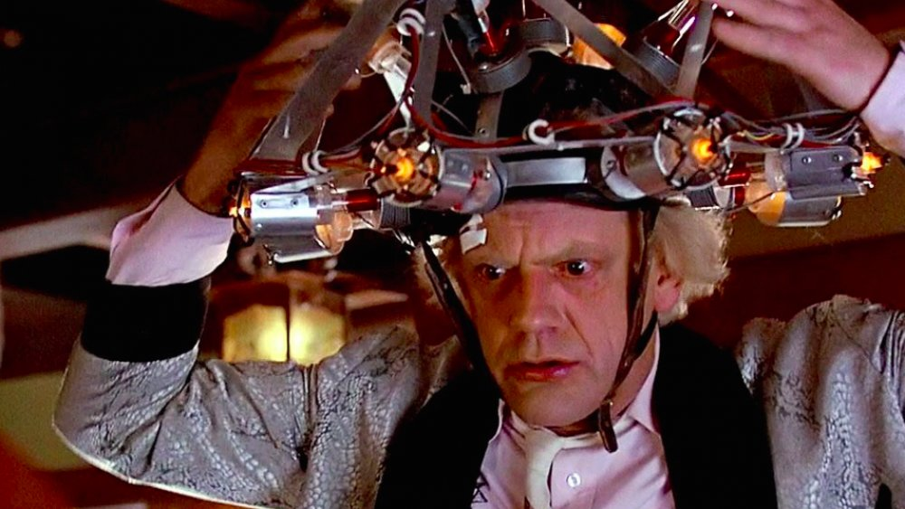

The Future is Now. Like, right now.
Notes:
We can leverage this disruptive change for GOOD, but only if we start preparing early. So start preparing!
Embrace the future for your own good, but also for your students.

