Slide 1


Diffie-Hellman Key Exchange
Bachelor of Science in Computer Science
by
Tesso Jemal Ali
Roll No. AP22111260059
Under the guidance of
Dr. Sazzad Ali Biswas
Assistant Professor
Department of Mathematics
Course: Cryptography (Math 242)
November 2024

Slide 2


Introduction
Data often passes through public networks vulnerable to interception.
Cryptography secures data by making it unreadable to unauthorized parties. Diffie-Hellman is a foundational protocol that securely establishes shared secrets over insecure channels.
Introduced by Whitfield Diffie and Martin Hellman in 1976, it’s crucial for secure digital communications.

Slide 3
What is Diffie-Hellman Key Exchange?
Diffie-Hellman is a cryptographic algorithm enabling secure sharing of a secret key without prior contact.
Recognized as a milestone in cybersecurity, laying the groundwork for secure internet communication.
Allows two parties to create a shared secret based on mathematics, even if an eavesdropper observes the exchange.

Slide 4

Need for Diffie-Hellman
The Problem: Traditional communication exposes keys to attackers if directly transmitted.
The Solution: Diffie-Hellman generates a shared secret without ever transmitting it directly.
Applications: Used in protocols like TLS, SSH, and VPNs for secure data transmission across public networks.

Slide 5
Operational Steps in Diffie-Hellman
1. Parameter Setup: Agree on a large prime number p and a generator g (public).
2. Key Generation: Alice selects a private key a; Bob selects b.
3. Public Key Exchange: Each calculates their public key:
- Alice: g^a mod p
- Bob: g^b mod p
4. Shared Secret Key Calculation: Using the other’s public key and their private key, both calculate the shared secret.

Slide 6
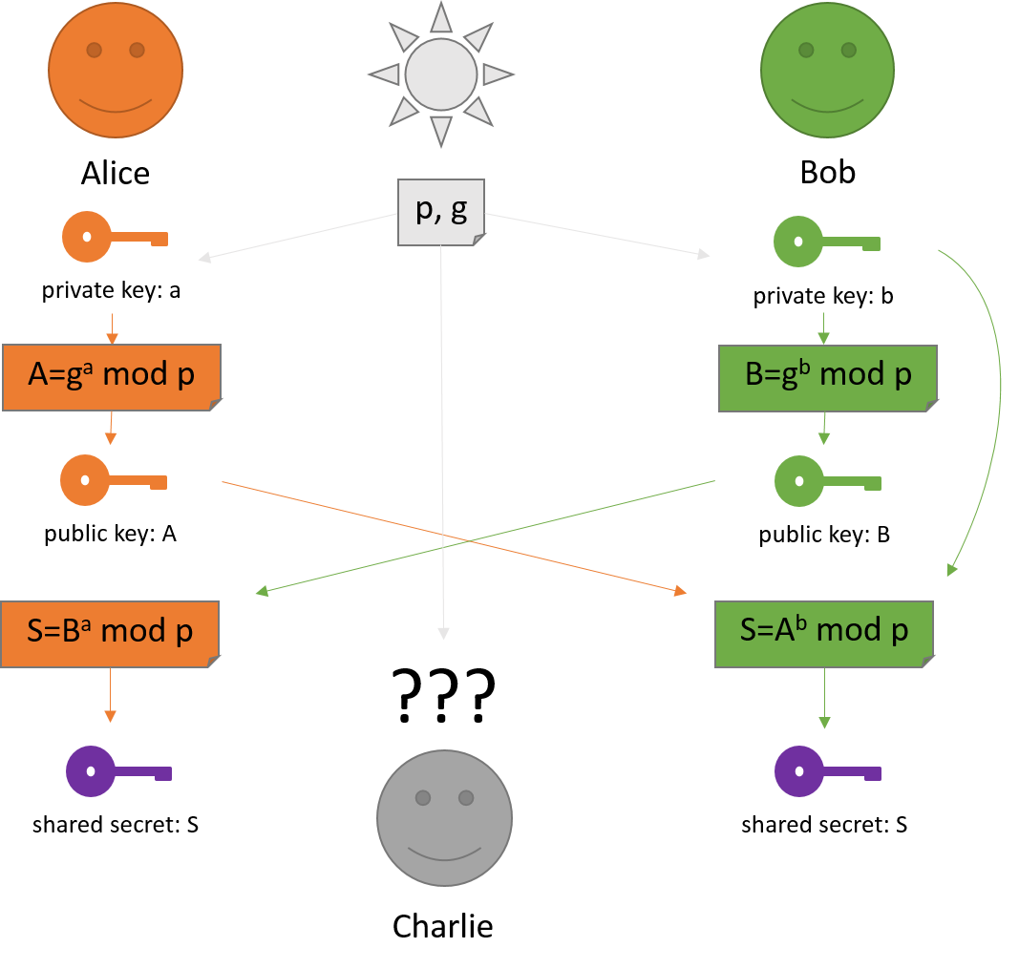
Diagrammatically

Slide 7

Numerical Example
Parameters: Prime p=23, generator g=5.
Step 1: Alice’s private key a=6;
public key g^a mod p=5^6 mod 23=8.
Step 2: Bob’s private key b=4;
public key g^b mod p=5^4 mod 23=4.
Step 3: Both calculate shared secret:
- Alice: 4^6 mod 23=2
- Bob: 8^4 mod 23=2
Result:
Shared secret key: k=2.

Slide 8

Security of Diffie-Hellman
Security Basis: The protocol’s security rests on the discrete logarithm problem.
Protection Against Eavesdropping: Attackers cannot deduce the shared secret without knowing private keys.
Strength: Higher prime values make securing exchanges exponentially harder for attackers.

Slide 9
Python Code for Diffie-Hellman Key Exchange
import random
# Parameters
p = 23 # A prime number
g = 5 # A generator of the group
# Private keys (randomly chosen)
alice_private = random.randint(1, p-1)
bob_private = random.randint(1, p-1)
# Public keys
alice_public = (g ** alice_private) % p
bob_public = (g ** bob_private) % p
# Shared secrets
alice_shared_secret = (bob_public ** alice_private) % p
bob_shared_secret = (alice_public ** bob_private) % p
# Check if shared secrets match
print("Alice private key: ",alice_private)
print("Bob private key: ", bob_private)
print("Alice public key: ",alice_public)
print("Bob public key: ", bob_public)
print("Alice's Shared Secret:", alice_shared_secret)
print("Bob's Shared Secret:", bob_shared_secret)
print("Keys Match:", alice_shared_secret == bob_shared_secret)

Slide 10
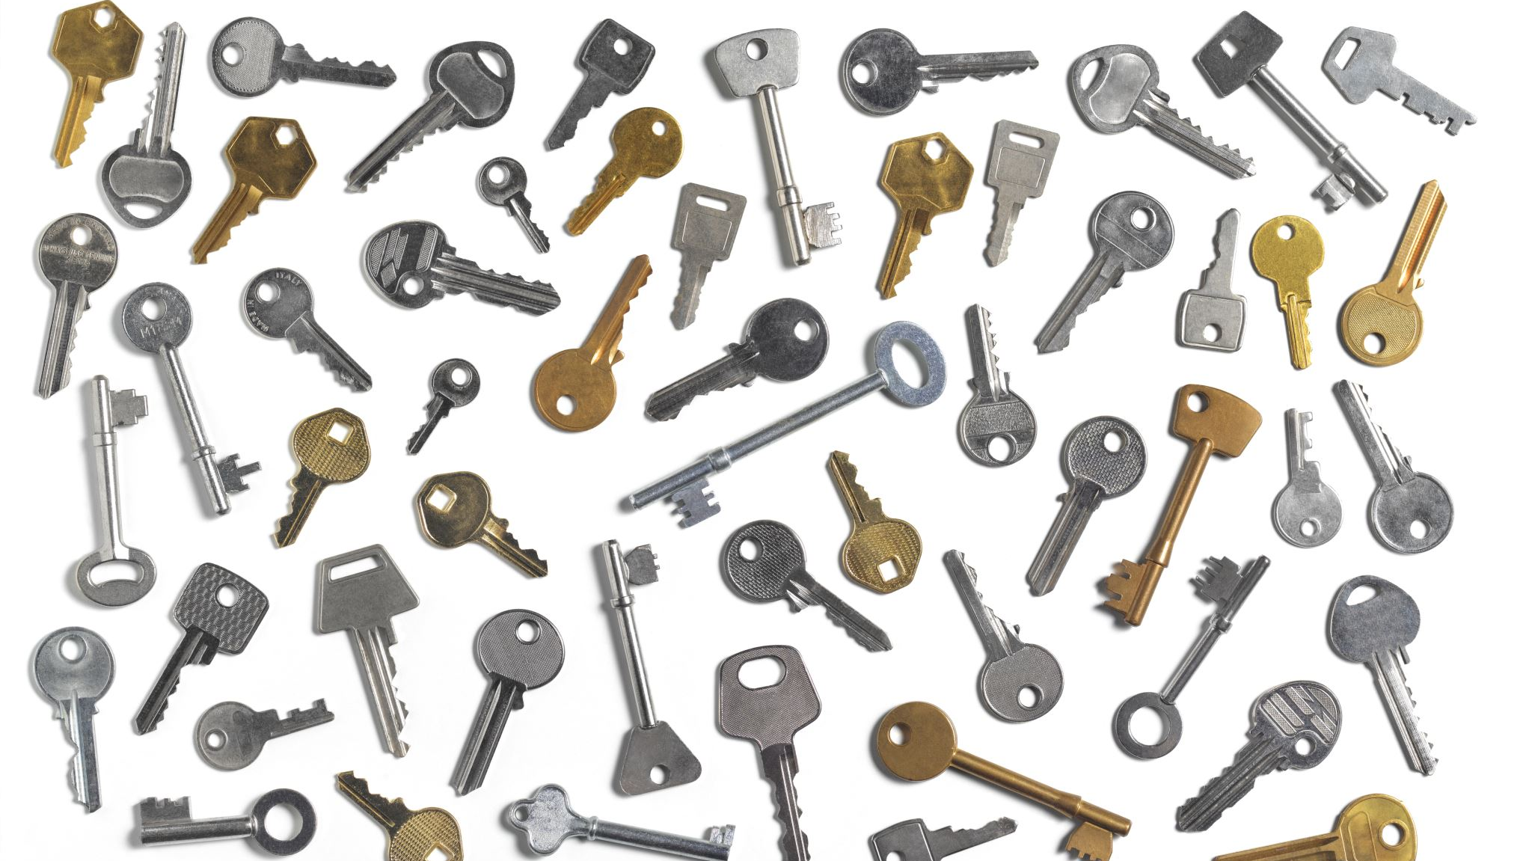
Testing Results
Sample Output:
Alice’s private key: 22
Bob private key: 1
Alice public key: 1
Bob public key: 5
Alice's Shared Secret: 1
Bob's Shared Secret: 1
Keys Match: True
Explanation of Result: Matching keys confirm the algorithm’s success in securely establishing a shared secret.

Slide 11
Perfect Forward Secrecy (PFS)
PFS ensures that past and future communications remain secure even if a long-term key is compromised.
Key Properties:
1. Session Keys: Unique session key per communication session.
2. Independence from Long-Term Keys: A compromised key doesn’t affect other sessions.
3. Enhanced Security: Defends against decryption of previously intercepted data if future keys are exposed.

Slide 12
Practical Applications
TLS (Transport Layer Security): Used to secure HTTPS websites.
SSH (Secure Shell): Protects remote server access.
VPNs (Virtual Private Networks): Encrypts data across public channels.
Relevance: Understanding Diffie-Hellman prepares for applications in secure communications and cryptography.

Slide 13
Conclusion
Summary:
The Diffie-Hellman Key Exchange enables safe, encrypted communication by creating shared secrets. PFS adds a layer of protection.
Future Outlook:
As cryptography advances, Diffie-Hellman remains a relevant solution for secure communication.

Slide 14

Thank you!!!

