Slide 1

1
Detection of Fake vs. Real Instagram Accounts
Bachelor of Science in Computer Science
by
Maxwell Kopseb
Roll No. AP22111260072
Okai Legard
Roll No. AP22111260056
Tesso Jemal
Roll No. AP22111260059
Under the guidance of
Dr. Sunil Chinnadurai
Assistant Professor
Department of Computer Science and Engineering
SRMAP University
SRM University-AP, Neerukonda, Mangalagiri Mandal,
Guntur District, Mangalagiri,
Andhra Pradesh 522240
November 2024

Slide 2

Problem Statement
Objective: Detect fake accounts on social media to reduce platform misuse and improve authenticity.
Research Question: "Can machine learning accurately classify accounts as fake or real based on user engagement and behavioral metrics?"

Slide 3
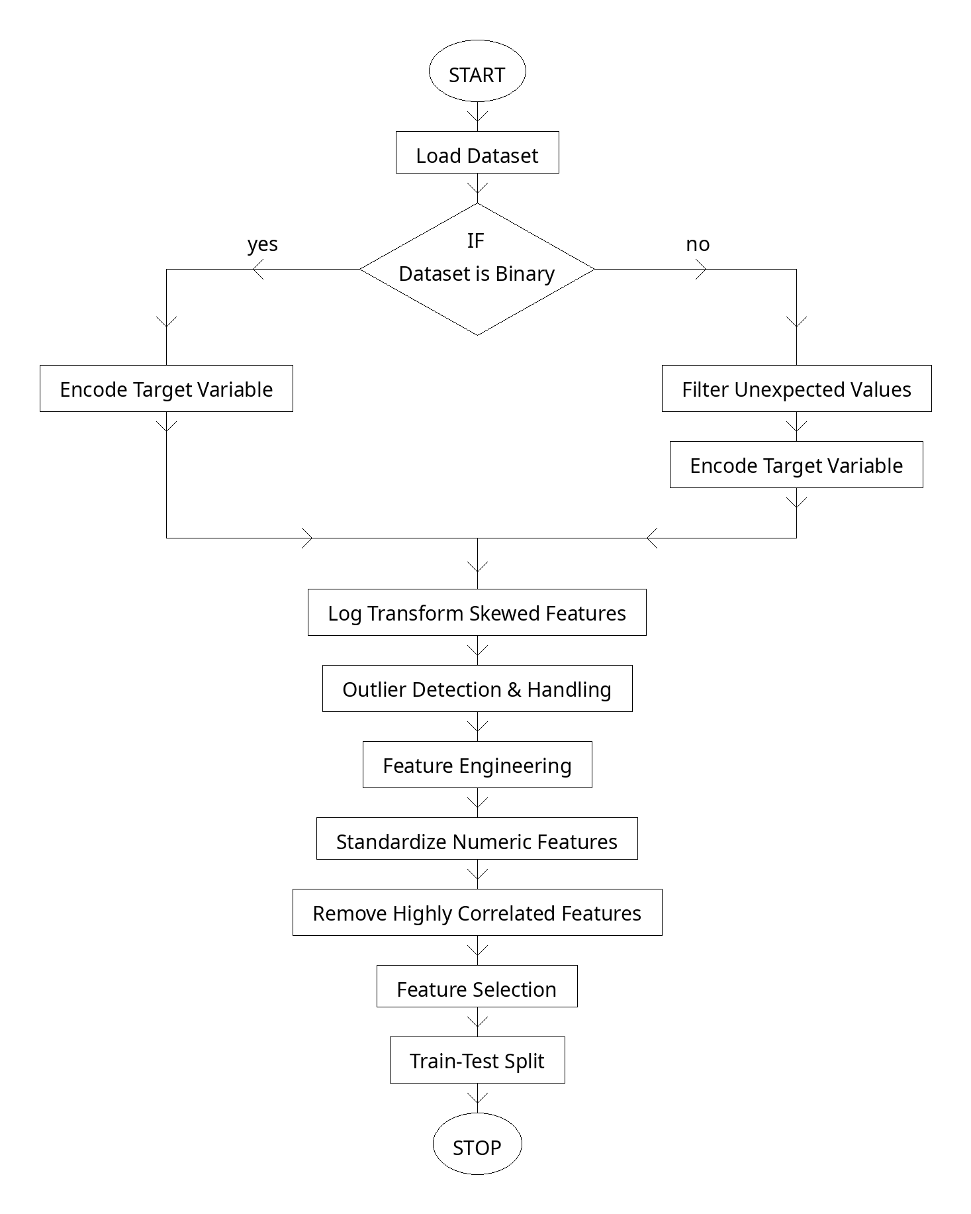
Data Preprocessing
Steps:
Median imputation for missing values
Z-score outlier removal
Standardization of numeric features
Removal of highly correlated features

Slide 4
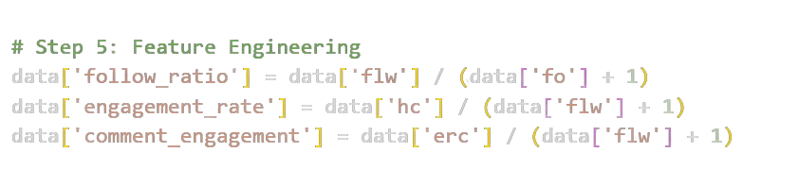
Novelty - Feature Engineering
Introduced unique engineered features such as:
Follow Ratio
Engagement Rate
Comment Engagement
These features are hypothesized to distinguish between fake and real accounts.

Slide 5
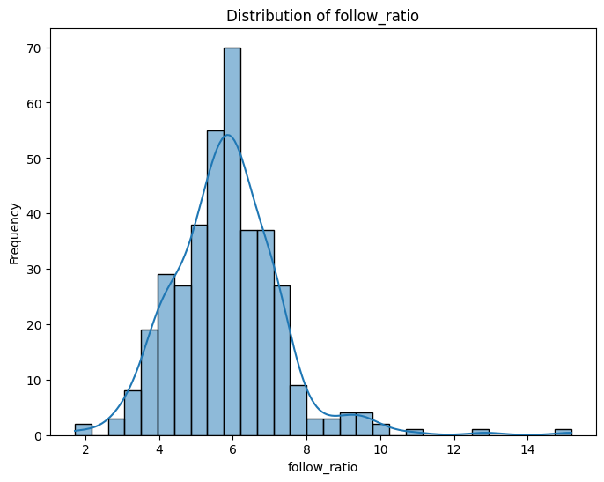
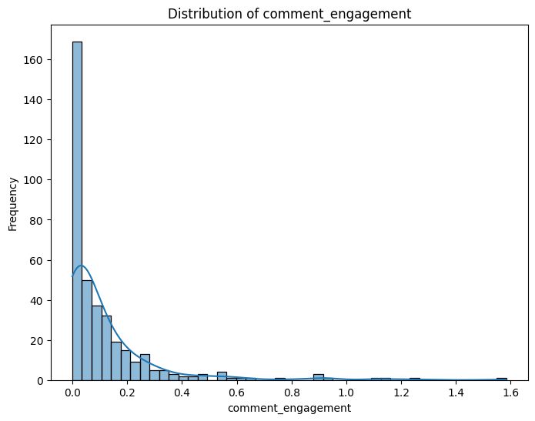
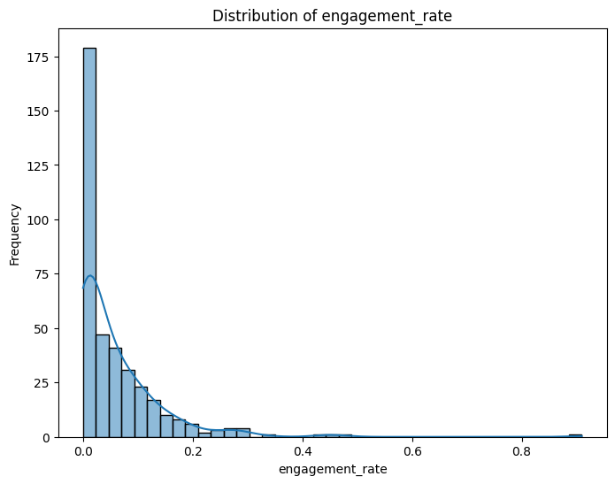
Novelty - Feature Engineering

Slide 6


Novelty - Comprehensive Evaluation of Models
Tested multiple classifiers (Random Forest, SVM, Logistic Regression, etc.)
Cross-validation and ROC-AUC evaluation used to ensure model robustness.
Naïve Bayes and KNN as additional algorithm

Slide 7
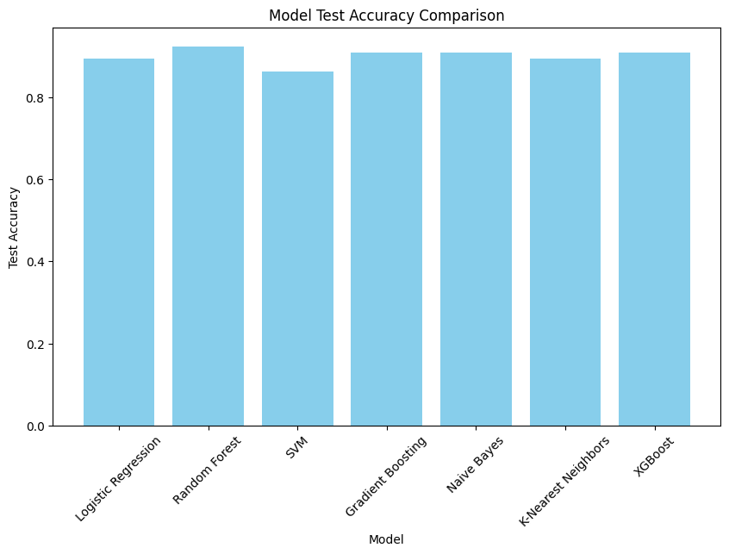
Results - Model Performance

Slide 8
Results - Model Performance
index | Model | Accuracy | ROC-AUC | Cross-Validation Accuracy
1 | Random Forest | 0.924242 | 0.984688 | 0.9200
2 | Gradient Boosting | 0.909091 | 0.976250 | 0.9200
3 | Naive Bayes | 0.909091 | 0.951875 | 0.8900
4 | XGBoost | 0.909091 | 0.917500 | 0.9375
5 | Logistic Regression | 0.893939 | 0.965625 | 0.9125
6 | K-Nearest Neighbors | 0.893939 | 0.973125 | 0.9000
7 | SVM | 0.863636 | 0.968750 | 0.9200
Summary of model performance (accuracy and ROC-AUC scores).
Model Summary Table (Ranked by Accuracy):

Slide 9
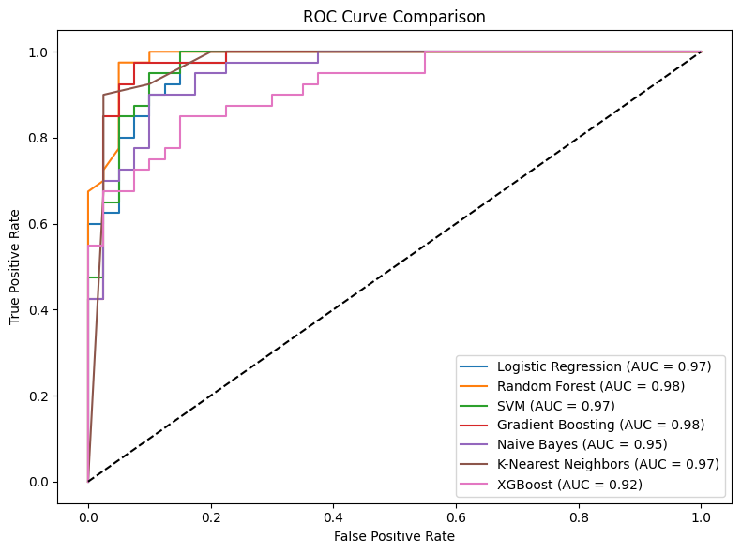
ROC Curve Comparison
The ROC curve shows the trade-off between sensitivity and specificity.

Slide 10
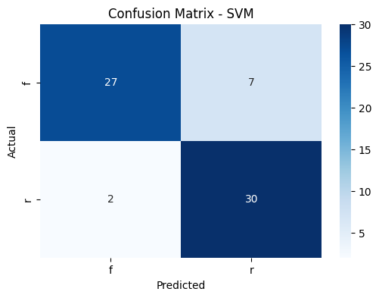
SUPPORT VECTOR MACHINE(SVM)
ACCURACY : 0.86

Slide 11

K NEAREST NEIGHBORS
ACCURACY : 0.89

Slide 12
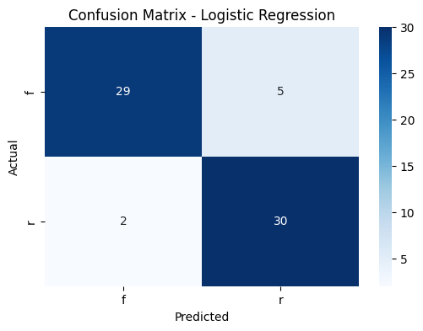
LOGISTIC REGRESSION
ACCURACY: 0.89

Slide 13

GRADIENT BOOSTING
ACCURACY : 0.91

Slide 14

NAÏVE BAYES
ACCURACY : 0.91

Slide 15
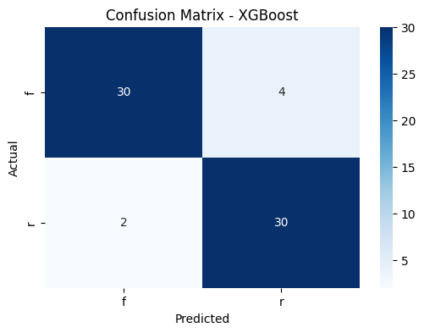
XGBOOST
ACCURACY : 0.91

Slide 16
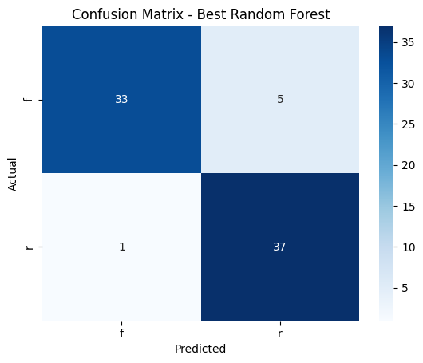
Confusion Matrix - Random Forest
Confusion matrix analysis for best-performing model.
ACCURACY: 0.92

Slide 17
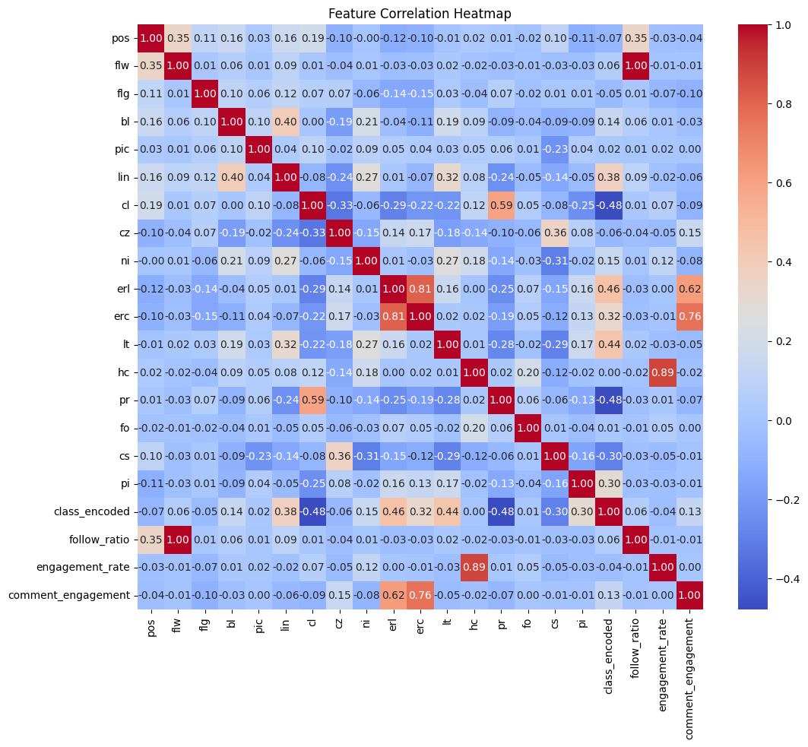
Correlation matrix

Slide 18
Feature Selection and Model Training
Feature selection using embedded Random Forest model.
Stratified cross-validation with 5-folds.

Slide 19
Model Setup and Hyperparameter Tuning
Initial parameter setups for the Random Forest model.
Hyperparameter tuning using GridSearchCV for Random Forest.
index | max_depth | min_samples_split | n_estimators
0 | 10 | 2 | 100

Slide 20
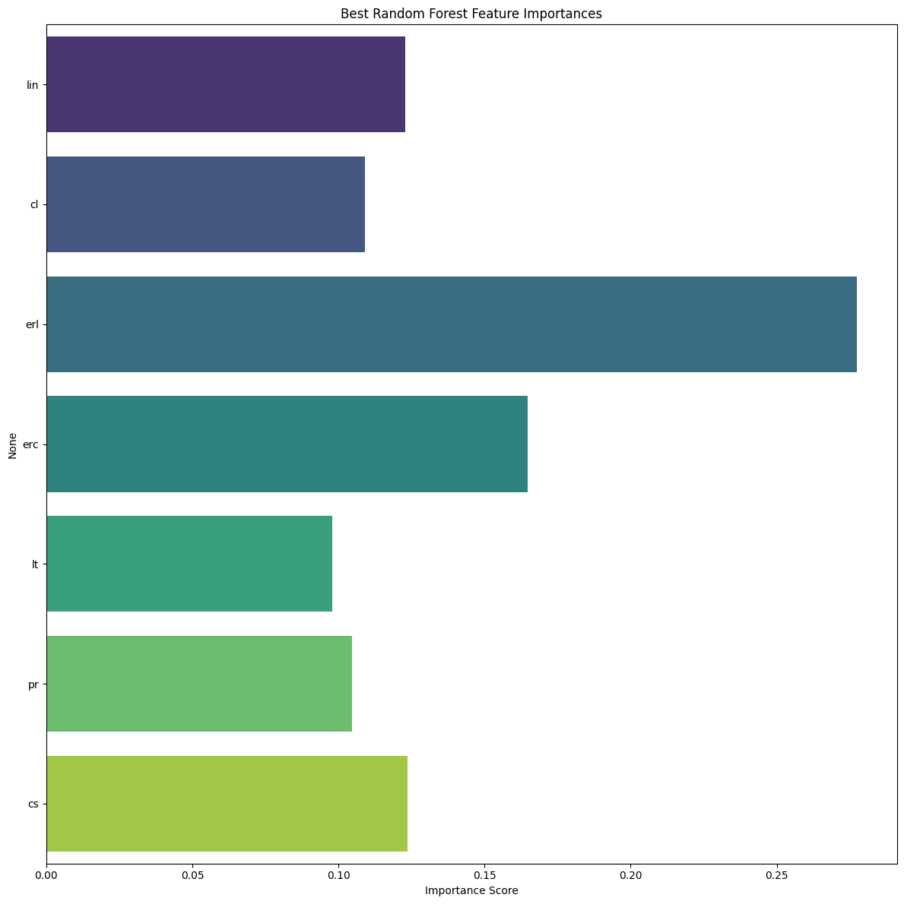
Feature Importance - Best Model
Top features in the best model (Random Forest).

Slide 21

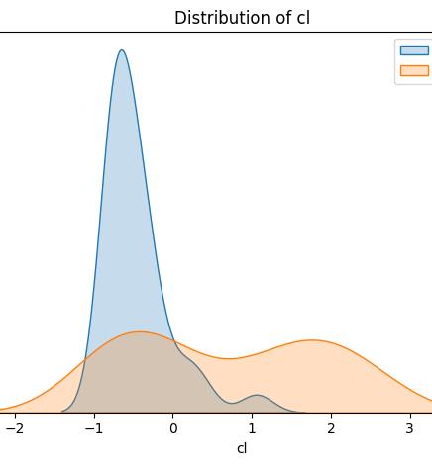
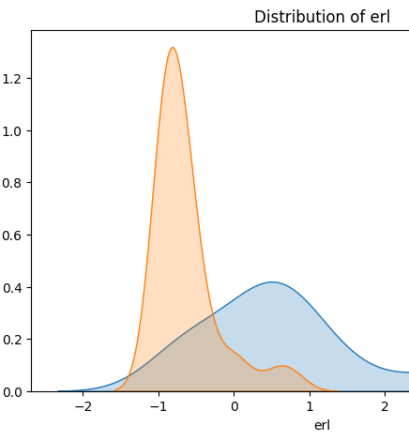


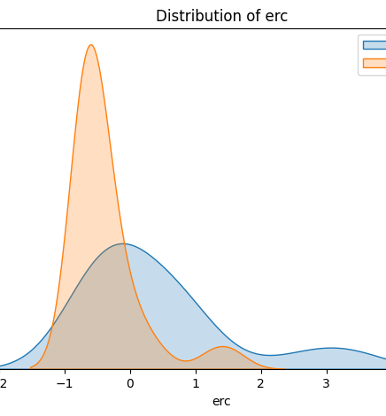
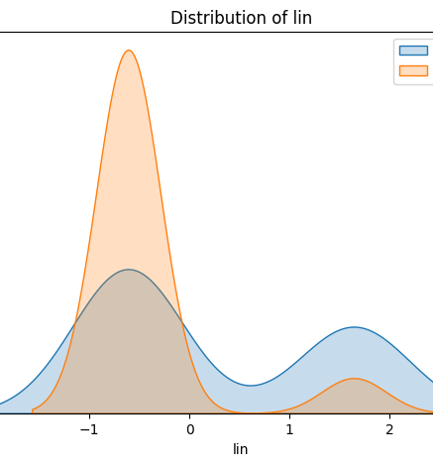
Distribution Analysis - Top Features

Slide 22
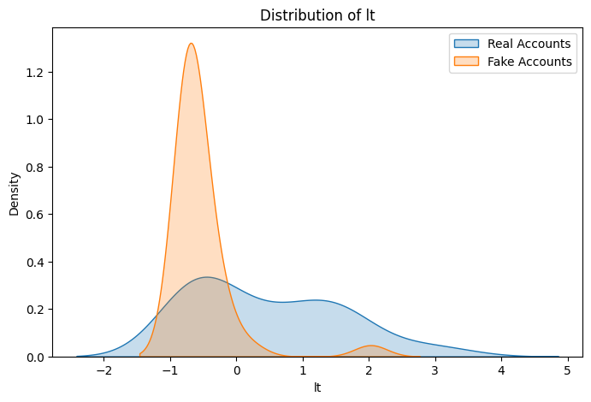
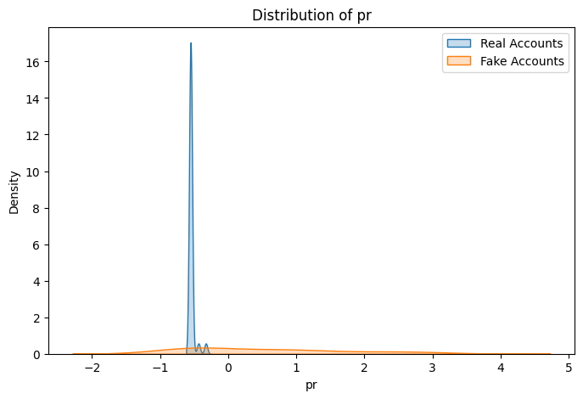
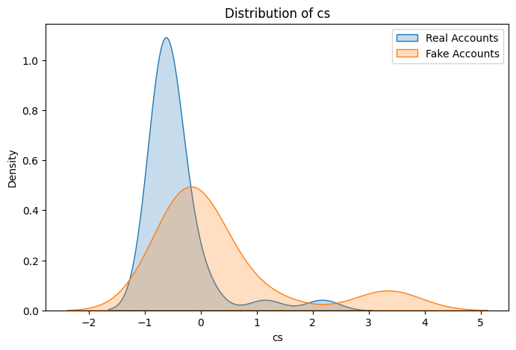
Distribution Analysis - Top Features

Slide 23
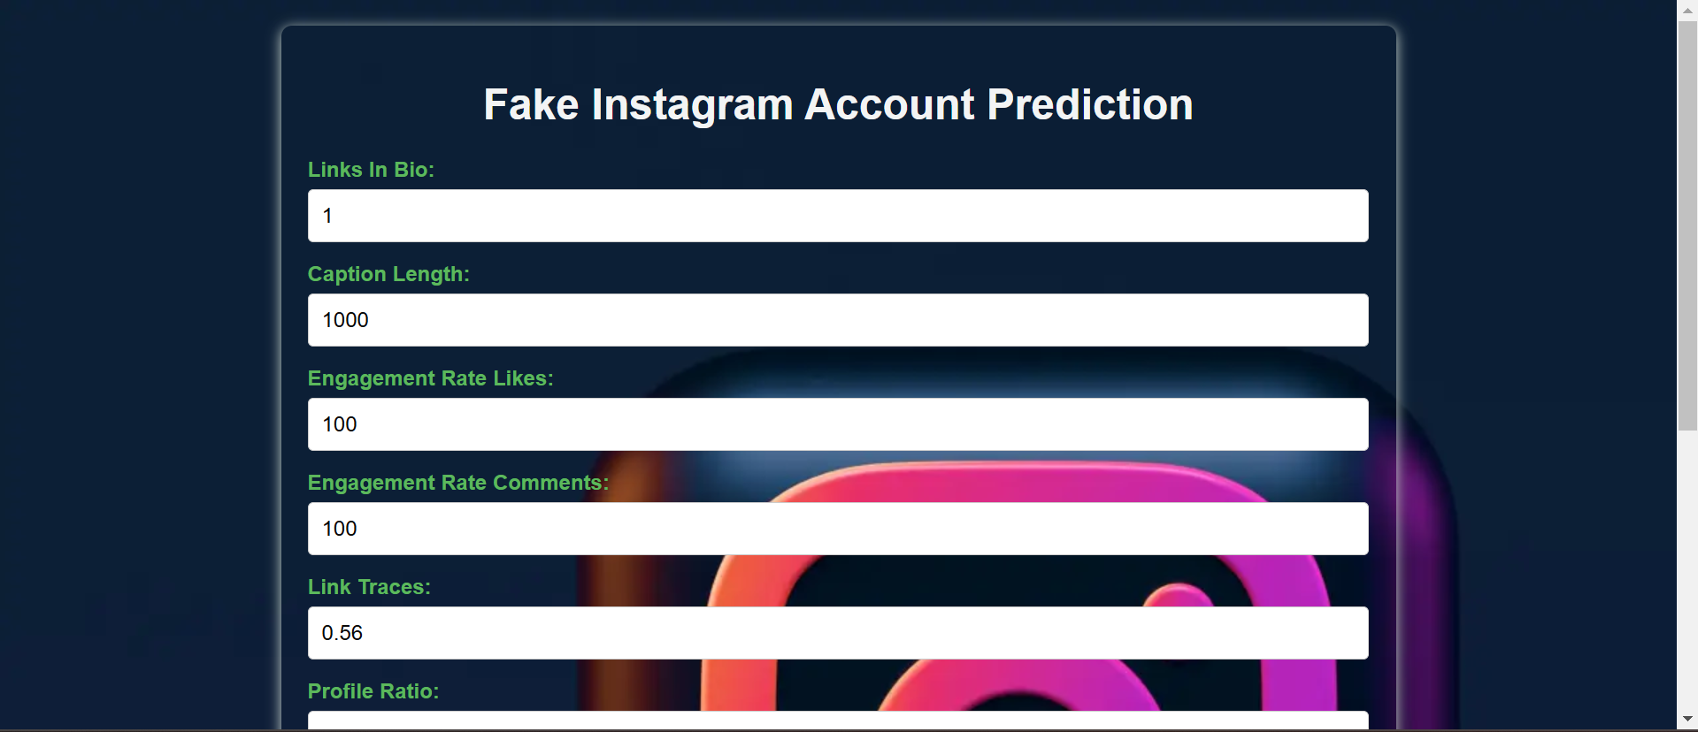
Deployment using frontend with flask app
Frontend Interface - Flask Application Our Flask-based frontend allows users to easily interact with the fake account detection model. Users can Enter account data, press “Predict," and see instant results, including a prediction label ("fake" or "real") with the probability of prediction

Slide 24
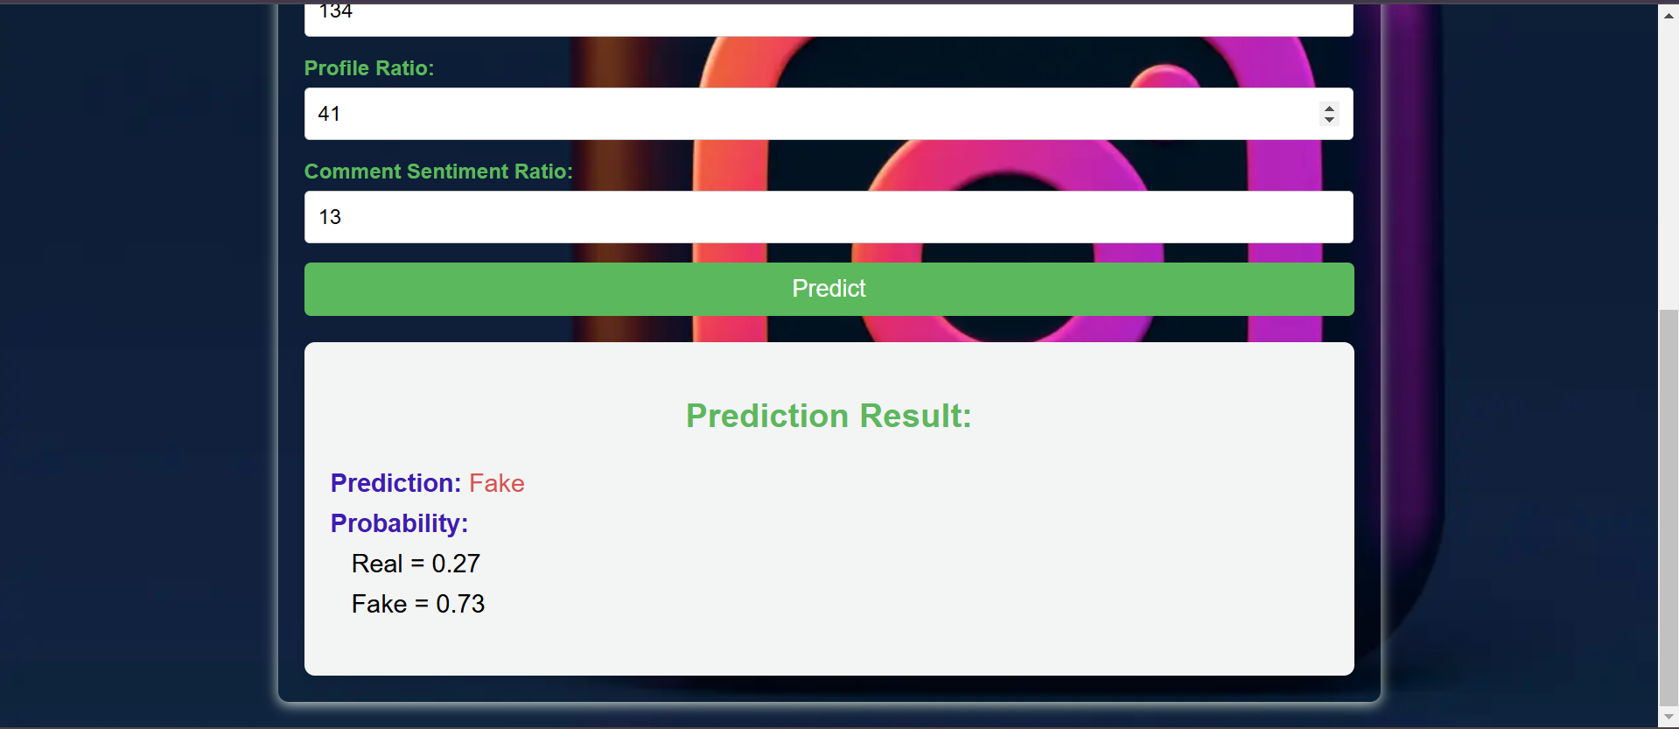
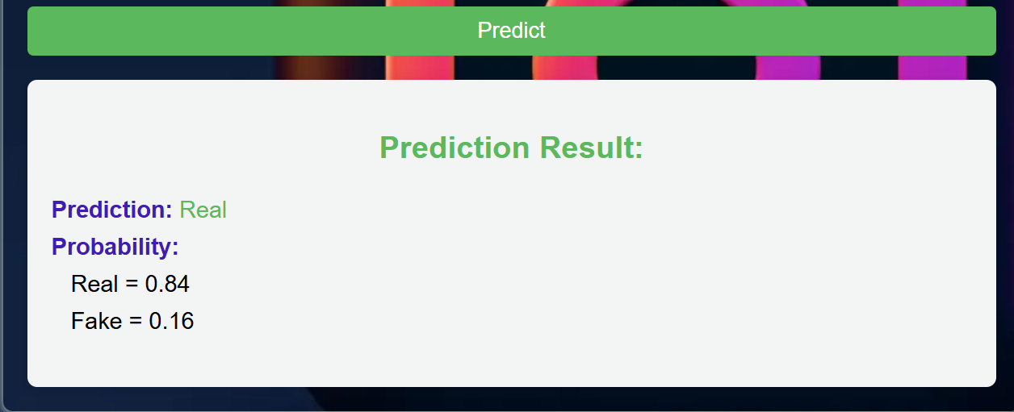
Deployment using frontend with flask app

Slide 25
Interpretation of Model Results
Summary of Insights - Key Points:
Performance of the Best Model (Random Forest)
The Random Forest model performed best in distinguishing between fake and real accounts, with a high ROC-AUC score and balanced accuracy across classes.
Insight: This result suggests that tree-based models are effective at capturing complex interactions in account behavior.

Slide 26
Interpretation of Model Results
Significant Features
Insight: Higher engagement rates and authentic comment patterns indicate real accounts, while lower values in these features may signal automated or fake accounts.
Random Forest is less prone to overfitting than single decision trees, making it more robust and accurate in real-world applications.

Slide 27
Interpretation of Model Results
Feature Importance and Model Interpretation
Feature importance analysis highlighted that behavioral metrics (e.g., comment engagement) and comment sentiment score were among the top indicators of authenticity.
Insight: These features reflect account interactions that are less likely to be artificially inflated by bots, supporting the model’s focus on genuine engagement metrics.

Slide 28
Interpretation of Model Results
Impact on the Problem
The model's ability to classify accounts accurately can be a valuable tool for social media platforms to combat fake accounts, reduce spam, and increase user trust.
Insight: Implementing a similar model in real-world systems can help platforms maintain higher standards of authenticity and engagement.

Slide 29
Limitations and Future Improvements
Limitations:
Potential data imbalance
Model interpretability challenges
Feature selection challenges
Future Work:
Improve feature engineering
Incorporate more behavioral metrics

Slide 30

Thank you!!

