Slide 1
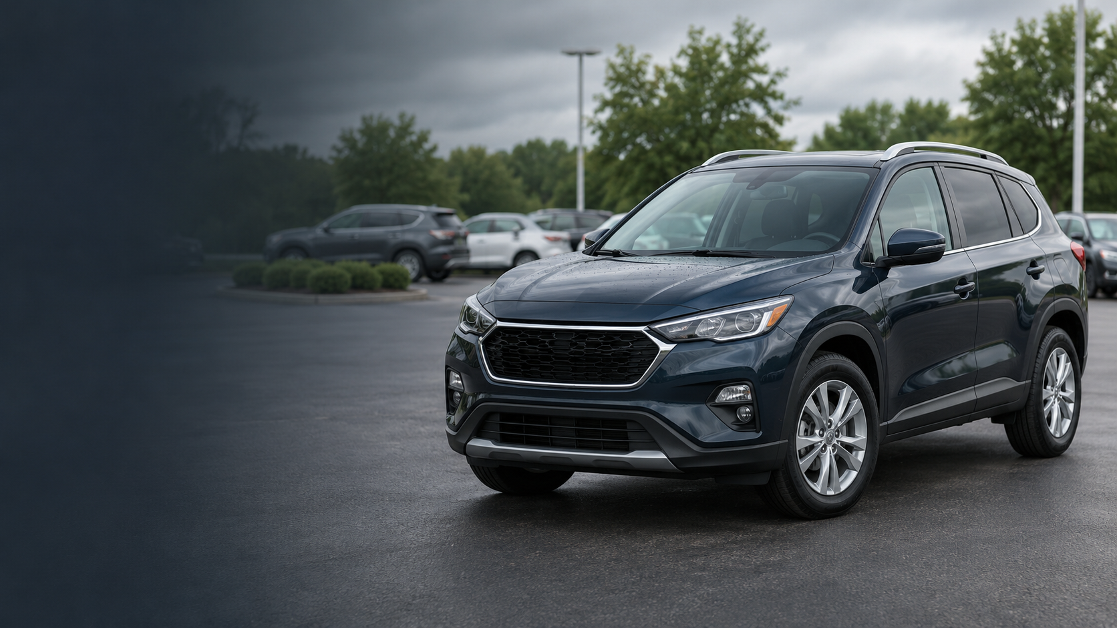
M
MotorScope
APP CONCEPT / US + CANADA LISTING SOURCE
Know the price
before you move.
A simple used-car explorer that turns vehicle details into a comparable asking-price range.
Pick a car. Compare similar listings. Shop with context.
Product idea and interface built from the supplied vehicle listings archive.
Notes:
MotorScope is a concept app built around the supplied vehicle listings archive. The archive is primarily US Craigslist listings, with a small Canadian subset. The app estimates US asking-price ranges from comparable listing records; it does not claim to predict UK prices or completed sale prices.

Slide 2
THE IDEA
Listings show a price. Buyers need a reference.
“Is this price reasonable for a car
with this year and mileage?”
WHO IT HELPS
01
Car shoppers
Get a quick price reference before contacting a seller.
MotorScope answers that first-pass question with a range and a visible count of comparable listings.
02
Private sellers
Compare an asking price with similar listings.
03
Learners and analysts
Explore how year and mileage relate to listing prices.
THE PRODUCT PROMISE
A useful first reference, not a final verdict on value.
MOTORSCOPE / USED-CAR PRICE EXPLORER / US + CANADA SOURCE
02
Notes:
Concept hypothesis: shoppers and private sellers can find many listings but may lack a quick reference for a particular make, model, year, and mileage. MotorScope presents a comparable listing range as a starting point. The deck makes no claim that this product need has been validated with user research.

Slide 3
THE APP EXPERIENCE
A few vehicle details become a clear range
Example search · 2018 Honda Civic · 65,000 miles
↗
Tell us about the car
YOUR PRICE RANGE
We’ll find its closest listing matches.
2018 Civic
MAKE
MODEL
$17,000
Honda
Civic
typical asking price
MODEL YEAR
MILEAGE
2018
65,000 mi
$14,600
$18,600
LOWER RANGE
HIGHER RANGE
Estimate asking price →
321 comparable listings
Civic listings
US listing comparisons · advertised asks
A guide based on listing data, not a formal valuation.
The number of matches stays visible so users can judge the context behind the range.
MOTORSCOPE / USED-CAR PRICE EXPLORER / US + CANADA SOURCE
03
Notes:
The interface mockup mirrors the working app. The sample values were obtained by entering a Honda Civic, 2018, 65,000 miles and selecting the Civic model. It returned a typical asking price of $17,000, a $14,600–$18,600 range, and 321 comparable listings. The listing count is presented with the range to make comparison depth visible.

Slide 4
HOW THE PRICE CHECK WORKS
Comparable listings explain the estimate
01
02
03
04
Describe
Match
Summarize
Show
Make and model
Model year
Mileage
Same model first
Nearby year bands
Nearby mileage bands
Comparable listing
price percentiles
weighted by closeness
Typical asking price
Low–high range
Comparable count
NEARBY COMPARISONS
Starts within ±2 model years and ±50,000 miles; expands the window when the sample is small.
If model matches stay sparse, MotorScope falls back to make-level comparisons and labels that fallback.
This is a transparent comparable-listing method, not a trained machine-learning valuation.
MOTORSCOPE / USED-CAR PRICE EXPLORER / US + CANADA SOURCE
04
Notes:
The demo groups eligible US asking prices into make/model, model-year, and mileage cohorts. It first gathers an exact model within ±2 years and two mileage bands (25,000 miles each). If there are fewer than 25 listings it broadens to ±4 years and ±100,000 miles. If fewer than 10 remain, it uses make-level cohorts within ±3 years and ±75,000 miles, with a wider make fallback if needed. Cohort 20th, median, and 80th percentiles are averaged with weights for cohort count and distance. The app reports the underlying listing count. This is a transparent heuristic, not machine learning.

Slide 5
MARKET SNAPSHOT
One estimate sits inside a broader market view
US LISTINGS ANALYSED
MEDIAN ASKING PRICE
MEDIAN MILEAGE
253,474
$12,995
110,645 mi
after the demo filters
across included listings
odometer reading
Median asking price by model year
THE APP ALSO SHOWS
Each bar shows the median advertised ask for US records in the snapshot.
A lightweight trend
for each model year
01
See where listings cluster
02
Compare a car estimate with the wider sample
Snapshot values reflect the app’s included US asking-price records, not live listings.
MOTORSCOPE / USED-CAR PRICE EXPLORER / US + CANADA SOURCE
05
Notes:
Market metrics are calculated from the bundled app lookup dataset: 253,474 US listings after filtering asking price to $1,000–$200,000, model year 1990–2026, odometer 0–400,000 miles, and nonblank manufacturer. The median asking price is $12,995 and median odometer is 110,645 miles. The bar chart uses app yearSnapshot medians for selected model years. These are listing snapshots, not live market prices.

Slide 6
SCOPE AND NEXT STEPS
A clear data boundary protects user trust
WHAT THIS VERSION USES
WHAT IT DOES NOT CLAIM
✓
US listings only for comparable price estimates
–
UK prices: the source is primarily US Craigslist
✓
A small Canadian subset remains in the source archive
–
Completed sale values: the target is asking price
✓
Advertised prices and structured vehicle details
–
A formal appraisal or guaranteed fair-market value
✓
About 253k records after demo quality filters
–
Live market coverage or verified listing quality
NEXT BUILD
Add verified UK listings, strengthen vehicle-condition inputs, and validate ranges against completed sales.
Source archive: 295,451 records · 280,445 US · 535 Canada · 14,471 country missing
MOTORSCOPE / USED-CAR PRICE EXPLORER / US + CANADA SOURCE
06
Notes:
The original archive contains 295,451 records: 280,445 US, 535 Canadian, and 14,471 with country missing. MotorScope’s demo estimate only uses US listings with nonblank make and with price, year, and odometer in the documented bounds; the resulting lookup covers about 253,474 records. The user previously chose to label the project US/Canada because that is what the source actually represents. UK pricing would require a verified UK source. The roadmap is a concept recommendation, not a validated product plan.

