Slide 1






Symphony & GHGSat
Current Status & Plans 2015-2016
M. Picard, I. Lamoureux, P. Allard, R. L’Archevêque
April 28th, 2015
Notes:
1

Slide 2
Objectives
Provide an update on the 2015-2016 plan for Symphony
Provide an update on Symphony core modules to be made available to GHGSat Inc.
Agree on future plans and next steps

Slide 3
Symphony Summary Status
Implementation plan for FY15-16 approved on April 9th.
Currently on schedule
Approval for licensing obtained, License in preparation, terms presented and acknowledged by GHGSat inc.
Open Source process on-going
Symphony development phase for GHGSat initial built by May 14th

Slide 4
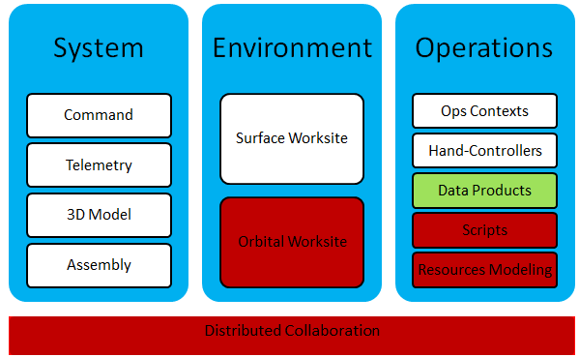
Architecture

Slide 5
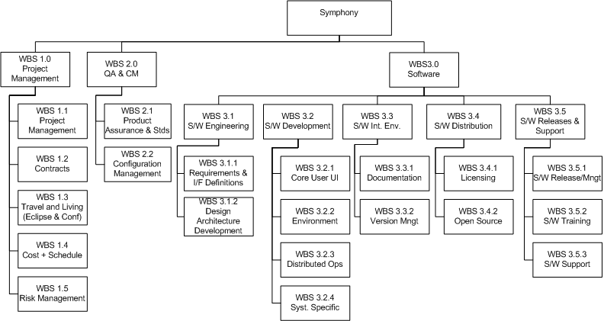
WBS

Slide 6
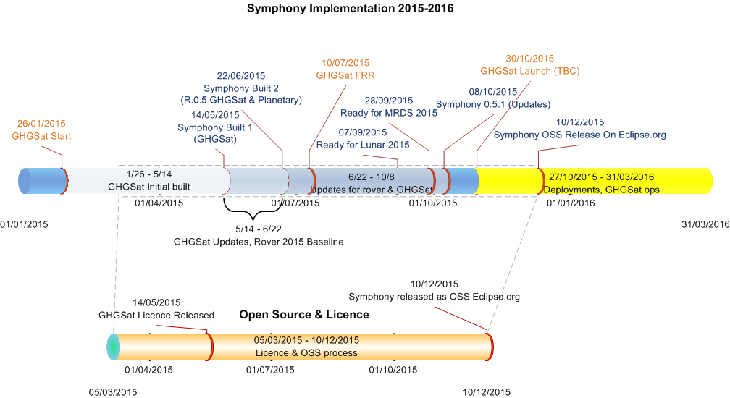
Schedule

Slide 7
Resources
S/W Development and Release
P. Allard, R. L’Archevêque, M. Picard
Licencing and OSS Release
I. Lamoureux, P. Allard, R. L’Archevêque, M. Picard
Management:
M. Picard

Slide 8
Licensing Status
IP disclosure & invention forms completed
Request and approval of draft terms from GHGSat received
CSA approval received,
License release Target May 2015
Non-exclusive License includes: 1 year license for R&D to GHGSat , 1 week training & 150 hrs support, renewal option

Slide 9
Licensing Open Source
IP Office Review of OSS licences complete.
Symphony needs to be renamed (already used)
Symphony logo is ok
EPL license terms under considerations
Plan to have Symphony released as OSS on Eclipse.org by Dec 2015.

Slide 10
Software Development Status
ESA Orekit and NASA World Wind integrated to Symphony Core
Symphony Functions provided:
Earth Orbit Propagation Capability (EOP)
GHGSat Base Planning (PLAN)
Earth Orbit Visualization Capability (VIS)
System Monitoring & Status (MON)
Data Recording (REC)
Interfaces to GHGSat Specific Module
Earth globe and Mercator representation with orbits trace and ground station coverage for 3 simultaneous orbiting objects for demonstration purpose
Orbiting objects driven by TLEs and provided projection models, customizable via Symphony/Orekit
Base plan generation capability in place

Slide 11
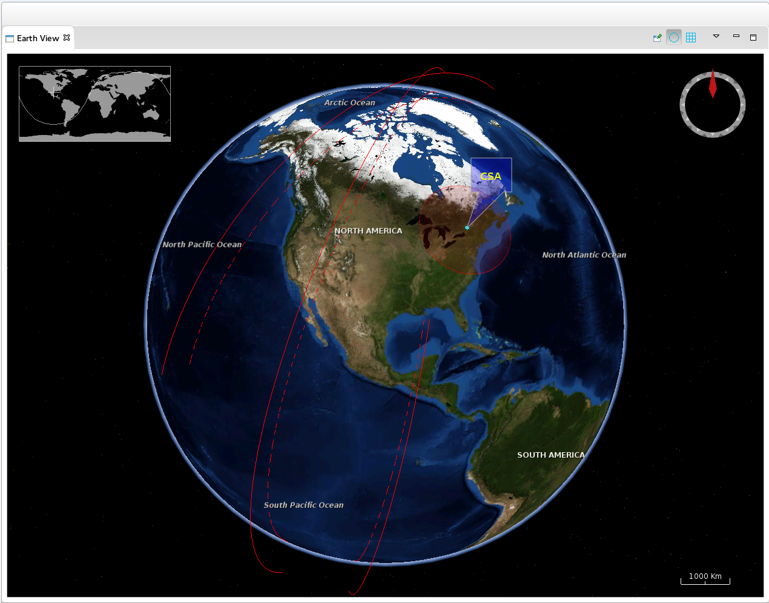
Software Development Status Symphony Orbital Environment

Slide 12
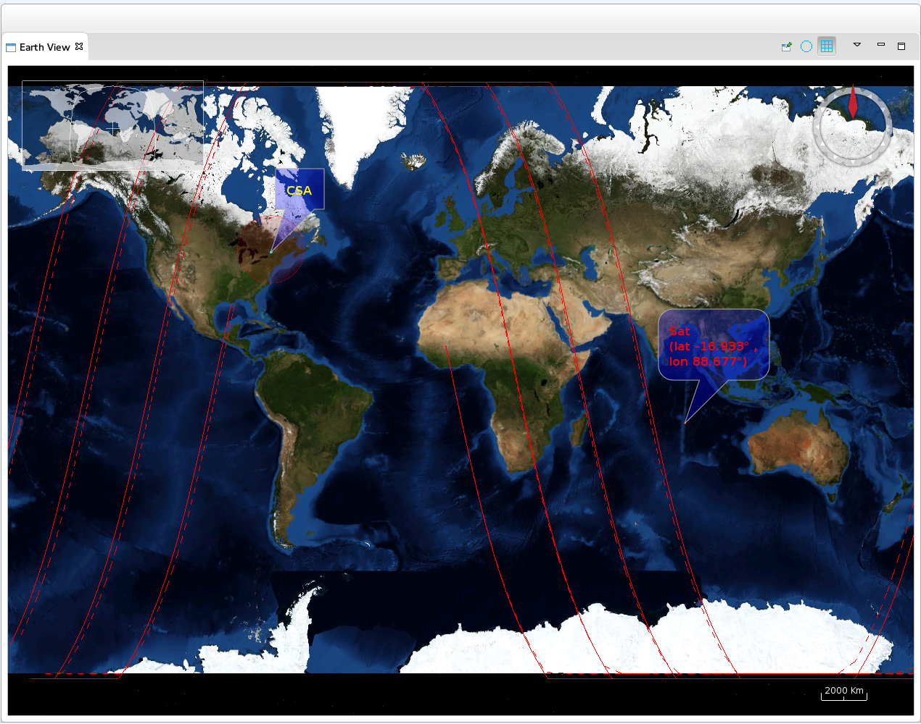
Software Development Status Symphony Orbital Environment

Slide 13
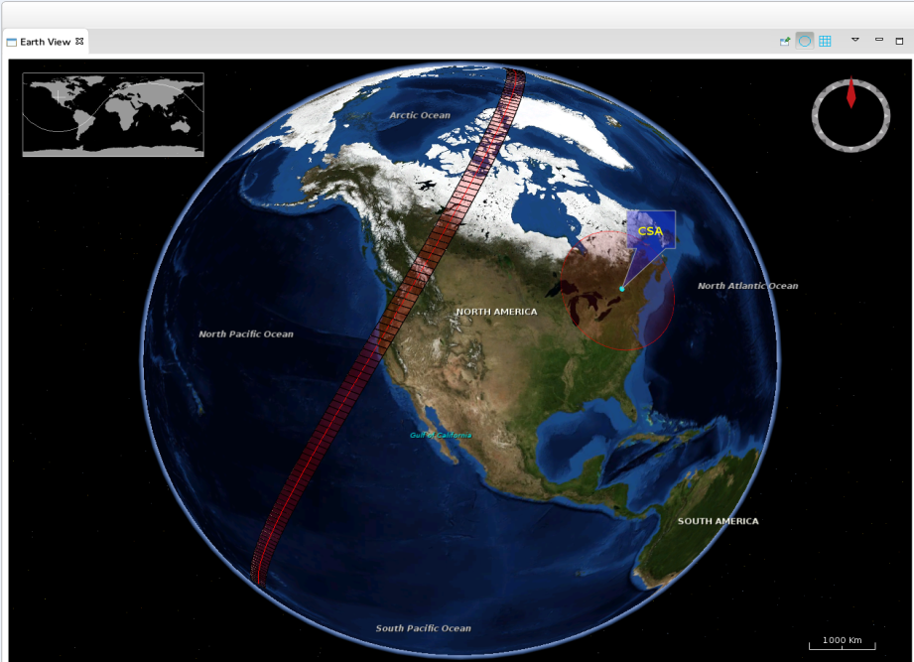
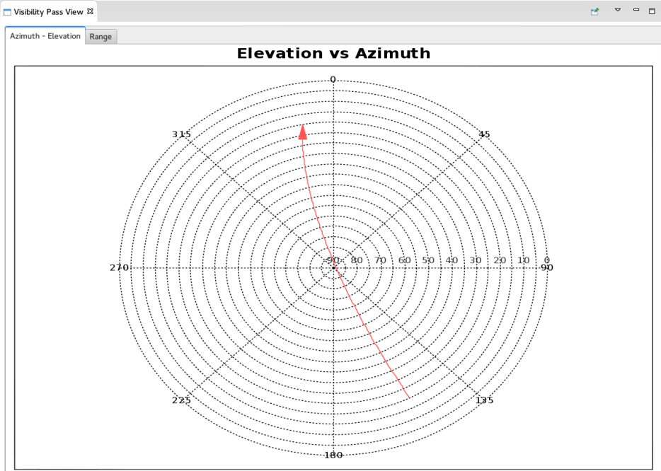
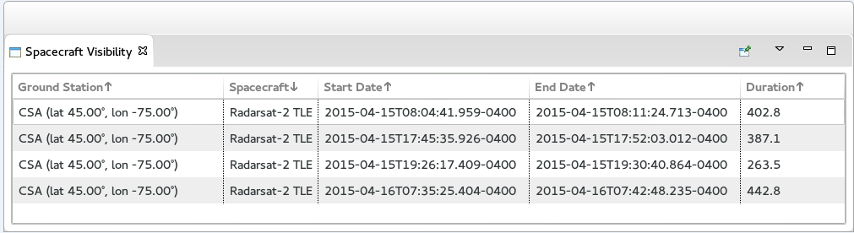
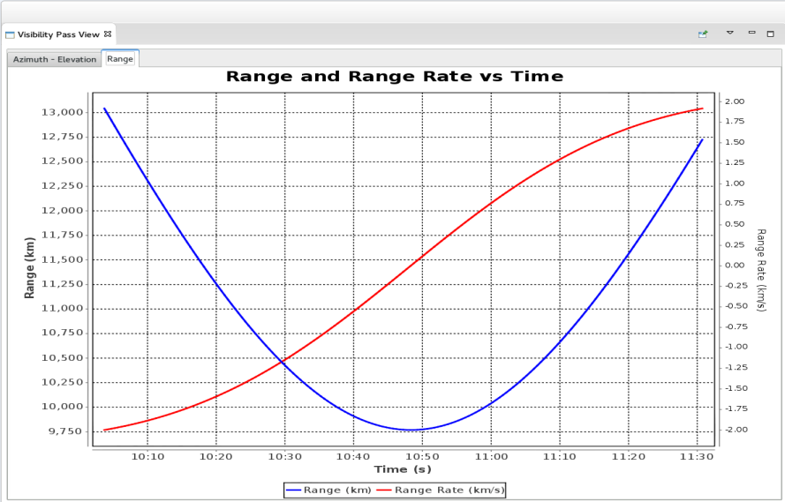
Software Development Status User Interface and Plan Generation
Satellite | Start Time | Command Type | arg0 | arg1
Sat-3 | 1 Apr 2015 04:43:12 GMT | SatelliteCommandRoll | 0.68
Sat-3 | 1 Apr 2015 04:43:11 GMT | SatelliteCommandAcquireImage | 3 | 1
Sat-3 | 3 Apr 2015 03:24:08 GMT | SatelliteCommandRoll | 3.19
Sat-3 | 3 Apr 2015 03:24:05 GMT | SatelliteCommandAcquireImage | 5 | 1

Slide 14
Upcoming Milestones & Considerations
Delivery of licence and Symphony Built 1 to GHGSat by mid May
Training to GHGSat at CSA in May (TBC by GHGSat)
Delivery of a second built by end of June as required
Update release October 2015
Delivery OSS by December 2015
Symphony core including orbiting environment available to GHGSat to pursue development
Training @ CSA ( 1 week) + 150 Hrs support (@ CSA) to transition

