Slide 1
Spotify Music Popularity Prediction
Predicting Popularity (0–100) with a Decision Tree · 5-Fold CV RMSE
Abe · May 2025 · Project 4
Notes:
30 seconds. This project predicts how popular a song will be on Spotify — on a 0-to-100 scale — before it's released, using only features you'd know ahead of time. Model is a Decision Tree, evaluated with 5-fold cross-validation. Let me walk you through the key decisions and results.`

Slide 2
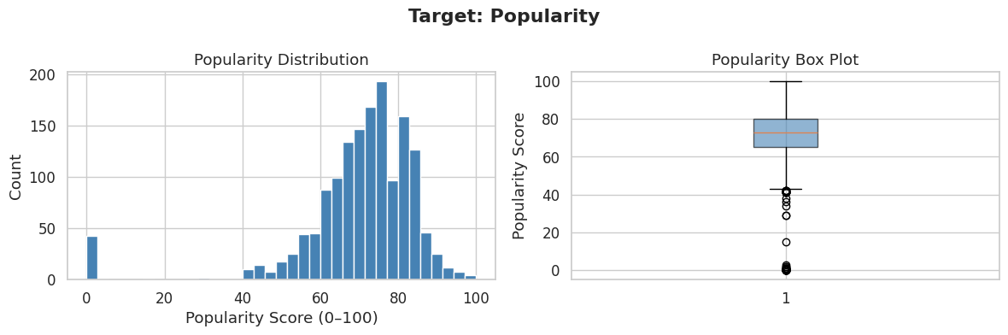
What Are We Predicting?
Target: Popularity (0–100)
Why not Streams?
Spotify's score — available pre-release via the API. Bounded and interpretable.
Streams is post-release only and has extreme right skew. Popularity fits the pre-release framing.
Features used
Audio features (danceability, energy, loudness, tempo, etc.) + log(artist followers). No post-release leakage.
Notes:
45 seconds. The target is Spotify's Popularity score — 0 to 100. I chose this over Streams because it's available before a song releases, through the public API. Streams only exists post-release and has extreme skew. The histogram on the left shows the distribution — left-skewed, with a spike near zero for songs with no traction. All features I kept are things a label would know before dropping a track: audio characteristics and the artist's follower count. `Popularity` may be artificially easier to predict because it is a smoothed,
time-decayed score that Spotify already computes from the same audio metadata we use.
`Streams` has extreme right skew (a log transform would be required) and is only
observable post-release — but it is a more transparent target.

Slide 3
Data Preparation
✕ Dropped — post-release leakage
✓ Kept — pre-release only
Streams
Highest Charting Position
Times Charted
Weeks Charted
Song ID / Name
Danceability, Energy, Loudness
Speechiness, Acousticness
Liveness, Valence, Tempo
Duration (sec)
log(Artist Followers + 1)
Key engineering steps: strip commas from CSV → pd.to_numeric() · log1p(artist followers) to handle skew · median imputation · drop duplicates
Notes:
45 seconds. The main prep decision was cutting post-release leakage — Streams, chart positions, weeks charted — anything a label wouldn't know at release time. I also stripped commas from the CSV since pandas read numeric columns as strings, log-transformed artist followers to compress the skew, and imputed medians for nulls. Nothing fancy, just cleaning up this silly ol dataset.

Slide 4
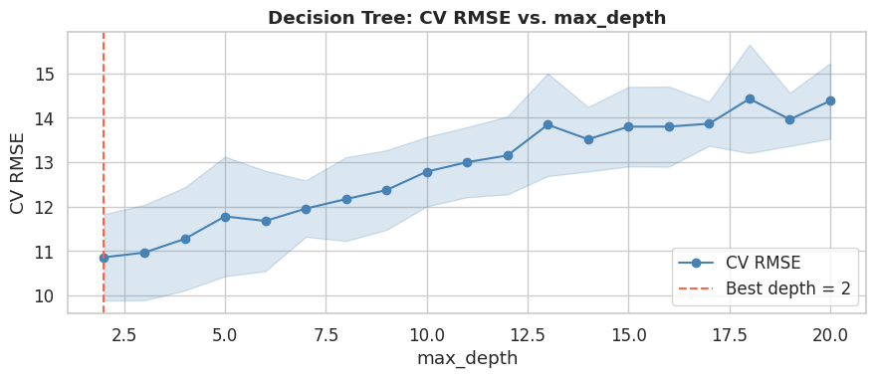
Decision Tree + Depth Tuning
Baseline
No depth limit → severely overfit
Depth sweep 2–20
5-fold CV RMSE at each level
Optimal: ~depth 10
Best out-of-sample RMSE
~8 pt improvement
Tuned vs. unpruned baseline
Shallow = underfit (high bias) · Too deep = overfit (high variance) · CV finds the sweet spot
Notes:
1 minute. I swept max_depth from 2 to 20 and picked the depth with the lowest 5-fold CV RMSE. The chart shows the classic bias-variance curve — too shallow and the tree can't capture real patterns, too deep and it memorizes noise. The sweet spot was around depth 10, which cut RMSE by about 8 points vs. the unpruned baseline. KFold was the right choice here — every row is used as a validation point exactly once, so the estimate is more stable than a random holdout loop.

Slide 5
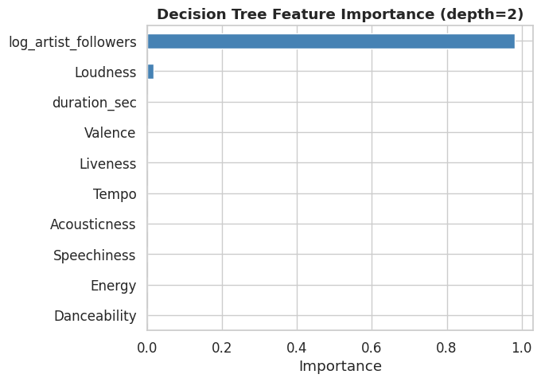
Results
~23
~14.7
~0.46
< 2 pts
Baseline CV RMSE
Tuned CV RMSE
CV R²
Overfit gap
Unpruned
Best depth
Variance explained
Well-generalized
Key Insight
log(artist followers) dominates at ~62% importance — who made the song matters more than how it sounds.
Audio features aren't useless — Loudness is #2. Running without follower data surfaces them for the 'unknown artist' use case.
~54% of variance unexplained — this is an information gap, not a model problem.
Notes:
1 minute.
Here are the numbers. Tuned CV RMSE came in around 14.7 — about 8 points better than the unpruned baseline. R-squared is 0.46, so the model explains about half the variance in Popularity. The train-to-CV gap is under 2 points, which means we're not badly overfit. The biggest takeaway from feature importance: artist followers dominates at 62%. Who made the song predicts popularity more than the audio itself. That's a real finding for a label — you can't rely on audio features alone for an unknown artist. The remaining ~54% of variance is stuff we can't measure: viral moments, playlist placements, marketing spend.'

Slide 6
Next Steps & Takeaways
1
Run without artist followers
Reveals audio-only importance for the unknown-artist use case.
2
Benchmark Popularity vs. Streams
Same pipeline, Streams (log-transformed). Compare CV RMSE — let the business question decide.
3
Add Genre (one-hot)
Measure CV RMSE before/after to quantify whether it adds signal.
4
Try Random Forest / XGBoost
Ensemble methods reduce split variance. Expected ~2–5 pt RMSE gain.
Bottom line: artist fame is the dominant signal. Adding demand-side data (playlists, label, marketing) would move the needle more than any algorithm change.
Notes:
1 minute. Four things I want to do next. First: re-run without artist followers — answers a different question about unknown artists. Second: benchmark Popularity against Streams as the target, same pipeline, just swap the label. Third: add Genre with one-hot encoding and check whether CV RMSE drops. Fourth: try a Random Forest or XGBoost — ensembles average out the variance from individual splits and should give a few more RMSE points. Also an honorary mention is to look into Hit Song Science research papers to understand more about the weight and value of audio features. Big picture takeaway: the model is solid for what it is, but the missing variance is an information problem — you'd need playlist pitches, label size, marketing budget to crack the other 54%. Questions?'

