Slide 1
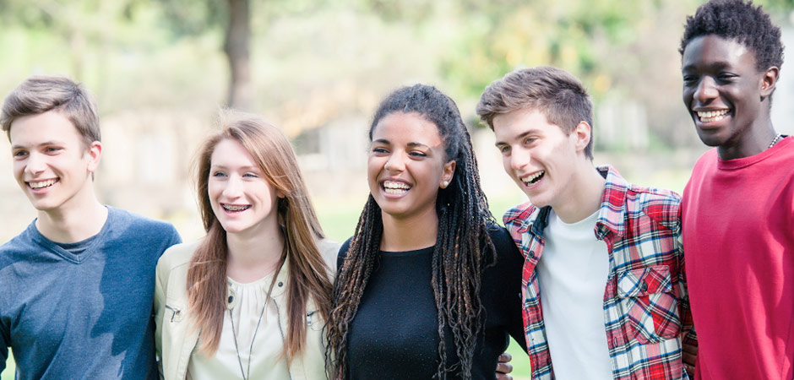
动词的时态和语态

Slide 2
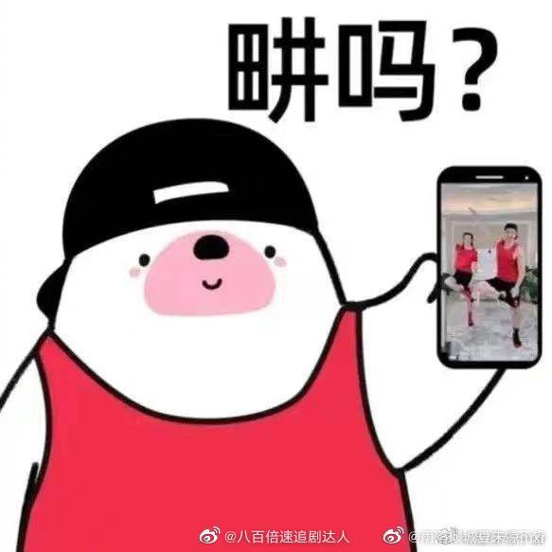
Read and pay attention to the words in red.
Liu Genghong is a fitness coach.
He was a singer and his wife was a model some years ago.
I have practiced the couple online for two weeks.
Now all my family are taking exercise with them.
We hope that we won’t give up because of feeling tired.
Bofore Mr Liu became a coach, he had studied many English magazines about fitness.
At this time tomorrow I will be dancing to the song by Jay Chou.

Slide 3
动词的时态
英语时态以动词形式变化表示句中谈到的动作、状态的时间关系和说话的时间。
体 时 | 一般 | 进行 | 完成 | 完成进行
现在
过去
将来
过去将来
一般现在时
be/do/does
现在进行时
am/are/is doing
现在完成进行时
have/has been doing
现在完成时
have/has done
一般过去时
was/were/did
过去进行时
were/was doing
过去完成时
had done
一般将来时
will + do
将来进行时
will be doing
一般过去将来时
would + do

Slide 4
一、一般现在时的用法
1) 表示经常性或习惯性的动作或存在的状态，常与表示频度的时间状语连用。 every…, sometimes, often, usually, on Sunday I get home from school at 5 every morning.
He is a teacher.
2) 客观真理，客观存在，科学事实。
The earth moves around the sun.
3)用在时间、条件、让步状语从句中表将来
I’ll go to the cinema with you if it doesn’t rain.
I’ll tell him the news as soon as he comes.

Slide 5
动词的时态
一、动词的基本形式
1；2；6
形式 | 变化规则 | 构成方法 | 例词
原形 | — | — | see, finish, teach
第三 人称 单数 形式 | 一般情况 | 加-s | look—looks, write—writes
 | 以 ch, sh, s, x 结尾 | 加-es | teach—teaches, finish—finishes, guess—guesses, mix—mixes
 | 以 o 结尾 | 加-es | do—does, go—goes
 | 以 “ 辅 音 字 母 ＋ y”结尾 | 变 y 为 i ， 加-es | try—tries, cry—cries play?

Slide 6
二、一般过去时的用法 1）过去某个时间里发生的动作或状态；过去习惯性、经常性的动作、行为。
2)常与表过去的时间状语连用，即仅谈过去，无关现在。如yesterday, last week, last year等。

Slide 7
1；2；4
形式 | 变化规则 | 构成方法 | 例词
过去 式、 过去 分词 规则 变化 | 一般情况 | 加-ed | stay—stayed, look—looked
 | 以不发音 e 结尾 | 直接加-d | decide—decided, hope—hoped
 | 以重读闭音节结 尾，末尾只有一 个辅音字母 | 双写末尾的 辅音字母再 加-ed | stop—stopped, admit—admitted stay—stayed
 | 以“辅音字母＋ y”结尾 | 变 y 为 i，加 -ed | carry—carried, try—tried destroy—destroyed
现在 分词 | 一般情况 | 加-ing | go—going, read—reading
 | 以不发音 e 结尾 | 去 e ，再加 -ing | have—having, write—writing see—seeing
 | 以重读闭音节结 尾，末尾只有一 个辅音字母 | 双 写 末 尾 的 辅 音 字 母 再 加-ing | cut—cutting, run—running throw—throwing

Slide 8
三. 一般将来时( The Simple Future Tense )
1. will do
2. 其他表达方式（详见讲义）
be going to do
be about to do, 表示马上做某事, 不能与明确表示将来的时间状语连用，常可以和when连用
The meeting is about to close.

Slide 9
三. 一般将来时( The Simple Future Tense )
1. will do
2. 其他表达方式
③一般现在时表示将来
一些瞬移动词：
come; go; leave; arrive; fly; return; start; begin; close; end; stop 等，用来表示时刻表上或日程安排上早就定好的事情
The plane flies at five o’clock.

Slide 10
三. 一般将来时( The Simple Future Tense )
1. will do
2. 其他表达方式
④进行时表示将来
come; go; leave; arrive; fly; return; start; begin; close; end;
The bus is coming.

Slide 11
四.过去将来时
1.结构: will do/ be going to do/ be about to do
1.结构: ①would do
②was/ were going to do
③ was/were about to+ do
2. 定义：表示在过去某个时间看将要发生的动作或存在的状态。
即过去将来时是“立足过去, 着眼未来”的一种时态, 常用于宾语从句中。
The manager said that the shops would soon close.
I didn’t expect that so many people would help me one day.
By the day of the show, more than 300 people had said they _________________(attend).
would attend

Slide 12
Pratice:
C C B B C
1. There _______ six countries in SCO (上合组织) at first, but now the number has increased to eight.
A. is B. are C. were D. will be
2. —When is the school art festival?
—It will be held on time if it_______next Monday.
A. don’t rain B. won’t rain C. doesn’t rain D. didn’t rain
3. They don't live here any longer. They______ to Chengdu last month.
A. move B. moved C. will move D. are moving
4. Before the sun ______, we need to get to the top of the mountain.
A. set B. sets C. is setting D. will set
5. The TV news reports that there ________ a storm the day after tomorrow.
A. is B. was C. will be D. has been

Slide 13
五. 现在进行时(The Present Continuous Tense)
1.结构: be (am, are, is)+ doing
2. 用法：
1) 表示现在( 指说话时)正在发生的事情。
We are having English class now.
2) 表示现阶段时间内正在进行的动作,但说话时动作未必正在进行。
We are having English homework these days.
3. 注意：与always, constantly, often, forever, continually等副词连用，表示反复发生的或习惯性的动作,常表示不满,抱怨,赞赏等.
She is always finding fault with others

Slide 14
▲ 不用进行时的动词
1) 事实状态的动词 have, belong, possess, cost, owe, exist, include, contain, matter, weigh, measure, continue
e.g. I have two brothers.
This house belongs to my sister.
2) 心理状态的动词 think see, believe, suppose, imagine, agree, recognize, remember, want, need, forget, prefer, mean, understand, love, hate
e.g. I need your help.
He loves her very much.

Slide 15
3) 瞬间动词 accept, receive, complete, finish, give, allow, decide, refuse.
e.g. I accept your advice.
4) 系动词 seem, remain, lie, see, hear, smell, feel, taste, get, become, turn
e.g. You seem a little tired.

Slide 16
六、过去进行时
1）概念：表示过去某时正在进行的状态或动作。
2）结构: was/were+ doing
3）以 when/while 引导的谓语动词是一般过去时的时间状语
My brother fell while he was riding his bicycle and hurt himself.
When I got to the top of the mountain, the sun was shining.
I was writing a letter _______ he came.
when

Slide 17
七、现在完成时
1）结构: have/ has done
2）时间状语
already; yet; lately/recently; since; so far; up till now; in the past/last… 等。
3)用法：
① 表示一个动作或状态开始于过去，持续到现在
②一个发生在过去的事情对现在产生的影响。
They have lived here since 2019.
She has already finished the work. She is very happy.
will be writing

Slide 18
注意：
非延续性动词的否定形式可以与表示延续时间的状语连用。即动作不发生的状态是可以持续的。 I have received his letter for a month. （错） I haven't received his letter for almost a month. （对）
比较since和for
since +时间点, 用来说明动作起始时间
for+ 时间段, 用来说明动作延续时间长度。 I have lived here for more than twenty years. I have lived here since I was born..

Slide 19
Pratice:
1.He has come to Beijing since last year. (错）
2. He has joined the army for 3 years. （错）
He has been / lived in Beijing since last year.
He came to Beijing last year.
He joined the army 3 years ago.
He has been a soldier for 3 years.

Slide 20
九、过去完成时
1）结构: have/ has done
2）时间状语:
three years before,
by+ 过去时间/the end of + 过去时间/the time that(过去时间)
when, before引导的时间状语从句
had done

Slide 21
九、过去完成时
3)用法：
以过去某个时间为标准，在此以前发生的动作或行为，即“过去的过去”。
By nine o’clock last night,we had got 200 pictures from the spaceship.
到昨晚9点钟，我们已经收到200张飞船发来的图片
The little girl ___ her heart out because she ____ her toy bear .
A. had cried; lost B. cried; had lost
C. has cried; has lost D. cries; has lost
had done
B

Slide 22
十、现在完成进行时
1）结构: have/ has been doing
2）用法：
① 表示动作从过去某一时间开始一直延续到现在。现在这个动作可能已经终止，并且会继续进行下去的
It has been raining for three hours.
雨已经下了三个小时了。(动作可能延续)
②表示到目前为止的一段时间里一直在反复进行的动作。
*He has been saying that ten times.
will be writing

Slide 23
现在完成进行时和现在完成时的区别
现在完成时→过去发生或开始的动作对现在的影响或结果
现在完成进行时→到目前为止的一段时间内动作一直在进行的过程。
I have been reading the book for the whole day.
我整天一直在读这本书。
（一直不停地读，没有说明是否读完。）
I have read the book.
我读过这本书了。
（说明读过或读完了。）
For the past two years, Gordon’s students ____________________(study) ways to kill bacteria, and they think they’re close to a solution(解决方案).
have been studying

Slide 24
时态考查方式
时态语态与主谓一致的综合运用
It is reported that a new house ______ at present in the disaster area.
A.are being built B.were being built
C.was being built D.is being built
D
在具体语境中考查动词的时态
---Were you surprised by the ending of the film?
---- No, I _____ the book,so I already knew the story.
A.was reading B.had read
C.am reading D.have read
B
从句时态的考查
---I’ll plan a visit to Hong Kong if it ____ tomorrow .
--- Really ? I think I ________with you .
A.don’t rain , go B. won’t rain , go
C. isn’t rain , will go D. doesn’t rain , will go
D
D

Slide 25
Exercises
-Did you go to the show last night?
--Yeah.Every boy and girl in the area ____invited.
A.were B.have been C.has been D.was
2.Large amounts of water _____every day.
A.is wasted B.are wasted C.was wasted D.were wasted
3.Mr. Smith _____ short stories, but he ____ a TV play these days.
A. is writing…is writing B. is writing… writes
C. writes… is writing D. writes… writes
4. — How did the accident happen?
— You know, it_____difficult to see the road clearly because it .
A. was…was raining B. was…had rained
C. is…is raining D. was…rained
D
A
B
C

Slide 26
4. — How did the accident happen?
— You know, it_____difficult to see the road clearly because it .
A. was;was raining B. was;had rained
C. is;is raining D. was; rained
5.---Hi! Kelly . I didn't see you at the party.
---Oh, I ________ ready for the maths exam.
A. am getting B. was getting C. got D. have got
6.--Guess what,we've got our visas for a short-term visit to the UK this summer.
--How nice!You _____ a different culture then.
A.will be experiencing B.have experienced
C.have been experiencing D.will have experienced
A
B
A

Slide 27
7.He will have learned English for eight years when he ______from the university next year.
A.will graduate B.will have graduated
C.graduates D.is graduating
8.The book has been translated into thirty languages since it ______on the market in 1973.
A.had come B.has come C.came D.comes
9.My father ______________in this school when he was 12 years old .
A. study B. was studying C. would study D. studied
C
C
D

Slide 28
One good turn deserves another
I _____________ (have) dinner at a restaurant when Tony Steele came in. Tony _______ (work) in a lawyer's office years ago, but he ____________ (work) at a bank now. He ______ (get) a good salary, but he always _______ (borrow) money from his friends and never ______ (pay) it back. Tony _____ (see) me and _____ (come) and ____ (sit) at the same table. He ___ never ____________ (borrow) money from me. While he ______________ (eat), I _____ (ask) him to lend me twenty pounds. To my surprise, he _____ (give) me the money immediately. 'I have never borrowed any money from you,' Tony said, 'so now you can pay for my dinner!'
was having
worked
is working
gets
borrows
saw
pays
came
sat
has
borrowed
was eating
asked
gave

