Slide 1
Startup
(StartUpT)
(MinOffT)
Energize
(OnT)
De-energize
(Dynamic Off time)
Comp2On
OilEquVlv

Slide 2
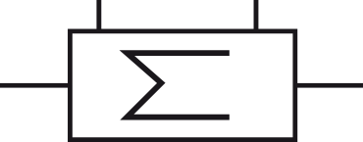



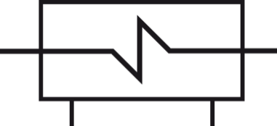
Oil Separator
SV.3
Condenser
P
SV.2
M
P
SV.1
T
EEV
ϑ
ϑ
A
B
BLDC
FIX
T
T
Evaporator
P
T
P
Liquid Separator

