Slide 1
RUNC
ISPF Edit Command Processor
Lionel B. Dyck (lionel.dyck@va.gov)

Slide 2
RUNC
Document frequently and infrequently used TSO and ISPF commands
Sequential dataset or PDS member
Comments
Symbolics

Slide 3
RUNC - Syntax
Must be under ISPF Edit or View
RUNC options

Slide 4
RUNC - Options
blank (default)
? or HELP to display this info
n - must be the first option and will skip the first n characters to find the command
? or HELP to display help information
-T to not trap and let the results go to screen
-B to browse the results using STEMEDIT
-V to view the results using STEMEDIT default is to View
-ALL enables all records to be considered for commands

Slide 5
RUNC - Options
ONLY(string)
will search for the string (e.g. xyz) in the command string and if not found will ignore that command.
PREFIX(string)
will append the string to the front of each command.
SUFFIX(string)
will append the string to the end of each command.
NOTE: PREFIX and SUFFIX do not apply for ISPF commands

Slide 6
Data Syntax
Comments in Column 1: * /* // //*
TSO Commands anywhere in the record
Use n to skip over comments to get to command
ISPF Commands anywhere in the record
Must start with SELECT
Use n to skip over comments to get to command
Continue a command with a +
Symbolics: words that start with &

Slide 7
Command Selection
Individual record: C
Range: CC . . . CC
Range: Cnn

Slide 8
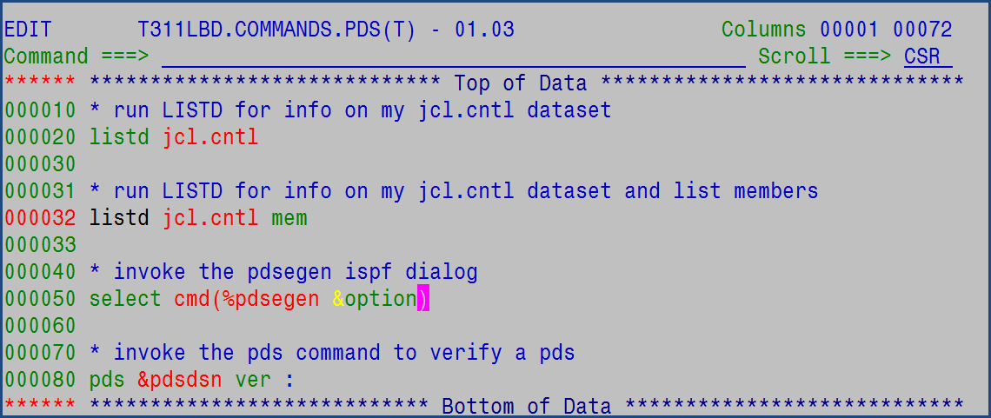
Sample Data

Slide 9
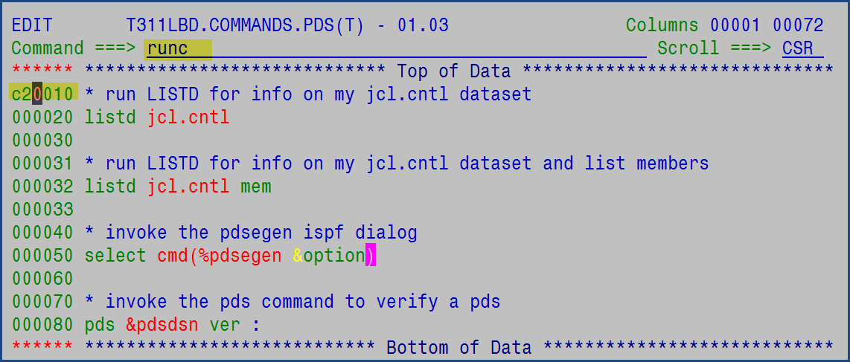
Sample Use

Slide 10
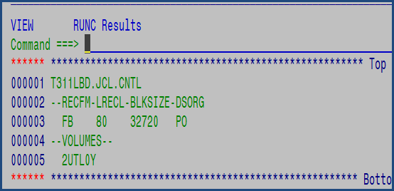
Sample Use - Results

Slide 11
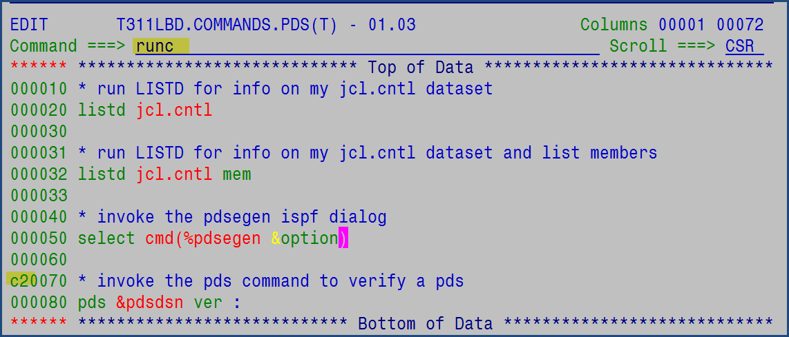
Sample Use

Slide 12
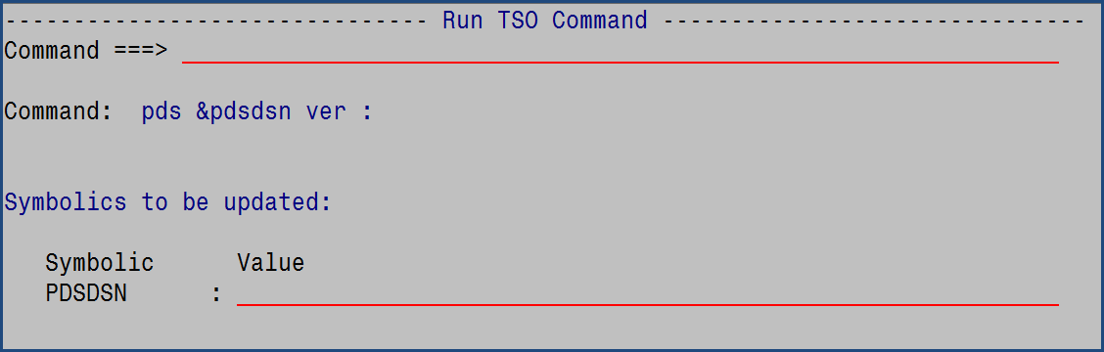
Sample Use – Symbolic Prompt

