Slide 1
SETCLIP
ISPF Edit Clipboard Manager
Lionel B. Dyck (lionel.dyck@va.gov)

Slide 2
SETCLIP
Define up to 10 clipboards
Data is copied from dataset or member
Activate at ISPF Startup

Slide 3
SETCLIP - Syntax
Must be under ISPF
TSO %SETCLIP or
TSO %SETCLIP X

Slide 4
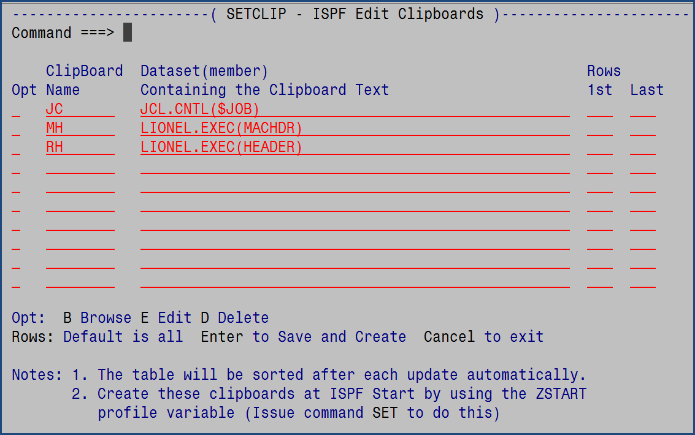
SETCLIP Dialog

Slide 5
SETCLIP Commands
CANCEL – Cancel all updates
SET – Enable SETCLIP to run at ISPF Startup
Enter key – Set/Update the Clipboards
B – Browse the dataset/member
D – Deletes the row (does not delete the active clipboard)
E – Edit the dataset/member
HELP (PF1) - Tutorial

Slide 6
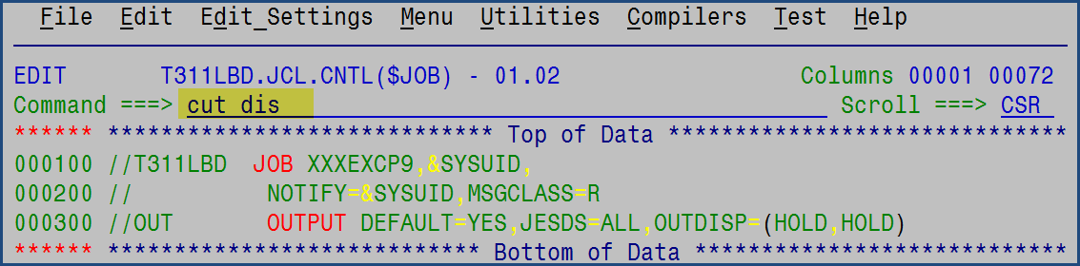
View Clipboards

Slide 7
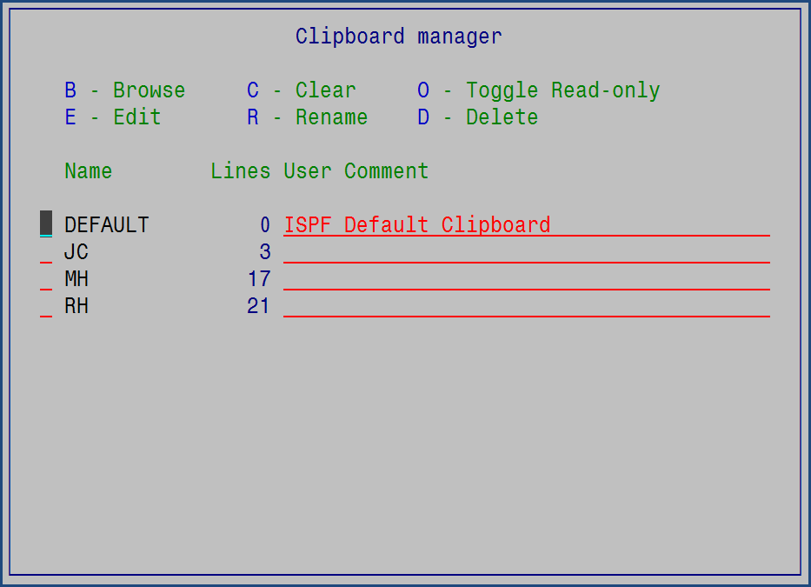
View Clipboards

Slide 8
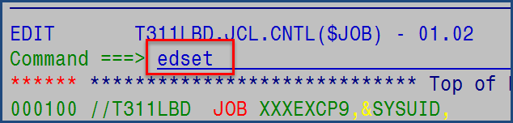
Clipboard Defaults - EDSET

Slide 9
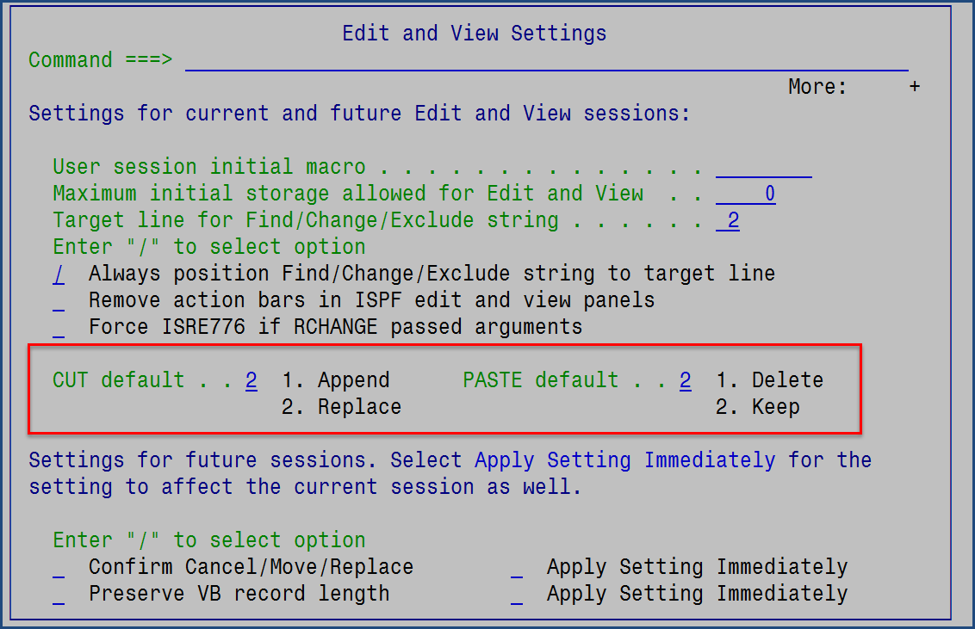
Clipboard Defaults - EDSET

