Slide 1

CS4225/CS5425 Big Data Systems for Data Science
Course Overview
Bingsheng He
School of Computing
National University of Singapore
hebs@comp.nus.edu.sg
Notes:
Welcome to CS4225. I am Bingsheng. In this part, I will give a brief overview for CS4225.

Slide 2
Learning Objectives
Not a lot, just to give you an idea of who I am, what I do, and most of all what this course is about.
Why?
It’s important for you to have a road-map that you can refer to when you can’t connect the dots together. ☺
Notes:
The learning objectives of this part is to give you a brief overview of the course, about who I am and the components of the course. We will give you a roadmap of the entire course. More importantly, assessment.

Slide 3
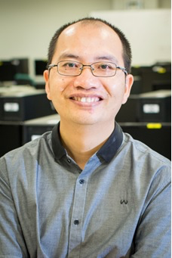
About Bingsheng
Bingsheng HE
Office: COM2 #03-21
Phone: 6516-7998
Email: hebs@comp.nus.edu.sg
Consultation:
By appointment through email
My research interests: big data systems, cloud computing, parallel and distributed computing
Industrial experiences: Microsoft Research
Notes:
I am bingsheng. You can find my office, phone, email here. You can always feel free to email me, or make an appointment for consultation via email.
My research interests are more on systems, such as big data, cloud computing and parallel and distributed systems. I have been working in Microsoft Research. As you all know, Microsoft is one of the major players in big data or data science. In the coding assignment, you can use windows azure. Also you are welcome to use Windows Azure in your course project. In this course, I will share some experiences from Microsoft as well.

Slide 4
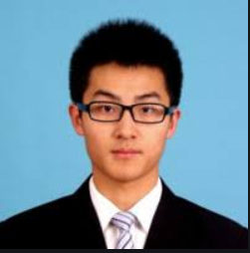

Teaching Assistant
Responsibility
Tutorials
Assist you in matters pertaining to the coding assignments
We are fortunate to have the following great TAs.
Xinyu Chen, e0204951@u.nus.edu
Qinbin Li, e0321199@u.nus.edu
Notes:
We have four great TAs. They are responsible for coding assignments and tutorials. Again, if you have any questions/comments, feel free to email me.

Slide 5
Course Components
Lectures:13 weeks, 2 hours/week
1 week for oral project presentation
Tutorials: 10 tutorials
Two sessions for introducing coding assignments
Assignments: 2 coding assignments
Assessment for both CS4225 and CS5425:
Assignments (20%)
Test (35%)
Project (45%)
Additional assessment for CS5425 only
Survey (10%)
All materials are available in LumiNUS.
Notes:
About course components, we have lecture, tutorials, and labs. We have 12 week of lectures. 1 week for oral projection presentation. 1 week for a test and an invited guest lecture from Huawei. As you may know, Huawei is one of the biggest telecom and IT companies in the world. The invited talk is about the future 5G systems.
We have 9 tutorial sessions. one tutorial session is allocated for introducing the coding assignment and Hadoop. Note, there will be in-tutorial quiz for each tutorial.
We have two coding assignments. More details are given later.
Now, assessment: assignment 20%, test 35% and course project 45%.
There is no final exam.

Slide 6
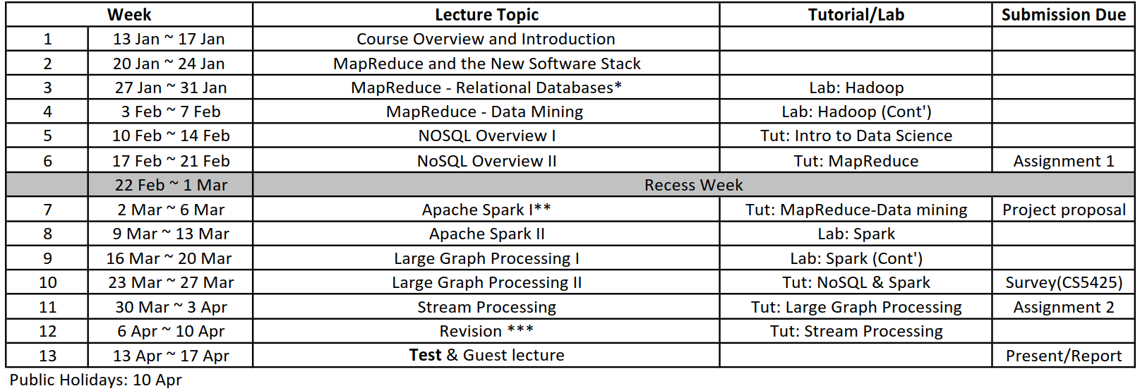
Schedule
Tutorial starts from Week 3
Pay attention to the time management
Special arrangement
*: this part is for e-learning, examinable; no lecture at CNY’s eve.
**: no lecture due to my compulsory duty; content will be shifted to Weeks 6/8.
***: revision is for e-learning; no lecture at Good Friday.
Notes:
This is the overall schedule.
Tutorial starts at week 3.
Two points to highlight:
1. Pay attention to the report submission due date.
Final report is one week after the oral presentation. That means, you can still adding new results and findings into the final report even after the oral presentation.
Pay attention to the time management (some students in the past semester have difficulties in time management).

Slide 7
Lectures
Reference textbooks
[JimmyBook] Jimmy Lin and Chris Dyer. 2010. Data-Intensive Text Processing with Mapreduce. Morgan and Claypool Publishers. https://lintool.github.io/MapReduceAlgorithms/MapReduce-book-final.pdf
[JureBook] Jure Leskovec, Anand Rajaraman, and Jeffrey David Ullman. 2014. Mining of Massive Datasets (2nd ed.). Cambridge University Press. http://www.mmds.org/
Study materials:
Related chapters in the reference textbooks +
The related technical articles (for the state of the art)
Notes:
We do not require you to buy a textbook. When we prepare the course, we refer to two major textbooks, and take the relevant chapters as references. the chapters are available online. I will point out the relevant chapters to read for each part.
Data science is an emerging field. Many online materials are available. Thus, our study materials include related chapters in the reference textbooks plus the related technical articles (for more state of the art).
https://en.wikipedia.org/wiki/Data_science
When I prepare the course, I have put some comments in the comment box. Please check out the latest slide before/after the lecture.
Although I put some comments in the comment box, the content beyond the slide is not examinable. They are for your reference and help you to learn more.

Slide 8
Tutorials
Starts from Week 3
Attendance is important.
All tutorial questions are available in the course website
Necessary to attempt questions before tutorial
Some questions are samples for tests.
Two tutorials are allocated to introduce Hadoop/Spark and coding assignments.
Notes:
All tutorial questions are available in LumiNUS.
You are encouraged to attend the tutorial. Tutors will give explanations to the questions in details. Attending the tutorial can help you to understand the key concepts in this course.
Also, it will be good if you attempt questions before the tutorial. Also, some questions can be viewed as samples for tests.
One tutorial is allocated to introduce Hadoop and coding assignments. Please attend.

Slide 9
Assessment
For both students in CS4225/CS5425
Coding assignment (20%)
Test (35%)
Course project (45%)
For CS5425 students only
Big data system survey (10%)

Slide 10
Coding Assignments
Two coding assignments on Hadoop and Spark (20% total)
Analytics tasks
Sufficient materials are given on each analytics task.
Briefing will be conducted in tutorials.
Submission to LumiNUS
Requirements for submission can be found in lab manuals
Deadline
Assignment 1: Feb 22, 2020, Sat 11:59pm.
Assignment 2: Apr 4, 2020, Sat 11:59pm.
Lab manuals and other supplement documents are available in LumiNUS.
Notes:
We will two coding assignment on Hadoop. http://hadoop.apache.org/
The assignment is on data analytics tasks. But we can also implement it on Hadoop or Spark.
//there are some jargons or terms. if you are puzzled, fine, you can keep them in mind, until we describe them carefully in the future lectures.
All the due dates are with the time of 11:59pm Singapore time ☺

Slide 11
Coding Assignments (cont’)
Individual assignments
Hadoop/Spark Resources
on your local machine
in a virtual machine on your local machine
on a virtual cluster of Microsoft Azure Cloud
My expectations
Self-learning is important.
This course does not teach programming.
You’re expected to pick up Hadoop/Spark with the provided materials and other online materials.
Learn compiling, patching, and installing open source software (this is very important in big data era!)
Notes:
It is an individual assignments.
In this course, we will try different Hadoop resources: your local machine, virtual machine (via virtual box) or Microsoft Azure Cloud.
This is a Level 4 course. Thus, Self-learning is important. Otherwise, this can be a good tutorial: https://docs.oracle.com/javase/tutorial/
You are always encouraged to learn other online materials, and discuss with me.
Lastly, the other purposes of the coding assignment is to learn compiling, patching, and installing open source software… this is very important in big data era.
There are so many open source projects coming out from now and then. It is a big community as well as business ☺

Slide 12
Test
Test (35% in the final mark)
Date: Apr 17, 2020 (in the normal lecture hour)
Time: 1 hour
Closed book (allowing one A4 help sheet)
Example questions
Integrative: Require you to combine knowledge from different chapters of the textbook
“Why not”: Example, Tommy proposed a solution A to solve problem B in the lecture. Tell me what is the problem with solution A and how to overcome this problem
“From the book”: Answerable as long as you read the additional materials I asked you to read
Notes:
We do not have final exam. We will have a test around 1 hour. Closed book.
You can find the example questions in tutorials. Basically, questions will be like three categories. We question you about the understanding of concepts and techniques, rather than memorizing the terms word by word.
Integrative: Require you to combine knowledge from different chapters of the textbook. The question will cover different chapters.
“Why not”: Example, Tommy proposed a solution A to solve problem B in the lecture. Tell me what is the problem with solution A and how to overcome this problem.
“From the book”: Answerable as long as you read the additional materials I asked you to read.

Slide 13
Course Project
Team project with 3 or 4 members
The topic of the course project can be ONE of the followings:
Data Analysis (work on a reasonably large and new dataset and get meaningful results, examples: https://blog.data.gov.sg/)
Algorithmic Implementation (identify a problem on big data analytics, and examine existing solutions to the problem in-depth)
Special topics from NUS-Grab joint lab
Self-proposed Projects (talk to me)
Project description and other supporting materials are available in the course website.
Pay attention to the grading guideline.
Notes:
Course project is very important for this course. It is a group project.
Large data sets are usually be in the scale of GB or even more.
Pay attention to the timeline and do not wait for the last minute.
I strongly recommend you to have brain storming among team members, and read more online materials. I encourage you to look at new data sets.

Slide 14
Project Timeline
Project Grouping
8 Feb 2020 (optional)
Project Proposal (10%)
7 March 2020 to be submitted to LumiNUS
Oral Project Presentation (15%)
18 April 2020
More details will be released later.
Final Project Report (20%)
22 Apr 2020 to be submitted to LumiNUS
Indicate the contribution of each member (by default, I assume a uniform contribution among members).
Notes:
In your final project report, please indicate the contribution of each member (by default, I assume a uniform contribution among members). For example, a group of three persons, I will assume equal contributions from the three team members by default, and thus they will get the same mark.

Slide 15
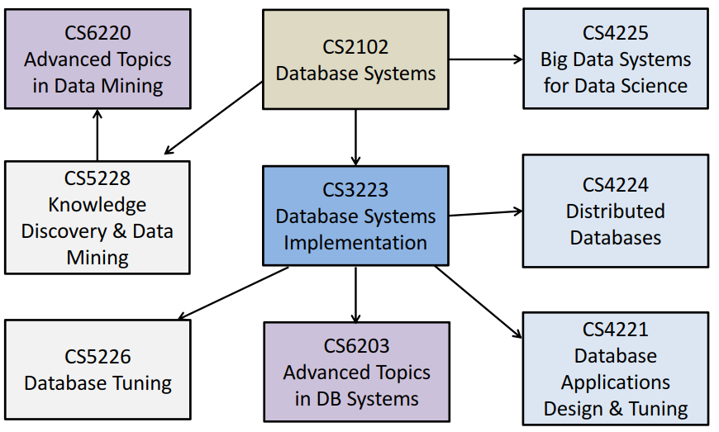
Database Courses @ SoC

Slide 16
Relationships with Other Course
This course has some overlaps with the following course
CS5344:Big Data Analytics Technology
If you have already taken/or taking the above course, you should not take this course.

Slide 17
Course Policies
Zero‐tolerance for plagiarism
Plagiarism resources
http://www.cdtl.nus.edu.sg/ug/resources/plagiarism.htm
Plagiarism prevention
http://cit.nus.edu.sg/plagiarism‐prevention/
Plagiarism E‐Module
http://emodule.nus.edu.sg/ac/
Self-plagiarism
You cannot “copy and paste” from your previous reports.

Slide 18
Additional Instructions for CS5425 Students
According to course design, CS5425 students will have an additional assignment
Big Data System Survey (10%)
So far, all components have 110 marks.
Your normalized final mark will be calculate as: (your mark) * 10/11.

Slide 19
Big Data System Survey
Big data systems are the key infrastructure for data science.
This component is to train you on “self-learning” capabilities on big data systems.
Majority information about the system is online.
Many of the systems are open-sourced.
Write a short survey on THREE big data systems from different categories (10% of the final mark).
Categories are defined in http://nosql-database.org/.
The submission due date: March 28, 2020.
Guidelines are given in the documentation of LumiNUS.
Notes:
There are many big data systems. They are the key infrastructure for data science. A list of NoSQL databases can be found http://nosql-database.org/.
Still many more new systems are coming up. Therefore, it is important to have self-learning capabilities. This component is actually for this purpose. We hope you to learn about big data systems from online materials.
Write a short survey on THREE big data systems from different categories. The categories are defined in http://nosql-database.org/.
Note, guidelines are given in the documentation of LumiNUS.

Slide 20
Take-away
All materials are available at course site in LumiNUS.
Workbin (Files): Lecture notes, assignments, lab exercises
Lesson Plan: Very important; describes in detail the schedule for each week
Forum: Ask course-related technical questions in the forum. It can be an effective way of sharing.
If you are in CS5425, you need to submit a big data system survey.
Feedback and comments are always open.
Notes:
If you have any question, feel free to email me.
All the materials are on LumiNUS. You should check the lesson plan and know the details of the learning task each week.

Slide 21
Acknowledgement
Education grant of Windows Azure from Microsoft

Slide 22
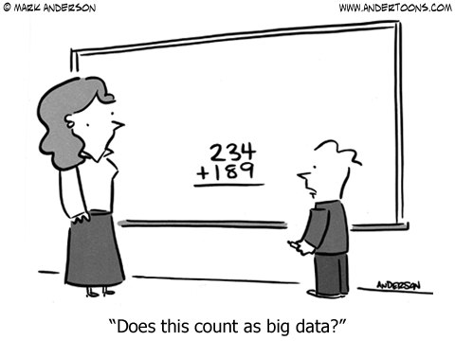
Questions?
Notes:
Big data and data science are buzz words. But, there is no such a strict and precise definition. Enjoy the course ☺

