Slide 1
Pharmacy Apps
Android and iOS:
CVS
Bradleys Pharmacy Group App, Ireland

Slide 2
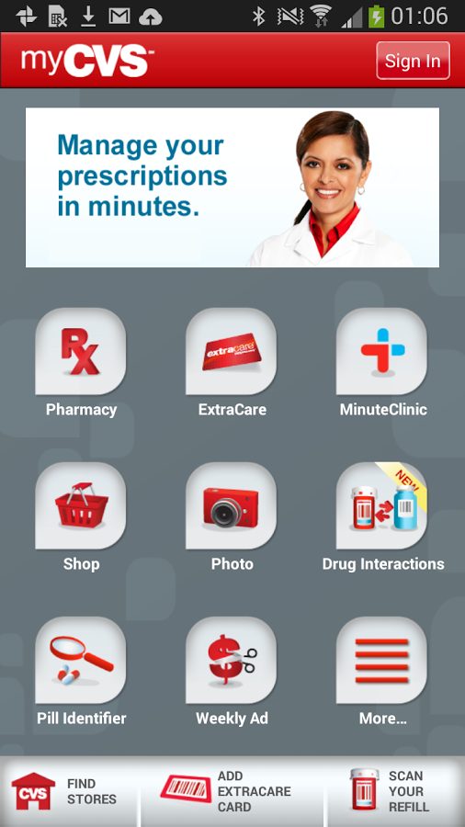
Pharmacy Example App : CVS
CVS Home Screen

Slide 3
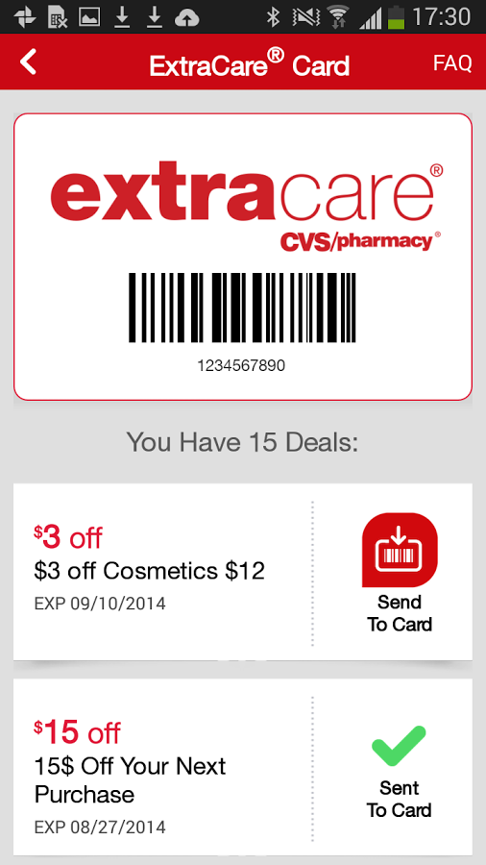
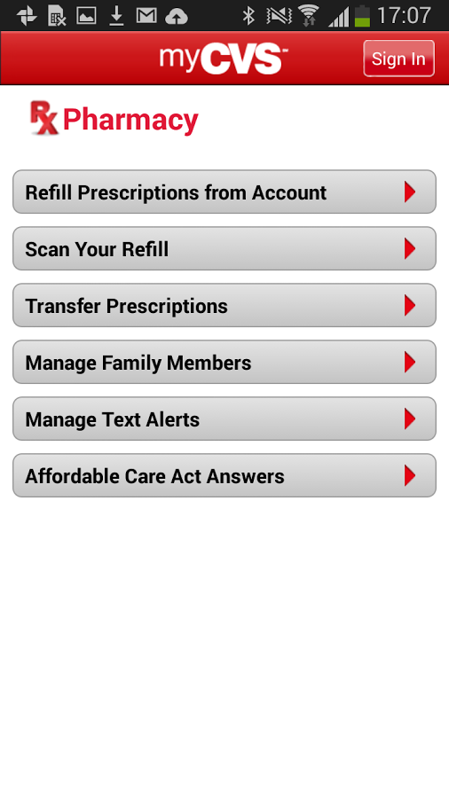
Latest offers Screen

Slide 4
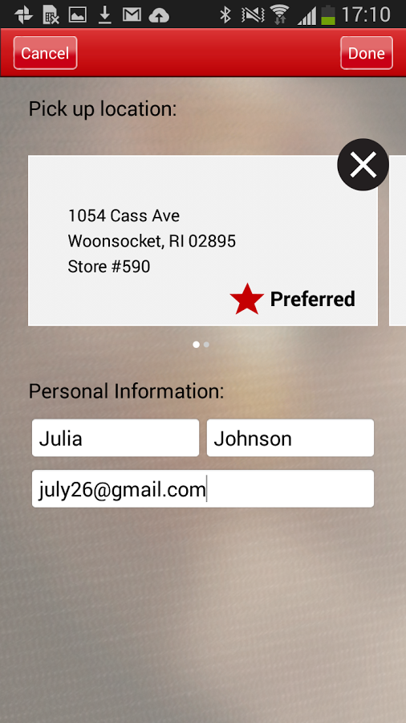
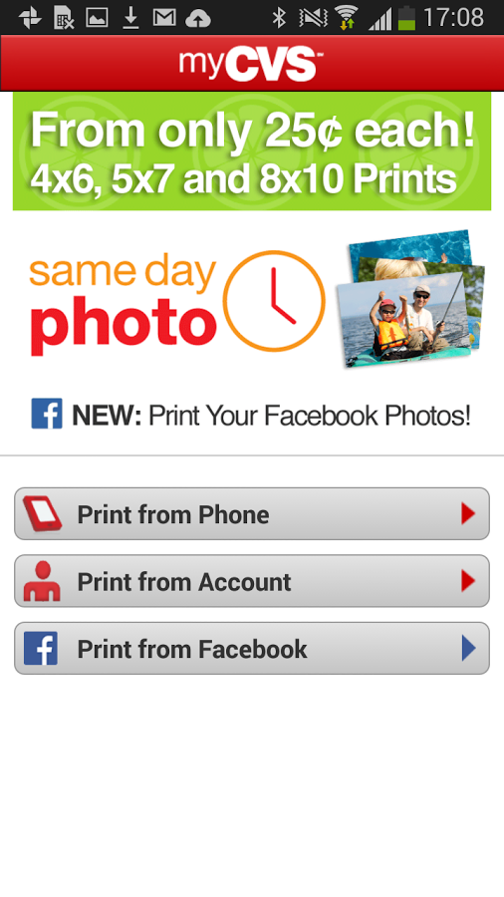
Probably don’t need

Slide 5
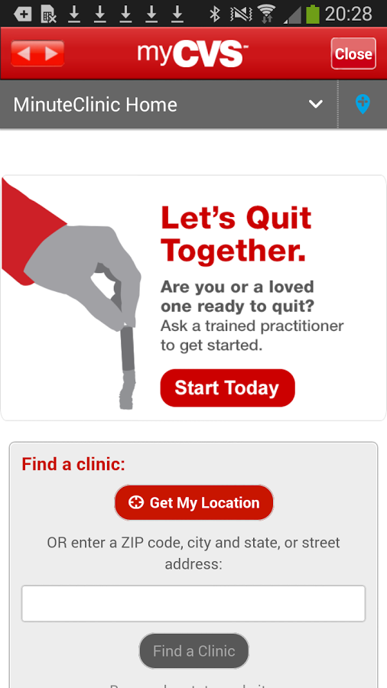
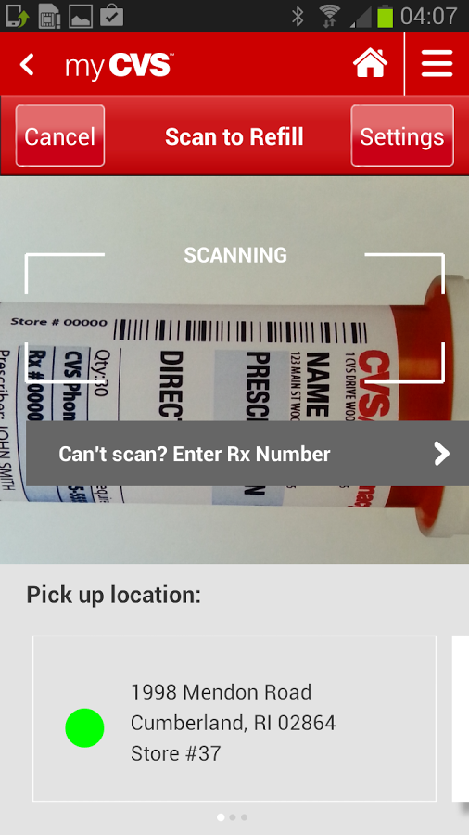
Probably don’t need

Slide 6

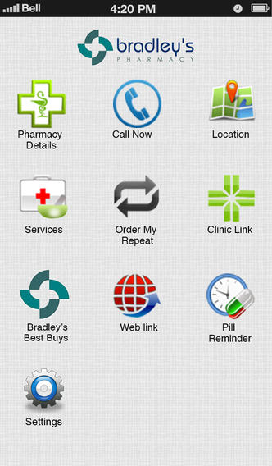
Bradley’s Pharmacy App
Splash Screen
Home Screen

Slide 7

End of Document:

