Slide 1

GUVI Geek Network Pvt Ltd
Notes:
Need to convert these points into icons with text

Slide 2
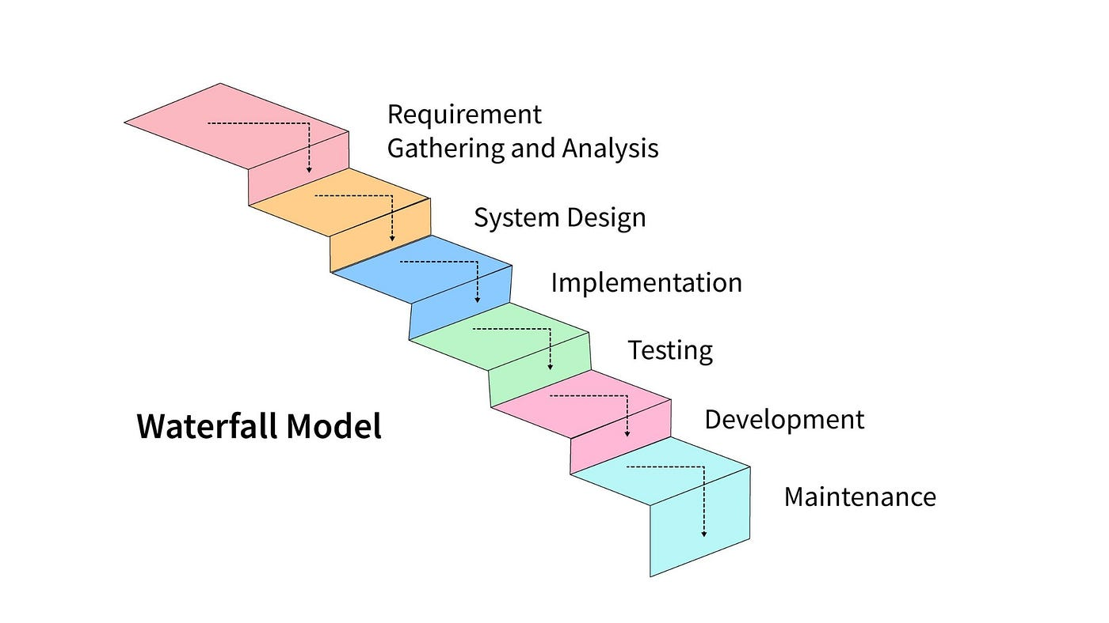

https://www.guvi.in/

Slide 3
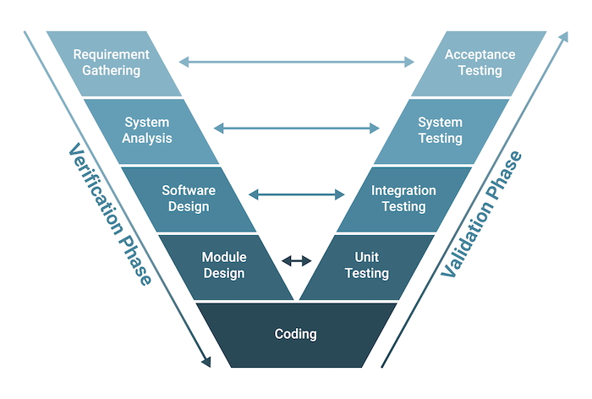
https://www.guvi.in/

Slide 4
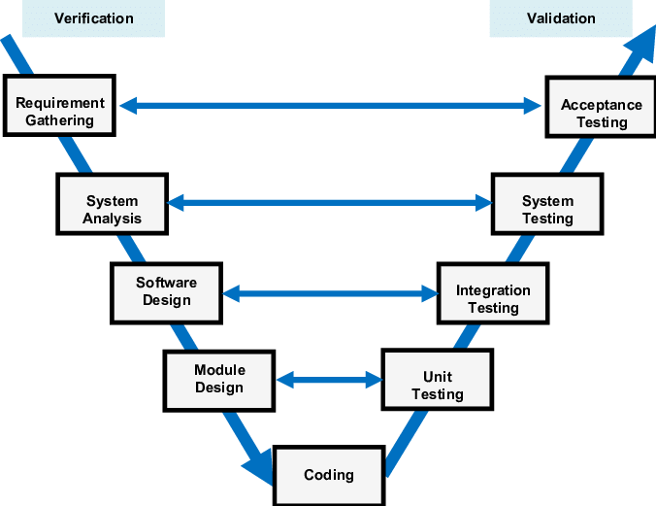
https://www.guvi.in/

Slide 5
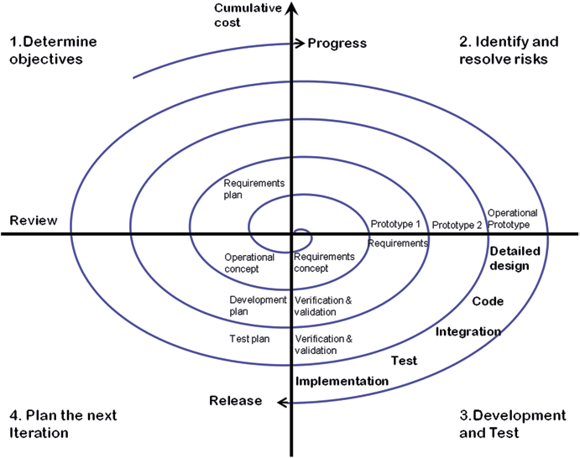
https://www.guvi.in/

Slide 6
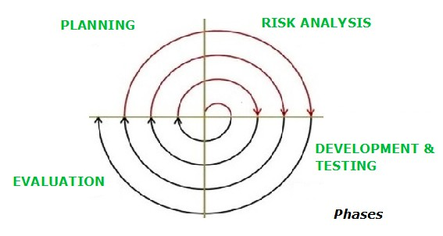
https://www.guvi.in/

Slide 7
Thank You

