Slide 1

GUVI Geek Network Pvt Ltd
Notes:
Need to convert these points into icons with text

Slide 2

Popular SDLC Models
  Waterfall Model
  Spiral Model
  V-Model
  Agile Model
  Incremental Model
  Iterative Model
  Big Bang Model

Slide 3
Waterfall Model
https://www.guvi.in/

Slide 4
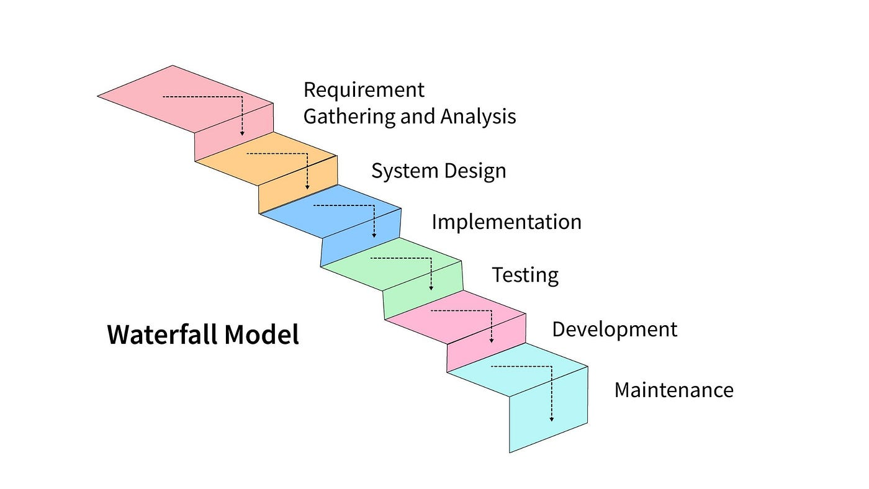
https://www.guvi.in/

Slide 5
Software Development Life Cycle (SDLC)
  SDLC is a structured process used to develop high-quality software.
  It guides development from planning to maintenance.
  Ensures quality, cost control, and timely delivery.

Slide 6
Phases of SDLC
  Requirement Gathering & Analysis
  System Design
  Implementation (Coding)
  Testing
  Deployment
  Maintenance

Slide 7
Requirement Gathering & Analysis
Collect business requirements from stakeholders.
  Identify functional and non-functional requirements.
  Conduct feasibility study (technical, economic, operational).
  Output: SRS Document

Slide 8
Design
  Develop HLD and LLD documents.
  Output: Design Documents

Slide 9
Implementation (Coding)
  Develop code based on design documents.
  Use programming languages (Java, Python, C#, etc.).
  Perform unit testing.
  Output: Source Code

Slide 10
Testing
  Test software to find defects.
  Perform functional, integration, and system testing.
  Fix bugs and retest.
  Output: Tested & Verified Software

Slide 11
Deployment
  Release software to production.
  Install in client/server environment.
  End users start using the system.
  Output: Live Application

Slide 12
Maintenance
  Fix post-release bugs.
  Add new features and improvements.
  Enhance performance.
  Output: Updated Versions

Slide 13
Importance of SDLC
  Reduces development risks.
  Improves software quality.
  Provides structured project management.
  Improves team coordination and time management.
  SDLC provides a systematic approach to software development.
  Different models suit different project types.
  Choosing the right model increases project success.

Slide 14
Stage | Full Form | Focus | Prepared By | Purpose | Output
BRS | Business Requirement Specification | Business needs | Business Analyst | Defines business objectives and project scope | Business Requirements Document
SRS | Software Requirement Specification | System requirements | System Analyst | Defines detailed functional & non-functional requirements | SRS Document
FDD | Functional Design Document | Functional behaviour | Functional Consultant / Analyst | Explains how system will work (user perspective) | Functional Design Document
TDD | Technical Design Document | Technical implementation | Technical Architect / Developer | Explains how system will be built technically | Technical Design Document
Coding | Implementation Phase | Writing source code | Developers | Convert design into working software | Source Code
Testing | Quality Assurance Phase | Validation & verification | Testers / QA Team | Identify and fix defects | Tested & Verified Software
Deployment | Release Phase | Production release | DevOps / Deployment Team | Make software live for users | Live Application

Slide 15
Document | Full Form | Belongs to SDLC Phase | Explanation
BRS | Business Requirement Specification | Requirement Gathering Phase | Defines business goals and high-level requirements
SRS | Software Requirement Specification | Requirement Analysis Phase | Defines detailed functional & non-functional system requirements
FDD | Functional Design Document | System Design Phase (Functional Design) | Describes how system will function from user perspective
TDD | Technical Design Document | System Design Phase (Technical Design) | Describes technical architecture and implementation details

Slide 16
Thank You

