Slide 1

GUVI Geek Network Pvt Ltd
Notes:
Need to convert these points into icons with text

Slide 2

Software Testing Life Cycle
https://www.guvi.in/

Slide 3
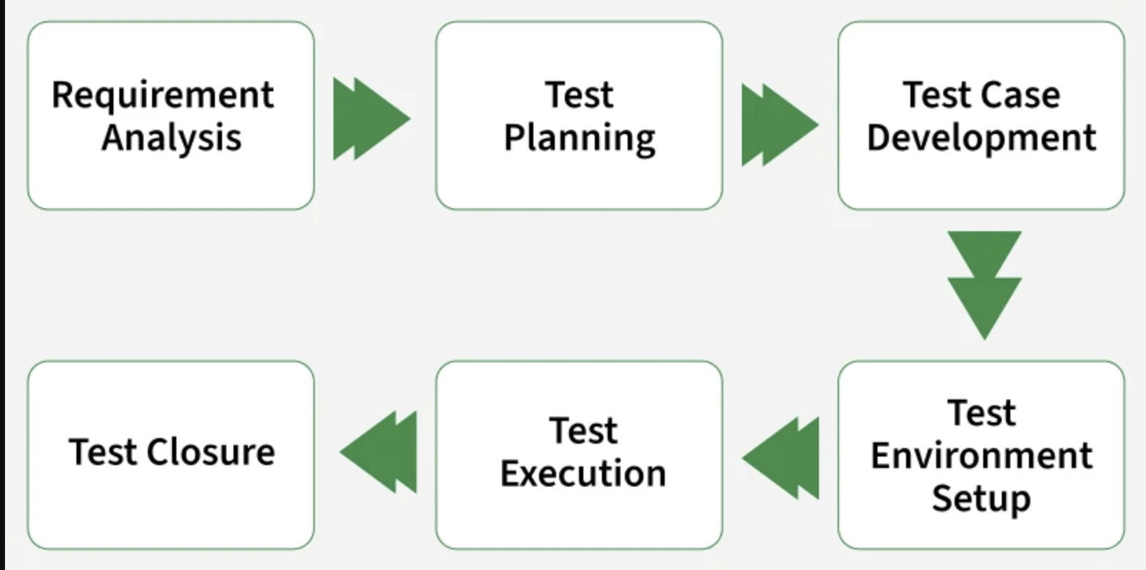
https://www.guvi.in/

Slide 4
Phases of STLC
Requirement Analysis
Test Planning
Test Case Development
Test Environment Setup
Test Execution
Test Closure
https://www.guvi.in/

Slide 5
1. Requirement Analysis
Requirement Analysis is the first phase where the QA/testing team understands what needs to be tested.
The activities that take place during the Requirement Analysis stage include:
Reviewing the software requirements document (SRD) and other related documents
Interviewing stakeholders to gather additional information
Identifying any ambiguities or inconsistencies in the requirements
Identifying any missing or incomplete requirements
Identifying any potential risks or issues that may impact the testing process
https://www.guvi.in/

Slide 6
2. Test Planning
Test Planning is the most crucial phase where the overall test strategy and plan are created.
The major activities carried out during the Test Planning phase include:
Identifying the testing objectives and scope
Developing a test strategy: selecting the testing methods and techniques that will be used
Identifying the testing environment and resources needed
Identifying the test cases that will be executed and the test data that will be used
Estimating the time and cost required for testing
Identifying the test deliverables and milestones
Assigning roles and responsibilities to the testing team
Reviewing and approving the test plan
https://www.guvi.in/

Slide 7
3. Test Case Development
The Test Case Development phase testers design detailed test cases and prepare the necessary test data.
The main activities performed during the Test Case Development phase include:
Identifying the test cases that will be developed
Writing test cases that are clear, concise and easy to understand
Creating test data and test scenarios that will be used in the test cases
Identifying the expected results for each test case
Reviewing and validating the test cases
Updating the requirement traceability matrix (RTM) to map requirements to test cases
https://www.guvi.in/

Slide 8
4. Test Environment Setup
Test Environment Setup defines the hardware, software and network conditions under which testing will be executed.
The activities involved in the Test Environment Setup phase include:
Install and configure required software, tools and databases.
Set up servers, browsers, operating systems and devices.
Prepare access credentials and permissions.
Validate the environment before test execution.
https://www.guvi.in/

Slide 9
5. Test Execution
In Test Execution phase prepared test cases are executed in the defined environment. The activities performed during the Test Execution phase include:
Run manual or automated test cases.
Log defects with details like severity and priority.
Retest fixed defects (defect retesting).
Perform regression testing if required.
Collect and analyze test results.
Document and share test reports.
https://www.guvi.in/

Slide 10
6. Test Closure
Test Closure is the final phase where testing activities are completed and documented.
The final activities carried out during the Test Closure phase include:
Prepare a Test Summary Report (test cases executed, pass/fail count, defects found/resolved).
Ensure all defects are tracked and closed.
Clean up the test environment.
Archive test cases, data and reports.
Conduct a retrospective for lessons learned.
Share knowledge with stakeholders.
https://www.guvi.in/

Slide 11
Thank You

