Slide 1

GUVI Geek Network Pvt Ltd
Notes:
Need to convert these points into icons with text

Slide 2

Defect/Bug Life Cycle
https://www.guvi.in/

Slide 3
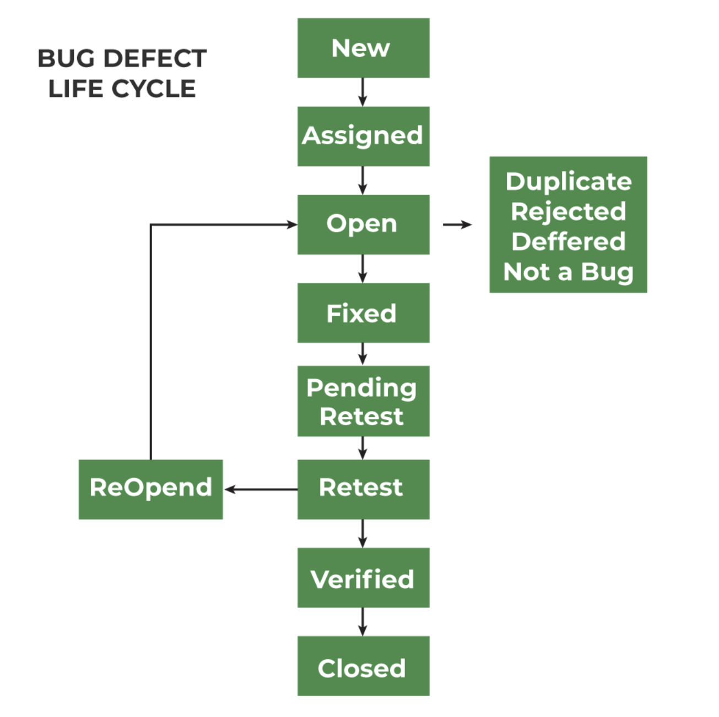
https://www.guvi.in/

Slide 4
Thank You

