Slide 1
Software testing

Slide 2
Objectives
To discuss the distinctions between validation testing and defect testing
To describe the principles of system and component testing
To describe strategies for generating system test cases
To understand the essential characteristics of tool used for test automation

Slide 3
The testing process
Component testing
  Testing of individual program components;
  Usually the responsibility of the component developer (except sometimes for critical systems);
  Tests are derived from the developer’s experience.
System testing
  Testing of groups of components integrated to create a system or sub-system;
  The responsibility of an independent testing team;
  Tests are based on a system specification.

Slide 4
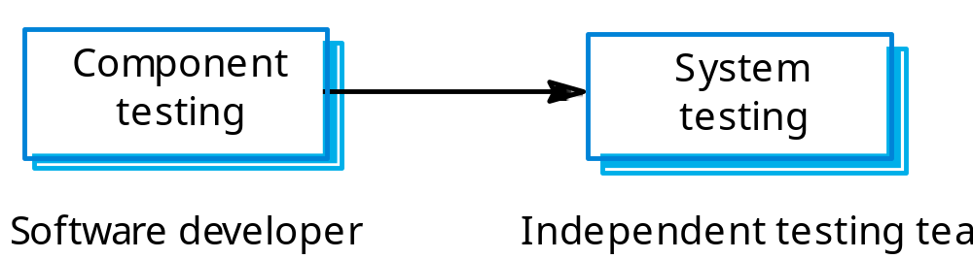
Testing phases

Slide 5
Defect testing
The goal of defect testing is to discover defects in programs
A successful defect test is a test which causes a program to behave in an anomalous way
Tests show the presence not the absence of defects

Slide 6
Testing process goals
Validation testing
  To demonstrate to the developer and the system customer that the software meets its requirements;
  A successful test shows that the system operates as intended.
Defect testing
  To discover faults or defects in the software where its behaviour is incorrect or not in conformance with its specification;
  A successful test is a test that makes the system perform incorrectly and so exposes a defect in the system.

Slide 7
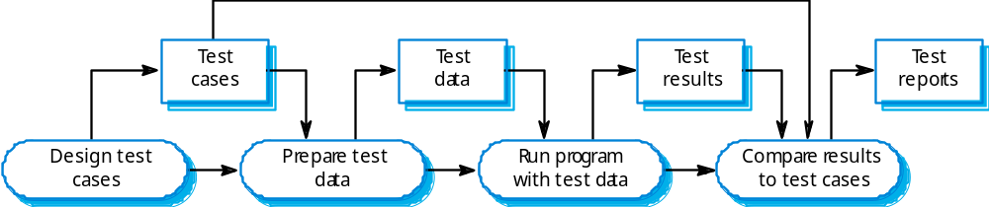
The software testing process

Slide 8
Testing policies
Only exhaustive testing can show a program is free from defects. However, exhaustive testing is impossible,
Testing policies define the approach to be used in selecting system tests:
  All functions accessed through menus should be tested;
  Combinations of functions accessed through the same menu should be tested;
  Where user input is required, all functions must be tested with correct and incorrect input.

Slide 9
System testing
Involves integrating components to create a system or sub-system.
May involve testing an increment to be delivered to the customer.
Two phases:
  Integration testing - the test team have access to the system source code. The system is tested as components are integrated.
  Release testing - the test team test the complete system to be delivered as a black-box.

Slide 10
Integration testing
Involves building a system from its components and testing it for problems that arise from component interactions.
Top-down integration
  Develop the skeleton of the system and populate it with components.
Bottom-up integration
  Integrate infrastructure components then add functional components.
To simplify error localisation, systems should be incrementally integrated.

Slide 11
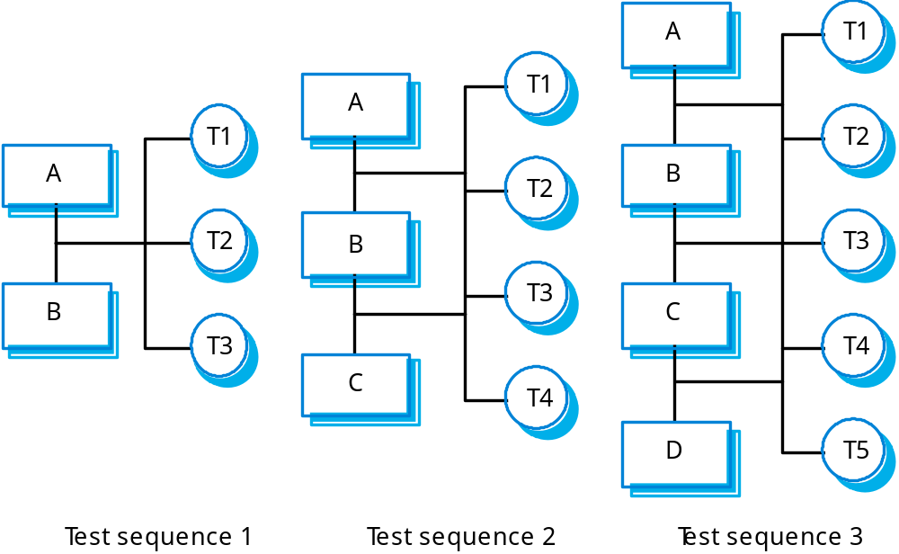
Incremental integration testing

Slide 12
Testing approaches
Architectural validation
  Top-down integration testing is better at discovering errors in the system architecture.
System demonstration
  Top-down integration testing allows a limited demonstration at an early stage in the development.
Test implementation
  Often easier with bottom-up integration testing.
Test observation
  Problems with both approaches. Extra code may be required to observe tests.

Slide 13
Release testing
The process of testing a release of a system that will be distributed to customers.
Primary goal is to increase the supplier’s confidence that the system meets its requirements.
Release testing is usually black-box or functional testing
  Based on the system specification only;
  Testers do not have knowledge of the system implementation.

Slide 14
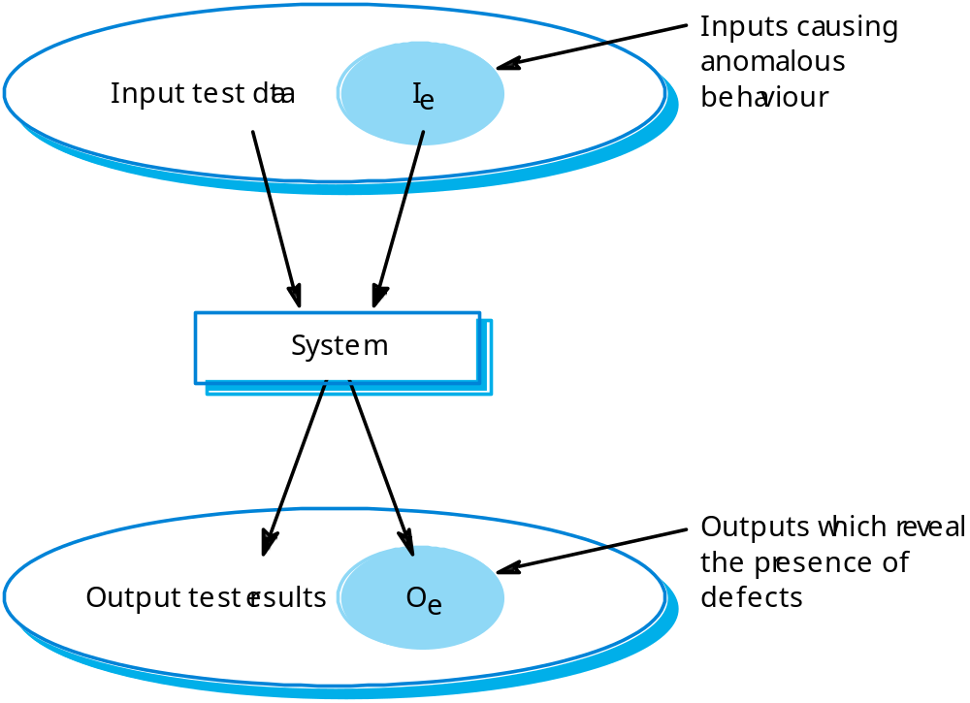
Black-box testing

Slide 15
Testing guidelines
Testing guidelines are hints for the testing team to help them choose tests that will reveal defects in the system
  Choose inputs that force the system to generate all error messages;
  Design inputs that cause buffers to overflow;
  Repeat the same input or input series several times;
  Force invalid outputs to be generated;
  Force computation results to be too large or too small.

Slide 16

Testing scenario

Slide 17
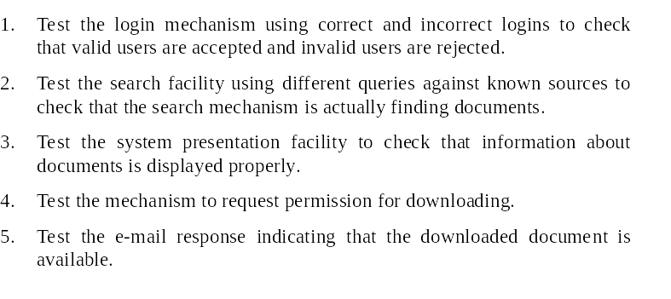
System tests

Slide 18
Use cases
Use cases can be a basis for deriving the tests for a system. They help identify operations to be tested and help design the required test cases.
From an associated sequence diagram, the inputs and outputs to be created for the tests can be identified.

Slide 19
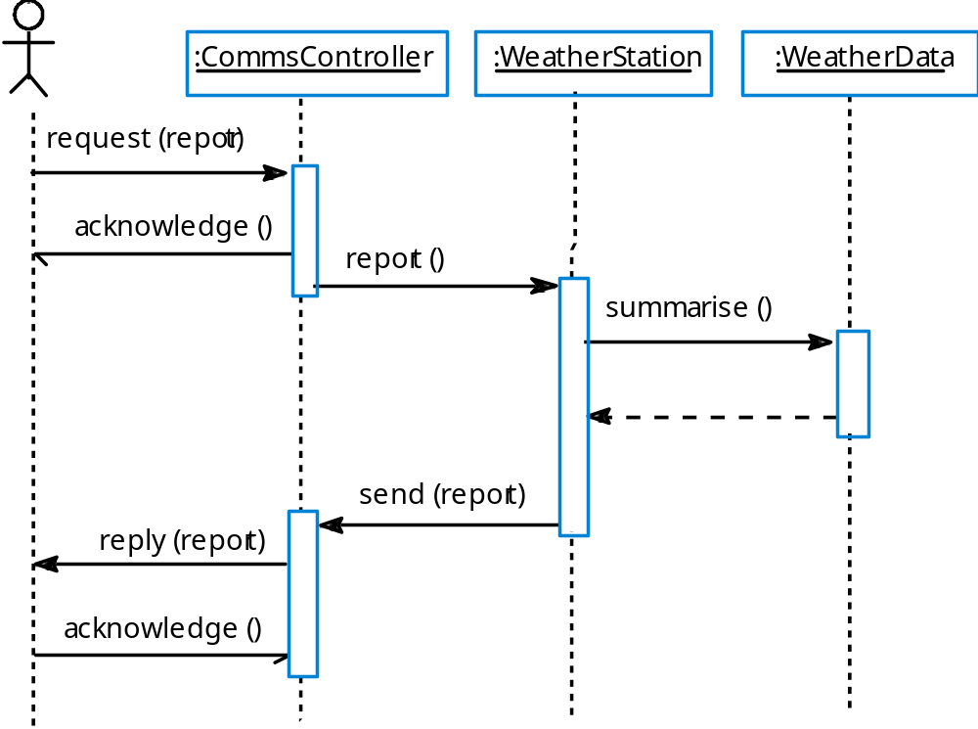
Collect weather data sequence chart

Slide 20
Performance testing
Part of release testing may involve testing the emergent properties of a system, such as performance and reliability.
Performance tests usually involve planning a series of tests where the load is steadily increased until the system performance becomes unacceptable.

Slide 21
Stress testing
Exercises the system beyond its maximum design load. Stressing the system often causes defects to
come to light.
Stressing the system test failure behaviour.. Systems should not fail catastrophically. Stress testing checks for unacceptable loss of service or data.
Stress testing is particularly relevant to distributed systems that can exhibit severe degradation as a
network becomes overloaded.

Slide 22
Key points
Testing can show the presence of faults in a system; it cannot prove there are no remaining faults.
Component developers are responsible for component testing; system testing is the responsibility of a separate team.
Integration testing is testing increments of the system; release testing involves testing a system to be released to a customer.
Use experience and guidelines to design test cases in defect testing.

