Slide 1
Jenkins setup:
#!/bin/bash
sudo apt-get update
sudo apt install openjdk-11-jdk -y
sudo apt install openjdk-8-jdk -y
curl -fsSL https://pkg.jenkins.io/debian-stable/jenkins.io.key | sudo tee \
/usr/share/keyrings/jenkins-keyring.asc > /dev/null
echo deb [signed-by=/usr/share/keyrings/jenkins-keyring.asc] \
https://pkg.jenkins.io/debian-stable binary/ | sudo tee \
/etc/apt/sources.list.d/jenkins.list > /dev/null
sudo apt-get install jenkins -y
sudo systemctl enable jenkins
sudo systemctl start Jenkins
sudo systemctl status Jenkins
EC2 ubuntu
jdk-11 ->
Jenkins
mvn --version
java --version
git --version
jenkins --version
Java project ->
GIT
Jdk-8 ->
Maven
Versionirovanie (Jenkins modul)

Slide 2
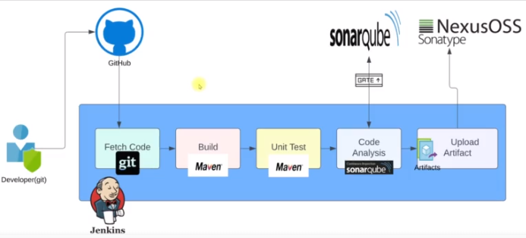
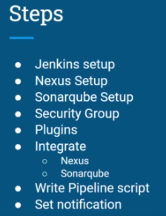
AWS + Jenkins CI
Jenkins (Ubuntu 20)
Allow 22, 8080, 80 (sonar)
T2.small, 2GB
Security group
Nexus (centos 7)
T2.medium, 4GB
Allow 8081
Security group
Create token for Jenkins
Sonarqube (Ubuntu 18)
T2.medium, 4GB
Allow 22, 80, 9000
Security group
Jenkins plugins
Nexus artifact uploader
Build timestamp
Sonarqube scanner
Pipeline utility steps
Pipeline maven integration
Slack notification
Jenkins tools:
OracleJDK8
MAVEN3
Integrate Jenkins with
Sonar cube
nexus
Jenkins:
added credentials for sonarqube scanner tool
Integrated sonarqube server with Jenkins
to connect for nexus
- Build artifacts automatically
- Slack integrated with Jenkins for auto notification
Write pipeline & set notification
Sonar
-create Quality Gate
-create Webhook
- http://3.235.246.9:8080/sonarqube-webhook
/usr/lib/jvm/java-8-openjdk-amd64
/var/lib/jenkins/workspace/git-pipeline
Slack
workspace, channel
Slack app configuration for Jenkins
Nexus:
- Create maven2(hosted) repository

Slide 3
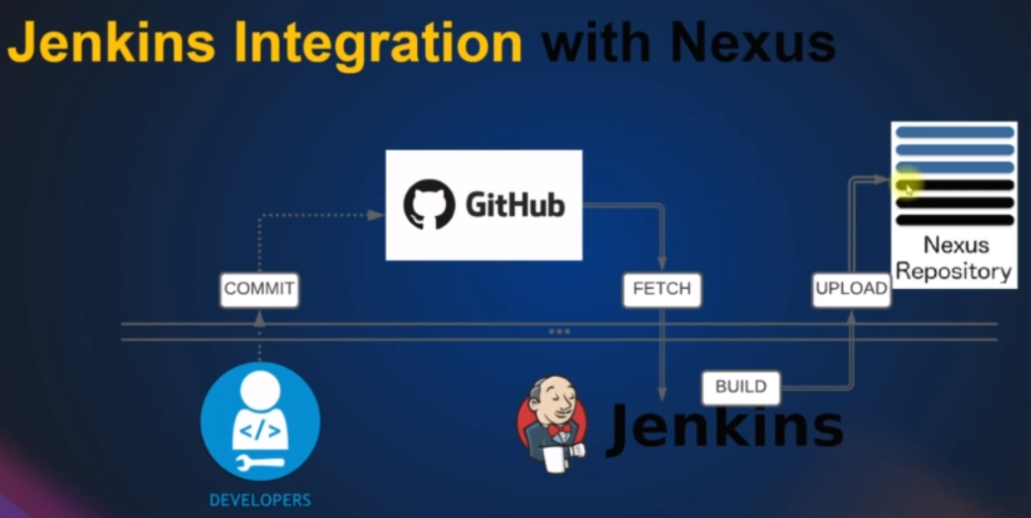
Sonarcube: code get from git
Nexus:
#!/bin/bash
yum install java-1.8.0-openjdk.x86_64 wget mc tmux -y
mkdir -p /opt/nexus/
mkdir -p /tmp/nexus/
cd /tmp/nexus/
NEXUSURL="https://download.sonatype.com/nexus/3/latest-unix.tar.gz"
wget $NEXUSURL -O nexus.tar.gz
EXTOUT=`tar xzvf nexus.tar.gz`
NEXUSDIR=`echo $EXTOUT | cut -d '/' -f1`
rm -rf /tmp/nexus/nexus.tar.gz
rsync -avzh /tmp/nexus/ /opt/nexus/
useradd nexus
chown -R nexus.nexus /opt/nexus
cat <<EOT>> /etc/systemd/system/nexus.service
[Unit]
Description=nexus service
After=network.target
[Service]
Type=forking
LimitNOFILE=65536
ExecStart=/opt/nexus/$NEXUSDIR/bin/nexus start
ExecStop=/opt/nexus/$NEXUSDIR/bin/nexus stop
User=nexus
Restart=on-abort
[Install]
WantedBy=multi-user.target
EOT
echo 'run_as_user="nexus"' > /opt/nexus/$NEXUSDIR/bin/nexus.rc
systemctl daemon-reload
systemctl start nexus
systemctl enable nexus
Jenkins setup ubuntu:
#!/bin/bash
sudo apt update
sudo apt install openjdk-11-jdk -y
sudo apt install maven -y
curl -fsSL https://pkg.jenkins.io/debian-stable/jenkins.io.key | sudo tee \
/usr/share/keyrings/jenkins-keyring.asc > /dev/null
echo deb [signed-by=/usr/share/keyrings/jenkins-keyring.asc] \
https://pkg.jenkins.io/debian-stable binary/ | sudo tee \
/etc/apt/sources.list.d/jenkins.list > /dev/null
sudo apt-get update
sudo apt-get install jenkins -y
sudo apt install openjdk-8-jdk -y

Slide 4
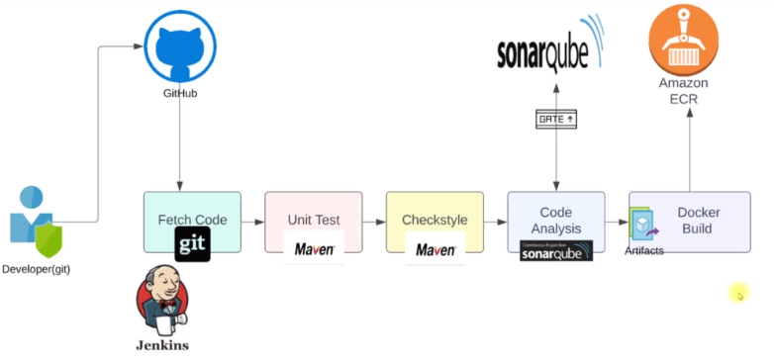
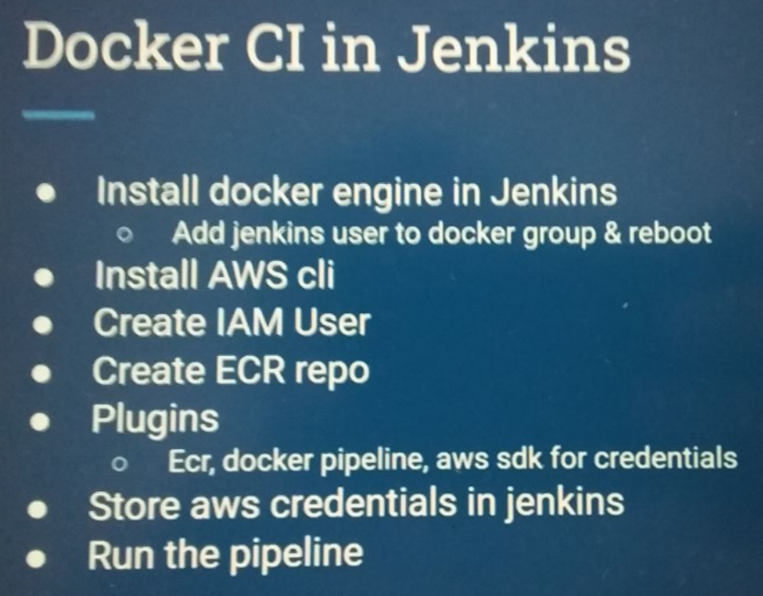
Docker CI in Jenkins
Deliver container to run time environment
AWS ECS: Elastic Container service
1.Installed Docker in Jenkins system
Steps:
install Docker in Jenkins server
add Jenkins user to Docker group and reboot in Jenkins server
Install awscli in Jenkins server
created IAM Jenkins user with registry + ECS access in aws
created ECR repo in aws = created aws container registry
These Plugins installed in Jenkins:
Docker pipeline
amazon ECR (for credentials)
amazon web services sdk
cloud bees Docker build and publish
Pipeline aws steps (for deploy)
Added aws credentials to Jenkins
Run the pipeline
Created ECS cluster
Created ECS service

Slide 5
Jenkins:
sudo apt-get install ca-certificates curl gnupg lsb-release
sudo mkdir -p /etc/apt/keyrings
curl -fsSL https://download.docker.com/linux/ubuntu/gpg | sudo gpg --dearmor -o /etc/apt/keyrings/docker.gpg
echo "deb [arch=$(dpkg --print-architecture) signed-by=/etc/apt/keyrings/docker.gpg] https://download.docker.com/linux/ubuntu \
$(lsb_release -cs) stable" | sudo tee /etc/apt/sources.list.d/docker.list > /dev/null
sudo apt-get update
sudo apt-get install docker-ce docker-ce-cli containerd.io docker-compose-plugin
sudo docker run hello-world
docker --version
id jenkins
usermod -aG docker jenkins
id jenkins
apt install awscli -y
SSH-keygen – in local comp
SSH between github (public key) and Jenkins (private key) – in Jenkins
No ask –y jenkins
(Configure Global Security ->Host Key Verification Strategy – accept 1-connection )
Create user ssh credentials to connect to git - jenkins
Jenkins uploads jenkinsfile from git. Create Jenkins job to access jenkinsfile from git - jenkins
http://54.172.56.121:8080/github-webhook/ - github
Project steps:
Git hook from git
Building
Auto notification to slack
Project is available via internet
Project: aws + get code from git, builds, notification

Slide 6
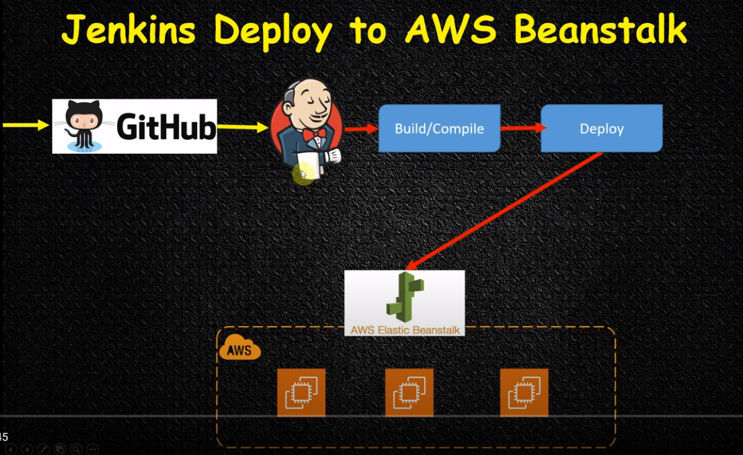
Elastic beanstalk
Jenkins user – full beans talk access
Create repo and Upload php app to github
Aws elastic beans deployment plugin installed
Chucknorris plugin
Add pipeline
add git -> add web hook
Github -> http://44.210.77.32:8080/github-webhook/
Build steps -> aws elastic beanstalk
Versioning -> jenkins-build-V${BUILD_ID}
Add post config -> chuknorris
My Project №1
Aws + Jenkins + git + godaddy dns
GoDaddy integration
SSH connection from Jenkins -> GIT repo
Configure Global Security ->Host Key Verification Strategy – accept 1-connection
Slack notification

Slide 7
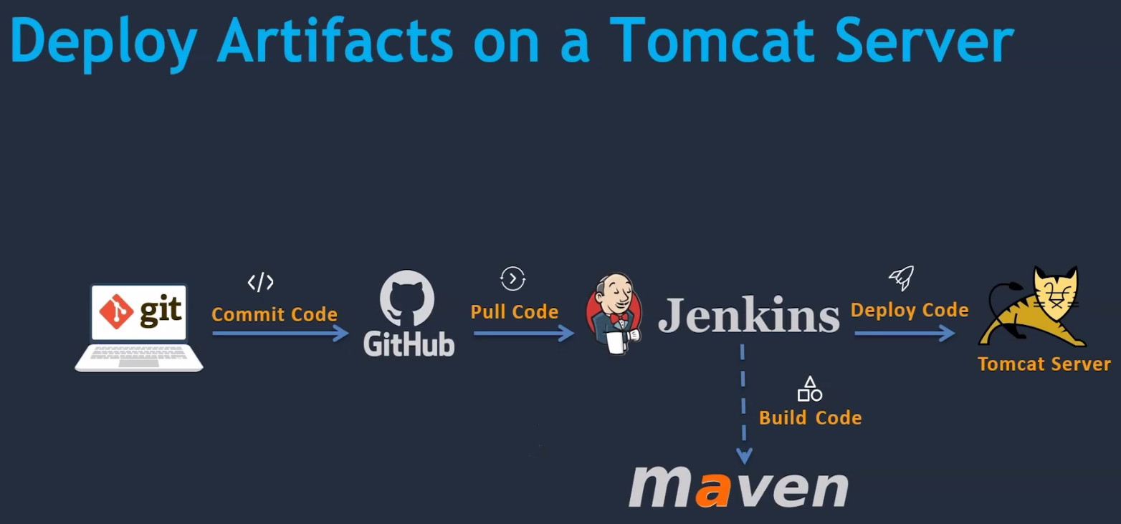
Project_2
Git ----------->
jenkins
https://github.com/testgit4me/Project_2
Jenkins system install file.sh
Jenkinsfile pipeline
Tomcatfile.sh
Artifact.war
SSH Agent Plugin
maven "maven3" tool
jdk "jdk8“ tool
/usr/lib/jvm/java-8-openjdk-amd64
Jenkins server ec2
Installed jenkins
Integrate git with jenkins
Installed git on lunix
Added github.plagin
Confgured git tool -> global.conf
Integrated maven with Jenkins
Downloaded & Installed tomcat server
Install java & start tomcat
Integrated tomcat with Jenkins
Installed deploy to container plugin
Configure tomcat server with credentials
Configure Jenkins with tomcat credentials
Web hook
CI/CD
Auto notify to slack
Attach to domain name
find /opt -name *user*

