Slide 1

Human Capital Attrition
Barclays Women Hackathon - 2019
Puja Chakraborty, Manisha Dsouza & Rupa Sureshkumar

Slide 2
Problem statement
OBJECTIVE
The problem statement is to build a predictive model for attrition which will help the organization in better resource planning and improve the employee experience.
The objective of this project is to use Machine Learning techniques to predict employee turnover which can aid organizations in better planning and precautionary strategic measures.
“You take away our top 20 employees and overnight we become a mediocre company” – Bill Gates

Slide 3
What are the key attributes of an employee leaving the company?
By using effective feature engineering, data wrangling, visualizations and model prediction, the key attributes will be derived
What plans can be devised to improve employee retention?
Proposal of a tactical retention strategy based on the key indicators and overall results
Solution
To address the problem in hand, we will attempt to decipher the following using various Machine Learning techniques, algorithms and models.
What is the likelihood of an active employee quitting the company?
Employees can be assigned a “Risk Score” based on the predicted attrition probability such that:
Low-risk for employees with label < 0.6 (not likely to leave)
Medium-risk for employees with label between 0.6 and 0.8 (good chances of attrition)
High-risk for employees with label > 0.8 (very likely to leave)
TECH STack
Machine Learning, Python (Numpy, Pandas, Stats-Model,
Sci-kit learn, Matplotlib, Seaborn etc.)
Coding console: Jupiter, Pycharm
Dashboard: Qlikview

Slide 4


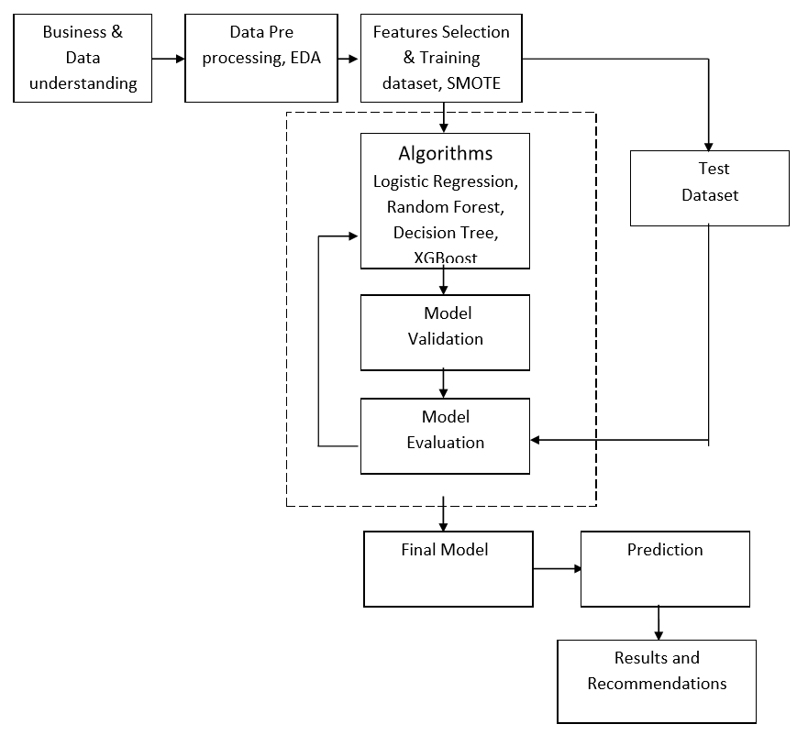
Solution workflow

Slide 5
Data understanding
Data understanding
There are 1470 records and 35 features in the dataset:
Age
Attrition
BusinessTravel
DailyRate
Department
DistanceFromHome
Education
EducationField
EmployeeCount
EmployeeNumber
EnvironmentSatisfaction
Gender
HourlyRate
JobInvolvement
JobLevel
JobRole
JobSatisfaction
MaritalStatus
MonthlyIncome
Data sourced from Kaggle: https://www.kaggle.com/pavansubhasht/ibm-hr-analytics-attrition-dataset
20. MonthlyRate
21. NumCompaniesWorked
22. Over18
23. OverTime
24. PercentSalaryHike
25. PerformanceRating
26. RelationshipSatisfaction
27. StandardHours
28. StockOptionLevel
29. TotalWorkingYears
30. TrainingTimesLastYear
31. WorkLifeBalance
32. YearsAtCompany
33. YearsInCurrentRole
34. YearsSinceLastPromotion
35. YearsWithCurrManager
DATA DEFINITION:
Education: 1 'Below College' 2 'College' 3 'Bachelor' 4 'Master' 5 'Doctor'
EnvironmentSatisfaction: 1 'Low' 2 'Medium' 3 'High' 4 'Very High'
JobInvolvement: 1 'Low' 2 'Medium' 3 'High' 4 'Very High'
JobSatisfaction: 1 'Low' 2 'Medium' 3 'High' 4 'Very High'
PerformanceRating: 1 'Low' 2 'Good' 3 'Excellent' 4 'Outstanding'
RelationshipSatisfaction: 1 'Low' 2 'Medium' 3 'High' 4 'Very High'
WorkLifeBalance: 1 'Bad' 2 'Good' 3 'Better' 4 'Best'

Slide 6
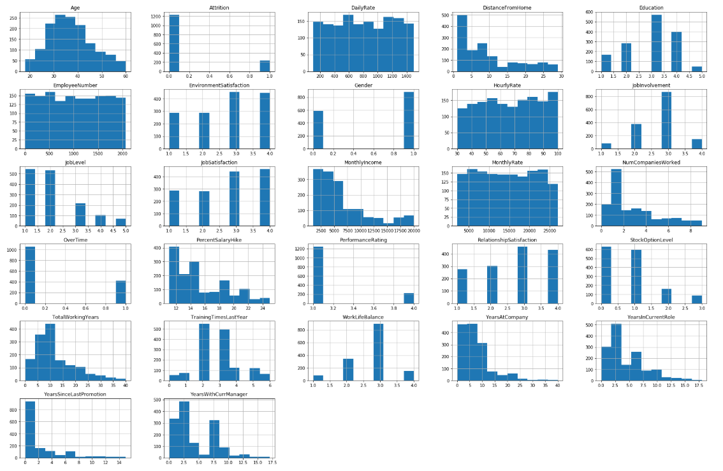

Slide 7
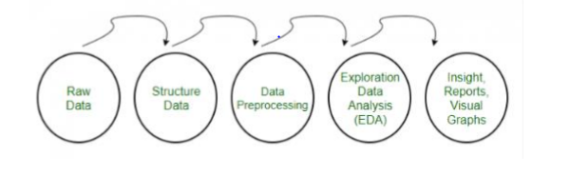
Data preprocessing
Missing value treatments,
Data exploration (EDA)
Outliers detection,
Handling Categorical Variables – Hot Encoding
Feature Scaling

Slide 8
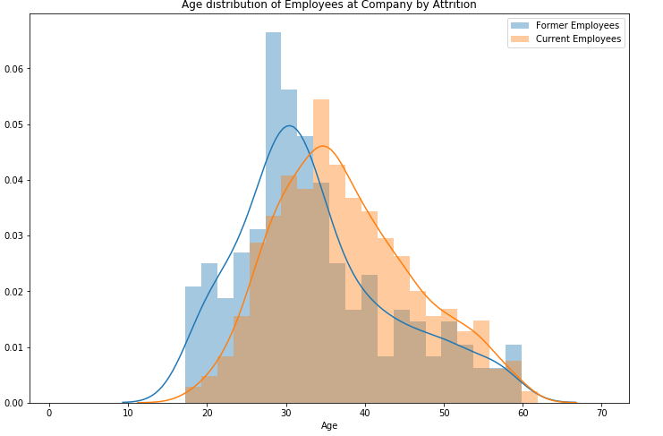
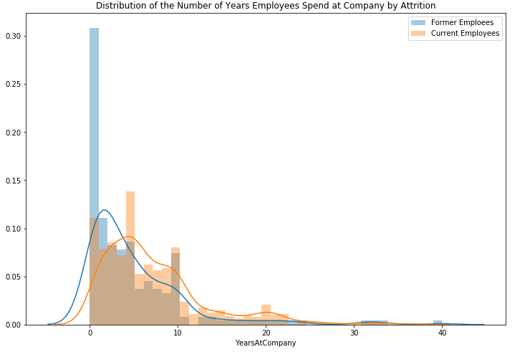
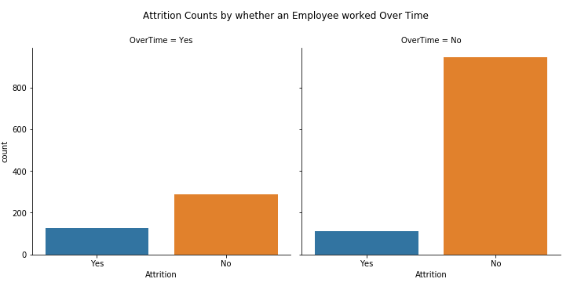
Identifying patterns in data
EDA (Exploratory data analysis)
Attrition Vs Age
Attrition Vs OverTime
Attrition Vs Tenure in Company

Slide 9
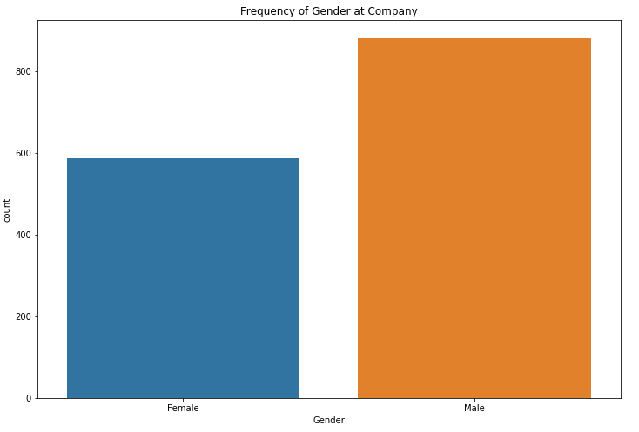
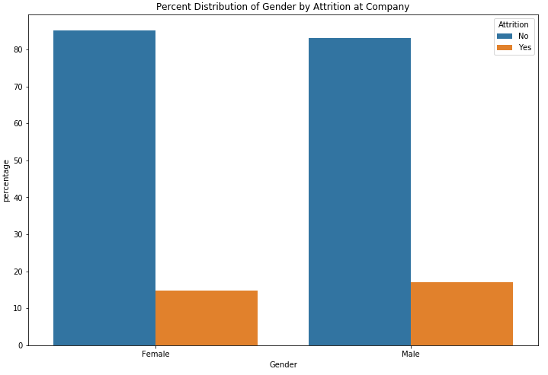
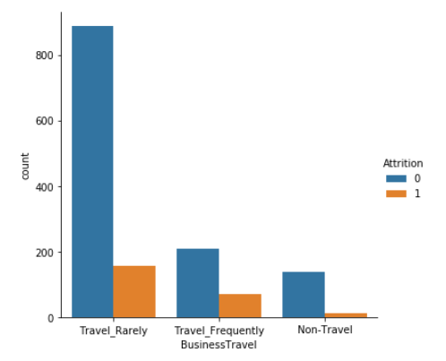
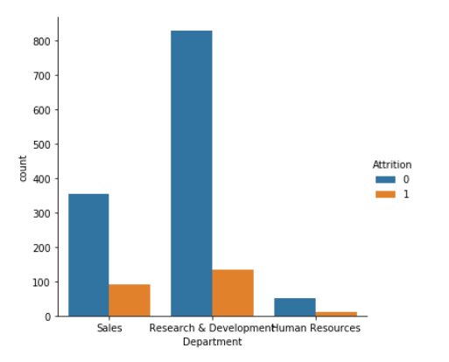
EDA (Exploratory data analysis)
Attrition Vs Gender
Almost same rate of Attrition observed among Men and Women employees!
Gender Attrition Percentage
Female No 85.204082
Male No 82.993197
Female Yes 14.795918
Male Yes 17.006803
Attrition Vs Business Travel
Attrition Vs Department
There is hardly any attrition with employees who don’t travel as opposed to employees who travel, also employees who rarely travel are more likely to leave.
Research & Development and Sales departments have high employee turnover rates

Slide 10
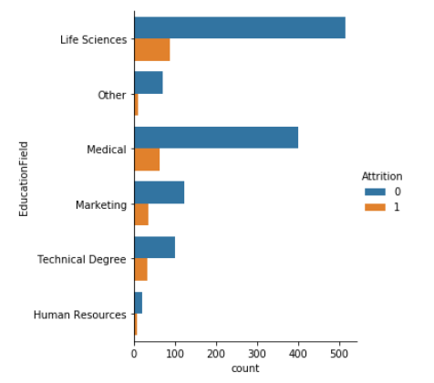
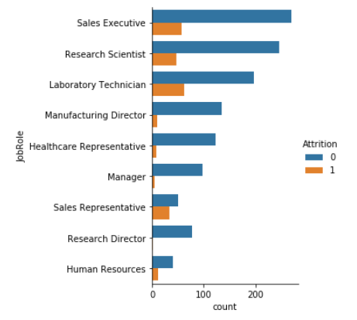
EDA (Exploratory data analysis)
Attrition Vs Education Field
Attrition Vs Job Roles
Attrition is higher among employees with Life Sciences & Medical Educational backgrounds and are working in their current job role as Sales executives/Representatives, Research Scientists and Laboratory technicians

Slide 11
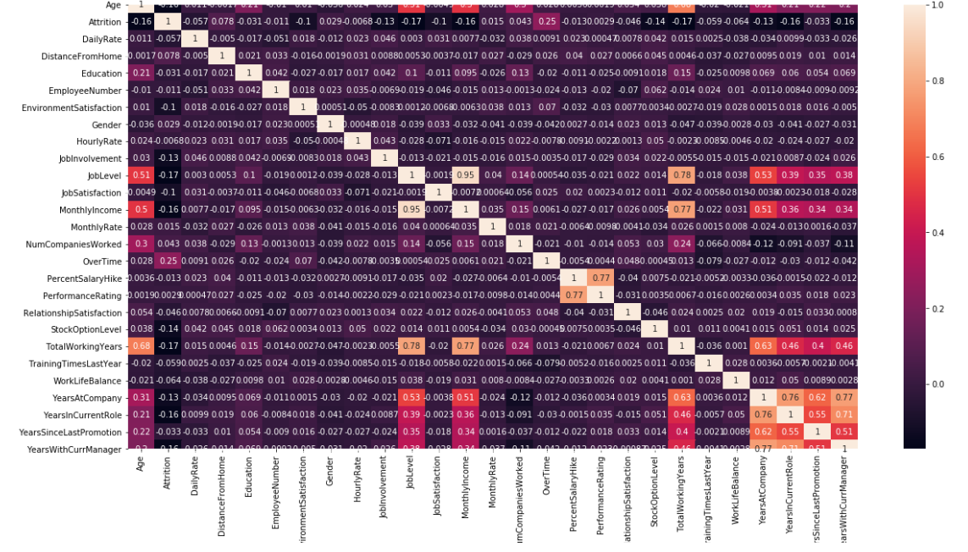
Exploratory data analysis (Corr-plot)
High Correlated Features
(We are considering greater than 0.6)
TotalWorkingYears vs Age: 0.68
TotalWorkingYears vs Joblevel: 0.78
TotalWorkingYears vs MonthlyIncome: 0.77
TotalWorkingYears vs YearsAtCompany:0.63
YearsAtCompany vs yearsInCurrentRole:0.76
YearsAtCompany vs YearsWithCurrentManager:0.77
YearsAtCompany vs YearsSinceLastPromotion:0.62
YearsWithCurrentmanger vs YearsInCurrentRole:0.71
PercentSalaryhike vs PerformanceRating :0.77

Slide 12
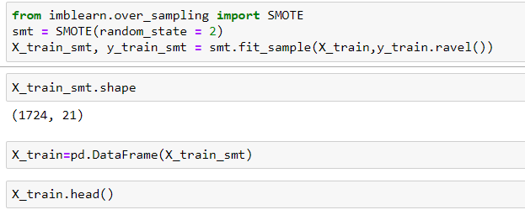
Training, TEST dataset & SMOTE
Feature Selection
70% data is used for training model and remaining 30% for testing the model.
Most machine learning algorithms work best when the number of samples in each class is about equal. This is because most algorithms are designed to maximize accuracy and reduce error
Our data set is highly imbalanced so for balancing we are using SMOTE, i.e. over sampling technique
We have used RFE (Recursive Feature Elimination) and VIF (Variance Inflation Factor) techniques for feature selection
Also, the importance function from the Random Forest algorithm gives a good insight into the most important features of the dataset

Slide 13
SIGNIFICANT FEATURES
MonthlyIncome
MaritalStatus
JobRole
EducationField
OverTime
NumCompaniesWorked
YearsWithCurrManager
DistanceFromHome
YearsSinceLastPromotion
StockOptionLevel
BusinessTravel
JobInvolvement
EnvironmentSatisfaction
Feature Selection
Significant features obtained from RFE & VIF

Slide 14
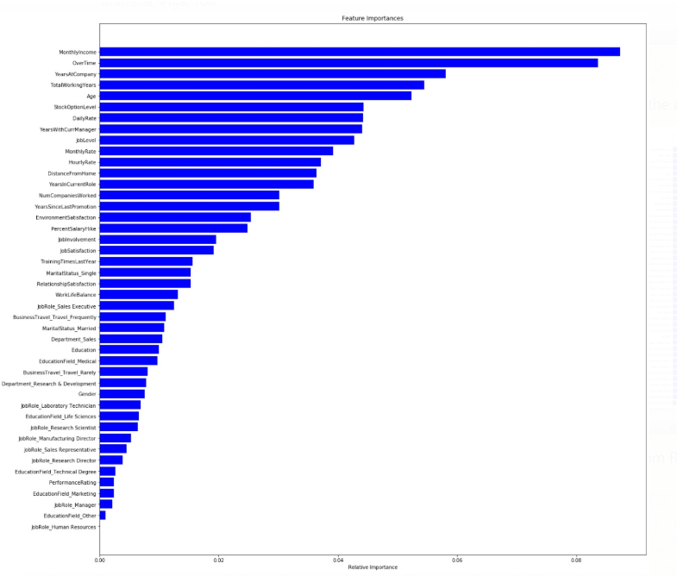
Important
features
Important features obtained from Random Forest Importance function plot
Random Forest Important Features!

Slide 15
ALGOrithms & modelling
As per the theme, Human Capital Attrition project is a Machine Learning ‘classification’ problem. Here, data would have two classes for label attrition i.e. ‘Yes’ and ‘No’. Hence, we are dealing with supervised learning binary classification.
We have created different models using the below Machine Learning classification algorithms and chosen the best performing model based on outcome.
Logistic Regression
Decision Tree
Random Forest
XGBoost

Slide 16
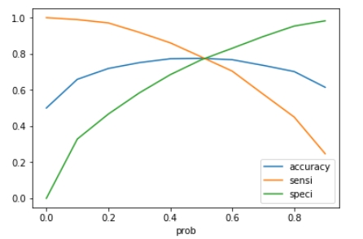
Probability cut off
Plotting accuracy sensitivity and specificity for various probabilities to determine probability cut off.
From the above plot, 0.5 is a reasonable cut-off

Slide 17
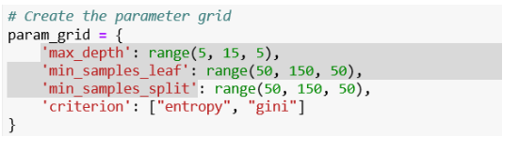
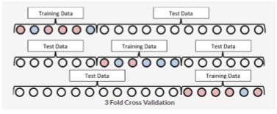
Grid search and cross validation
Hyper parameter tuning
Hyperparameter tuning is one of the essential tasks in the model building process. For a model to perform best on the data, we need to tune the hyperparameter. In this case study, we have tuned below hyperparameters for decision tree and random forest.
'max_depth': range 'min_samples_leaf' 'min_samples_split’
We have used grid search cross-validation for tuning hyperparameters.
Hyper parameters were tuned for getting more precise accuracy. We have tried to minimize type I error as we do not want to incorrectly select employees under “No Attribute” category who may in reality fall under the Attrition category.
At the time of prototype building we have validated our models by using Grid search - Cross-validation:
It is a method for robustly estimating test-set performance (generalization) of a model. Grid-search is a way to select the best of a family of models, parameterized by a grid of parameters. So in below figure K=3. We are planning to use K=5.

Slide 18
Evaluation Criteria for Models
3. Sensitivity: Sensitivity (SN) is calculated as the number of correct positive predictions divided by the total number of positives. We will be using this to evaluate actual attrition correctly predicted by model over total number of actual attrition.
4. Specificity: Specificity (SP) is calculated as the number of correct negative predictions divided by the total number of negatives. We will be using this to evaluate actual no attrition count correctly predicted by model over total number of actual no attrition
5. ROC AUC: ROC curve is a performance measurement for classification problem at various thresholds settings.. ROC Curves shows the trade-off between the True Positive Rate (TPR) and the False Positive Rate (FPR). It tells how much model is capable of distinguishing between classes. Higher the AUC, better the model TPR: Sensitivity, FPR: 1-Specificity
1. Confusion matrix: It is a performance measurement for machine learning classification problem where output can be two or more classes. It is a table with 4 different combinations of predicted and actual values
2. Accuracy: The proportion of the total number of predictions those are correct.
Actual/Predicted | No Attrition | Attrition
No Attrition | True Negative | False Positive
Attrition | False Negative | True Positive

Slide 19
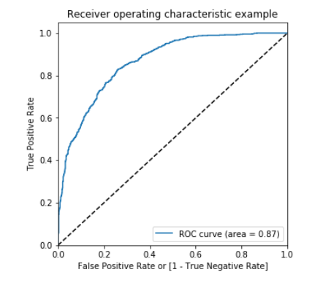
Results & Model performance measures
Model | Accuracy (%) | Sensitivity (%) | Specificity (%)
Logistic Regression 76.41 |  | 71.42 | 77.3
Random Forest 83.77 |  | 59 | 72
Decision Tree 67.57 |  | 67 | 68
XGBoost | 75 | 23 | 98
ROC of Logistic Regression

Slide 20

Final model selection
Actual/Predicted | No Attrition | Attrition
No Attrition | True Negative | False Positive
Attrition | False Negative | True Positive
Based on the obtained model performance measures comparison, we can conclude that Logistic Regression gives the most accurate predictive results for this dataset.
Even though the accuracy of Random Forest is higher than Logistic Regression, we pick LR as the sensitivity and specificity values are higher for this and lower for Random forest, what this means is that the no. of +ve and –ve predictions are far more accurate in our Logistic model.
This means that this model can correctly distinguish between leavers and non-leavers with 75% accuracy which has a better prediction accuracy, scalability and performance.

Slide 21
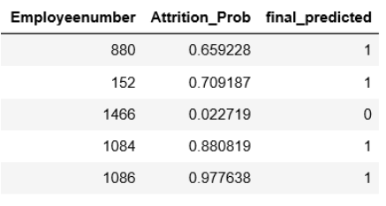
Prediction & results
As this is a binary classification problem, in the predicted results the leavers are marked with “1” (Attrition) and non-leavers are marked with “0” (No Attrition)
Csv of actual predicted results from the final Logistic Regression model are uploaded along with code
Bucketing of employees based on Risk score
Employees are assigned a “Risk Score” based on the predicted attrition probability such that:
Low-risk for employees with label < 0.6
Medium-risk for employees with label between 0.6 and 0.8
High-risk for employees with label > 0.8
More info on the interactive Dashboard!

Slide 22
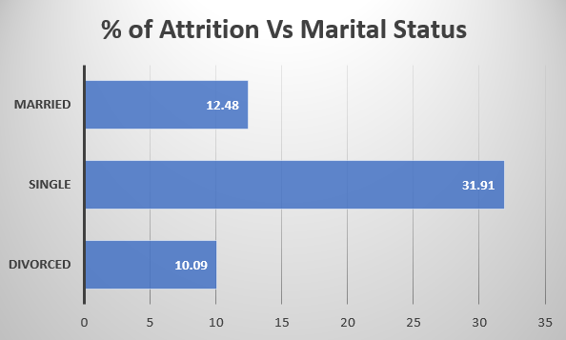
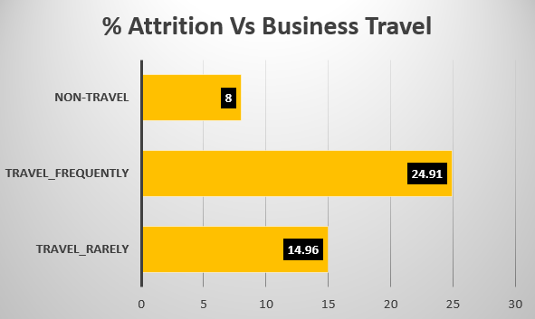
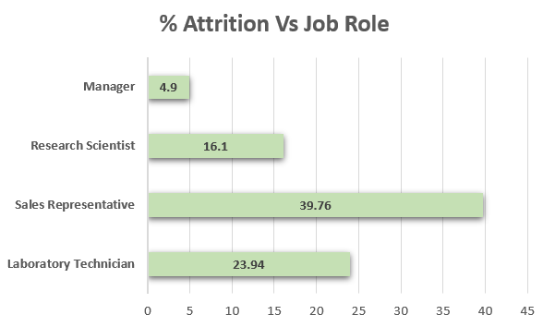
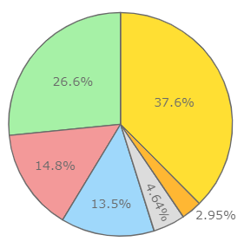
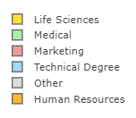
Strong indicators of attrition
From our model results, we can see that the below variables are strong indicators of people leaving
Features | coef
JobRole_Laboratory Technician | 1.5639
BusinessTravel_Travel_Frequently | 1.5559
MaritalStatus_Single | 0.8481
OverTime | 0.8383
YearsSinceLastPromotion | 0.7663
JobRole_Research Scientist | 0.6955
BusinessTravel_Travel_Rarely | 0.6661
JobRole_Sales Representative | 0.6144
NumCompaniesWorked | 0.4211
DistanceFromHome | 0.3438
MaritalStatus_Married | 0.2197
EducationField_Technical Degree | 0.2147
StockOptionLevel | -0.3093
EnvironmentSatisfaction | -0.4041
JobInvolvement | -0.4483
EducationField_Life Sciences | -0.5771
EducationField_Other | -0.6494
YearsWithCurrManager | -0.764
EducationField_Medical | -0.772
MonthlyIncome | -0.784
Attrition Vs Education

Slide 23
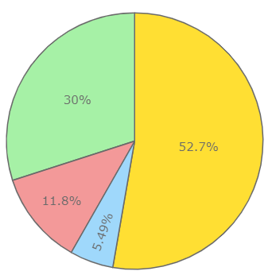

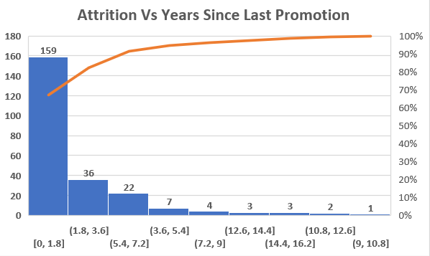
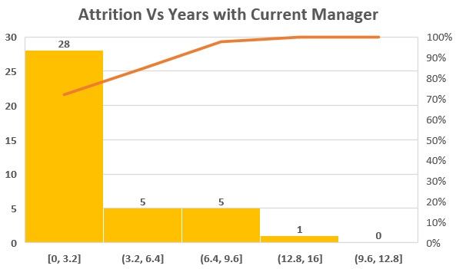
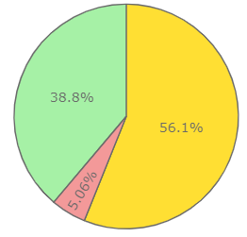

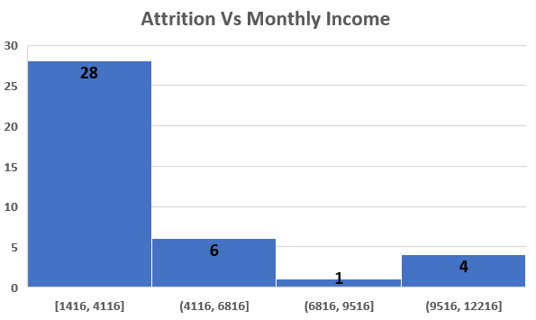
1 – Low
2 – Medium
3 – High
4 – Very High
Attrition Vs JobInvolvement
KEY INSIGHTS
Single employees
Employees with more Business Travels
Attrition is high amongst Sales Representatives followed by Laboratory Technicians
Educational background - Life sciences and Medical constitute 64%
Most attrition occurs in initial years (0-2)
Employees with less tenure with current manager (0-2) years are leaving early
Employees with High work load are quitting
Income wages is directly proportional to high attrition rates
Research & Dev is losing large no. of emp
Attrition Vs Department

Slide 24
Employees with frequent Business Travels are more likely to leave than non-travel employees
Better incentives and perks can be offered to employees who travel to prevent attrition in this section
Employees with Life Sciences & Medical educational background are more likely to leave than Marketing and Human Resources
Relevant trainings can be arranged for career and personal development
Single employees are more likely to leave than married employees
Offering extra curricular activities and training can help retain talented employees in this category, efforts should be made to clearly articulate the long-term vision of the company and young employees fit in that vision, as well as provide incentives in the form of clear paths to promotion
Employees from Research and Dev & Sales department have more probability of attrition
Department wise employee engagement & team building activities can be organized
Employees working as Laboratory Technician & Sales representatives are most likely candidates for attrition
Offering opportunities for career advancement and internal mobility options can help curb churn here
insights & Tactical retention strategy

Slide 25
Employees working as Laboratory Technician & Sales representatives are most likely candidates for attrition
Offering opportunities for career advancement and internal mobility options can help curb churn here
Years at Company and Years Since Last Promotion
Employees who hit their two-year anniversary should be identified as potentially having a higher-risk of leaving
Years with Current Manager
By using Line Manager details for each employee, one can determine which Manager has experienced the largest numbers of employees resigning over the past year and corrective action can be taken accordingly in terms of trainings, mentorship for new joins etc.
Over Time
People who work overtime are more likely to leave the company. Hence efforts must be taken to appropriately scope projects upfront with adequate support and manpower so as to reduce the use of overtime.
The HR can draw up a plan to address each risk category based on the key indicators discussed above to avoid attrition, addressing the high risk employees bucket first:
Low-risk for employees with label < 0.6
Medium-risk for employees with label between 0.6 and 0.8
High-risk for employees with label > 0.8
insights & Tactical retention strategy

Slide 26



Recommendations:
Availability of larger real time datasets will give better predictions that are closer to real time attrition
The below data can be collected for good insights
Rewards and recognitions,
Internal mobility,
Niche skills,
Market Demand,
Talent pool,
Compa Ratio
Better & relevant data collection of new joiners and recent leavers during entry/exit interviews which can be used to iterate, re-train and improve the models
Interactive drill down dashboards can be implemented for insights
Challenges & recommendations
Challenges:
Sourcing data set
Dealing with highly imbalanced dataset
Unavailability of real time continuous data collected over a period of at least one year

Slide 27


Deployment & scalability
To achieve higher scalability and performance, the deployment of the trained model can be done using docker (containerization platform) which packages an application & all its dependencies into a container. Docker is used when you have a lot of services which work in an isolated manner.
Running Docker on AWS provides developers and admins a highly reliable, low-cost way to build, ship, and run distributed applications at any scale.
Depending on the load, the instances can be spun off on-demand basis of the rules set up.

Slide 28
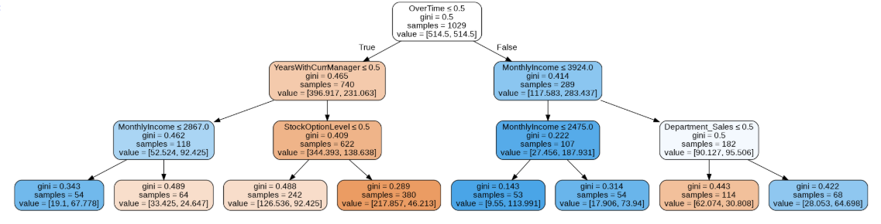
Trends - Attrition
Probability of Attrition | Emp no | % Hike | Performance | Last Promo | OverTime | MonthlyIncome | Years with Mgr | Job Role | Env Satisfaction | TotalWorkingYears | StockOption |  | Corrective Actions
High | 959 | 13 | 3 | 0 | Yes | 2121 | 0 | Laboratory Technician | 2 | 1 | 0 |  | Opt for more stock options Options for Internal Job Mobility
High | 1180 | 13 | 3 | 0 | Yes | 4422 | 0 | Laboratory Technician | 1 | 16 | 1 |  | Training & Career Dev plan Team building activities
High | 1489 | 23 | 4 | 10 | Yes | 4599 | 0 | Sales Executive | 4 | 16 | 1 |  | Promotion
High | 214 | 20 | 4 | 0 | Yes | 3346 | 0 | Laboratory Technician | 3 | 9 | 1 |  | Salary Correction
High | 454 | 11 | 3 | 0 | Yes | 2119 | 0 | Laboratory Technician | 1 | 7 | 3 |  | Training & Career Dev plan Team building activities
High | 72 | 19 | 3 | 0 | Yes | 4157 | 0 | Laboratory Technician | 1 | 5 | 0 |  | Training & Career Dev plan Team building activities
High OverTime with less Monthly Income
High OverTime with less tenure with Current manager
Classes will be High Risk, Medium Risk and Low Risk

