Slide 1


Accelerate Your Release Cadence with
Playwright
High Level Design
Playwright BDD Cucumber framework — Gherkin authoring, Page Object Model, branded reports, and optional AI failure triage for core banking.
Innovatz Global · Stakeholder briefing · 2026

Slide 2
Executive summary
What it is
Reusable UI automation: Gherkin (plain English) + Playwright browsers + branded reports and optional AI triage.
What we test
Core banking at corebanking.testingprofessor.net — staff login, customer lifecycle, and deposits.
Why it matters
Faster regression feedback, living documentation, audit-ready evidence, and CI against the real AUT.
Innovatz Global · High Level Design · Confidential

Slide 3
Business outcomes
Outcome | Framework support
Readable tests | Gherkin + business classes
Maintainable automation | POM + PlaywrightActions
Faster failure analysis | Extent, custom HTML, optional LLM
Audit / demo evidence | Screenshots, video, traces
CI confidence | GitHub Actions / Jenkins / Docker / BrowserStack
Innovatz Global · High Level Design · Confidential

Slide 4
Architecture at a glance
Feature
Step
Business
Page
Actions
Gherkin scenarios
→
Thin Cucumber glue
→
Flow orchestration
→
Locators & UI
→
Playwright APIs
Optional SelfHeal retries failed locators (cache → heuristics → LLM).
Stack: Cucumber runner · Playwright 1.62 · TypeScript · Allure + Extent + Dashboard · GitHub Actions
Innovatz Global · High Level Design · Confidential

Slide 5

HLD diagrams
System context through LLM routing — captured from the High Level Design
6 architecture views

Slide 6
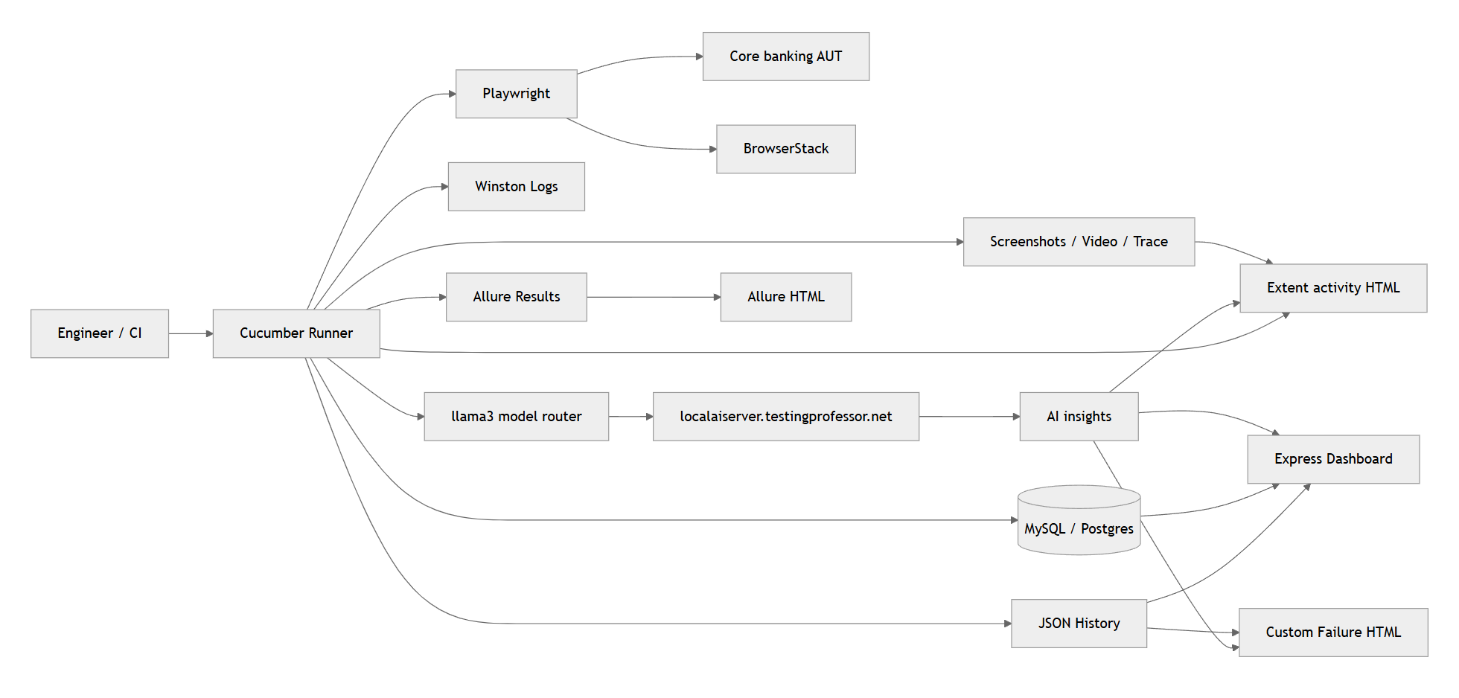
System context
Innovatz Global · High Level Design · Confidential

Slide 7
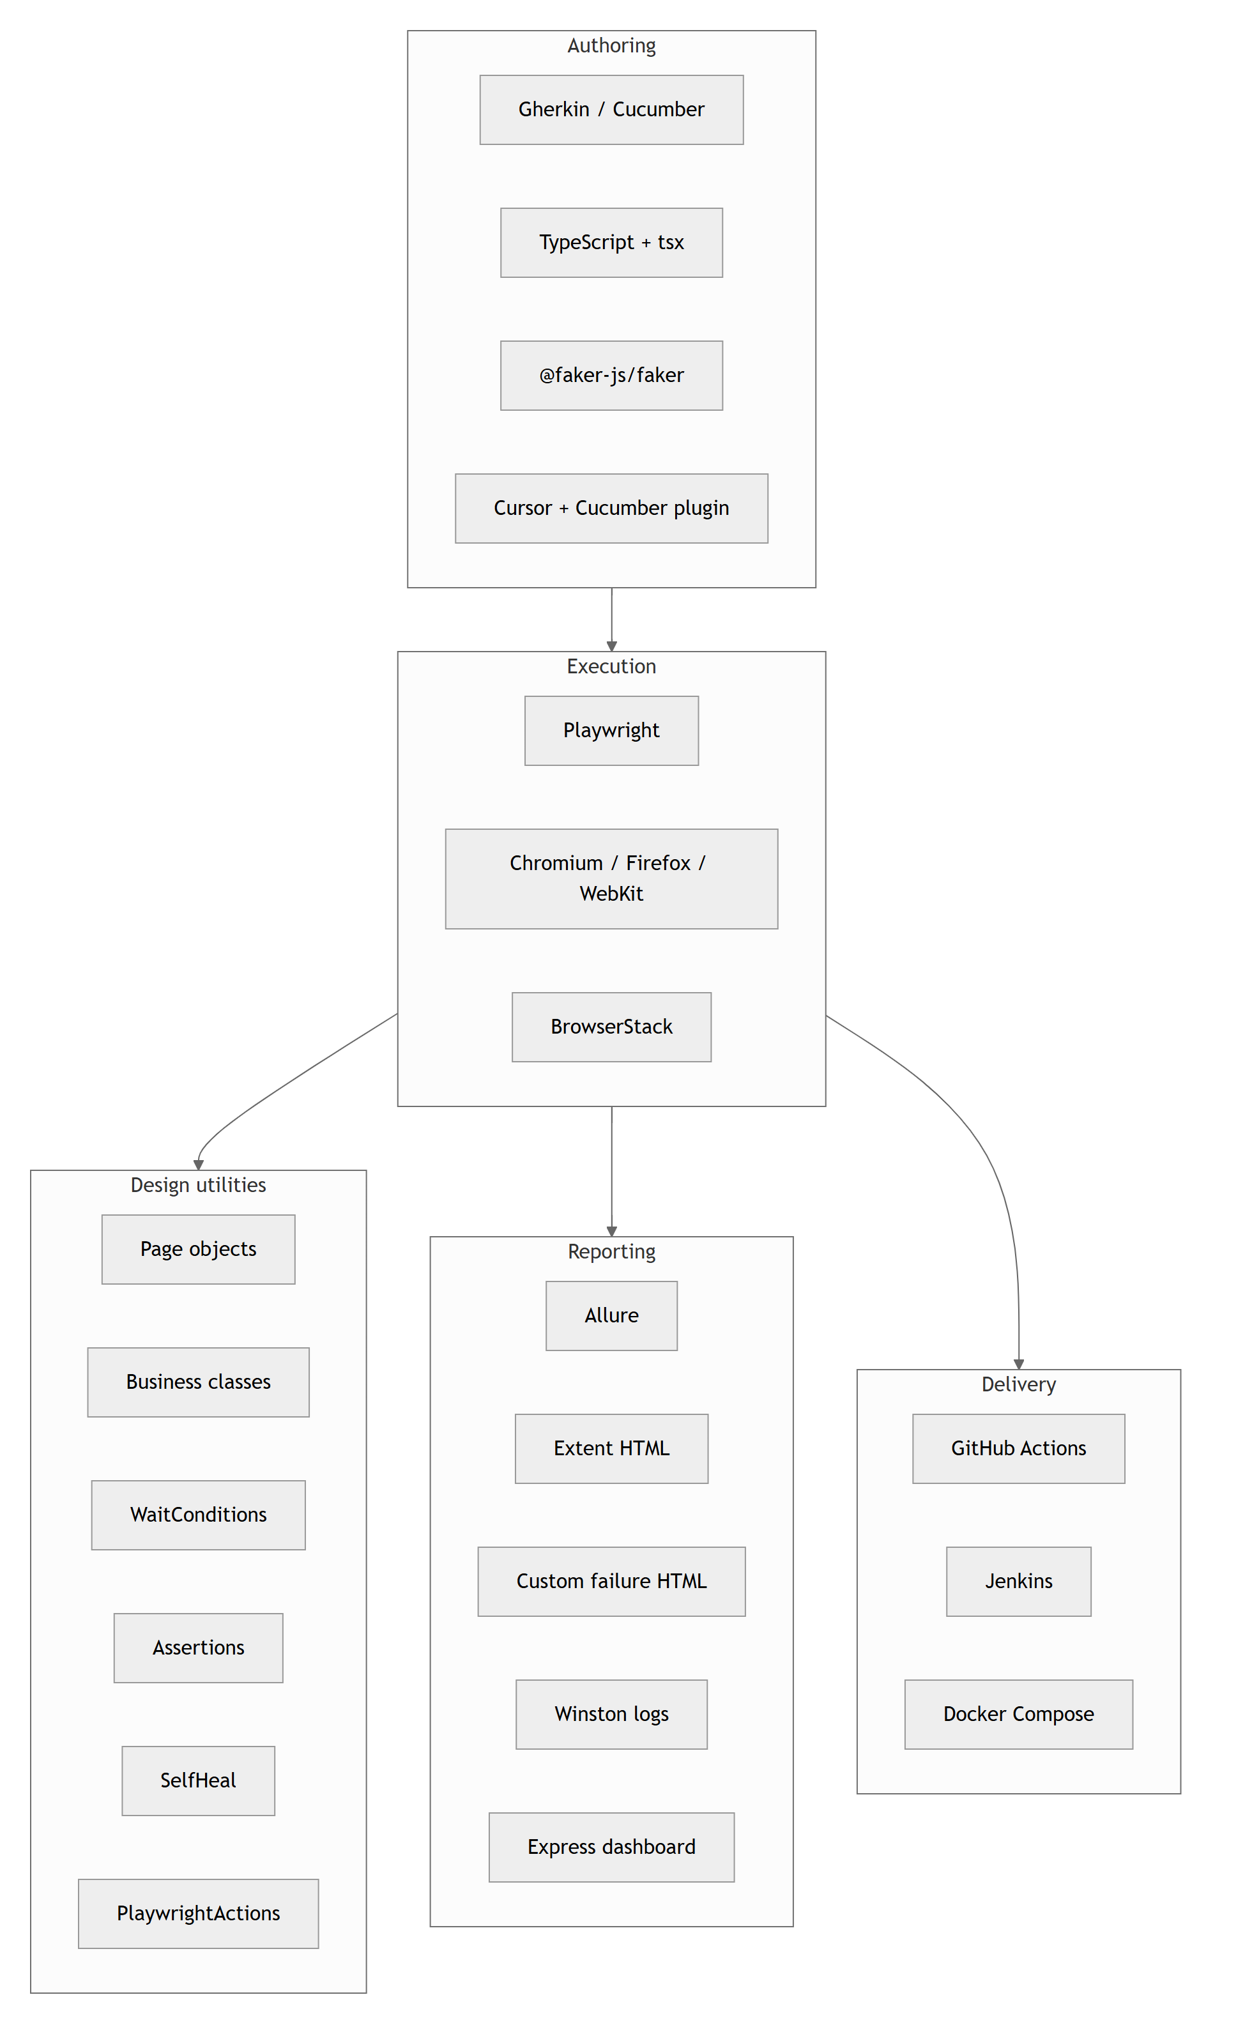
Automation testing tools
Innovatz Global · High Level Design · Confidential

Slide 8
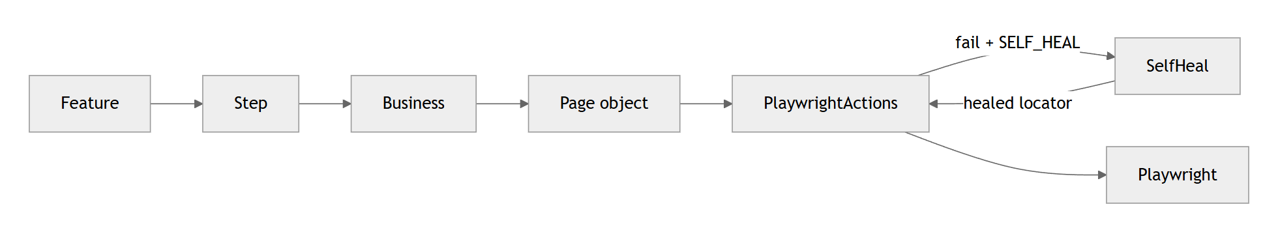
Call chain
Innovatz Global · High Level Design · Confidential

Slide 9
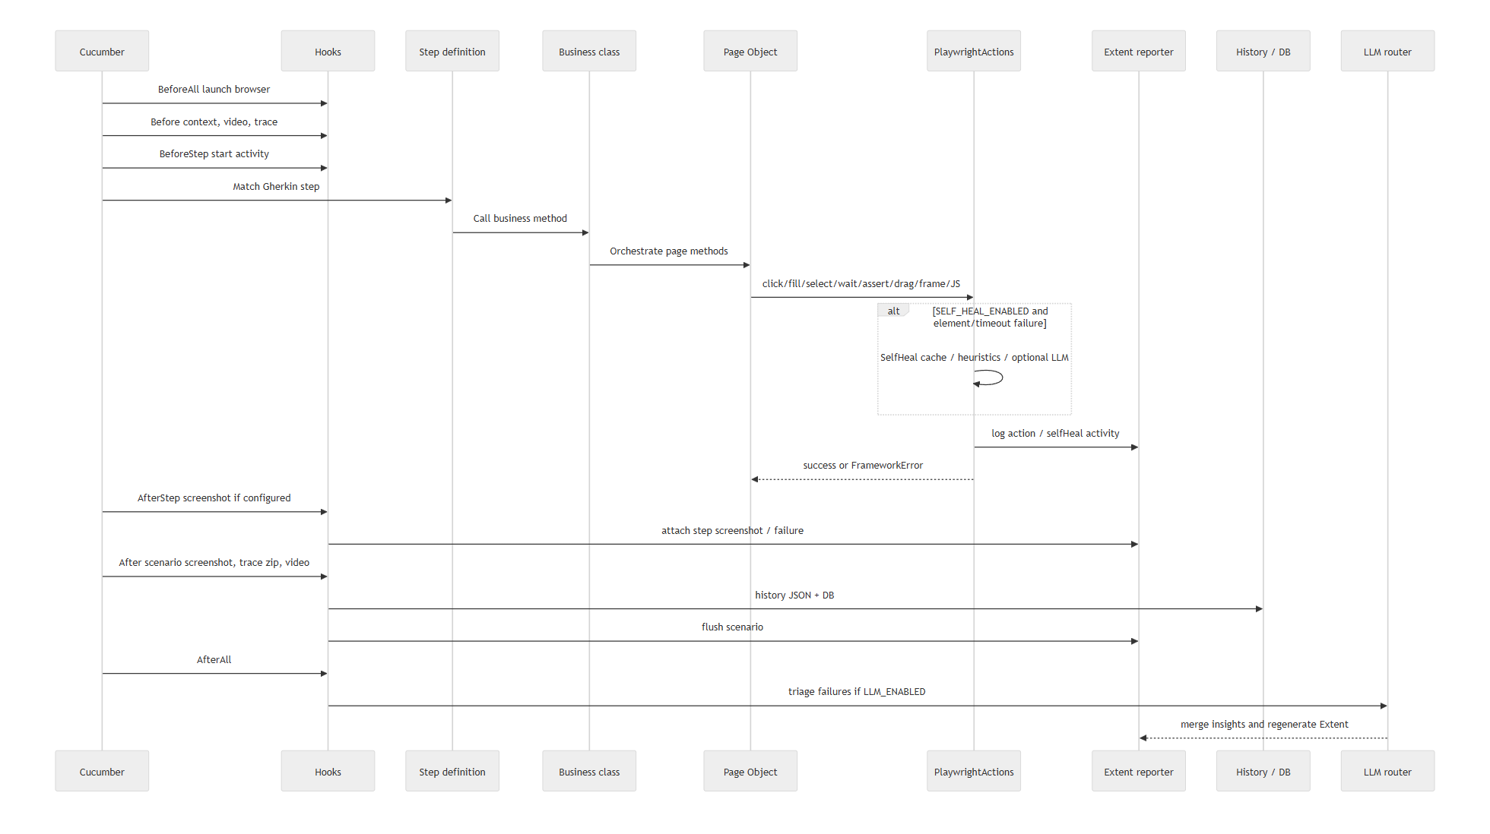
Execution flow
Innovatz Global · High Level Design · Confidential

Slide 10
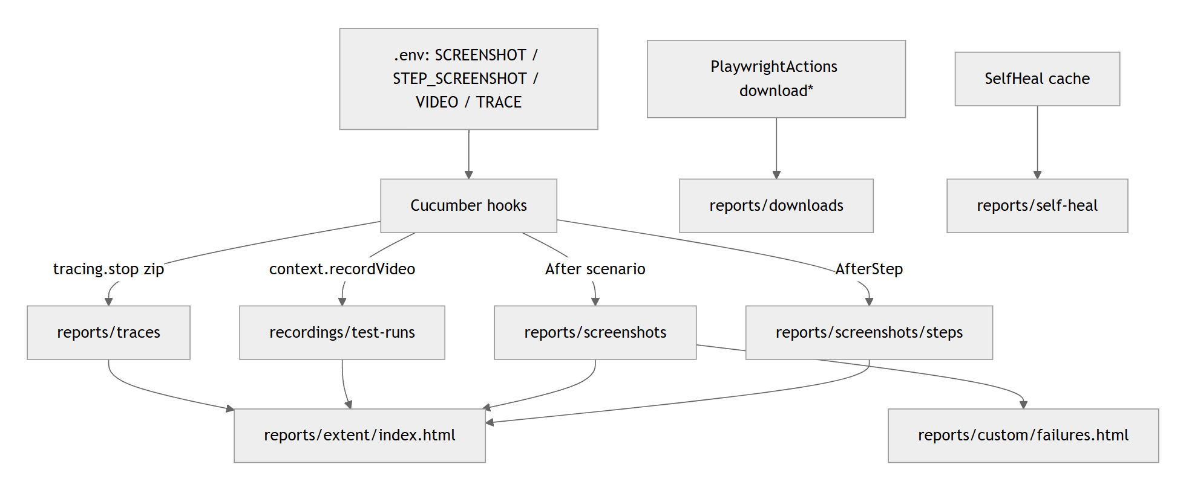
Artifact capture
Innovatz Global · High Level Design · Confidential

Slide 11
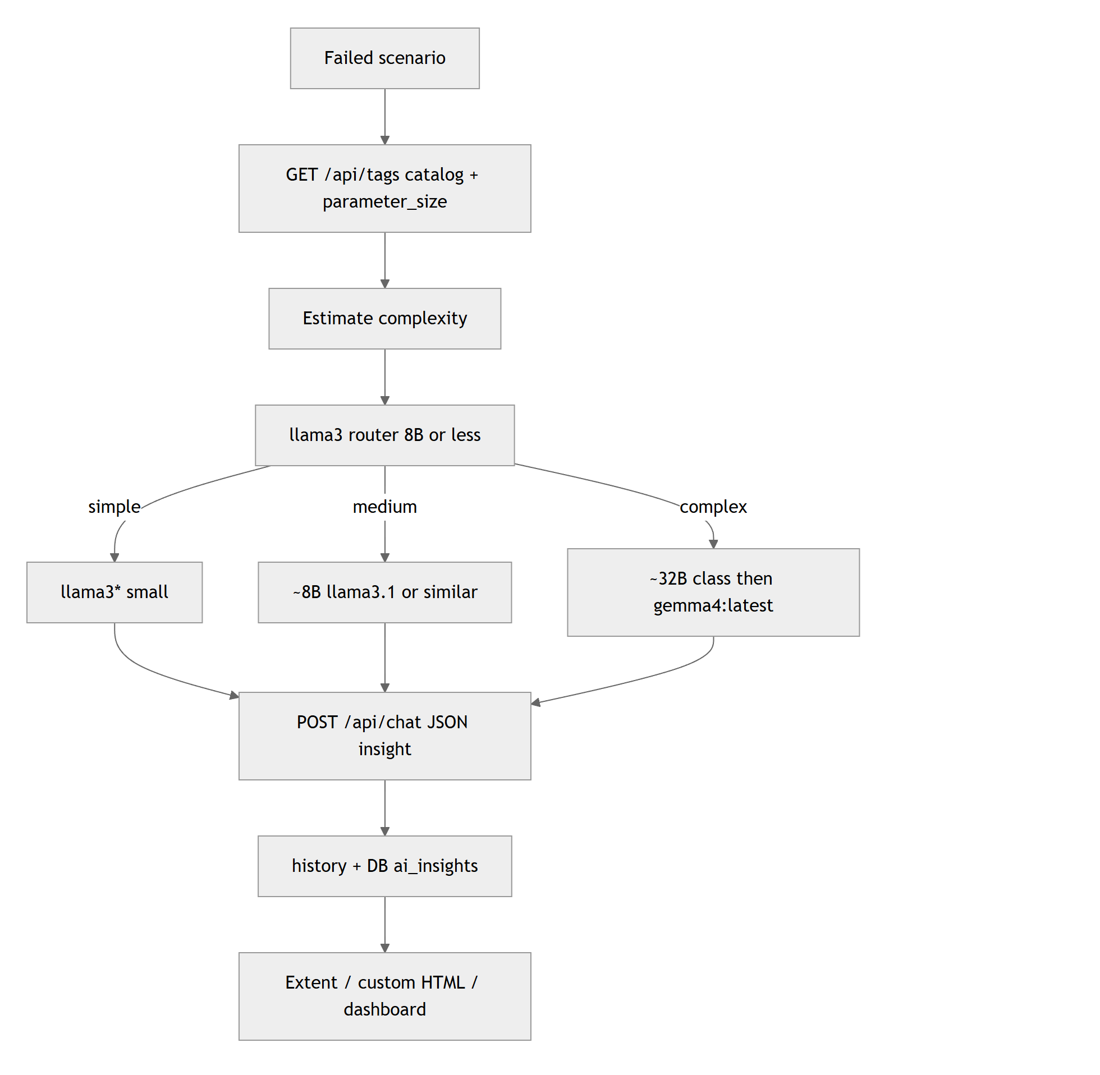
LLM triage and model routing
Innovatz Global · High Level Design · Confidential

Slide 12
Current automation scope
Login
Customers
Customer portal
Quality tags
Staff sign-in
Encrypted secrets
CI credentials
Add / search
Open accounts
Data-driven examples
Continue as user
Deposits
E2E tags
@smoke
@positive / @negative
@datadriven / @e2e
Innovatz Global · High Level Design · Confidential

Slide 13
Evidence & reporting
Channel | Audience
Extent activity HTML (branded) | Step + action log, video, traces
Custom failures.html (branded) | Root-cause review
Historical dashboard (branded) | Leads / trends / flaky / AI
Allure | QA / CI standard report
Screenshots · Video · Trace | Debug and demo evidence
Innovatz Global · High Level Design · Confidential

Slide 14
Delivery & CI secrets
Pipeline: GitHub Actions · Chromium / Firefox / WebKit · real AUT · LLM off in CI
Secret | Required | Purpose
APP_USERNAME | Yes | Core banking login user
APP_PASSWORD | Yes | Password or enc.v1… ciphertext
APP_ENCRYPTION_KEY | If encrypted | Decrypts APP_PASSWORD
BROWSERSTACK_* | Optional | BrowserStack job only
CI fails before tests if APP_USERNAME or APP_PASSWORD is missing. Never commit secrets.
Innovatz Global · High Level Design · Confidential

Slide 15
Next steps
Review the HLD diagrams with architecture and delivery owners
Confirm CI secrets: APP_USERNAME, APP_PASSWORD (+ APP_ENCRYPTION_KEY if needed)
Prioritize the next feature areas with the business team
Join us in revolutionizing your testing strategy with AI-driven insights

