Slide 1
Performing post request
Rest Assured Library

Slide 2
REST-Assured Pattern
Given
Specify Prerequisites
When
Describe the action to take
Then
Describe the expected result

Slide 3
Rest Assured Syntax
RestAssured.given()
.auth()
.basic(“username”, “password”)
.when()
.body(“request-payload”)
.post(“<endpoint-url>”)
.then()
.assertThat()
.statusCode(200);

Slide 4
Explanation of the "Given-When-Then" structure:
statusCode(200): Verifies that the HTTP status code of the response is 200 (OK
given(): This section is used to define the preconditions of the request.
auth().basic("username", "password"): Adds basic authentication to the request.
when(): This section defines the action to be performed.
body(“request-payload): Specify the request body that will be sent with an HTTP request, typically for methods like POST, PUT, or PATCH
post(“/<endpoint-url>"): Specifies the HTTP GET method and the path of the resource to be fetched.
then(): This section defines the assertions to be made on the response.
statusCode(201): Verifies that the HTTP status code of the response is 201 (Created).

Slide 5
API Request
Authorization
Path Parameter (Optional)
Accept Header (Optional)
Request Body

Slide 6
Post: Create A new Record
URL | https://dev214352.service-now.com/api/now/table/{tableName}
HTTP Method | GET
Path Parameter | tableName=incident
Header | ACCEPT: application/json
Authentication | username=admin, password=dLS9Qgs=V!0n
Request Body | { “description”: “Create a new record using POST method, “short_description”: “RESTAPISEP2025” }

Slide 7
API Response
HTTP Status Code
HTTP Status Name
Header
Response Body

Slide 8
Post: Create A new Record
HTTP Status Code | 201
HTTP Status Name | Created
Header | Content-Type: application/json
Response Body | Sends a newly created record in the incident table in a JSON format, with same value as mentioned in the request payload.

Slide 9
RestAssured.given()
// To define the base Uniform Resource Identifier (URI)
.baseUri("https://dev214352.service-now.com")
// To define a common path segment that will be prepended to the path of all subsequent requests
.basePath("/api/now/table")
// Request header for specifying the type of content that can be accepted in a response
.header("Accept", "application/json")
// To set the Path parameter which mentioned in the path of the endpoint
.pathParam("tableName", " incident")
.when()
// The request body that will be sent with an HTTP request, typically for methods like POST, PUT, or PATCH
.body(“””
{
“description”: “Create a new record using POST method,
“short_description”: “RESTAPISEP2025”
}
”””)
// Endpoint for fetching all incident records
.post("/{tableName}")
.then()
.assertThat()
// Assert response status code
. statusCode(Matchers.equalTo(201))
.statusLine(Matchers.containsString(“Created”)); // Assert response status name

Slide 10
Hamcrest Matches
statusCode(Matchers.equalTo(201))
Creates a matcher that matches when the examined object is logically equal to the specified operand, as determined by calling the Object.equals(java.lang.Object) method on the examined object.
statusCode(Matchers.equalTo(201)) == statusCode(201)
statusLine(Matchers.containsString(“Created”))
Validate the entire HTTP status line of a response. The status line comprises three parts: the HTTP protocol, the status code, and the status message. For example, a successful response often has a status line like "HTTP/1.1 201 Created".
containsString(“Created”) matcher used to assert that a given string contains a specified substring.

Slide 11
Request Payload
String
File
Object

Slide 12
Send Post request with Request Body as String
Rest Assured Library

Slide 13
Given
Specify Prerequisites
…
header
body
Send Post request with Request Body as a String
get method
…

Slide 14
API Request
Authorization
Path Parameter (Optional)
Accept Header (Optional)
Body as String
POST Method

Slide 15
RestAssured.given()
// To define the base Uniform Resource Identifier (URI)
.baseUri("https://dev214352.service-now.com")
// To define a common path segment that will be prepended to the path of all subsequent requests
.basePath("/api/now/table")
// Request header for specifying the type of content that can be accepted in a response
.header("Accept", "application/json")
// To set the Path parameter which mentioned in the path of the endpoint
.pathParam("tableName", " incident")
.when()
// The request body that will be sent with an HTTP request, typically for methods like POST, PUT, or PATCH
.body(“””
{
“description”: “Create a new record using POST method,
“short_description”: “RESTAPISEP2025”
}
”””)
// Endpoint for fetching all incident records
.post("/{tableName}")
.then().assertThat()
// Assert response status code
. statusCode(Matchers.equalTo(201))
.statusLine(Matchers.containsString(“Created”)); // Assert response status name

Slide 16
API Response
HTTP Status Code
HTTP Status Name
Header
Response Body

Slide 17
Hamcrest Matches
body(“result.short_description”, Matchers.equalTo(“expected-value”))
Creates a matcher that matches when the examined object is logically equal to the specified operand, as determined by calling the Object.equals(java.lang.Object) method on the examined object.
Validate the short_description key actual value should match exactly against the expected value.

Slide 18
Send Post request with Request Body as File
Rest Assured Library

Slide 19
Given
Specify Prerequisites
…
header
body
Send Post request with Request Body as a File
get method
…

Slide 20
API Request
Authorization
Path Parameter (Optional)
Accept Header (Optional)
Body as File (Store the request body JSON in the File and send location of the same in the body method.)
POST method

Slide 21
RestAssured.given()
// To define the base Uniform Resource Identifier (URI)
.baseUri("https://dev214352.service-now.com")
// To define a common path segment that will be prepended to the path of all subsequent requests
.basePath("/api/now/table")
// Request header for specifying the type of content that can be accepted in a response
.header("Accept", "application/json")
// To set the Path parameter which mentioned in the path of the endpoint
.pathParam("tableName", " incident")
.when()
// The request body that will be sent with an HTTP request, typically for methods like POST, PUT, or PATCH
.body(new File(“JSON file location”))
// Endpoint for fetching all incident records
.post("/{tableName}")
.then().assertThat()
// Assert response status code
. statusCode(Matchers.equalTo(201))
// Assert response status name
.statusLine(Matchers.containsString(“Created”));
// Assert the response is in the JSON format
.contentType(Matchers.ContainsString(“application/json”));

Slide 22
API Response
HTTP Status Code
HTTP Status Name
Header
Response Body

Slide 23
Hamcrest Matches
contentType(Matchers.ContainsString(“application/json”));
containsString(“Created”) matcher used to assert that a given string contains a specified substring.
Validate the Content-Type header contains the substring “application/json” with in the “application/json;charset=UTF-8” string.

Slide 24
Send Post request with Request Body as POJO Object
Rest Assured Library

Slide 25
Given
Specify Prerequisites
…
header
body
Send Post request with Request Body as a POJO Object
get method
…

Slide 26
What is pojo?
A POJO (Plain Old Java Object) class in Java is a simple, standard Java class that represents a data structure.
It's designed to hold data and typically includes methods to access and modify that data.
The term "Plain Old Java Object" emphasizes that it's a basic Java object without special restrictions or dependencies on specific frameworks or APIs.
Key characteristics of a POJO class:
Encapsulation
Getters and Setters
Constructors
No Special Dependencies
Focus on Data

Slide 27
What is Serialization?
Serialization is the process of converting an object into a compact, portable format like a stream of bytes, JSON, or XML for storage or transmission.
These complementary processes enable data to be saved to a disk, sent across a network, or exchanged between applications, making complex data structures manageable for persistence and inter-process communication.

Slide 28
Steps to Create a POJO Class in Java
Serialization

Slide 29
Step 1) Define the Class Structure:
Create a public class with a meaningful name that reflects the data it will hold
(e.g., Employee, Product, User).
public class Employee {
// Class members will be defined here
}

Slide 30
Step 2) Declare Private Fields (Attributes):
Declare instance variables (fields) within the class to represent the data attributes. These fields should be declared as private to enforce encapsulation, meaning they can only be accessed or modified through methods defined within the class.
public class Employee {
private String firstName;
private String lastName;
private int age;
private double salary;
}

Slide 31
Step 3) Create a Public No-Argument Constructor:
Provide a public no-argument (default) constructor. This is often required by frameworks for object instantiation. If you define other constructors, you must explicitly define this one as well.
public class Employee {
private String firstName;
private String lastName;
private int age;
private double salary;
public Employee() {
// Default constructor
}
}

Slide 32
Step 4) Implement Public Getter and Setter Methods:
For each private field, create public "getter" methods (e.g., getFirstName()) to retrieve the value of the field, and public "setter" methods (e.g., setFirstName(String firstName)) to modify its value. These methods provide controlled access to the encapsulated data.
public String getFirstName() {
return firstName;
}
public void setFirstName(String firstName) {
this.firstName = firstName;
}

Slide 33
public class IncidentPojo {
private String description;
private String short_description;
// Default constructor
public IncidentPojo() {}
// Parameterized constructor
public InicdentPojo(String description, String short_description) {
this.description = description;
this.short_description = short_description;
}
// Setter methods
public void setDescription(String description) {
this.description = description;
}
public void setShort_description(String description) {
this.short_description = short_description;
}
// Getter methods
public String setDescription(String description) {
return description;
}
public String setShort_description(String description) {
return short_description;
}
}

Slide 34
API Request
Authorization
Path Parameter (Optional)
Accept Header (Optional)
Body as Object (Use the POJO class to create the JSON object)
POST method

Slide 35
RestAssured.given()
// To define the base Uniform Resource Identifier (URI)
.baseUri("https://dev214352.service-now.com")
// To define a common path segment that will be prepended to the path of all subsequent requests
.basePath("/api/now/table")
// Request header for specifying the type of content that can be accepted in a response
.header("Accept", "application/json")
// To set the Path parameter which mentioned in the path of the endpoint
.pathParam("tableName", " incident")
.when()
// The request body that will be sent with an HTTP request, typically for methods like POST, PUT, or PATCH
.body(pojo-class-object)
// Endpoint for fetching all incident records
.post("/{tableName}")
.then().assertThat()
// Assert response status code
.statusCode(Matchers.equalTo(201))
// Assert response status name
.statusLine(Matchers.containsString(“Created”));
// Assert response time should be less than
.time(Matchers.lessThan(5000L))

Slide 36
API Response
HTTP Status Code
HTTP Status Name
Header
Response Body

Slide 37
Hamcrest Matches
time(Matchers.lessThan(5000L));
to retrieve and assert the response time of an API request.
Validate the response time of the create a new record should be less than 5000 ms. If exceeds the test case will failed

Slide 38
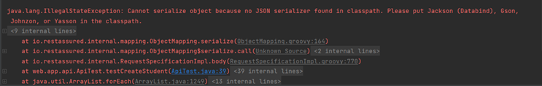

Slide 39
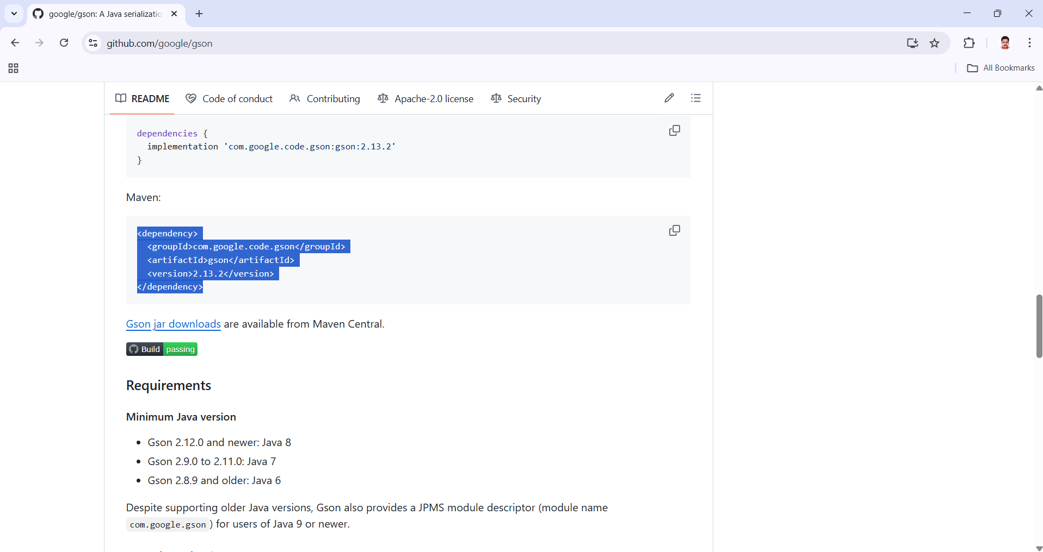
https://github.com/google/gson

Slide 40
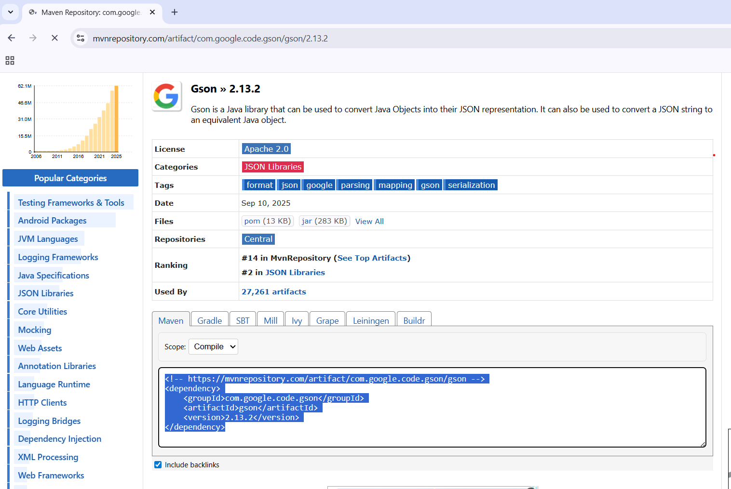
https://mvnrepository.com/artifact/com.google.code.gson/gson/2.13.2

Slide 41
Pom.xml
. . .
<dependencies>
. . .
<dependency> <groupId>com.google.code.gson</groupId> <artifactId>gson</artifactId> <version>2.13.2</version> </dependency> </dependencies>
. . .

Slide 42
Steps to Generate a POJO Class using jsonschema2pojo-maven-plugin
Serialization

Slide 43
jsonschema2pojo-maven-plugin
The jsonschema2pojo-maven-plugin is a Maven plugin designed to generate Plain Old Java Objects (POJOs) from JSON schema files.
The jsonschema2pojo-maven-plugin is a Maven plugin designed to generate Plain Old Java Objects (POJOs) from JSON schema files.
This plugin automates the creation of Java classes that correspond to the structure defined in your JSON schemas, saving development time and reducing the potential for manual errors in data model creation.

Slide 44
Pom.xml
<groupId>org.jsonschema2pojo</groupId>
<artifactId>jsonschema2pojo-maven-plugin</artifactId>
<version>1.2.2</version>

Slide 45
jsonschema2pojo-maven-plugin
The jsonschema2pojo-maven-plugin is a Maven plugin designed to generate Plain Old Java Objects (POJOs) from JSON schema files.
The jsonschema2pojo-maven-plugin is a Maven plugin designed to generate Plain Old Java Objects (POJOs) from JSON schema files.
This plugin automates the creation of Java classes that correspond to the structure defined in your JSON schemas, saving development time and reducing the potential for manual errors in data model creation.

Slide 46
Key features and usage
The jsonschema2pojo-maven-plugin is a Maven plugin designed to generate Plain Old Java Objects (POJOs) from JSON schema files.
Automatic POJO Generation: The core function is to take JSON schema files as input and automatically generate corresponding Java classes. These classes represent the data structure described by the schema, including fields, types, and potentially nested objects or lists.
Maven Integration: As a Maven plugin, it integrates seamlessly into your project's build lifecycle. You add the plugin configuration to your pom.xml file, and the generation process can be triggered during a Maven build phase, typically generate-sources.

Slide 47
Pom.xml
<build>
<plugins>
<plugin>
<groupId>org.jsonschema2pojo</groupId>
<artifactId>jsonschema2pojo-maven-plugin</artifactId>
<version>1.2.2</version>
<plugin>
<plugins>
<build>

Slide 48
Pom.xml
<configuration>
<sourceType>json</sourceType>
<sourceDirectory>${basedir}/src/main/resources/json</sourceDirectory>
<targetPackage>com.example.pojos</targetPackage>
<outputDirectory>${basedir}/src/main/java</outputDirectory>
<annotationStyle>none</annotationStyle>
<includeHashcodeAndEquals>false</includeHashcodeAndEquals>
<includeToString>false</includeToString>
</configuration>

Slide 49
Configuration Options
The jsonschema2pojo-maven-plugin is a Maven plugin designed to generate Plain Old Java Objects (POJOs) from JSON schema files.
The plugin offers various configuration options to customize the generated POJOs. These include:
sourceType: Indicates the type of source document (e.g., jsonschema, json, yamlschema, yaml).
sourceDirectory: Specifies the directory containing your JSON schema files.
outputDirectory: Specifies the target directory where the generated Java source files will be placed
targetPackage: Defines the Java package where the generated classes will reside.
annotationStyle: Allows choosing the annotation style for generated classes (e.g., jackson, gson, none).

Slide 50
Pom.xml
<executions>
<execution>
<goals>
<goal>generate</goal>
</goals>
</execution>
</executions>

