Slide 1


Team Details
  Team name: testofschool
  Team leader name: Jung Min Kang
  Problem Statement: People who pay per generation for AI video only learn a clip is unusable after they have paid for it.
Notes:
Content canon: Felix-supplied CODEX_ONESHOT_preflight_final_v5, Track B row(s) 1.
Canonical local copy: reports/final_v6/CODEX_ONESHOT_preflight_final_v5.md. Wording shortened only within the authorized table facts.

Slide 2
Brief about the idea
Preflight: check an AI-video prompt before you pay
"you still burn credits on the failed attempt"
Trustpilot, Runway review, Sept 2026
"Only one of the generations was usable for my purposes"
Trustpilot, Sept 2026
"I'm tired of wasting valuable credits on bad footage, I simply can't use"
Adobe Community
"I recommend a lo-res preview render before having to spend actual credits"
Adobe Community
In a 2024 public benchmark (GenAI-Bench), 21% of 1,911 human pairwise votes rejected both videos.
Notes:
Content canon: Felix-supplied CODEX_ONESHOT_preflight_final_v5, Track B row(s) 2.
Canonical local copy: reports/final_v6/CODEX_ONESHOT_preflight_final_v5.md. Wording shortened only within the authorized table facts.
Known quote link (first quote), reproduced from README: https://www.trustpilot.com/reviews/6a9f952dc2a80e997c67354a
Known quote link (preview request), reproduced from README: https://community.adobe.com/questions-404/wasted-generative-credits-on-bad-results-1479378
Other quote source labels: Trustpilot, Sept 2026; Adobe Community, as supplied in v5. No missing individual quote URL was invented.
Dataset link, reproduced from README: https://huggingface.co/datasets/TIGER-Lab/GenAI-Bench

Slide 3
Opportunities
Refunds cover generation errors, not finished clips that are unusable.
Nothing sits before "pay".
Who pays today
Per-generation buyers. Runway TrustScore 1.1/5 from 340 reviews (Sept 2026). Adobe feature request: "I lose too many credits doing trial and error" (219 votes).
Who would buy a pre-pay step
Studios and agencies running generation pipelines. Generator platforms as an embedded step.
Built by a Seoul producer who ran generative-video pipelines for 2.5 years. Tested by a teammate in India.
Business model: free risk check; paid API per check for studios, agencies and generator platforms.
No revenue or market-size figure is claimed.
Notes:
Content canon: Felix-supplied CODEX_ONESHOT_preflight_final_v5, Track B row(s) 3 and 8.
Canonical local copy: reports/final_v6/CODEX_ONESHOT_preflight_final_v5.md. Wording shortened only within the authorized table facts.
Refund-policy link, reproduced from README: https://help.runwayml.com/hc/en-us/articles/34266159290003-Can-I-have-credits-refunded
Runway review counts, Adobe feature-request votes, buyer hypotheses and producer history are the supplied v5 facts; no separate URL for an unspecified review/feature-request page was invented.

Slide 4
List of features offered by the solution
Preflight: three rungs before you pay
Risk check (free)
Failure-risk estimate from 1,911 human votes, with the nearest historical prompts as evidence.
Gemini rewrite
Kept only if the estimated risk drops.
A still before a $3.20 Veo attempt
Veo 3.1, 8 s at $0.40/s (Google pricing page).
After generation: upload a clip for a Gemini second look. Its verdict is stored separately as feedback.
Notes:
Content canon: Felix-supplied CODEX_ONESHOT_preflight_final_v5, Track B row(s) 4.
Canonical local copy: reports/final_v6/CODEX_ONESHOT_preflight_final_v5.md. Wording shortened only within the authorized table facts.
Cost source label: Google pricing page, as supplied in v5. No new price estimate or claim was introduced.

Slide 5


Process flow diagram or Use-case diagram
Prompt
Risk check
(free)
Gemini rewrite
(kept only if
risk drops)
Still
preview
Pay &
generate
Clip
second look
Preflight · before "pay"
Saved original still
Saved rewrite still
Notes:
Content canon: Felix-supplied CODEX_ONESHOT_preflight_final_v5, Track B row(s) 3 and 5.
Canonical local copy: reports/final_v6/CODEX_ONESHOT_preflight_final_v5.md. Wording shortened only within the authorized table facts.
Visual evidence: docs/deck_assets/spoon_original.jpg and spoon_rewritten.jpg. Byte-identical saved assets verified in reports/final_v6/track_b_saved_stills.json.

Slide 6
Architecture diagram of the proposed solution
Browser request and Google Cloud services
Browser
Cloud Run
FastAPI
asia-southeast1
Google ADK
rewrite agent
Gemini 3.5 Flash
Vertex AI
Tools
Nearest prompts
IRT difficulty
Cloud Firestore
1,911 votes
IRT parameters
Feedback
Saved stills
Agent Platform
Sessions
Clip review: Gemini video understanding
Still preview: Gemini image model
Notes:
Content canon: Felix-supplied CODEX_ONESHOT_preflight_final_v5, Track B row(s) 6.
Canonical local copy: reports/final_v6/CODEX_ONESHOT_preflight_final_v5.md. Wording shortened only within the authorized table facts.
Architecture facts: supplied v5 row 6; existing README Architecture and Google Cloud services sections.

Slide 7
Technologies to be used in the solution
Cloud Run (FastAPI, asia-southeast1)
Hosts the browser request workflow.
Google ADK + Gemini 3.5 Flash on Vertex AI
Rewrite agent with Agent Platform Sessions. Tools retrieve nearby prompts and IRT difficulty.
Cloud Firestore
Stores 1,911 votes, IRT parameters, feedback and saved stills.
Gemini video understanding + Gemini image model
Clip second look and still preview.
Active for sample prompts (saved stills); live generation limited
Notes:
Content canon: Felix-supplied CODEX_ONESHOT_preflight_final_v5, Track B row(s) 6 and 7.
Canonical local copy: reports/final_v6/CODEX_ONESHOT_preflight_final_v5.md. Wording shortened only within the authorized table facts.
Service facts: supplied v5 rows 6 and 7; current samples wording is reproduced from README.

Slide 8
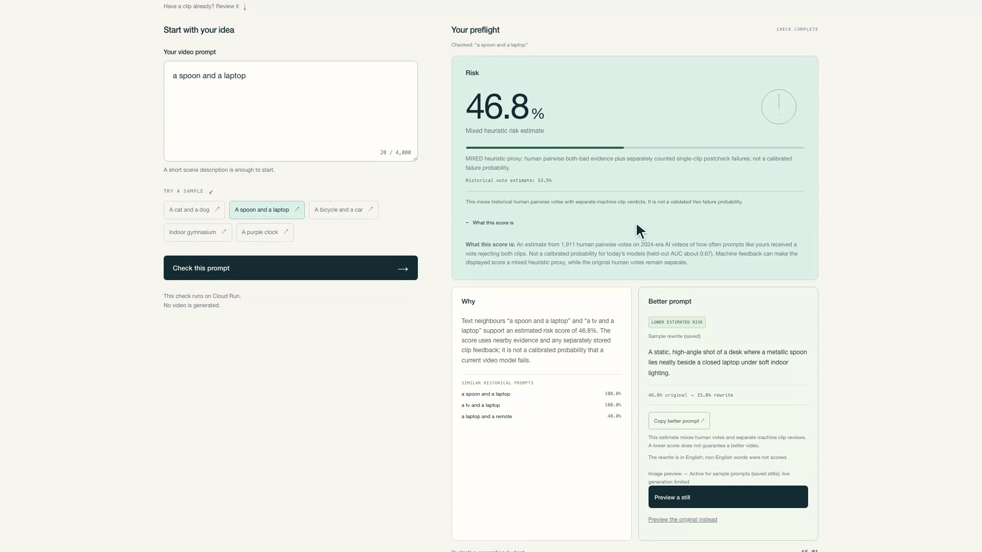
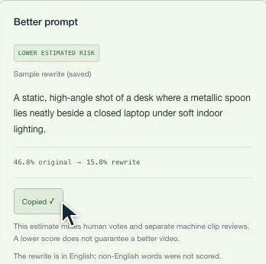
Snapshots of the prototype
a spoon and a laptop: 46.8% → 15.8% estimated risk after the Gemini rewrite.
Risk + why
Better prompt
Saved still
0 model calls
$0.00
A still cannot judge motion, flicker or timing.
Notes:
Content canon: Felix-supplied CODEX_ONESHOT_preflight_final_v5, Track B row(s) 5.
Canonical local copy: reports/final_v6/CODEX_ONESHOT_preflight_final_v5.md. Wording shortened only within the authorized table facts.
Visual evidence: demo/frames/02_risk_and_score_details.png and 04_better_prompt_copied.png, plus frame-05 byte-matched saved still asset docs/deck_assets/spoon_original.jpg.

Slide 9
Prototype Performance report/Benchmarking
What we measured, and the limits
Held-out AUC 0.67
Historical signal, not a calibrated probability for today's models.
Live image generation
60 test calls across three Gemini image models. Best 8/20 under shared capacity.
Judges see saved stills for the 5 samples, labelled "0 model calls · $0.00".
Clip-review accuracy: not measured
Notes:
Content canon: Felix-supplied CODEX_ONESHOT_preflight_final_v5, Track B row(s) 7.
Canonical local copy: reports/final_v6/CODEX_ONESHOT_preflight_final_v5.md. Wording shortened only within the authorized table facts.
All measured figures and claim limits are exactly the supplied v5 row 7. The deck build did not run a new evaluation.

Slide 10
Additional Details/Future Development (if any)
Next
Live stills with dedicated image capacity.
Separate tabs for check and clip review.
Non-English vote data before scoring non-English prompts.
Notes:
Content canon: Felix-supplied CODEX_ONESHOT_preflight_final_v5, Track B row(s) 9.
Canonical local copy: reports/final_v6/CODEX_ONESHOT_preflight_final_v5.md. Wording shortened only within the authorized table facts.

Slide 11
Provide links to your:
GitHub Public Repository
https://github.com/testofschool/preflight
Demo Video Link (3:28)
https://youtu.be/1A8I-9NZ3Kc
Final Product Link
https://preflight-jcgro45veq-as.a.run.app
Notes:
Content canon: docs/submission-notes.md links and the user-supplied pending-upload state.
Canonical local copy: reports/final_v6/CODEX_ONESHOT_preflight_final_v5.md. Wording shortened only within the authorized table facts.
Known links reproduced from docs/submission-notes.md: https://github.com/testofschool/preflight and https://preflight-jcgro45veq-as.a.run.app
Video URL has not been supplied. Pending public upload is displayed. The template-origin 3 Minutes label is a field label, not a measured-duration claim.

