Slide 1


Team Details
  Team name: testofschool
  Team leader name: Jung Min Kang
  Problem Statement: People who pay per generation for AI video only learn a clip is unusable after they have paid for it.
Notes:
Content canon: Felix-supplied CODEX_ONESHOT_preflight_final_v5, Track B row(s) 1.
Canonical local copy: reports/final_v6/CODEX_ONESHOT_preflight_final_v5.md. Wording shortened only within the authorized table facts.

Slide 2

Brief about the idea
You pay first. You find out later.
“you still burn credits on the failed attempt”
Trustpilot, Runway review
“a lo-res preview render before having to spend actual credits”
Adobe Community
2024 GenAI-Bench: 21% of 1,911 human votes rejected both videos. Conceptual photograph.
Notes:
Content canon: user-supplied Preflight final v7 slide map; original organizer section and template resources preserved.
The two user quotes are intentionally shortened only to the exact fragments explicitly supplied in the v7 map.
https://www.trustpilot.com/reviews/6a9f952dc2a80e997c67354a
https://community.adobe.com/questions-404/wasted-generative-credits-on-bad-results-1479378
https://huggingface.co/datasets/TIGER-Lab/GenAI-Bench
GenAI-Bench 2024: 21% of 1,911 human pairwise votes rejected both videos.
Concept photograph generated using built-in image tool; model name not returned: UNREPORTED. It depicts no actual user event or product.

Slide 3
Opportunities
A check belongs before pay.
Refunds cover errors, not unusable finished clips. Runway 1.1/5 (340 reviews). Adobe preview request: 219 votes.
Preflight
Prompt
Pay
Generate
Judge
Re-prompt
Sources: Runway credit-refund policy, Trustpilot, Adobe Community preview request.
Notes:
Content canon: user-supplied Preflight final v7 slide map; original organizer section and template resources preserved.
https://help.runwayml.com/hc/en-us/articles/34266159290003-Can-I-have-credits-refunded
Runway TrustScore 1.1/5, 340 reviews; Adobe preview request 219 votes, per supplied v7 canon. These do not measure Preflight demand or savings.
A check belongs before pay describes the displayed workflow. It intentionally avoids claiming no competing market product exists.

Slide 4
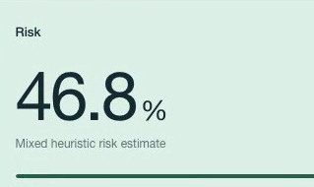
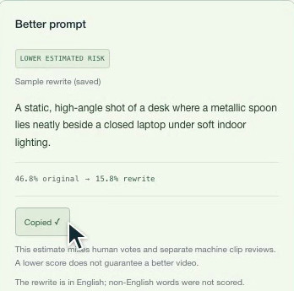

List of features offered by the solution
Three checks before you spend.
Risk from 1,911 human votes
Historical, uncalibrated
Gemini rewrite, kept only if risk drops
A still before a $3.20 video
Motion untested
Sources: demo/frames, saved spoon/laptop still, Google video pricing page.
Notes:
Content canon: user-supplied Preflight final v7 slide map; original organizer section and template resources preserved.
Risk and rewrite are genuine crops from demo/frames/02_risk_and_score_details.png and 04_better_prompt_copied.png. Saved still is a square crop of docs/deck_assets/spoon_original.jpg.
Risk comes from 1,911 human votes plus separately stored feedback, and is a mixed heuristic, not calibrated failure probability.
Gemini rewrite is presented only if estimated risk drops. Still before $3.20 video; price calculation in supplied canon is 8 s at $0.40/s.
Saved still cannot judge motion, flicker or timing; no new image or video model call was made for product evidence.

Slide 5
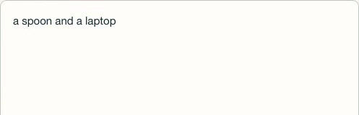
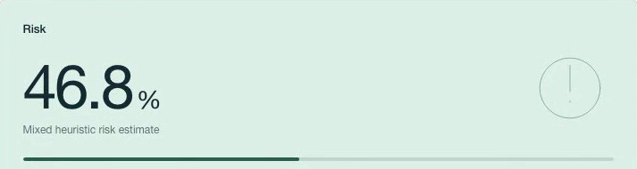





Process flow diagram or Use-case diagram
Paste. Check. Rewrite. Look.
1
Paste
2
Risk + why
3
Better prompt
4
Still / clip review
Source: demo/frames and saved spoon/laptop still.
Notes:
Content canon: user-supplied Preflight final v7 slide map; original organizer section and template resources preserved.
Four product storyboard thumbnails: paste, risk and why, better prompt, saved still and separate clip-review workflow.
Process ordinals 1–4 are explicitly authorized by root from the user-mapped numbered thumbnails; they are structural identifiers, not new measured quantities. Actual source crops remain unmodified apart from cropping and resampling.

Slide 6
Architecture diagram of the proposed solution
One request, a traceable check.
Browser
Cloud Run
FastAPI
Google ADK
Gemini rewrite
Agent Platform
Sessions
Firestore
Nearest prompts
IRT
Source: deployed application architecture and README service inventory.
Notes:
Content canon: user-supplied Preflight final v7 slide map; original organizer section and template resources preserved.
Six-box simplification of deployed README architecture. Browser requests Cloud Run/FastAPI; Google ADK runs Gemini rewrite tools; nearby prompts and IRT support checking; Firestore persists data and feedback; Agent Platform Sessions stores anonymous sessions.
Image and video understanding services appear on the following technology page. This diagram simplifies connections and does not imply those services execute serially.

Slide 7
Technologies to be used in the solution
All on Google Cloud.
Cloud Run
Firestore
Gemini 3.5 Flash
(Vertex AI)
Google ADK
Agent Platform
Sessions
Gemini image +
video understanding
Hosts
Stores
Rewrites
Orchestrates
Remembers
Stills/reviews
Source: README service inventory and deployed workflow.
Notes:
Content canon: user-supplied Preflight final v7 slide map; original organizer section and template resources preserved.
Six technology labels are exactly the supplied v7 map.
Gemini 3.5 Flash is the user-explicit model identifier, not a newly introduced numerical result.
Google Cloud roles reproduced from README; image service remains limited to saved samples and live rewrite remains active.

Slide 8

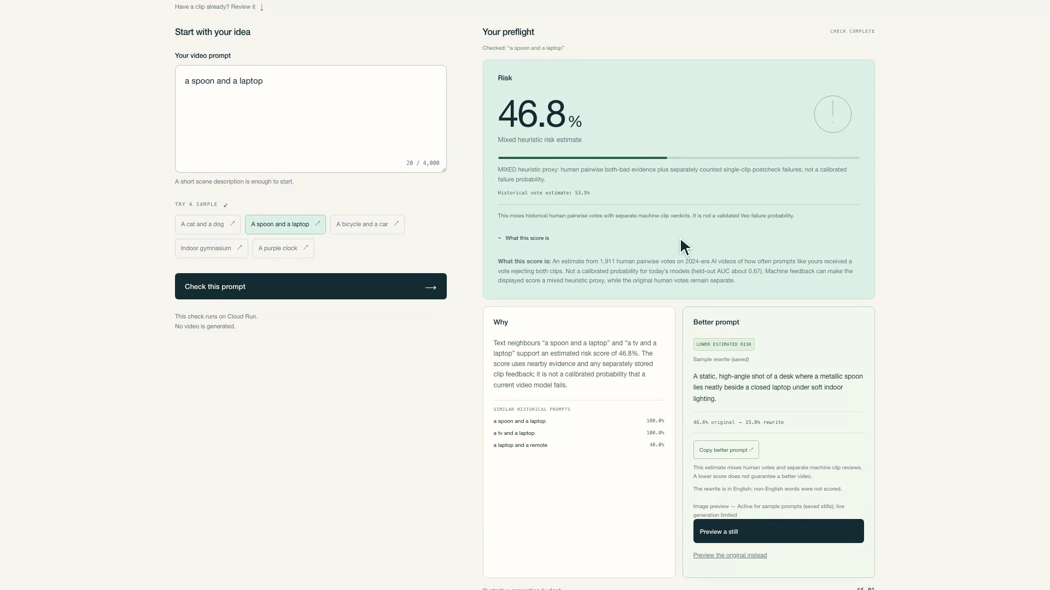
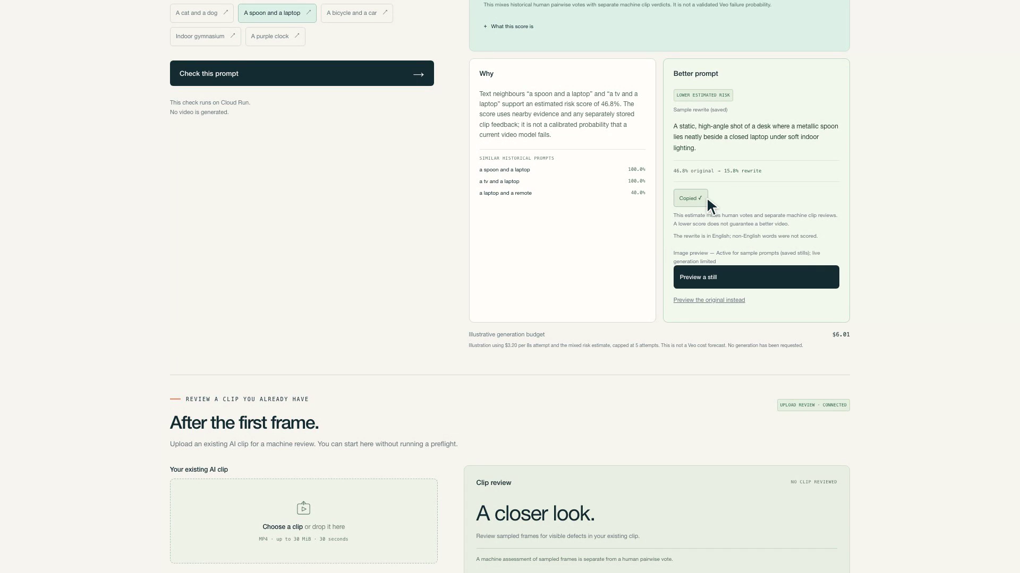
Snapshots of the prototype
See the estimate before the bill.
Original prompt
Rewritten prompt
46.8%
15.8%
Uncalibrated prompt estimates. Scene changed. Saved stills cannot establish video improvement or judge motion.
Sources: saved original and rewritten spoon/laptop outputs.
Notes:
Content canon: user-supplied Preflight final v7 slide map; original organizer section and template resources preserved.
Actual saved original and rewrite spoon/laptop images. Original 46.8%, rewrite 15.8%, mixed estimated risk. No empirical video-quality improvement claim.
Original SHA256 ec93ee2616e1b65ac4cad0d2d82aabebe5f913900d9af9a3cde26c2915fa0121; rewrite SHA256 8dac9ce3a56559eb67a707a322be16a59dc91e19557b77480ef1aec2f6738ea7.
Rewrite image is faithfully cropped to omit the white logo. The complete original spoon is retained: its apparent thin extra edge/trackpad line remains unresolved. No pixel retouch, reconstruction or new image generation was performed. The changed scene and uncalibrated estimates establish no controlled video improvement.
Each is a saved image-model still; no motion, flicker or timing judgment follows from the image. Saved retrieval uses 0 model calls and $0.00.

Slide 9
Prototype Performance report/Benchmarking
Measured, with the limits shown.
0 model calls
0.67
8/20
$0.00
valid images, best probe
60 calls across probes
held-out historical AUC
per saved-image replay
Risk uncalibrated. Clip accuracy unmeasured.
Sources: held-out evaluation, live-image probes, saved-image cache receipts.
Notes:
Content canon: user-supplied Preflight final v7 slide map; original organizer section and template resources preserved.
Historical held-out AUC 0.67 is signal, not calibrated probability for current models.
Live-image tests: 60 calls across three Gemini image models; best result 8/20 valid images under shared capacity. Saved stills support judging; no live-reliability pass is claimed.
Saved sample retrieval: 0 model calls, $0.00. Clip-review accuracy unmeasured.

Slide 10
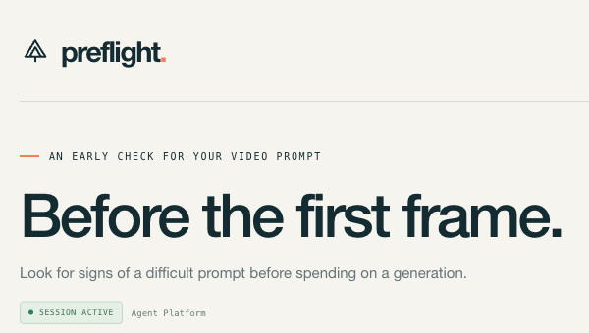
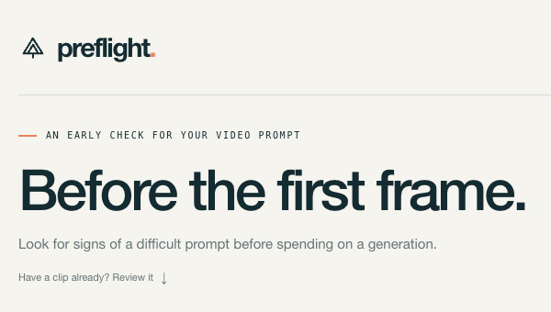
Additional Details/Future Development (if any)
Felix builds. Sidhant: 10 QA points, 6 fixes.
F
IRT preprints, 2.5 years
S
shipped
Objects 30 → 18. Colours 23 → 7.
Earlier interface
After teammate QA
Next: live stills, tabs, non-English.
Sources: teammate QA, first-viewport audit, archival header captures.
Notes:
Content canon: user-supplied Preflight final v7 slide map; original organizer section and template resources preserved.
Felix designed and shipped Preflight. IRT method derives from his two preprints. He has 2.5 years of generative-video pipeline experience.
Sidhant performed QA across 10 points; 6 shipped. First-screen audit reduced 30 to 18 objects and 23 to 7 colours. Supplied canon, consistent with reports/first_viewport_after.json for the after counts.
Next: live stills, separate tabs for check/clip review, non-English vote data before scoring non-English prompts.
Earlier crop source: sibling evidence/preflight-20261016/final-cloud-desktop.png, a checked full-page state. Now crop source: reports/first_viewport_d_primary/first_viewport.png, initial screen after cleanup. Both show only number-free headers.
These are authentic earlier/current header crops, not matched initial-viewport audit samples. The original initial-viewport before screenshot could not be found. The QA count strip is separate from the header comparison. Never infer the 30/23 measurement from this earlier checked-state crop.

Slide 11

Point–Reason–Example–Point
Check before you pay.
Generators bill attempts. Refunds skip unusable clips.
Uncalibrated spoon/laptop estimate: 46.8% → 15.8%, saved still before $3.20 video.
Preflight: check before you pay.
Sources: Runway refund policy, saved spoon/laptop example; conceptual photograph.
Notes:
Content canon: user-supplied Preflight final v7 slide map; original organizer section and template resources preserved.
Point: Know before you pay. Reason: Generators bill every attempt; refunds skip clips that finish but fail.
Example: A spoon and a laptop, mixed estimated risk 46.8% to 15.8%, with saved image stills before a $3.20 video. This is not measured savings or proven improvement in generated video quality.
Closing: Preflight, know before you pay.
Concept photograph generated using built-in image tool; exact model not returned: UNREPORTED. Blank slate image contains no product pixels or event claim.

Slide 12
Provide links to your:
GitHub Public Repository
https://github.com/testofschool/preflight
Demo Video Link (3 Minutes)
Pending public upload
Final Product Link
https://preflight-jcgro45veq-as.a.run.app
Notes:
Content canon: user-supplied Preflight final v7 slide map; original organizer section and template resources preserved.
https://github.com/testofschool/preflight
https://preflight-jcgro45veq-as.a.run.app
Public YouTube URL remains unprovided. Pending public upload is intentional.
Original organizer field label Demo Video Link (3 Minutes) is retained as template text; selected final video is 3:28.233, independently checked by Track I.

