Slide 1
Tenant Plugin Management
Omkar Kulkarni

Slide 2
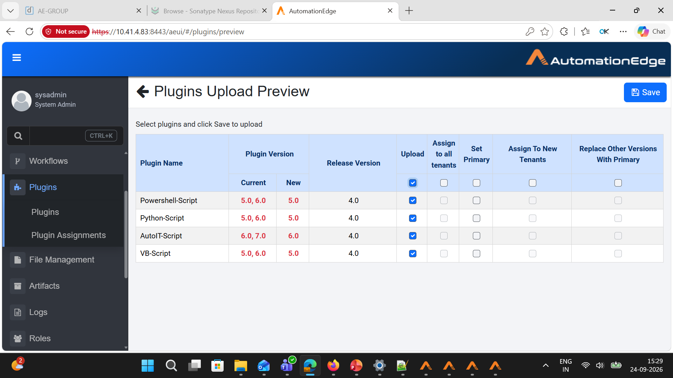

Slide 3


Slide 4
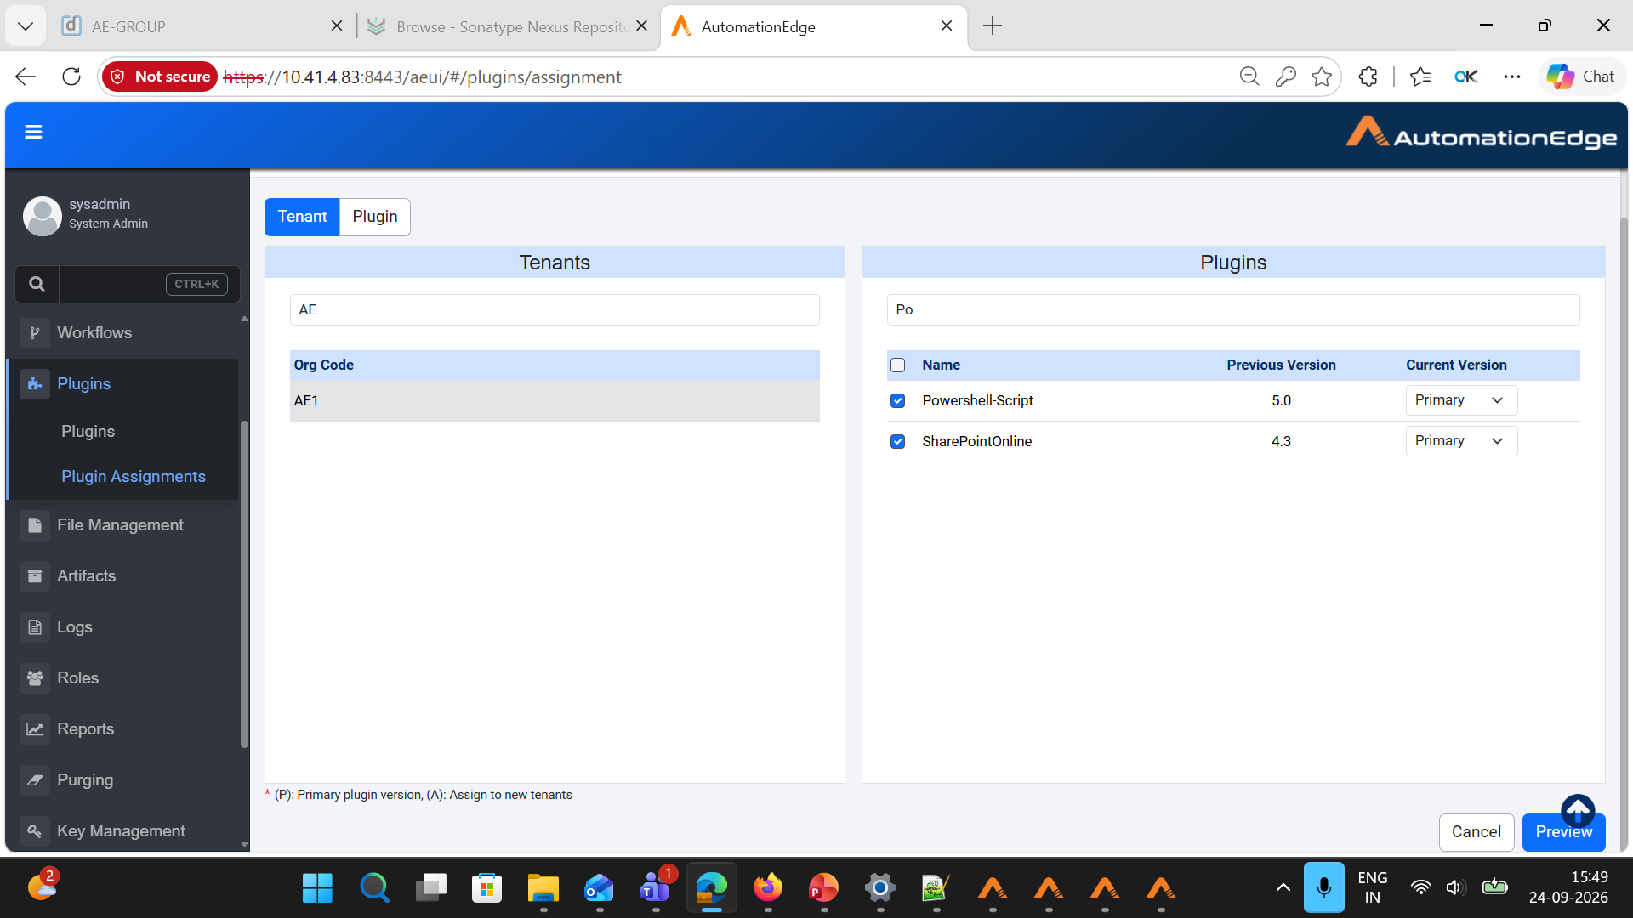
Notes:
Tenant1 Primary

Slide 5
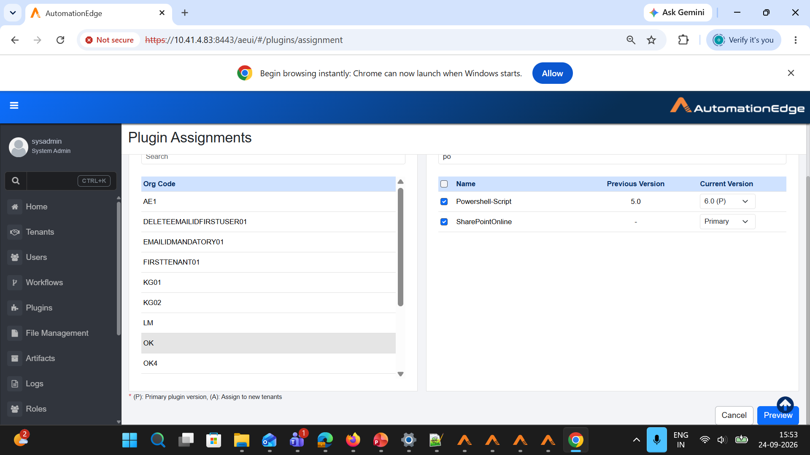
Notes:
Tenant2 specific version which is primary

Slide 6
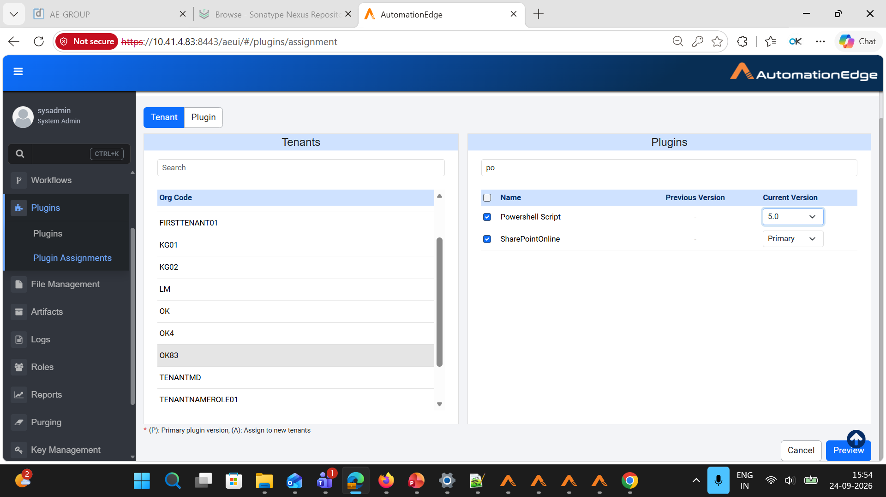
Notes:
Tenant3 lower version

Slide 7
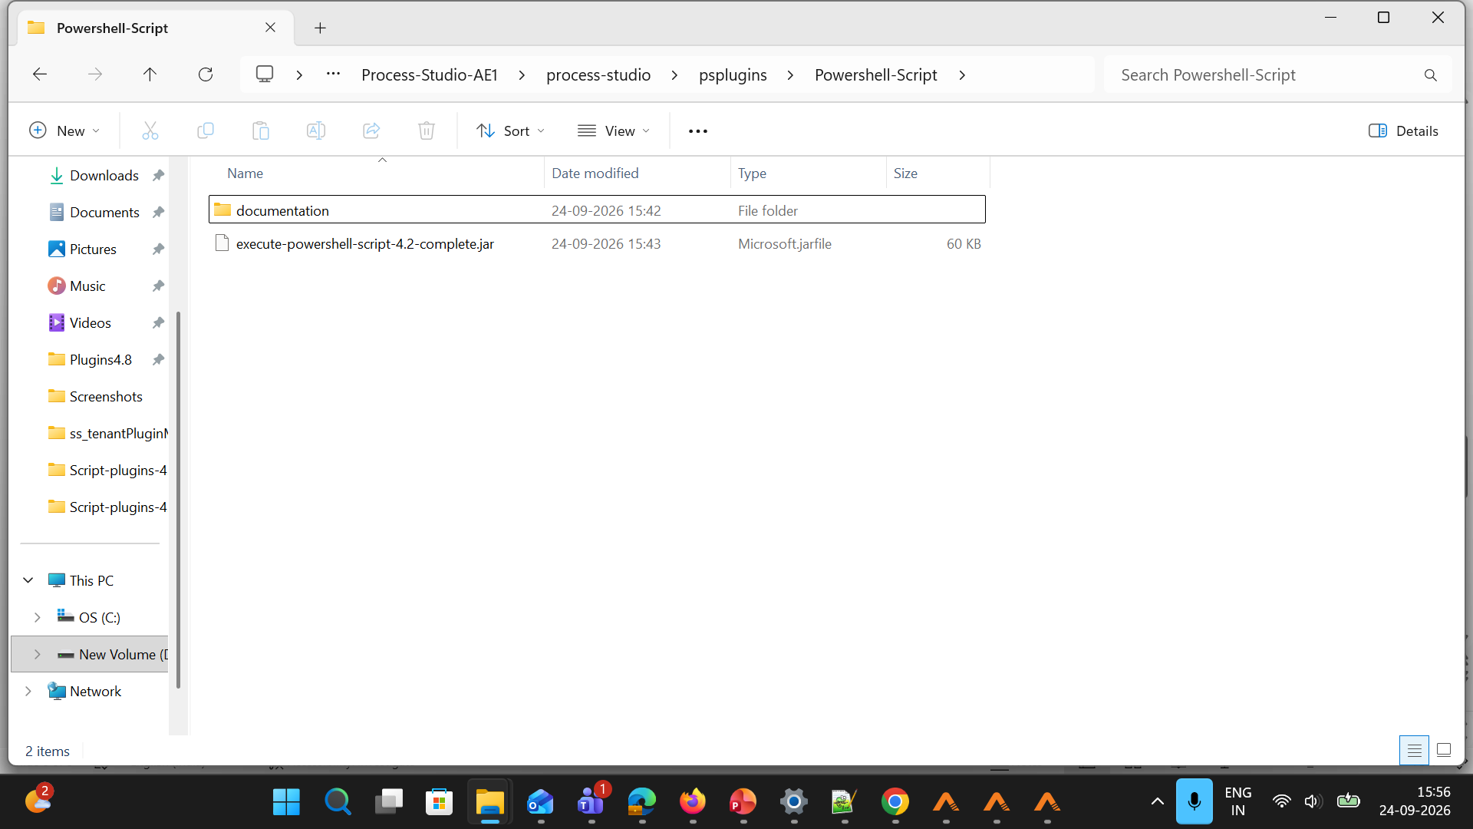
Notes:
Tenant1 primary jar psplugins process studio

Slide 8
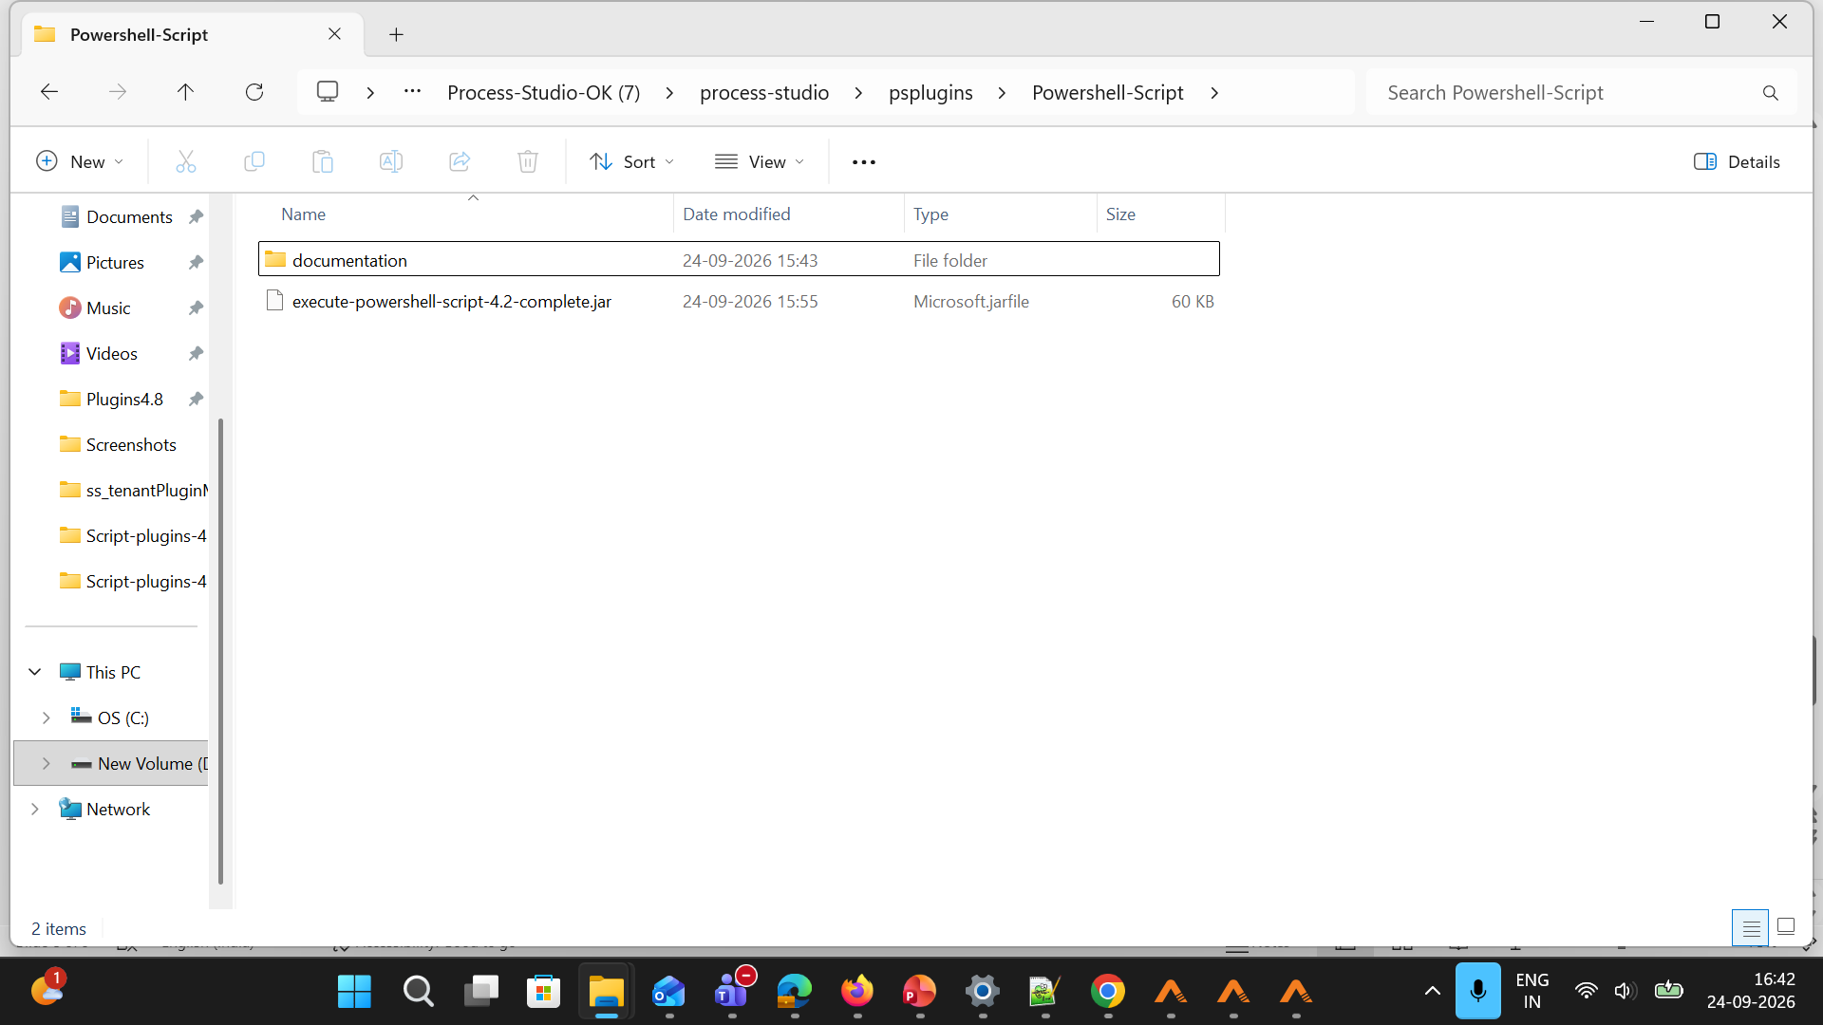
Notes:
Tenant2 specific version which is primary

Slide 9
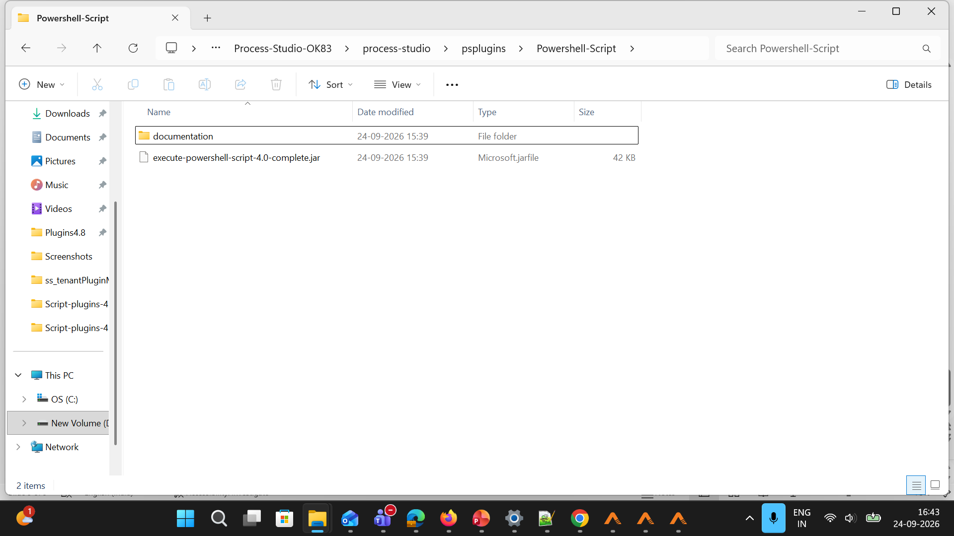
Notes:
Tenant3 lower version

Slide 10
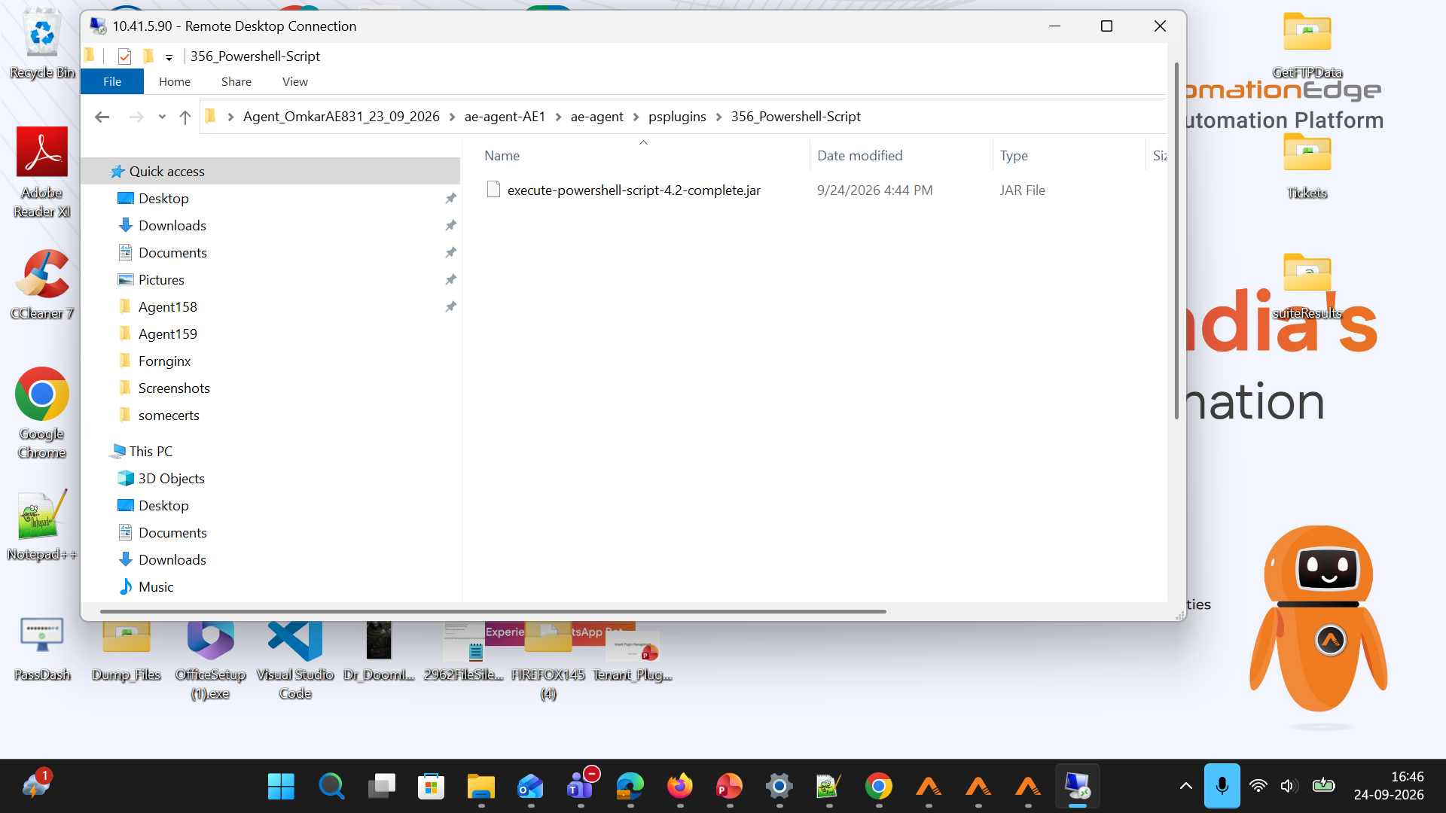
Notes:
Tenant1 Agent Primary Jar

Slide 11
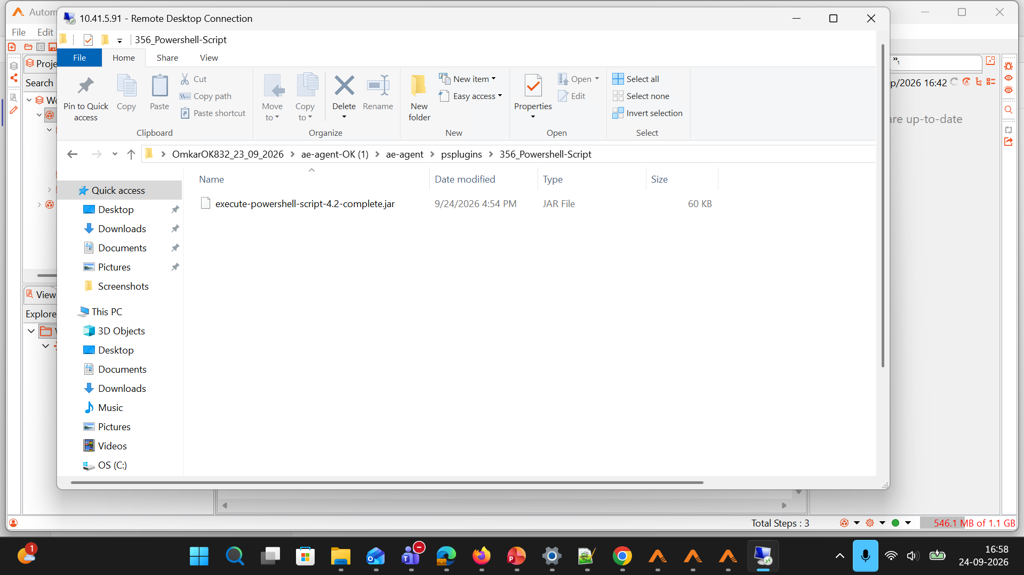
Notes:
Tenant2 Agent Specific version jar which is primary

Slide 12
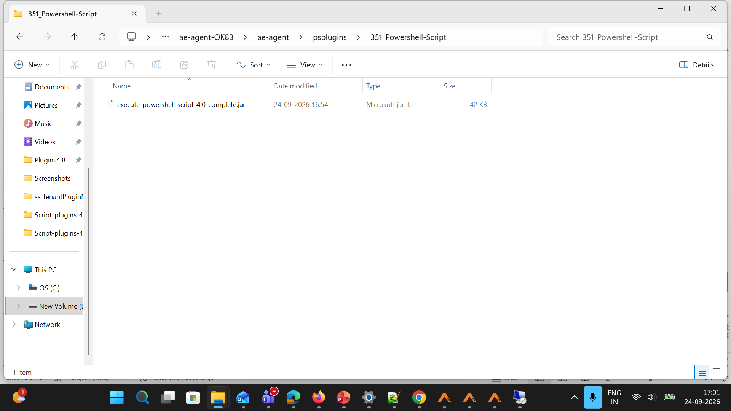
Notes:
Tenant3 Agent which is lower version

Slide 13
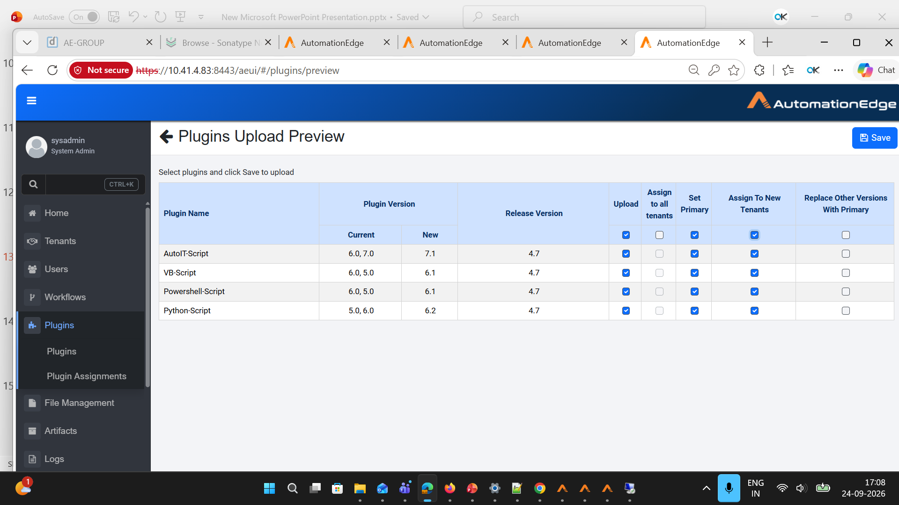
Notes:
Uploaded higher version & set as primary & assigned it to new tenants

Slide 14
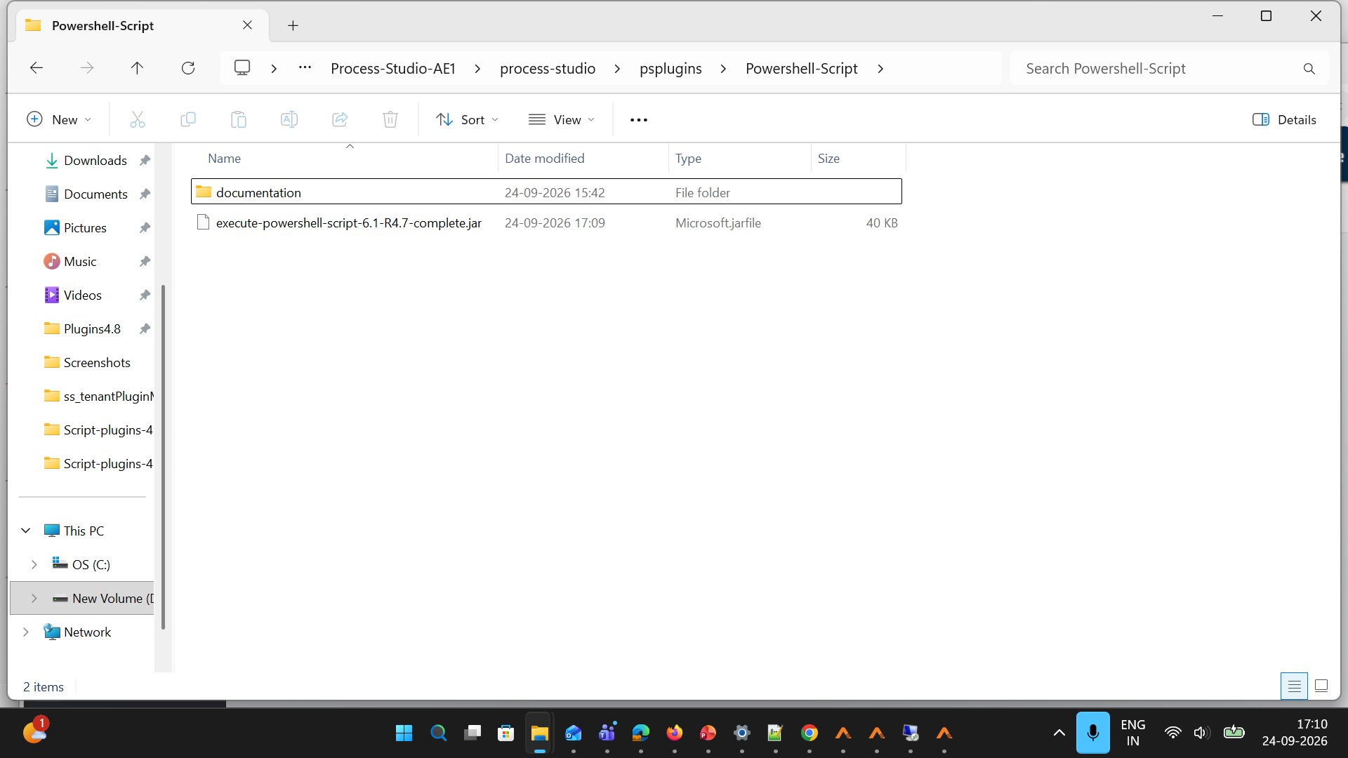
Notes:
Tenant1 primary jar updated to higher version

Slide 15
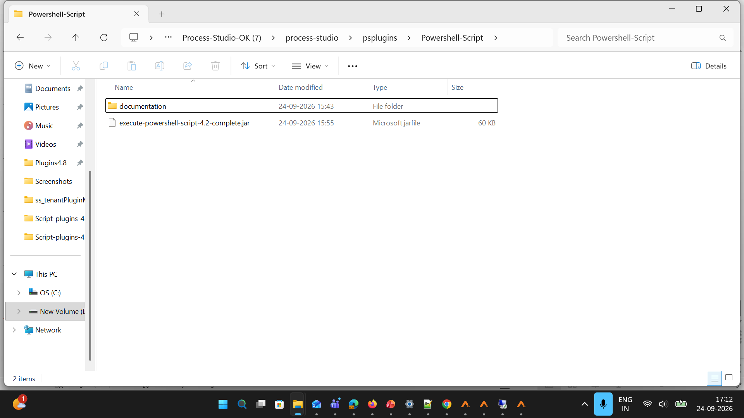
Notes:
Tenant2 jar not updated to primary version

Slide 16
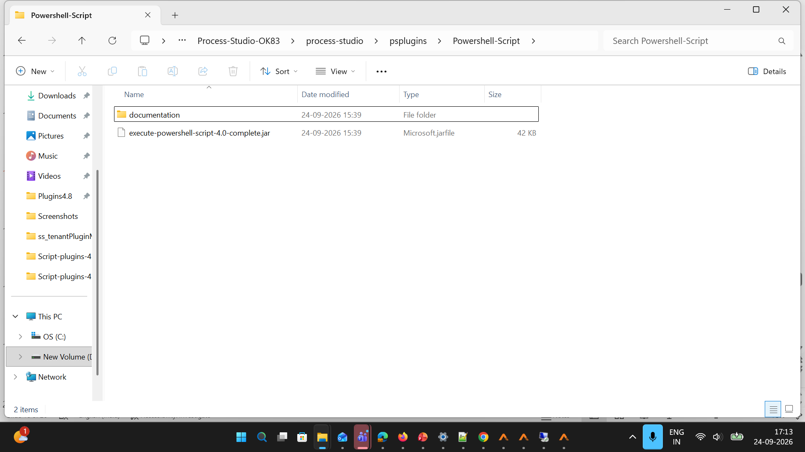

Slide 17
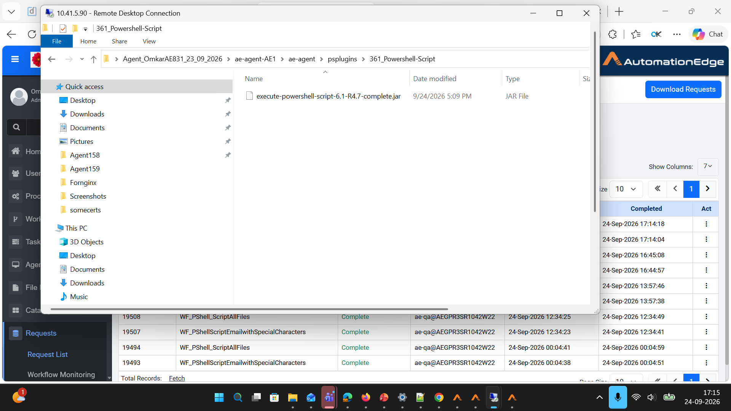
Notes:
Tenant1 Agent which is primary

Slide 18
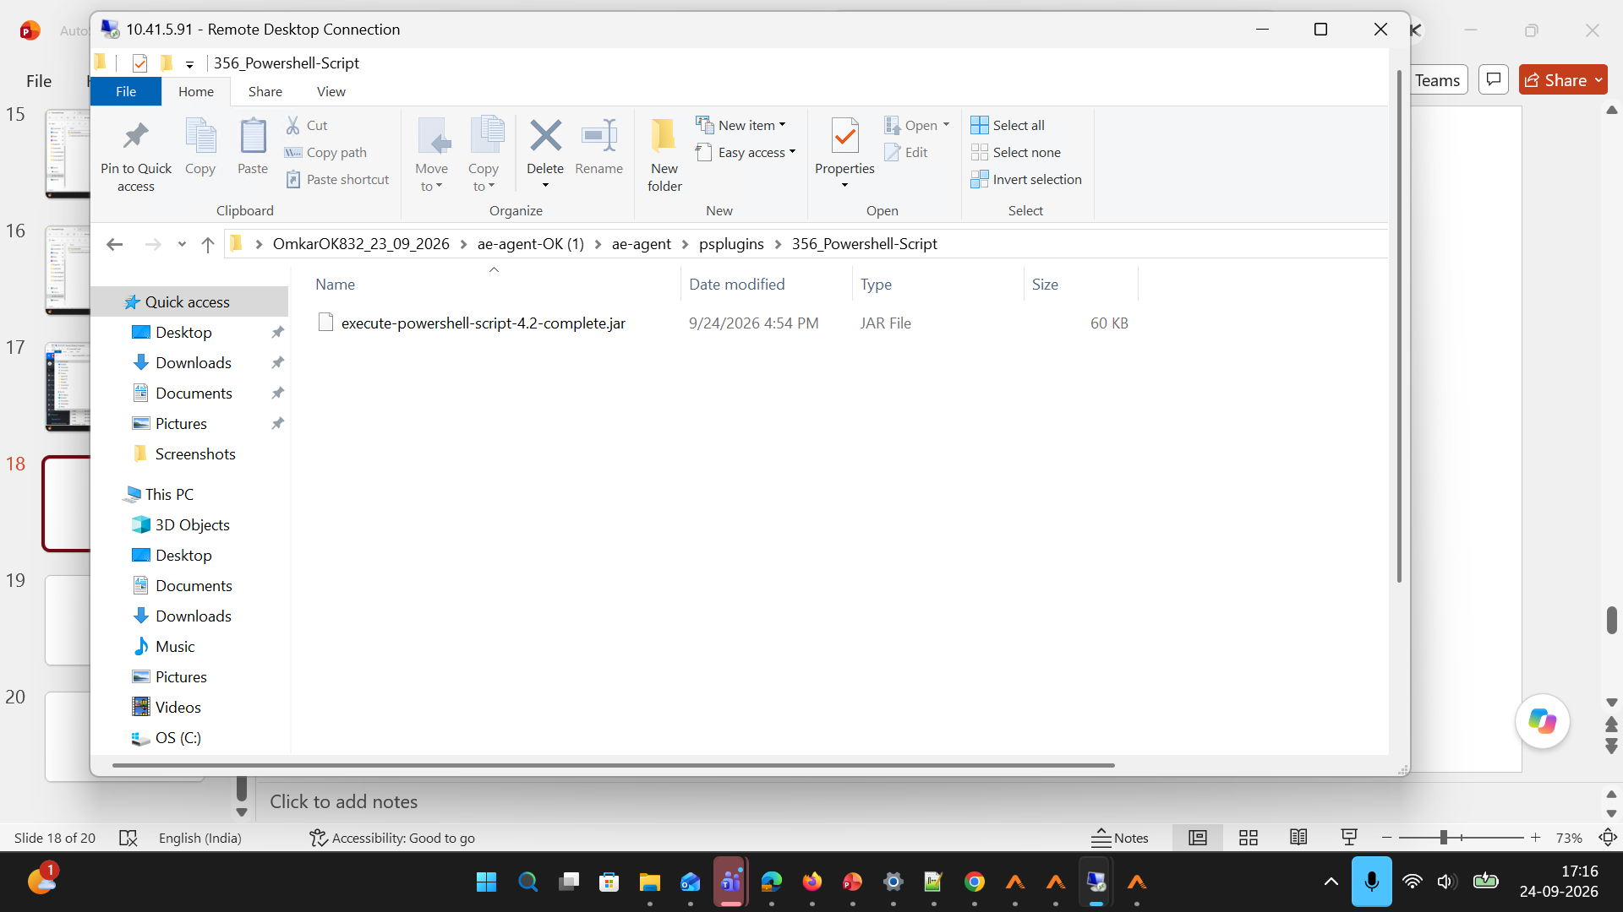
Notes:
Tenant2 jar did not change to primary

Slide 19
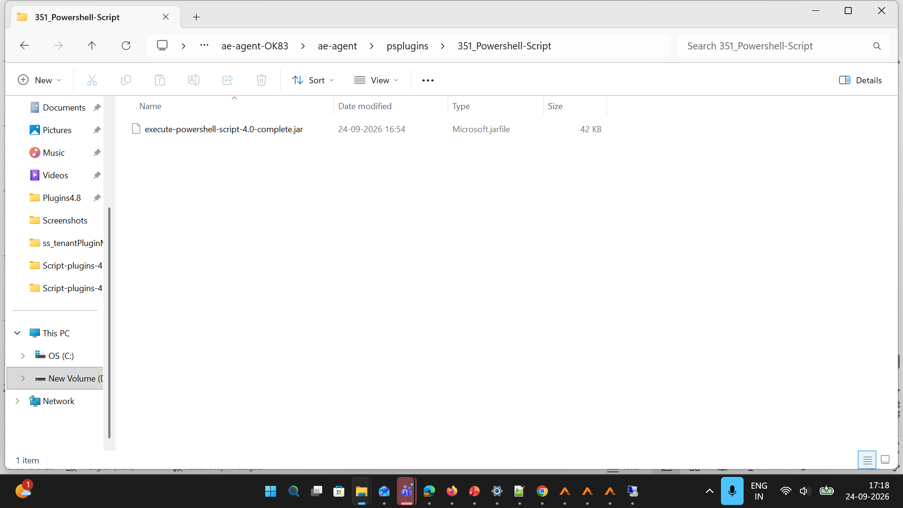
Notes:
Tenant3 jar of older version remains same

Slide 20
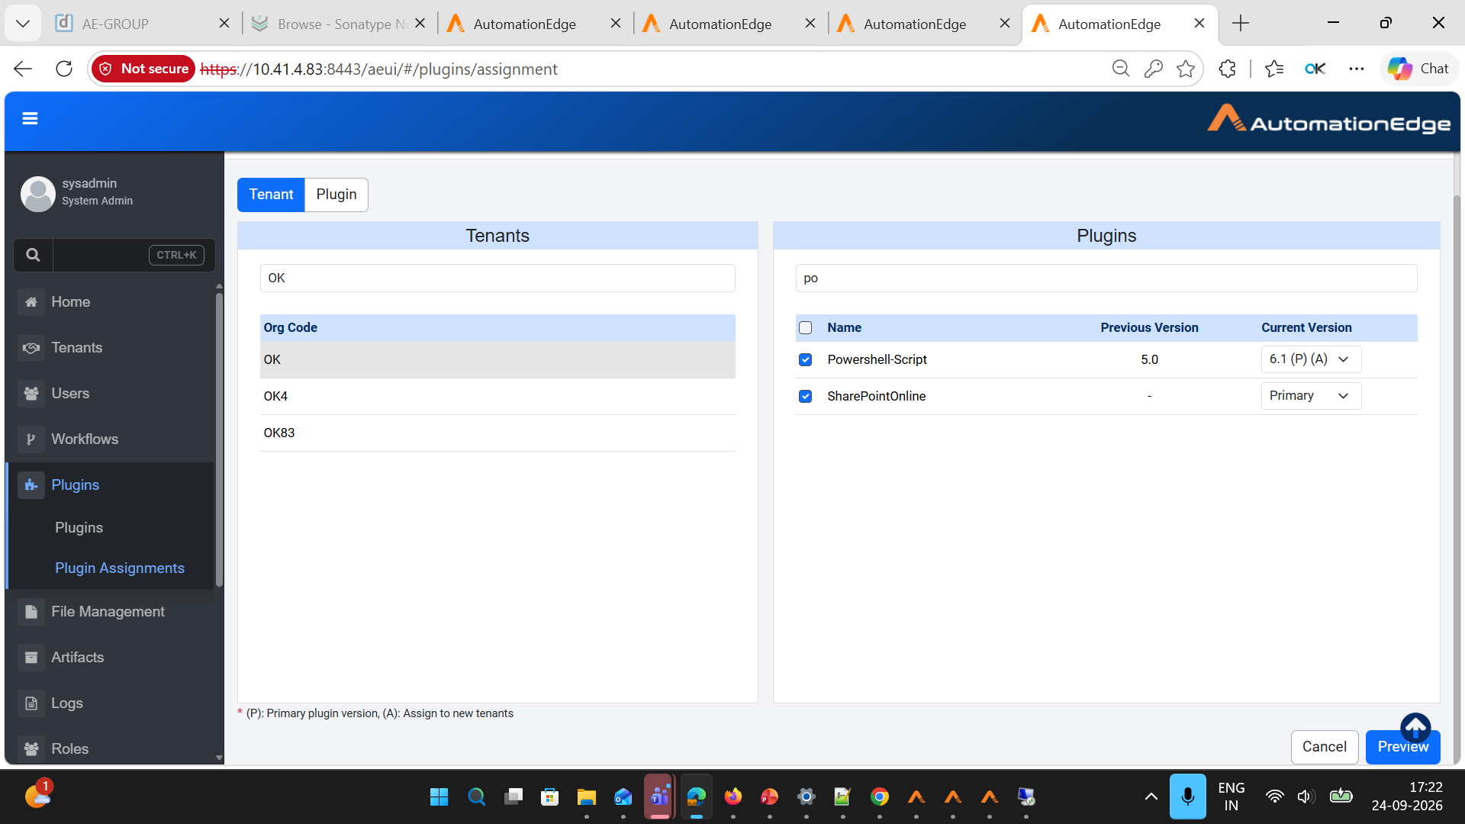
Notes:
Tenant2 updated to higher version (Tenant to Plugin)

Slide 21
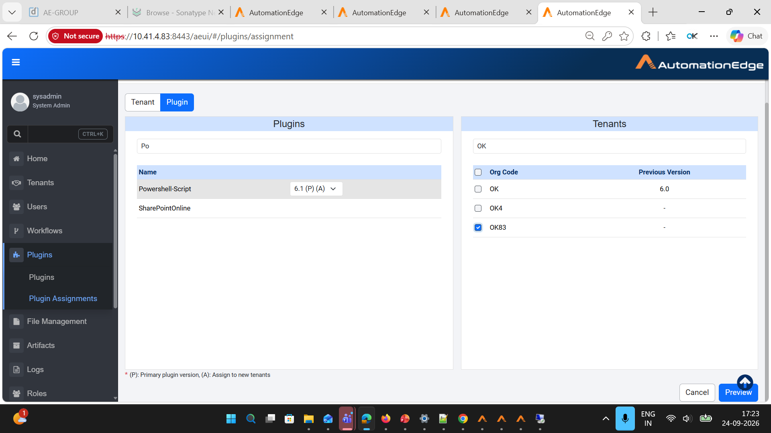
Notes:
Tenant3 Assigned Higher version (Plugin to Tenant)

Slide 22
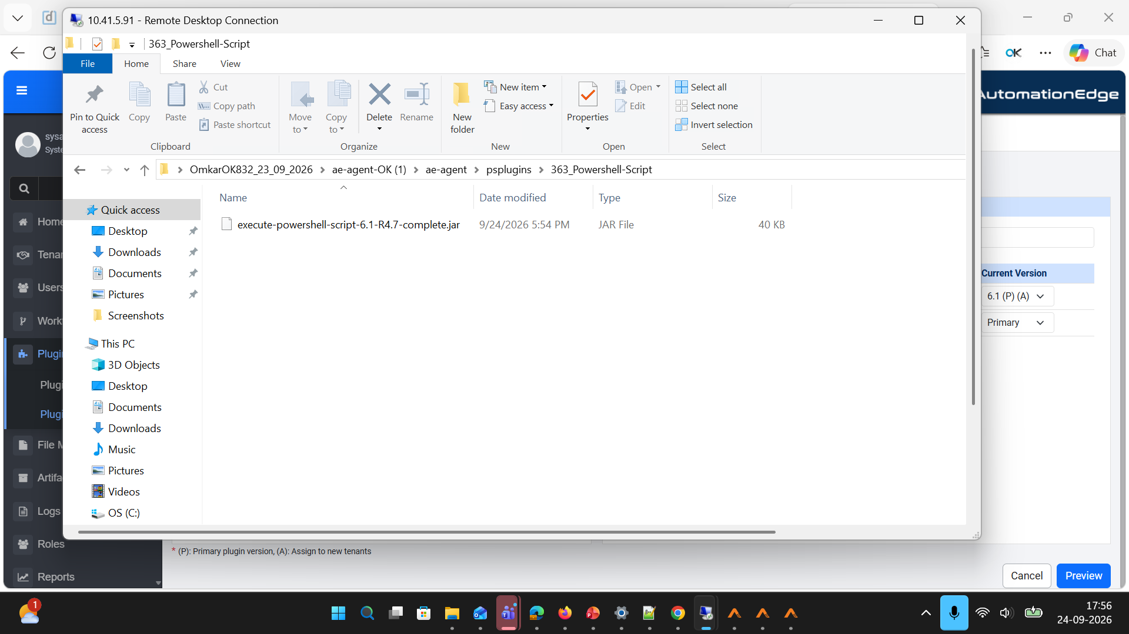
Notes:
Tenant2 Agent upgraded to higher version

Slide 23
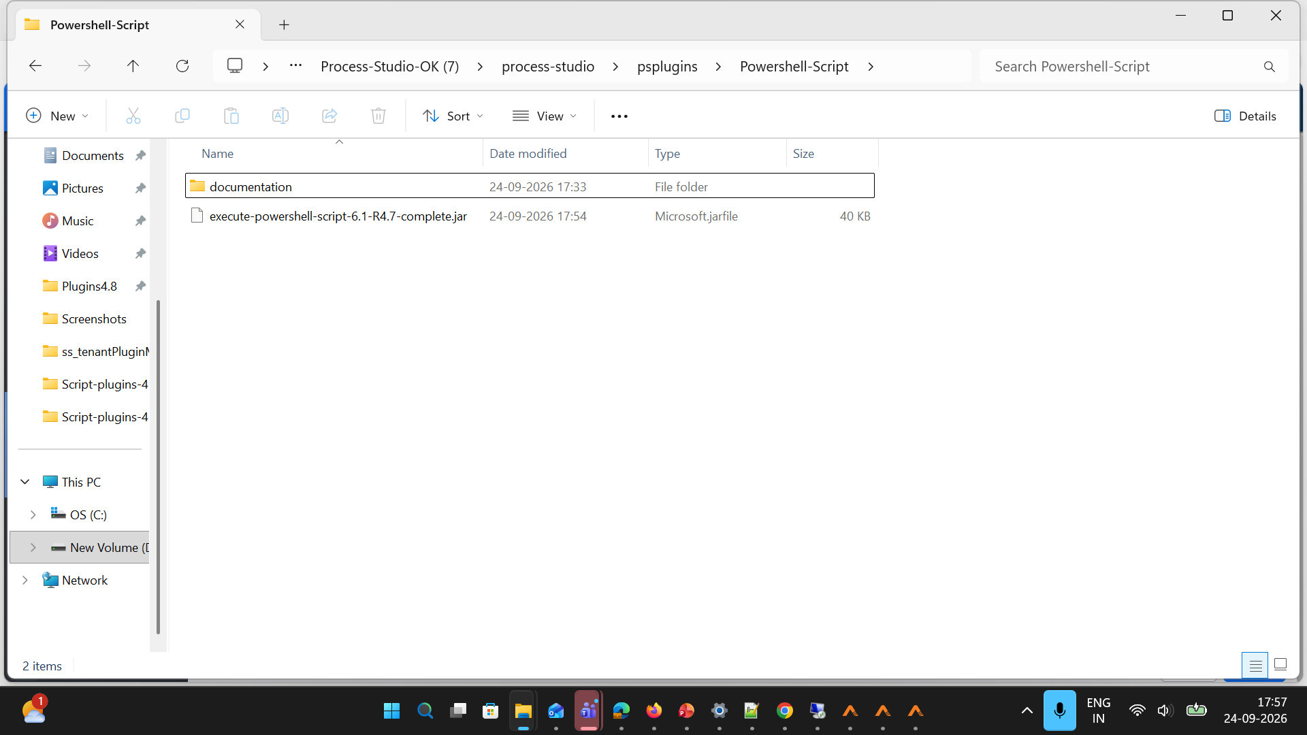
Notes:
Tenant2 upgraded to higher version

Slide 24
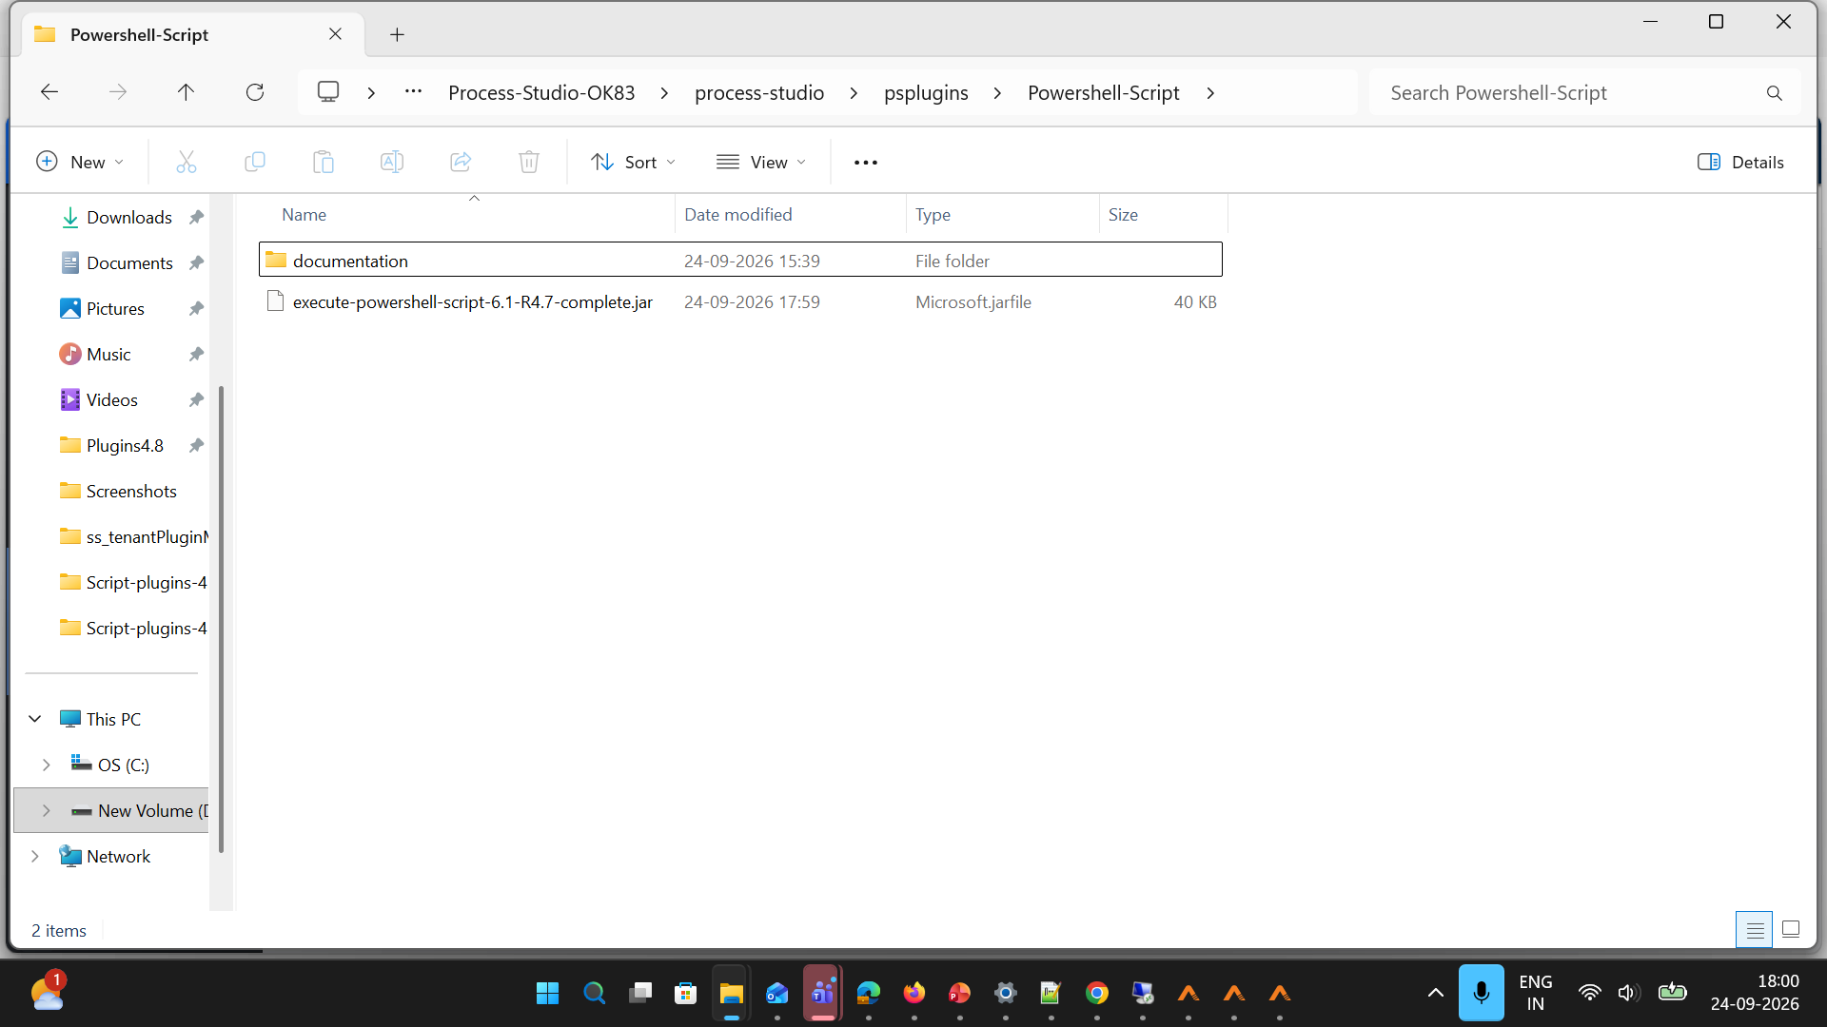
Notes:
Tenant3 upgraded to higher version Process studio

Slide 25
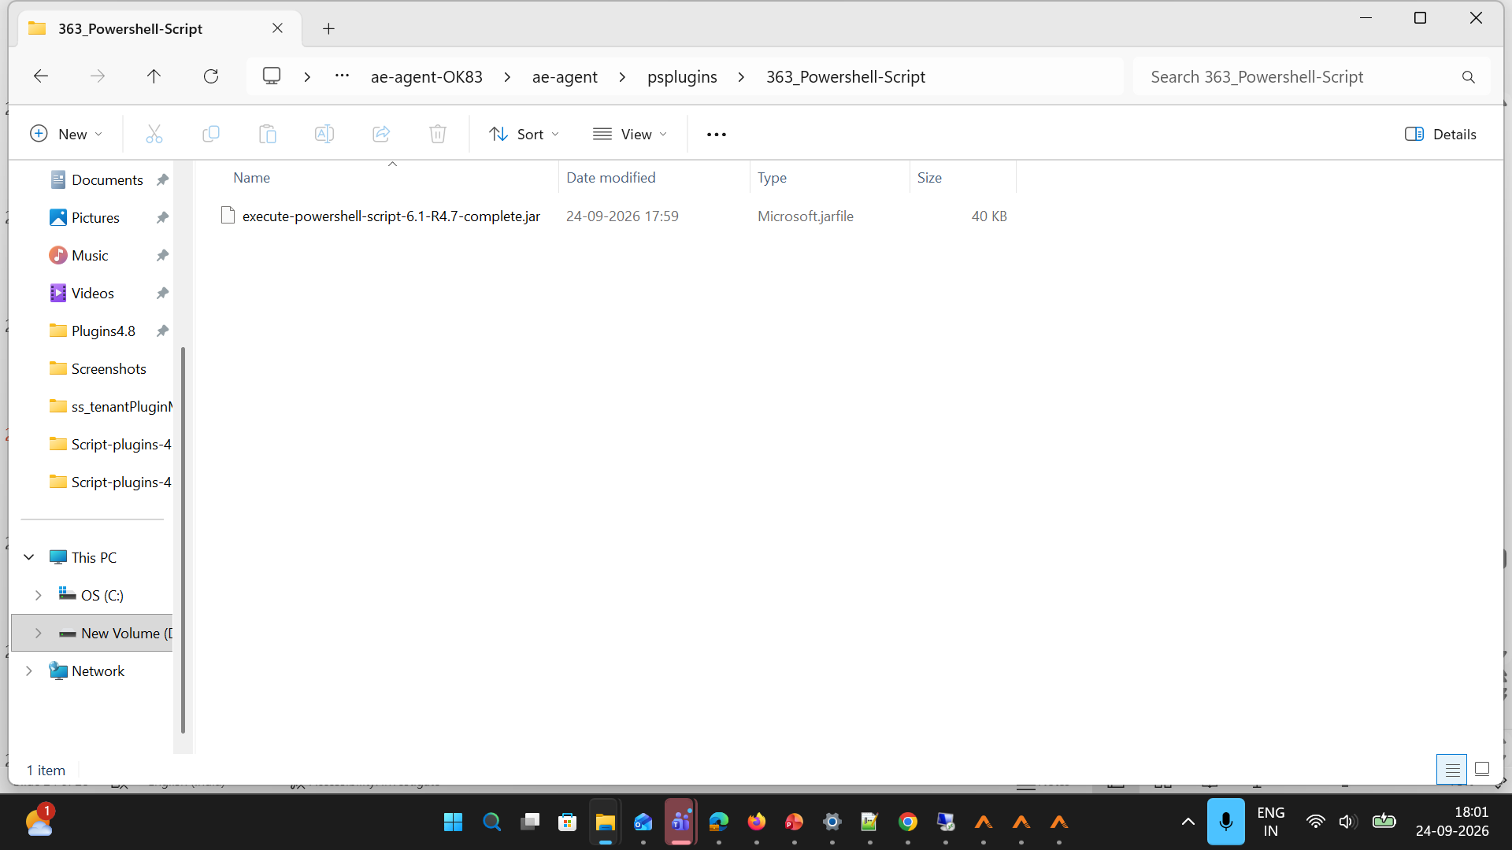
Notes:
Tenant3 Agent upgraded to higher version

