Slide 1



Making an NFT on the IC
MY NOTES as A beginner IN SUPPORT OF MOTOKO BoOTCAMP
@tedreinhardt
Ver 1.0
24 Feb 2022

Slide 2



This work is licensed under a Creative Commons Attribution-NonCommercial 4.0 International License.
Attribution- 4.0 International (CC BY-NC 4.0)
See https://creativecommons.org/licenses/by-nc/4.0/legalcode
Copyright © 2022 by T. Reinhardt

Slide 3
Aim
Share what I have been learning about creating NFTs so that others may be able to advance their own projects.

Slide 4
Disclaimer
These are my notes and may contain inaccuracies.
Use the information at your own risk. No warranty is implied.
Sorry, I cannot provide technical support.
  A word of advice: Never share your wallet recovery seed with anyone.

Slide 5
My first NFT
I started learning about NFTs in August/2021. I minted my first 360 degree NFT in August/2021 using DepartureLabs’ Minter. Here is the NFT content.
  https://jb6ng-naaaa-aaaaf-qacvq-cai.raw.ic0.app/mmiwg.html

Slide 6
Non-Fungible Token (NFT)
A non-fungible token (NFT) is a unique and non-interchangeable unit of data stored on a digital ledger (blockchain).
NFTs can be associated with reproducible digital files such as photos, videos and audio.
NFTs use a digital ledger to provide a public certificate of authenticity or proof of ownership, but it does not restrict the sharing or copying of the underlying digital file.
The lack of interchangeability (fungibility) distinguishes NFTs from blockchain fungible token such as ICP and Bitcoin.
Source: Wikipedia contributors. (2021, December 15). Non-fungible token.
In Wikipedia, The Free Encyclopedia. Retrieved 19:53, December 15, 2021, from https://en.wikipedia.org/w/index.php?title=Non-fungible_token&oldid=1060457068

Slide 7




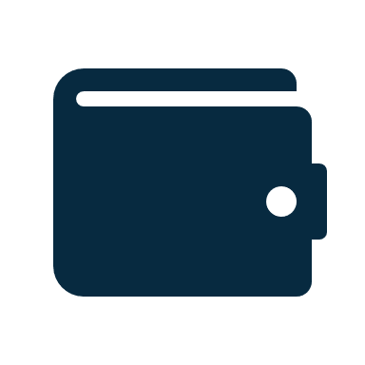
The NFT terminology
Digital asset: photo, music, video, game piece, software, ticket stub, etc.
Minter: process that converts an asset into an NFT.
Wallet – where your assets can be viewed/transferred.
Marketplace – where you can buy and sell NFTs.
Digital Asset
NFT
Minter
Marketplace
Wallet
E.g. Entrepot
e.g. Stoic, Plug, Earthwallet

Slide 8

Difference between a digital asset and a NFT?
Built-in transfer, registration and
access services.
Optionally a program to transform or
display the asset or deliver a service.
+
Ownership recorded in the NFT registry.
+
Digital Asset
An NFT
The IC enables you to do all this on-chain in a canister (smart contract).
It is also economical to do on the IC.

Slide 9
Costs of minting an NFT on the IC
NFTs are stored in canisters.
Minting a canister costs about $3 USD on the IC:
  Canister creation costs 2 trillion Cycles.
  1 trillion Cycles costs 1 Standard Define Rate (SDR), a term defined by the International Monetary Fund or approximately $1.39 USD as at 22 Feb 2022.
In addition, there is an ongoing fee for storage, transmittal and processing (very low paid in Cycles).
Over time, the cost of storage and execution will have to be topped up unless it is loaded with more Cycles to maintain it. If not, it will be removed from the blockchain when it is depleted.

Slide 10
Multiple NFTs can also be stored in a single canister reducing cost.
Using a multi-NFT canister, minting 100 000 tokens would cost around $3 vs $300 000.

Slide 11
How do you make an NFT?
Create a digital asset , e.g. an image saved as a .png file. (Any digital asset supported by the minter/marketplace can be used.)
Use an online minter to create the NFT or do it yourself.
Create
the asset
They are slowly emerging!
Online Minting Service
Do it
yourself
NFT
Created

Slide 12
Online minting of your content
DepartureLabs had an experimental minter – offline now.
NFT anvil is in development.
https://5rttq-yqaaa-aaaai-qa2ea-cai.raw.ic0.app/mint
Toniqlabs will mint collections as part of the collect intake process if deemed of interest to Entrepot.
BobNFTs.com is a new minting service with potential.
NFTStudio.biz is a new minting service with potential.
ICME are working on a minting offering.
Blocks Editor has a DIP721 example which can be built to mint and learn.
Let me know if you find any others.
Notes:
qz7gu-giaaa-aaaaf-qaaka-cai to support HZLD Token

Slide 13
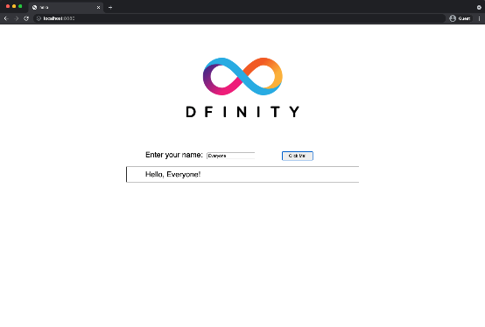
Create it yourself
You will need to have the DFINITY Canister SDK and dependencies installed and running on a computer using :
  Windows with WSL2 and Linux subsystem installed (e.g. Ubuntu2004);
  Linux; or
  Mac
Follow the quick start tutorial and deploy the sdk Hello example.
Test to see if you can see the front end that looks like this:

Slide 14
So what did that achieve?
Following the quick start tutorial means you created a smart contract owned by you that displays an image (the dfinity symbol) stored on the local replica. It has an index.html, index.js and the dfinity logo png.
Turning into an NFT means adding:
  the NFT data elements for the certificate of ownership data
  the NFT smart contract functions to enable minting, transfer, etc
  digital assets.

Slide 15
ERC-721
A standard called ERC-721 (ERC is Ethereum Request for Comment) defines data elements and methods that must be present when constructing an NFT for trading within the Ethereum eco-system to aid interoperability with wallets and ecosystems.
The Internet Computer community has not defined a standard. Instead a variety of implementations are in use that define data elements and functions.
We use one derived from
DIP721.
Signficant NFT development work
Name | Creator | Language | Repository
ICP721 | C3Protocol | Motoko | https://github.com/C3-Protocol/NFT-standards
EXT | Toniq Labs | Motoko | https://github.com/Toniq-Labs/extendable-token
IC-NFT | Rocklabs | Motoko | https://github.com/rocklabs-io/ic-nft
DIP721 | Psychedelic | RUST | https://rustrepo.com/repo/Psychedelic-DIP721
DIP721 | SuddenlyHazel | Motoko | https://github.com/SuddenlyHazel/DIP721/tree/main/src/DIP721
Hazeld | Departure Labs | Motoko | https://github.com/DepartureLabsIC/non-fungible-token
Legends NFT | Sagacards | Motoko | https://github.com/sagacards/legends-nft

Slide 16





The workflow
1. Create the asset
Digital Asset
NFT
2. Build your minter
Your own
Minter
Wallet
3. Mint your NFT
4. Load it in your wallet

Slide 17
Minting with a @BlocksEditor DIP721 example

Slide 18
DIP721 Example
DIP721 “standard” was developed in Rust by @PsychedelicDAO
@SuddenlyHazel implemented DIP721 in Motoko.
@BlocksEditor adapted the @SuddenlyHazel’s version and will be used as the example. It is found here: https://blocks-editor.github.io/
It differs from the DIP721 implementation in that the functions are not using the DIP721 postfix namespace and only a subset of DIP721 functions are implemented.

Slide 19
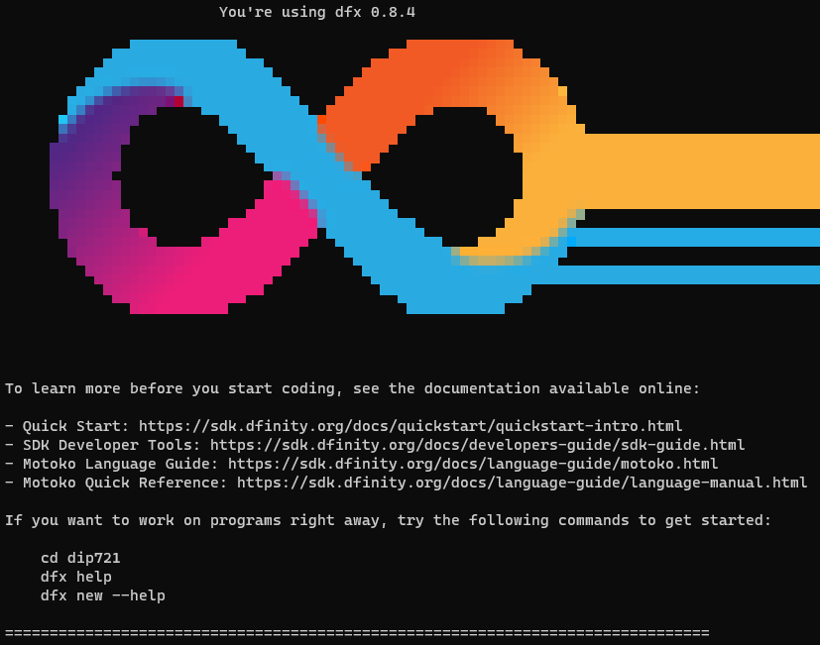
How to build (after you installed the SDK)
Create a new project called dip721
It will install and when successful displays the following.
$ dfx new dip721

Slide 20



DIP721 - Create your digital assets
Create 3 digital assets and store them in into the ~/dip721/src/dip721_assets/assets subdirectory naming them 1.png, 2.png and 3.png.
1.png
2.png
3.png

Slide 21
Deploy the canister locally and test
While in the top project directory:
dfx start (in a separate window as it starts the replica processes)
dfx deploy
npm start
In a browser go to: http://localhost:8080/1.png
Your first image should be displayed.

Slide 22
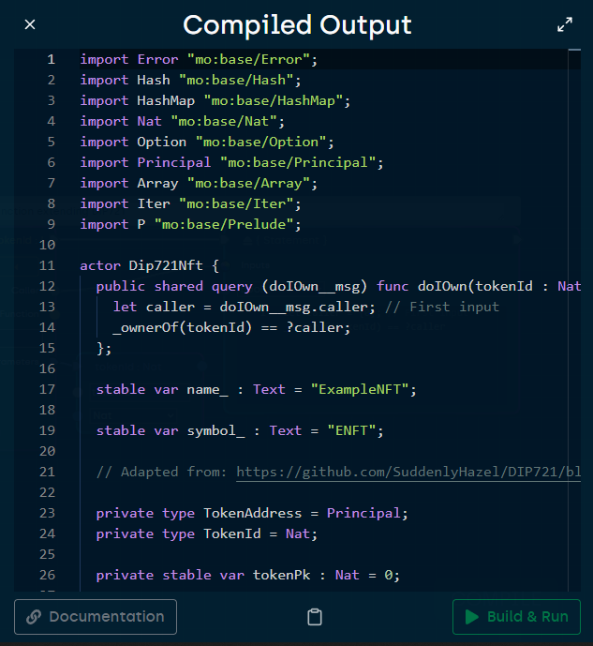
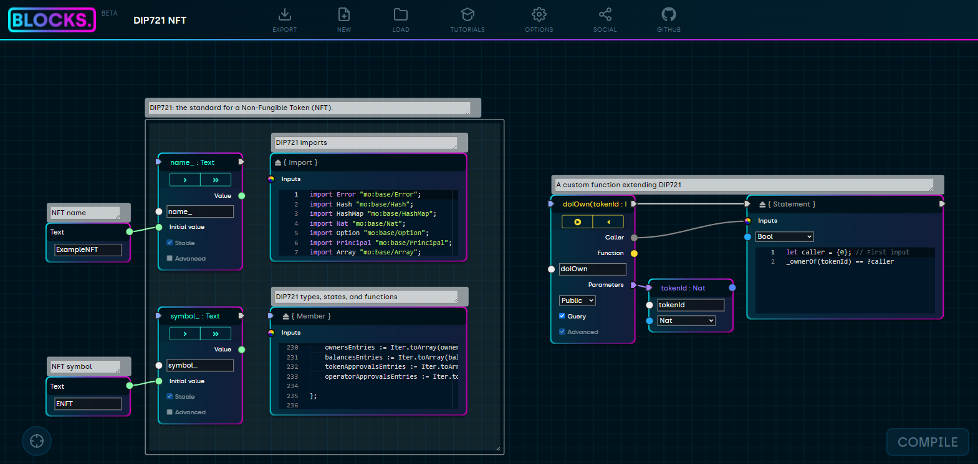
Add the DIP 721 smart contract code
Go to https://blocks-editor.github.io/
Load the DIP721 example and compile
Copy the compiled output (the source code) and paste the contents of main.mo into ~/dip721/src/dip721/main.mo
main.mo

Slide 23
Deploy the smart contract
dfx deploy
npm start
Results in 2 canisters
Dip721
Smart contract
Dip721
Asset Canister

Slide 24
Let’s try it out.
This is the Uniform Resource Identifier where the asset is stored
$ dfx canister call dip721 name
("ExampleNFT")
Show the name of the NFT
$dfx canister call dip721 symbol
("ENFT")
Show the name of the Symbol
Mint a token using the first
1.png as the digital asset
$dfx canister call dip721 mint http://localhost:8080/1.png
(1 : nat)
This is the TokenId
$dfx canister call dip721 ownerOf '(1)'
(
opt principal "p3oiq-zvq7o-ir4je-ngxhk-br4ps-ymn3e-i7lsc-a6o67-irbt3-h5ddq-pae",
)
Show the owner of TokenID 1.

Slide 25
Transfer the token to someone else.
TokenID 1
Confirm you own it.
$dfx canister call dip721 doIOwn '(1)’
(true)
Transfer it.
$dfx canister call dip721 transferFrom '(principal "p3oiq-zvq7o-ir4je-ngxhk-br4ps-ymn3e-i7lsc-a6o67-irbt3-h5ddq-pae",principal "zht7g-jivec-azc2g-f5bkj-oxsfc-nvyo6-ch4jb-el2tb-ebyuf-zeo4d-gae",1)’
(NULL)
Confirm you don’t own it.
$dfx canister call dip721 doIOwn '(1)’
(false)
$dfx canister call dip721 ownerOf '(1)’
(
opt principal "zht7g-jivec-azc2g-f5bkj-oxsfc-nvyo6-ch4jb-el2tb-ebyuf-zeo4d-gae",
)
Who is the owner now?

Slide 26
@BlocksEditor DIP721 has more methods
approve(to : Principal, tokenId : TokenId)
balanceOf(p : Principal)
doIOwn(tokenId : Nat)
getApproved(tokenId : Nat)
isApprovedForAll(owner : Principal, opperator : Principal)
mint(uri : Text)
name()
ownerOf(tokenId : TokenId)
setApprovalForAll(op : Principal, isApproved : Bool)
symbol()
tokenURI(tokenId : TokenId)
transferFrom(from : Principal, to : Principal, tokenId : Nat)

Slide 27



This is not production ready yet.
No front end.
No Marketplace integration.
Lacks wallet integration.
Access control and security is missing.
The example does not implement the full DIP721 interface standard. DFINITY is publishing this in the coming weeks as part of their tutorial.
Ownership history is missing
Integration with other Wallets and Marketplaces via DAB SDK has not been implemented.
Payment/refund flows are missing.
Topping/monitoring up cansister cycles is missing.
Dip721
Smart contract
Dip721
Asset Canister

Slide 28
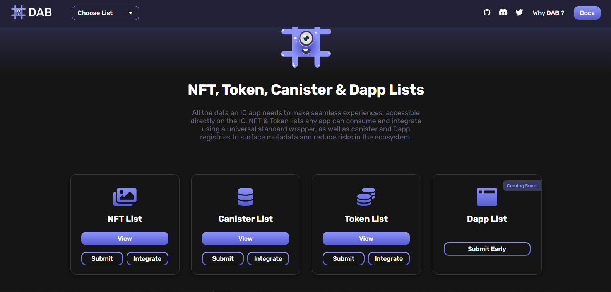
DAB

Slide 29
CAP
Certified Asset Provenance (CAP)
CAP is an open internet service providing transaction history & asset provenance for NFT’s & Tokens on the Internet Computer. It solves the huge IC problem that assets don’t have native transaction history, and does so in a scalable, trustless and seamless way so any NFT/Token can integrate with one line of code.

Slide 30
Clean up the old code
Get rid of the leftover assets, html, css and etc. from the greet application create by the dfx new process and re-deploy.

Slide 31
Additional info on the EXT follows.

Slide 32
EXT Standard
This next section is based on the EXT style --- there are no standards yet on the IC.
I have not been able to integrat into a wallet…

Slide 33
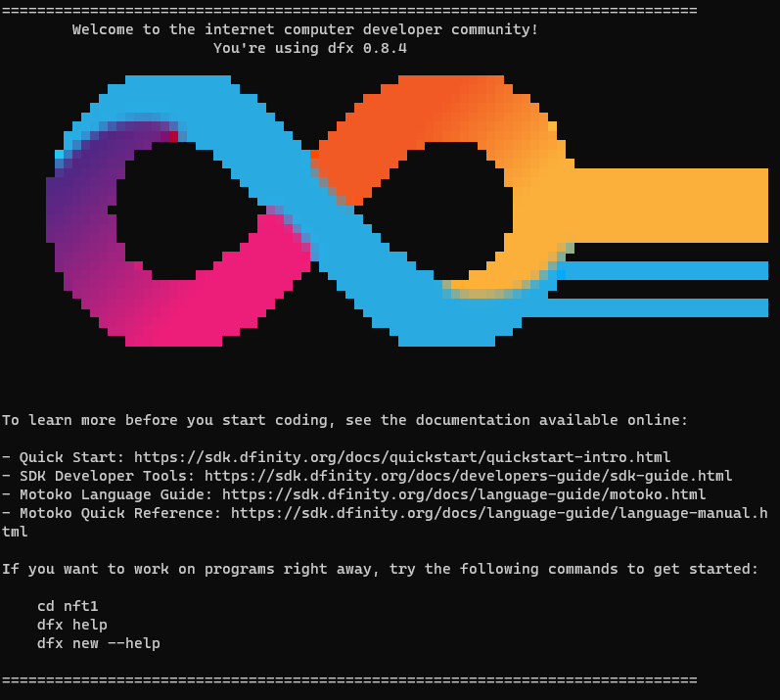
Steps to build (after you installed the SDK)
Create a new project called nft1
It will install and, when successful, display the following:
$ dfx new nft1

Slide 34
Clone the NFT code repository from GITHUB
Change directory into ~nft1.
Install github (if not already done google for your particular platform).
Clone the repository (repo) locally.
Copy the erc721.mo file in the examples subdirectory into the ~nft1/src/nft1 subdirectory.
Rename the existing main.mo to main.old or delete it.
Rename the erc721.mo to main.mo
This replaces the Motoko code with the ERC721 code.
$ git clone git@github.com:Toniq-Labs/extendable-token.git

Slide 35
Move the dependencies
Copy the extendable-token motoko sub-directory and its contents into the ~nft1/src directory.
Check ext and util directories exist and the files are there:
$ ls -lR motoko
motoko:
total 8
drwxr-xr-x 2 jhm jhm 4096 Dec 16 10:24 ext
drwxr-xr-x 2 jhm jhm 4096 Dec 16 10:24 util
motoko/ext:
total 48
-rw-r--r-- 1 jhm jhm 621 Dec 16 10:24 Allowance.mo
-rw-r--r-- 1 jhm jhm 831 Dec 16 10:24 Archive.mo
-rw-r--r-- 1 jhm jhm 445 Dec 16 10:24 Batch.mo
-rw-r--r-- 1 jhm jhm 550 Dec 16 10:24 Common.mo
-rw-r--r-- 1 jhm jhm 6672 Dec 16 10:24 Core.mo
-rw-r--r-- 1 jhm jhm 400 Dec 16 10:24 Fee.mo
-rw-r--r-- 1 jhm jhm 701 Dec 16 10:24 Ledger.mo
-rw-r--r-- 1 jhm jhm 394 Dec 16 10:24 NonFungible.mo
-rw-r--r-- 1 jhm jhm 999 Dec 16 10:24 Operator.mo
-rw-r--r-- 1 jhm jhm 546 Dec 16 10:24 Secure.mo
-rw-r--r-- 1 jhm jhm 202 Dec 16 10:24 Subscribe.mo
motoko/util:
total 20
-rw-r--r-- 1 jhm jhm 1564 Dec 16 10:24 AccountIdentifier.mo
-rw-r--r-- 1 jhm jhm 3991 Dec 16 10:24 CRC32.mo
-rw-r--r-- 1 jhm jhm 1866 Dec 16 10:24 Hex.mo
-rw-r--r-- 1 jhm jhm 5392 Dec 16 10:24 SHA224.mo

Slide 36
Start the local replica
In a separate window/terminal session.
dfx start --clean warning: --clean wipes out the old replica state
dfx start
OR
$ Dfx start --clean
Starting webserver for /_/
binding to: 127.0.0.1:45621
Dec 18 11:30:16.222 INFO ic-starter. Configuration: ValidatedConfig { replica_path: Some("/home/ted/.cache/dfinity/versions/0.8.4/replica"), replica_version: "0.8.0", log_level: Warning, cargo_bin: "cargo", cargo_opts: "", state_dir: "/home/ted/nft1/.dfx/state/replicated_state", http_listen_addr: 127.0.0.1:0, http_port_file: Some("/home/ted/nft1/.dfx/replica-configuration/replica-1.port"), metrics_addr: None, provisional_whitelist: Some(All), artifact_pool_dir: "/home/ted/nft1/.dfx/state/replicated_state/node-100/ic_consensus_pool", crypto_root: "/home/ted/nft1/.dfx/state/replicated_state/node-100/crypto", state_manager_root: "/home/ted/nft1/.dfx/state/replicated_state/node-100/state", registry_local_store_path: "/home/ted/nft1/.dfx/state/replicated_state/ic_registry_local_store", unit_delay: None, initial_notary_delay: Some(600ms), detect_consensus_starvation: None, consensus_pool_backend: Some("rocksdb"), state_dir_holder: None }, Application: starter
Dec 18 11:30:16.223 INFO Initialize replica configuration "/home/ted/nft1/.dfx/state/replicated_state/ic.json5", Application: starter
Dec 18 11:30:17.154 INFO Executing "/home/ted/.cache/dfinity/versions/0.8.4/replica" "--replica-version" "0.8.0" "--config-file" "/home/ted/nft1/.dfx/state/replicated_state/ic.json5", Application: starter
Dec 18 11:30:23.398 WARN s:knvjx-zgkm4-hkvvw-3ueag-xlh7y-zje4m-54tyb-vp2bf-xigrc-mrffa-xae/n:6ufqp-7ok73-oxrj6-zgchl-xllg5-dukck-4zeln-dlz3g-megws-lov4f-qae/ic_p2p/download_management PeerManagerImpl::new(): relay_config = None
version: 0.7.0
Dec 18 06:30:23.433 INFO Log Level: INFO
Dec 18 06:30:23.433 INFO Starting server. Listening on http://127.0.0.1:8000/

Slide 37
Create an empty Canister
$ dfx canister create nft1
Creating a wallet canister on the local network.
The wallet canister on the "local" network for user "default" is "rwlgt-iiaaa-aaaaa-aaaaa-cai"
Creating canister "nft1"...
"nft1" canister created with canister id: "rrkah-fqaaa-aaaaa-aaaaq-cai"

Slide 38
Build the wasm code
dfx build nft1
These warnings are not an issue
$ dfx build nft1
Building canisters...
/home/ted/nft1/src/motoko/util/Hex.mo:48.17-48.30: warning [M0154], field unwrap is deprecated:
Option.unwrap is unsafe and fails if the argument is null; it will be removed soon; use a `switch` or `do?` expression instead
/home/ted/nft1/src/motoko/util/Hex.mo:49.17-49.30: warning [M0154], field unwrap is deprecated:
Option.unwrap is unsafe and fails if the argument is null; it will be removed soon; use a `switch` or `do?` expression instead
/home/ted/nft1/src/motoko/util/Hex.mo:48.17-48.30: warning [M0154], field unwrap is deprecated:
Option.unwrap is unsafe and fails if the argument is null; it will be removed soon; use a `switch` or `do?` expression instead
/home/ted/nft1/src/motoko/util/Hex.mo:49.17-49.30: warning [M0154], field unwrap is deprecated:
Option.unwrap is unsafe and fails if the argument is null; it will be removed soon; use a `switch` or `do?` expression instead
/home/ted/nft1/src/motoko/util/AccountIdentifier.mo:38.14-38.27: warning [M0154], field unwrap is deprecated:
Option.unwrap is unsafe and fails if the argument is null; it will be removed soon; use a `switch` or `do?` expression instead

Slide 39
Get the principal
dfx identity get-principal will show you the identity you are using on the local replica. Your principal response will be different to this.
$ dfx identity get-principal
zht7g-jivec-azc2g-f5bkj-oxsfc-nvyo6-ch4jb-el2tb-ebyuf-zeo4d-gae
Copy your result to the clipboard

Slide 40
Install the code into the canister
The dfx canister install is used to move the code into the canister and to set the owner of the registry to your principal. Your principle will be different (the output from the dfx identity get-principal)
dfx canister install nft1 --argument="(principal \"zht7g-jivec-azc2g-f5bkj-oxsfc-nvyo6-ch4jb-el2tb-ebyuf-zeo4d-gae\")"
Change to match your principal from the previous step

Slide 41
Status check
You now have a canister with the dfinity logo in it and the NFT logic to manage the token. It also has an HTML page to render it and a no-longer-needed index.js which can be removed.
Check to see which identity will be the minter.
$ dfx canister call nft1 getMinter
(principal "zht7g-jivec-azc2g-f5bkj-oxsfc-nvyo6-ch4jb-el2tb-ebyuf-zeo4d-gae")
Should match your principal

Slide 42
Mint your first NFT
One line
Call the mintNFT method passing the principal (vs a stoic address) with the appropriate principal
$dfx canister call nft1 mintNFT "(record { to = (variant { \"principal\" = principal \"zht7g-jivec-azc2g-f5bkj-oxsfc-nvyo6-ch4jb-el2tb-ebyuf-zeo4d-gae\" })} )“
(0 : nat32)
Minted a NFT in position 0 of the registry.
Run it again and the next one will be in position 1
Result
Sets the NFT token owner and
may be different for each token.

Slide 43
You can use dfx to call public methods of the canister
getMinter() e.g. dfx canister call nft1 getMinter
setMinter(minter : Principal)
mintNFT(request : MintRequest)
transfer(request: TransferRequest)
approve(request: ApproveRequest)
extensions()
balance(request : BalanceRequest)
allowance(request : AllowanceRequest)

Slide 44
…continued
bearer(token : TokenIdentifier)
supply(token : TokenIdentifier)
getRegistry()
getAllowances()
getTokens()
metadata(token
public func acceptCycles()
availableCycles()

Slide 45
This is what was achieved
You minted an NFT with ownership information stored within the canister on the local replica.
There is no access control implemented – anyone can see the content of the canister or call the methods – not just the NFT holder.
Upgrading the contract may clobber persistent data (I have not checked this) so be aware.
You can mint additional tokens by running the mint command again and it will store it in the same canister with an index increment.

Slide 46
Deploying an NFT costs Cycles
Creating a canister costs 2 Trillion Cycles.
Sign up to GITHUB to get free Cycles from the Dfinity Cycles faucet:
https://faucet.dfinity.org/auth
With a GITHUB account created more than 90 days ago, you can get free Cycles to test deployment on the IC.
The Faucet will give about $20 worth of Cycles once.

Slide 47
Now moving to the real world
Doing it on the IC involves:
  creating a canister (incurs a cost of 2 x SDR) using the NNS or using dfx
  Noting the canister ID.
  Replacing the Dfinity logo image file with your digital asset image.
  Cleaning up unused code (index.js and index.html).
  Adding access controls in the Motoko code.
  Installing the code into the canister on the IC with the correct principle.
  Then running the dfx minter command pointing to the canister on the IC.
dfx deploy --network ic --argument="(principal \"zht7g-jivec-azc2g-f5bkj-oxsfc-nvyo6-ch4jb-el2tb-ebyuf-zeo4d-gae\")“
dfx canister --network ic call nft1 mintNFT "(record { to = (variant { \"principal\" = principal \"zht7g-jivec-azc2g-f5bkj-oxsfc-nvyo6-ch4jb-el2tb-ebyuf-zeo4d-gae\" }); metadata=opt vec {92;120;48;65;116;105;100;34;114;121;106;108;51;45;116;121;97;97;97;45;97;97;97;97;97;45;97;97;97;98;97;45;99;97;105;48;48;48;49} } )"
dfx canister --network ic call nft1 getTokens

Slide 48
Now moving to the real world
Doing it on the IC involves:
dfx deploy --network ic --argument="(principal \"zht7g-jivec-azc2g-f5bkj-oxsfc-nvyo6-ch4jb-el2tb-ebyuf-zeo4d-gae\")”
dfx canister --network ic call nft1 mintNFT "(record { to = (variant { \"principal\" = principal \"zht7g-jivec-azc2g-f5bkj-oxsfc-nvyo6-ch4jb-el2tb-ebyuf-zeo4d-gae\" }); metadata=opt vec {92;120;48;65;116;105;100;34;114;121;106;108;51;45;116;121;97;97;97;45;97;97;97;97;97;45;97;97;97;98;97;45;99;97;105;48;48;48;49} } )"
dfx canister --network ic call nft1 getTokens
This metadata is encoded
for acceptance by a
particular wallet - to be tested.
Often it is the URI for the asset.
This is one line (dfx… })”

Slide 49
Moving into a wallet (theory):
In order for this to work, the NFT must be minted with the specific metadata and format supported by the wallet. It likely will need the canister reference URI encoded as a base64 reference. The wallet or marketplace may not accept all NFT projects.
Install a wallet that supports NFTs (e.g. Stoic wallet)
Go to the NFT option
Add NFTs
Enter the canister ID when you created it on the IC
Boom! Done! (if the canister is in a compatible format).
not working yet.
Also, need to create an
Endpoint to display it.

Slide 50
Appendix

Slide 51
ERC-1155 – Multi-NFT
ERC1155 uses a single smart contract to represent multiple tokens at once (fungible and non-fungible).
Storing multiple NFTs into one smart contract reduces the cost of creating a canister for each and every NFT.
Toniq-Labs/extendable-token examples has an advanced token that enables multiple NFTs to be stored in a single canister available on GITHUB.
For the purpose of this document, building is shown using an ERC-721-like token and not the multi-NFT canister.

Slide 52
A word about wallets
Wallets are a place to load, view and transfer NFTs. They will accept NFTs only in formats they support.
Popular wallets are:
  Stoic Wallet by Toniq Labs and
  Plug Wallet
  EarthWallet by EarthDAO
  Wallets only work with NFTs in certain formats. If it is in the wrong format, it may be possible to use a wrapper to transform one NFT format into another NFT format. For example, the metadata may need certain encoding.
  A Wallet’s code may be periodically updated and may result in temporary loss of access to your NFTs.

