Slide 1
MySQL and Sybase
August 7, 2020

Slide 2
MySQL
Sr no | SQL Commands Category | Commands
1 | DDL(structure) | create,alter,drop,truncate (table keyword)
2 | DML | insert, update, delete
3 | DQL(choosing) | select
4 | DCL(permission) | grant, revoke
5 | TCL(transactions) | commit, rollback, savepoint
August 11, 2020

Slide 3
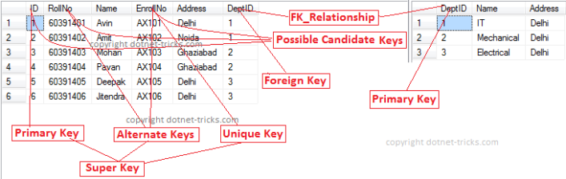
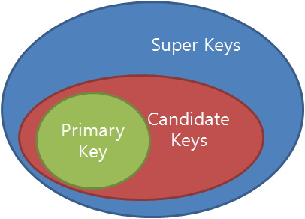
MySQL
Keys in SQL
Super Key(many attribute unique tuple identification) Unique Key(uniquely identify record, can be NULL, non-updatable)
Candidate Key(minimal Super Key) Alternate Key(unimplemented Candidate Key)
Primary Key(candidate key used by DBA, cant be null). Foreign Key(refer PK of other table)
Secondary Key(key required for indexing & faster search) Composite Key(PK composite of multiple attributes)
Surrogate Key(uniquely identify record, can’t be NULL, updatable) Partial Key(key using which all records cannot be uniquely identified)
August 7, 2020

Slide 4
MySQL
Normalization
Form
1NF | 1 table cell should contain 1 value & each record/row be unique
2NF | DB should be in 1 NF & Single Column Primary Key
3NF | DB should be in 2 NF & have no transitive dependency
3.5NF | DB should be in 3 NF & if multiple Candidate Keys, anomalies occur
4NF | DB should be in BCNF & if no table contains multivalued data describing the relative entity
5NF | DB should be in 4 NF & it cant be decomposed into smaller number of tables without loss of data
August 7, 2020

Slide 5
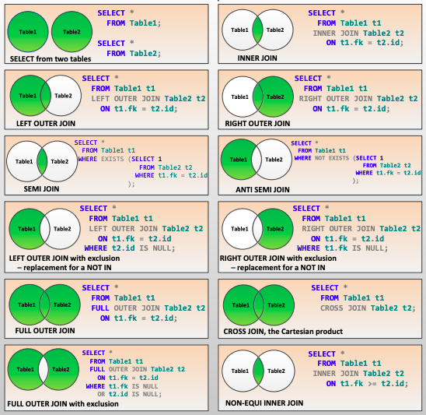
MySQL
August 7, 2020

Slide 6
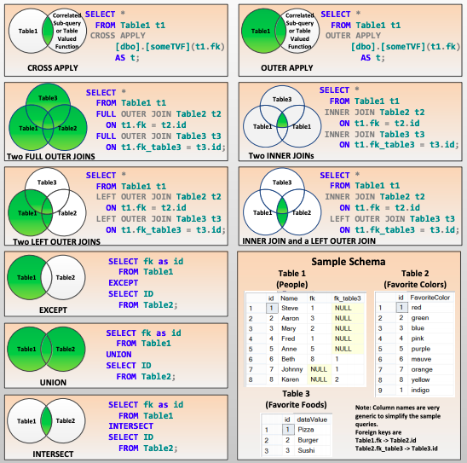
MySQL
August 7, 2020

Slide 7
MySQL
Constraint
NOT NULL | Ensures values stored in a column are not null
DEFAULT | Ensures a default value is provided to column if no other value is specified
UNIQUE | Ensures values in a column/group of column is unique
PRIMARY KEY | Ensures to uniquely identify each record in table. It is not null. Only 1 primary key per table. It can be a single/multiple columns.
FOREIGN KEY | Ensures a column in T1 refers to primary key column in T2
CHECK | Ensures values in a column/group of column satisfy a boolean expression
INDEX | Assigns a ROWID to each row before it sorts out the data
August 7, 2020

Slide 8
Sybase ASE or SAP ASE (Adaptive Server Enterprise)
Sybase System Databases Classification:
1. Master (Controls operations of ASE, stores info about other databases)
2. Model (Template for new databases, if we change model it reflects in new db)
3. Sybsystemprocs (ASE searches for System Stored procedures here, if not found then searches for it in Master)
4. Sybsystemdb (Stores info for distributed Tx propagated to remote servers)
5. Tempdb (shared space for all users of all databases)
6. Dbccdb (Tables user for IO for DBCC Check Storage Commands)
7. Sybmgmtdb (Job Schedular database)
8. pubs2 and pubs3 (sample databases)
Other Utilities:
1. Sybase Control Center (Web Based Utility to manage multiple servers, resources, monitor servers & memory)
2. DBISQL (DB Interactive SQL which is GUI tool to access Sybase ASE similar to SQLite)
August 7, 2020

Slide 9
Sybase ASE or SAP ASE (Adaptive Server Enterprise)
Sybase Global Variables
@@boottime (returns time since last boot)
@@servername (returns machine hostname)
@@version (return Sybase ASE version)
@@spid (returns server process ID)
August 7, 2020

Slide 10
Sybase ASE or SAP ASE (Adaptive Server Enterprise)
Sybase ASE Built in Functions
abs, ascii,, ltrim, rtrim, dateadd, datediff, len
avg, count, min, max, sum, case
floor, ceiling, power, sqrt
cast, convert, substring, host_name, Isnull
current_date, current_time, datalength, dateadd, getdate
upper, lower, char
coalesce(alternative for case exp)
August 7, 2020

Slide 11
Sybase ASE or SAP ASE (Adaptive Server Enterprise)
Sybase ASE Commands Brief names
alter database, alter table, begin…end, break, commit, continue, create database, create function, create index, create procedure, create table, create trigger, create view, declare, drop database, drop index, drop table, drop function, drop view, drop trigger, execute, fetch, if…else, open, return, grant, revoke, rollback, save transaction, select, set, truncate table, update
Interactive SQL (iSQL) Commands Brief names
clear, connect, disconnect, exit
Catalog Stored Procedures Brief name
sp_columns, sp_databases, sp_server_info, sp_stored_procedures, sp_tables
Inbuilt System Tables Brief name
sysdatabases, syscolumns, sysindexes, sysusers
Utilities Brief name
showserver, isql, startserver, showserver, stopserver
References
http://infocenter.sybase.com/help/topic/com.sybase.infocenter.dc70202.1570/pdf/quickref.pdf
https://www.gatevidyalay.com/keys-in-dbms/
August 7, 2020

Slide 12
THANK YOU

