Slide 1



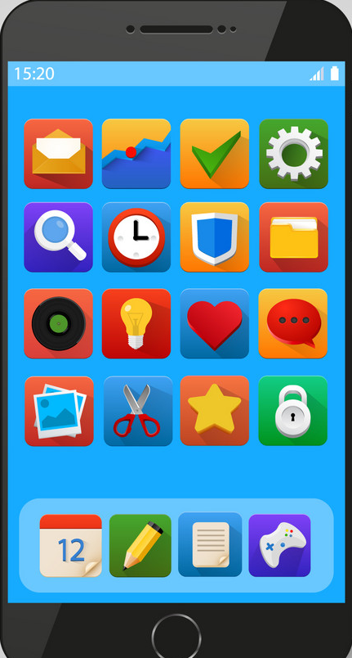
Concept in Brief – Architecture
Partner App
REST API
Computer Vision
Service
Internet
Load Balancer
Mobile App
Customer
Service
Mobile DB
Mobile Users
Auth
Service
Notes:
Note :
Hybrid Mobile App built using Angular, Bootstrap and HTML5
Build platform installer for iOS or Android (APK / IPA)
REST API Integration to server-side components
Build and Deploy server-side components (packaged as WAR) using standard based OSS technologies

