Slide 1
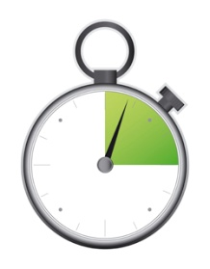
Session Tester

Slide 2
Vision
Develop a tool to aid in session-based exploratory testing
Tool manages the structure of session-based testing
Convert painful tasks into tools to help testers perform better
Create an exploratory testing IDE equivalent: “ITE” integrated test environment
  Requires different thinking and tools than programming

Slide 3
History
Big gaps in the SBT tool space. Bach scan tool deals with information already gathered. Text file format is painful.
Why not develop a tool to help testers in the same way programmers enjoy using xUnit tools?
  How do you get the information from the tester’s experience into something persisted and useful?
Tool needs to have a tiny footprint to encourage installation and use.

Slide 4
History: First Design
Developed a small, lightweight tool to enter in session information quickly, using very little screen real-estate
Goal was to aid in information capturing, and to help provide structure to enforce the SBT format
Decided to persist with XML, since it is so common, and less brittle than text files/scan tool

Slide 5
History: Development
Approached SBTM consultants, but didn’t get commitment
Aaron West and I did almost all of the initial design/development work
Decided to release early, and incrementally, and get community feedback to drive design instead of following the Bach scan tool to the letter
  Risky to release a half-baked tool, but it paid off in finding real commitment and contribution

Slide 6
History: First Release
We decided to just put what we had out there, and let the community respond
  Some consultants complained it didn’t meet their vision ,but…
Actual users loved what they saw, and saw the potential in the tool and were excited they could help drive the design
  Actual users were deviating from the Bach SBTM system in various ways
  A lot of different community ideas, but a pattern emerged

Slide 7
Community Response
We got some things right:
  Format, supporting features, XML, idea primer, timer
We got some things wrong:
  Tool was too small, no ability to edit and view sessions other than XML view, not supporting Bach format as well and scan tool
  (no Bach support for the tool as a result)

Slide 8
Community Response
The Most Common response:
Great potential!
BUT
“I’m not ready to drop my text editor and replace it with Session Tester, yet.”
We realized that text editor is what we are competing with.

Slide 9
Community Response
We now have users from all over the world, from some of the most influential companies in the world
A handful of senior, very dedicated testers from around the world
A community of practice has emerged
  Session Tester has ended up in journal articles
  Has spawned imitators
And we haven’t released a v. 1.0 yet!

Slide 10
Thoughts So Far
Given the positive and some negative reactions, I know we are on to something special
Now have the opportunity to try different technologies and ideas than we might in our day jobs
Have a dedicated community to provide feedback on the tool
“Release early, release often,” change and adjust the tool as needed works!

Slide 11
Changing Direction (slightly)
We are competing with text editors - let’s make something better!
A lot of feature requests fit into the “tester’s IDE” model
Why not create something as powerful as NetBeans or BBEdit, but smaller, simpler and designed for testers?
Let the community drive, not the consultants.
  Real projects trump theory. Watir demonstrated this.

Slide 12
0.3 Release Vision
First version of the “tester’s IDE”
  Direction change is important, and fundamental to the direction of the tool
  Enhance existing structure, smooth out usability, fix bugs

Slide 13
Longer Term Vision
Client version with team integration
  Share missions, session sheets, project information
  Ease of debrief
Reporting for auditors, managers, etc.
  Tools like XQuery, client/server frameworks will fit in here
  Still need to sort out details here

Slide 14
0.3 Release Items
User Interface changes:
  Start with full-screen, IDE style view – more than just session management
  Session browser:
    Find, view, edit sessions in usable fashion
  Text editor plugin
    Provide the power of a real text editor
    Highlight tags
Reporting
    Clean up workflow
    Clean up file system usage

Slide 15
0.3 Release
This release represents a change in the direction of the tool from simple session manager, with information gathering to a simple, powerful, “IDE for exploratory testers”
Potential to use the tool beyond session-based testing

Slide 16
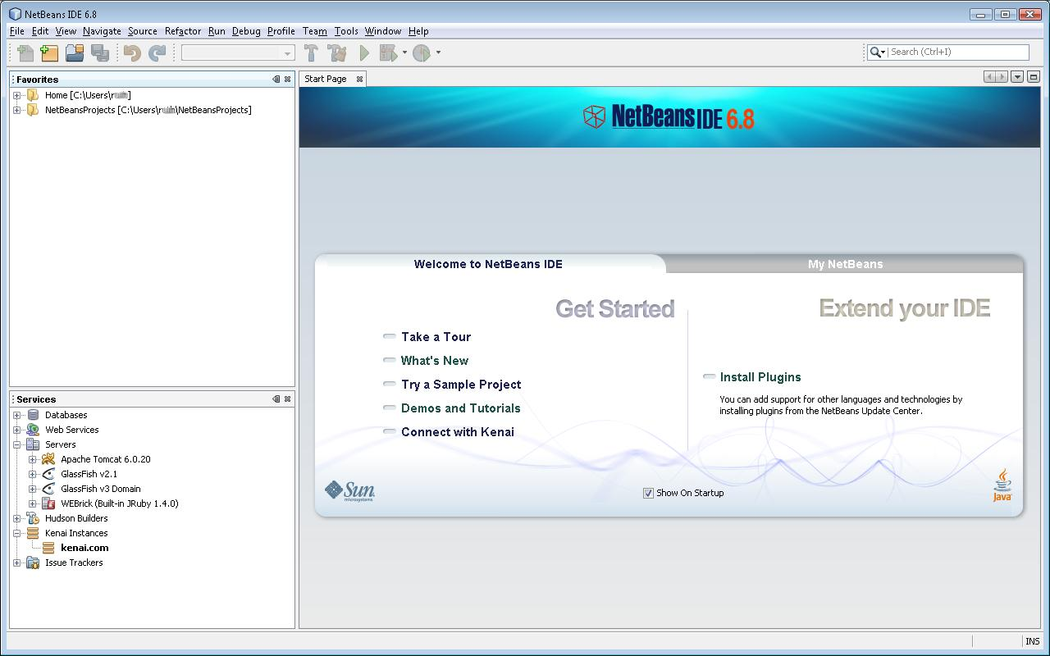
IDE Examples: Start Screen

Slide 17
ST Design Lesson
An IDE starts up and gives you a lot of places to start to be productive
A clean project/file browser on the left allows you to quickly navigate and get going
Developers can configure and wire in their own tools and use an IDE as the central tool for their work
An IDE is a generic productivity tool

Slide 18
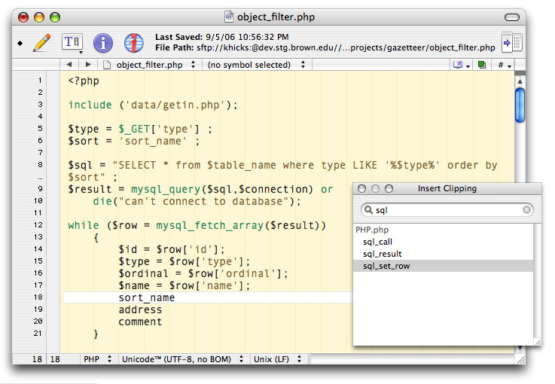
IDE Examples: Working with Text

Slide 19
ST Design Lesson
Text highlighting is important
Working with something pleasant on the eyes makes using the tool more enjoyable
Helpful tools like intellisense and context-driven options are powerful
  Will the tool help me as I think?

Slide 20
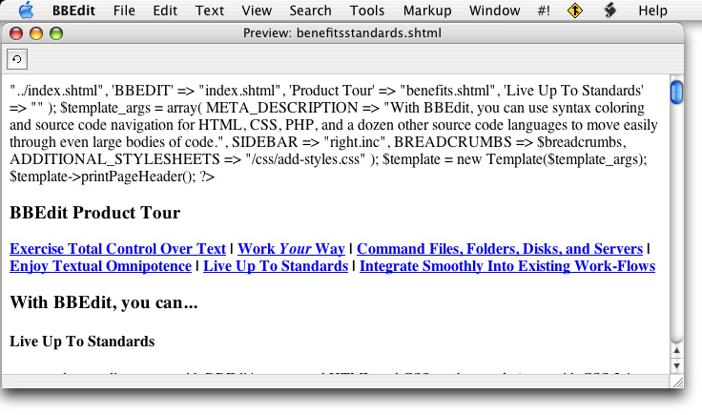
IDE Examples: Powerful File Menu

Slide 21
ST Design Lesson
A simple, useful file menu is powerful
I like BBEdit for its simplicity (or vi) :P
“#!” option allows me to wire in my own scripts
  Eg. Bash script to check out and compile
Source control integration
Search, Edit, Tools, etc. provide a lot of options
What options do testers need?

Slide 22
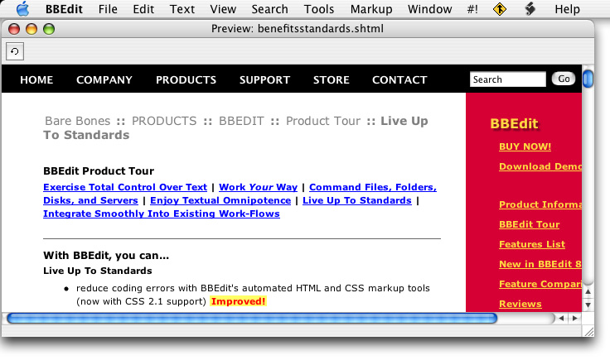
IDE Examples: WYSIWYG View

Slide 23
ST Design Lesson
Reviewing your work in a pleasant format is useful
Session debriefs are a cornerstone of SBT, so being able to have a nice display of session is important
  Edit to make sure they look ok for a reviewer/auditor
  Ease of debrief or audits
  WYSIWYG editing is also useful

Slide 24
Getting Community Feedback
I have a vision for the tool, and if we keep it small and powerful, people will use it
Ultimately, the community will decide what is useful and what isn’t
  If we get releases to them early and often, it is less painful than a big release once in a while
This is experimental development – we will get some things wrong
  Open Source projects tolerate and encourage this

Slide 25
Questions?

