Slide 1
MetricGAN-Reloaded
By
Team DeepSpeech
["MetricGAN: Generative Adversarial Networks based Black-box Metric Scores Optimization for Speech Enhancement", Fu et. al., ICML 2019.

Slide 2
Key idea: D(G(x)) is differentiable, so we can backpropagate
STOI (black box)
Difficult to differentiate, so direct training is difficult
MSE
Discriminator
D
Generator
G
Discriminator tries to provide accurate STOI scores to outputs of G
Generator must “fool” discriminator
["MetricGAN: Generative Adversarial Networks based Black-box Metric Scores Optimization for Speech Enhancement", Fu et. al., ICML 2019.

Slide 3
True STOI
STOI predicted by Discriminator
Target
0
1
Discriminator reduces/optimizes this
Generator reduces/optimizes this
The crux of MetricGAN, in one diagram.
["MetricGAN: Generative Adversarial Networks based Black-box Metric Scores Optimization for Speech Enhancement", Fu et. al., ICML 2019.

Slide 4
Demo
["MetricGAN: Generative Adversarial Networks based Black-box Metric Scores Optimization for Speech Enhancement", Fu et. al., ICML 2019.

Slide 5
Dataset
The paper used 300 utterances from the TIMIT corpus, and 10 types of noise. Even assuming 3 s per utterance, this is < 3 hours of training data.
We used the Microsoft Scalable Noisy Speech Dataset (MS-SNSD) to produce over 30 hours of training data and 1 hour of test data. Over 120 types of noises were used.
["MetricGAN: Generative Adversarial Networks based Black-box Metric Scores Optimization for Speech Enhancement", Fu et. al., ICML 2019.

Slide 6
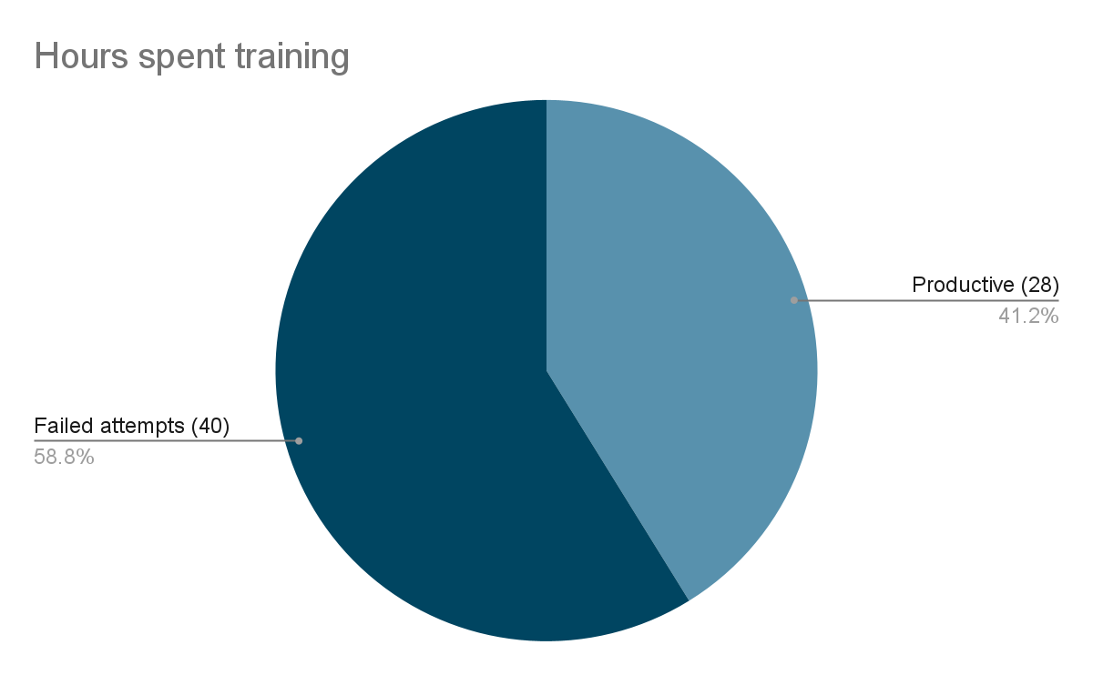
Training
We used 8 GAN epochs (v/s 200 in the paper), but each GAN epoch had 1 (before epoch 3) or 2 (after 3) discriminator epochs and 2 generator epochs.
Time per epoch: (1 or 2) x 45 min (dis) + 2 x 52 min (gen) + 30 min (run files through gen)
That is, up to 3.75 hours per epoch, or ~28 hours of “productive” training .
["MetricGAN: Generative Adversarial Networks based Black-box Metric Scores Optimization for Speech Enhancement", Fu et. al., ICML 2019.

Slide 7
Training GANs is hard.
Training MetricGANs is harder.
["MetricGAN: Generative Adversarial Networks based Black-box Metric Scores Optimization for Speech Enhancement", Fu et. al., ICML 2019.

Slide 8
New Failure Mode
STOIs were in [0.5,0.7] originally, so the Discriminator would settle for predicting “average” values without learning much.
The Generator is also happy optimizing this, which harms real STOI.
Repeats next epoch. Discriminator predicts lower values due to (2), and we degenerate into noise.
Generator
G
Added artificially constructed examples with high STOI to the training data to break (1), and also increased the complexity of the discriminator from the paper’s model.
Neither step alone managed to work. Needed both.
Discriminator
D
Partners in Crime
["MetricGAN: Generative Adversarial Networks based Black-box Metric Scores Optimization for Speech Enhancement", Fu et. al., ICML 2019.

Slide 9
Conclusion
Existence of approximate Win-Win scenarios is detrimental to adversarial training.
Data Augmentation is an effective method to break such feedback loops.
["MetricGAN: Generative Adversarial Networks based Black-box Metric Scores Optimization for Speech Enhancement", Fu et. al., ICML 2019.

Slide 10
Thank you

