Slide 1


ImpactLens
Assess infrastructure impact before implementation.
Development team
Lecturer
Members
Seed AI
Kashmira Chawak
Ashler Tet Hong Yang
Phạm Thanh Phong
Trần Thị Hồng

Slide 2

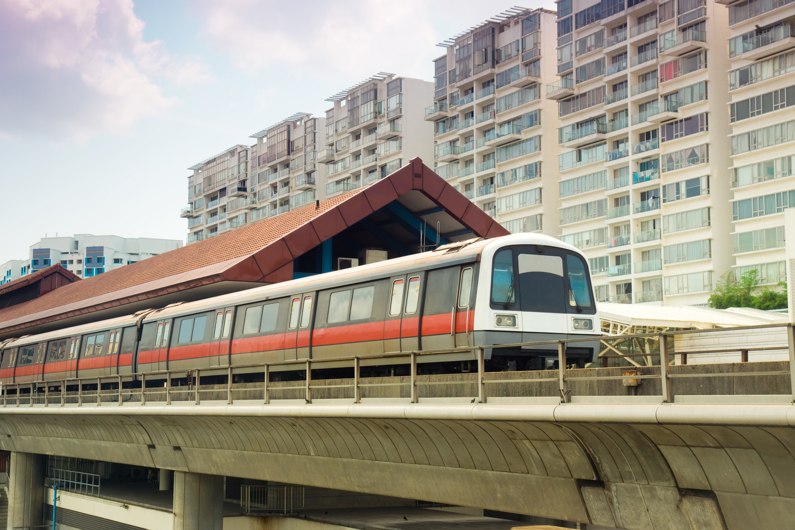

Do you know?
How often have Singapore’s biggest projects been delayed by misjudged demand and public pushback?
S$80 million project stalled for 3 years
Buangkok MRT station was ready by 2003 but remained closed to 2006 because of insufficient rider demand.
S$134.7 million highway delayed three times
A highway required exhuming about 4,000 pioneer-era graves, sparking public backlash. Exhumation ran a year behind schedule, and the road opened about two years late.

Slide 3




The Pressing Problem
Planning tools can map where people may go, but they can't tell us how people react.
Expensive listening
Surveys and focus groups take months, and testing multiple options can be expensive
Late Discoveries
Gaps surface mid-project, pushing timelines back and budgets up.
Public Pushback
Concerns only surface after launch, turning feedback into opposition.

Slide 4




Our solution
ImpactLens simulates “AI citizens”, based on real Singapore demographic data, to gauge the community impact of projects before being built
Data-grounded AI citizens
Each AI citizen is built using the real Singapore demographics data*
Full-picture impact
One run shows sentiment, concerns, usage and ripple effects (eg. commutes, rents, and local business) broken down by demographic.
Knowledge Graph
Visual representation of impact across demographics
*Simulation uses a representative sample of 4 million AI citizens, generated from SingStat demographic data.

Slide 5



Target User Group
Urban planners and transport authorities
Government policymakers
Agency policymakers
All three groups use ImpactLens to test options before decisions are made.

Slide 6





Key features
ImpactLens makes social impact forecasting simple, transparent and actionable for every planner and policymaker.
In-depth reporting
Knowledge graph
Voice to text
Human must decide
See demographic concerns and know what to fix first.
See how people, places and impacts connect.
Speak naturally. Turn voice into text.
User approves or denies certain assumptions from being made during simulation.

Slide 7
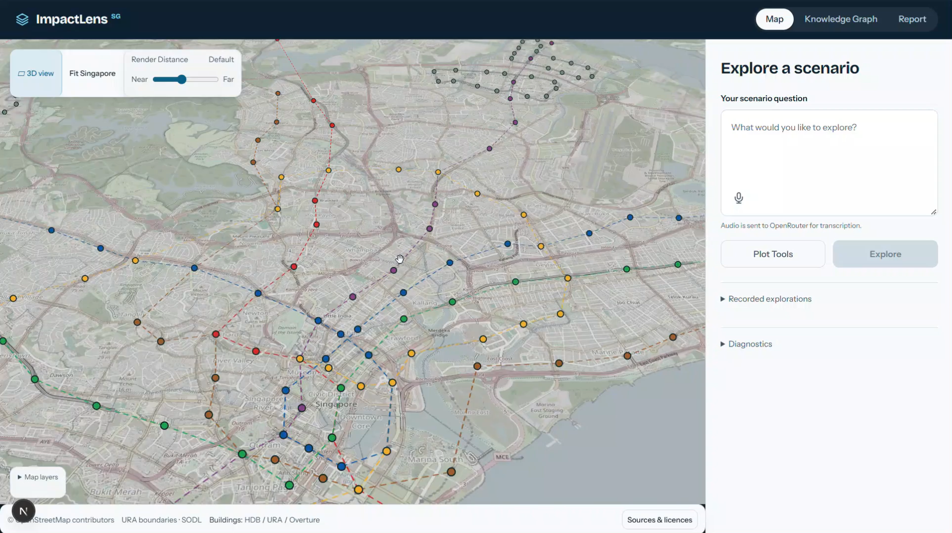

Slide 8
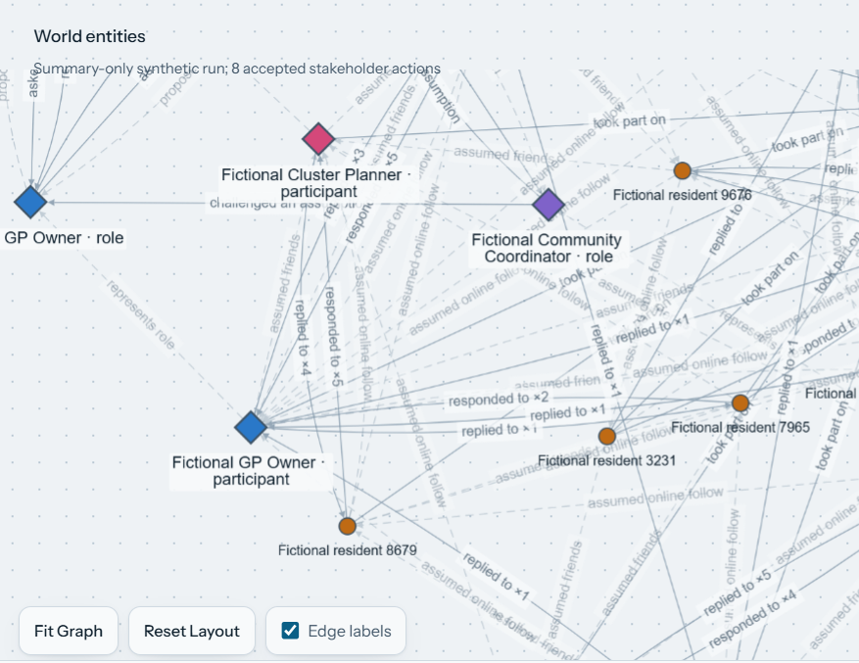
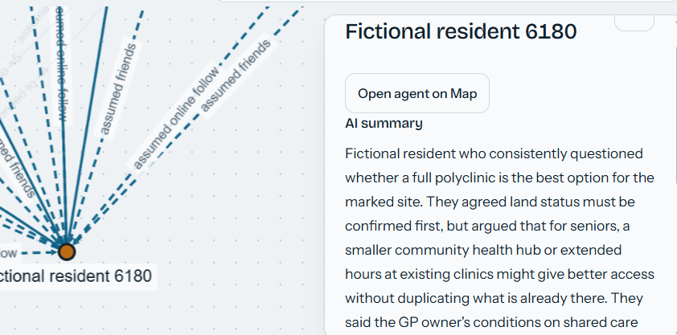
The knowledge graph shows interaction and relationships between the AI Citizens.
Clicking into a knowledge graph nodes displays a summary of its interactions.

Slide 9
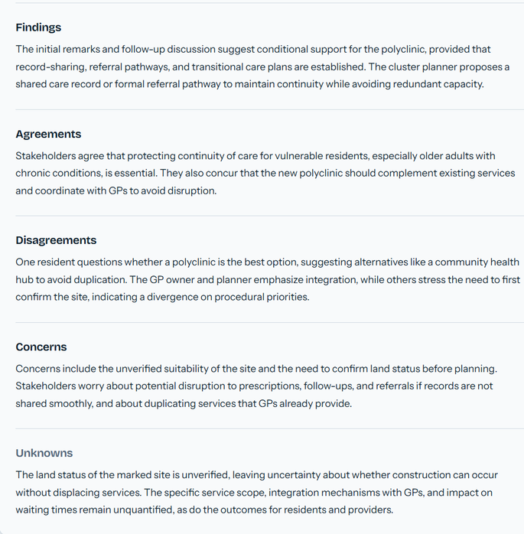
An AI summary of the Knowledge graph is generated upon completion
A detailed report is generated as well.
Points the detailed report cover:
  Overall Assessment
  Calculated Impacts
  Stakeholder Perspectives
  Agreements
  How the discussion developed
  Open questions & next steps

Slide 10




Responsible AI
AI informs decisions. People remain accountable.
Grounded in real data
Transparent by design
Exploratory tool
Protect privacy
Uses real census, housing and transport data.
Makes assumptions and risks visible.
Supports fast exploration, not final judgement.
Uses providers with zero data retention.

Slide 11
Thank you!
ImpactLens

