Slide 1
Empirical inference of Underlying Condition Probabilities Using Synthea-Generated Synthetic Health Data
Team TeMa
Dr. Michael D. Teter
miketeter@yahoo.com
Dr. Christopher E. Marks
cemarks@alum.mit.edu
Challenge Category: II (Novel Uses of Synthea Generated Data)

Slide 2
Background
Problem Motivation
Simulation is often used to investigate complicated phenomena for which analytic determination of outcome probabilities is intractable.
Synthea is built in a way that makes it well-suited for this purpose.
It inputs conditional probabilities that can be validated.
Its outputs are the result of tailorable combinations of these input probabilities.
Our Task
Use Synthea-generated data to investigate relationships between a patient's pathology and a given set of symptoms and severities.

Slide 3
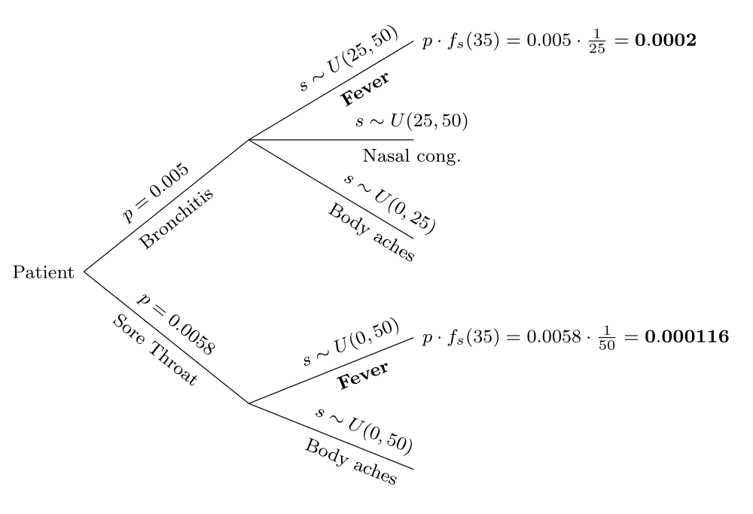
Our Methods (1 of 2)
Empirical Bayes
Canonical Bayesian analysis
Using empirical distributions in Synthea data, no need to enumerate a complicated tree.

Slide 4
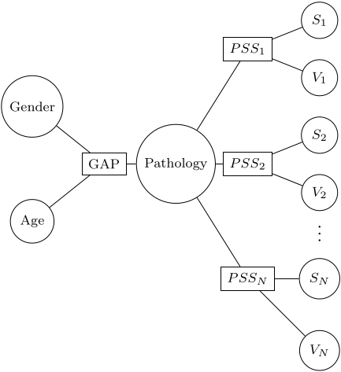
Our Methods (2 of 2)
Bayesian Network
Graph-based machine learning method.
We decide which variables are related.
More versatile than the strictly empirical model.

Slide 5
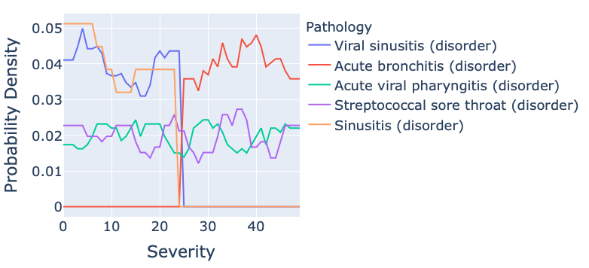
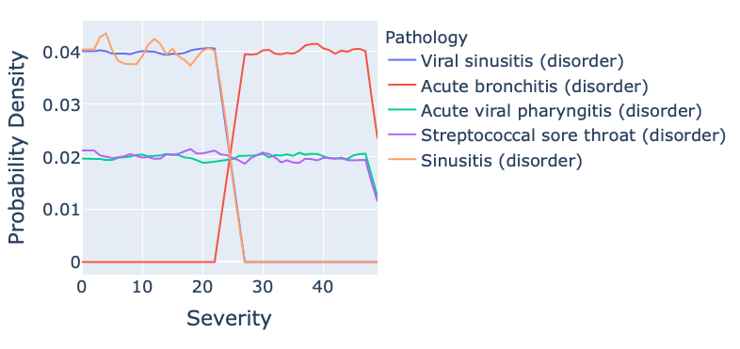
Example Outputs
Empirical
Bayes
Patient
5 years old
Female
Fever
Bayesian Network

Slide 6
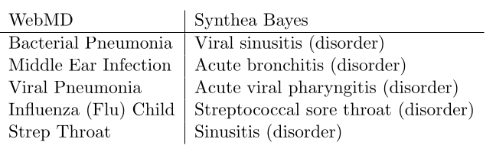
Validation
Internal Validation through code testing
External Validation through comparison with existing tools.
A useful method for validating Synthea!
External validation: comparison with WebMD

Slide 7
Summary & Next Steps
Our approach can be extended to account for demographics, encounter types, patient location, patient history, etc.
Compare results to known distributions as a way of validating Synthea.
Identify areas where Synthea can be improved.
Standardization!
Look for real-world applications.
Rare pathologies?

