Slide 1
Reasoning About
Action Feasibility from Physical Properties
Alex, Hyejin, Liangliang, Xiye
Sep 21, 2026

Slide 2
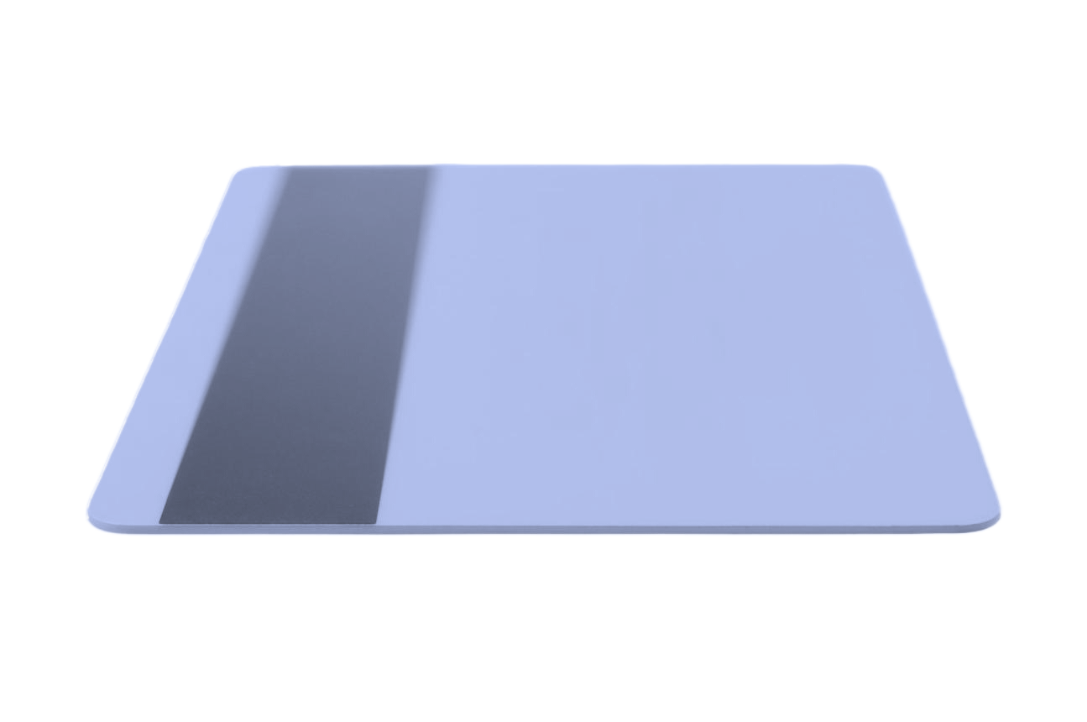
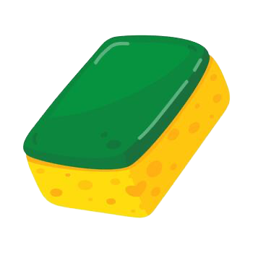
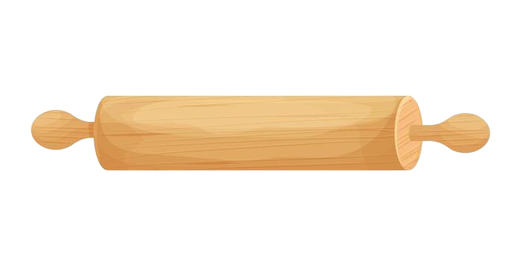
Oops, No Knife in the Kitchen Again!
Goal: Cut a carrot
1. Plastic Card
2. Rolling Pin
3. Sponge
Imagine that a conventional cutting tool is unavailable:
You have only three objects: a plastic card, a rolling pin, and a sponge.
Which object could physically support cutting?
And how can we explain why it would work?

Slide 3

Same Object Name, Different Physical Properties
You might think, “Why not just ask an LLM?” But simply answering “plastic card” is not enough.
A rigid card
Its edge may satisfy the physical requirements for Cut.
A flexible card
The same object category may no longer satisfy those requirements.
Even within the same object category, physical properties can differ. A rigid card and a flexible card may have very different cutting capabilities.
So, instead of relying on object names, we need to reason about the physical properties that make cutting possible.

Slide 4
Our Course Project: A Focused Scope
One action: CUT
Reasoning about cutting feasibility from physical properties
In Scope
• One action: Cut
• Fixed target: Carrot
• Ordinary human actor in a kitchen
• Already represented object-part properties
• Property–requirement reasoning
Out of Scope
• Other actions (Open, Pour, Squeeze)
• Identifying properties from raw inputs
• General action–target applicability
• Robots, vision, and object recognition
• Broader environments and industrial tools
Evaluation example: Cutting a carrot
Our main goal: Define the physical requirements for Cut and formalize their relationships with object-part properties.
What our ontology does: Given already represented physical properties, evaluate whether they satisfy the cutting requirements and explain the result.
What it does not do: Identify properties from raw images or determine action applicability to arbitrary targets. These belong to a larger system.
* We will update our written use case accordingly.

Slide 5
Core Ontology Idea
The ontology represents two connected structures, as shown on the left.
Reasoning:
  What object can support Cut?
  Is the object incompatible for the action or information that the current ontology has is insufficient?
  Provide a property-based explanation for the result.
Object
Action
ObjectPart
ActionRequirement
PhysicalProperty
Reasoning

Slide 6
Example
Rigid Card
Flexible Card
CUT
Card edge
CUT
Card edge
Sufficiently thin;
Rigid
Sufficiently thin;
Rigid
Sufficiently thin;
Rigid
Sufficiently thin;
Insufficiently rigid
Requirements satisfied
Explicit conflict
Feasible under represented conditions
Infeasible under represented conditions

Slide 7
Actors and Interaction
Researcher
Ordinary Human Actor
Ontology-Based Reasoning System
Knowledge Base/
Data Source
Submits queries to the ontology-based reasoning system. Receives the resulting feasibility judgment, candidate objects, and property-based explanations.
Represents the assumed physical capabilities of the person who would perform the action.
Uses the ontology to retrieve the requirements associated with Cut, identify relevant object parts and their represented physical properties, and reason about whether those properties satisfy or conflict with the action requirements.
Supplies structured information used to populate or support the ontology, including objects, object parts, physical properties, and evidence used to define or refine cutting requirements.

Slide 8
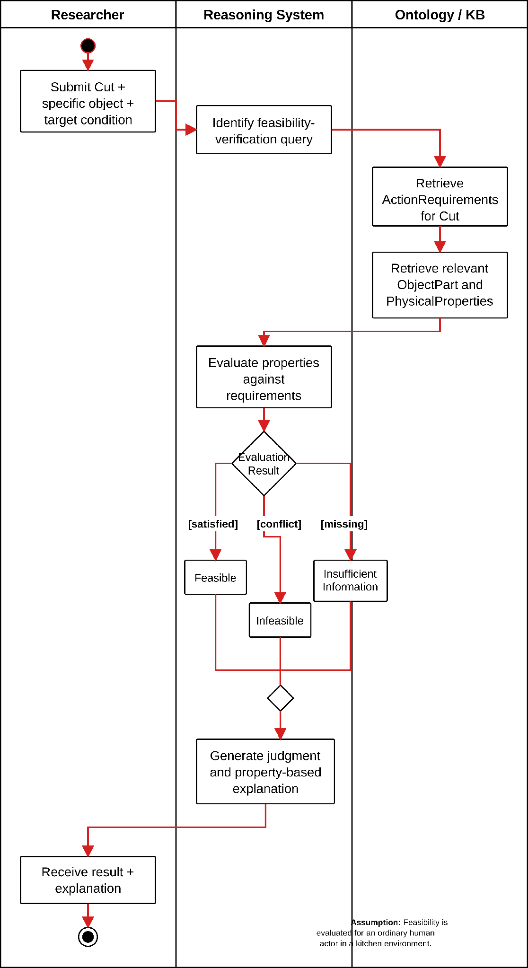
Usage Scenario 1:
Feasibility Verification
A researcher studying physical affordances wants to determine whether a specific everyday object could be used by an ordinary human actor to perform CUT in a kitchen setting.
  "Can a rigid plastic card could be used to cut a carrot"
The system uses the ontology to:
  Retrieve the physical requirements represented for cutting
  Identify the relevant part of the card
  Retrieve the physical properties associated with that part.
It then determines whether those represented properties SATISFY or CONFLICT with the cutting requirements.
The desired outcome is a feasible, infeasible, or insufficient-information judgment
  Paired with an explanation identifying the relevant object part, physical properties, and physical requirements that support the result.

Slide 9
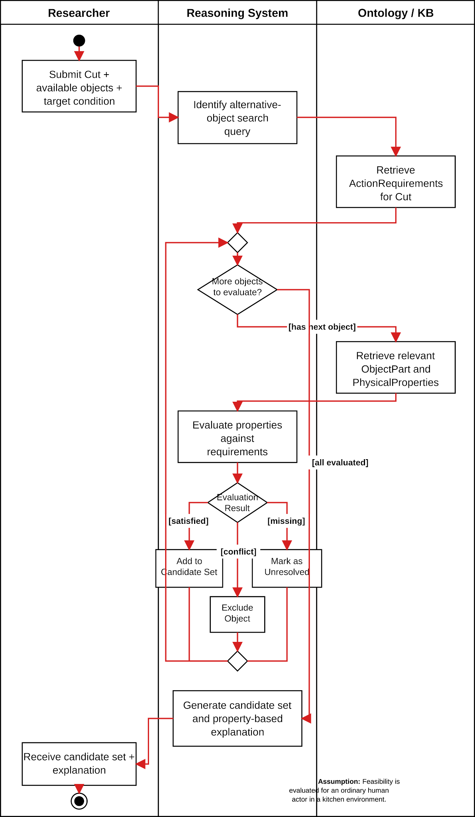
Usage Scenario 2:
Goal-Driven Alternative Object Discovery
A researcher studying alternative object use wants to identify which objects from a known set of available kitchen items could support CUT when a conventional cutting tool is unavailable or unusable.
  For example: the available objects may include a rigid plastic card, a rolling pin, and a kitchen sponge.
Rather than searching for objects conventionally categorized as cutting tools:
  the system starts from the physical requirements represented for cutting
  The system uses the ontology to examine the relevant parts and properties of each available object.
Objects whose represented properties satisfy the cutting requirements are RETURNED as candidates
  Objects with explicitly incompatible properties are EXCLUDED.
The desired outcome is a set of physically plausible alternative objects
  paired with property-based explanations for why each candidate satisfies the represented cutting requirements.

Slide 10
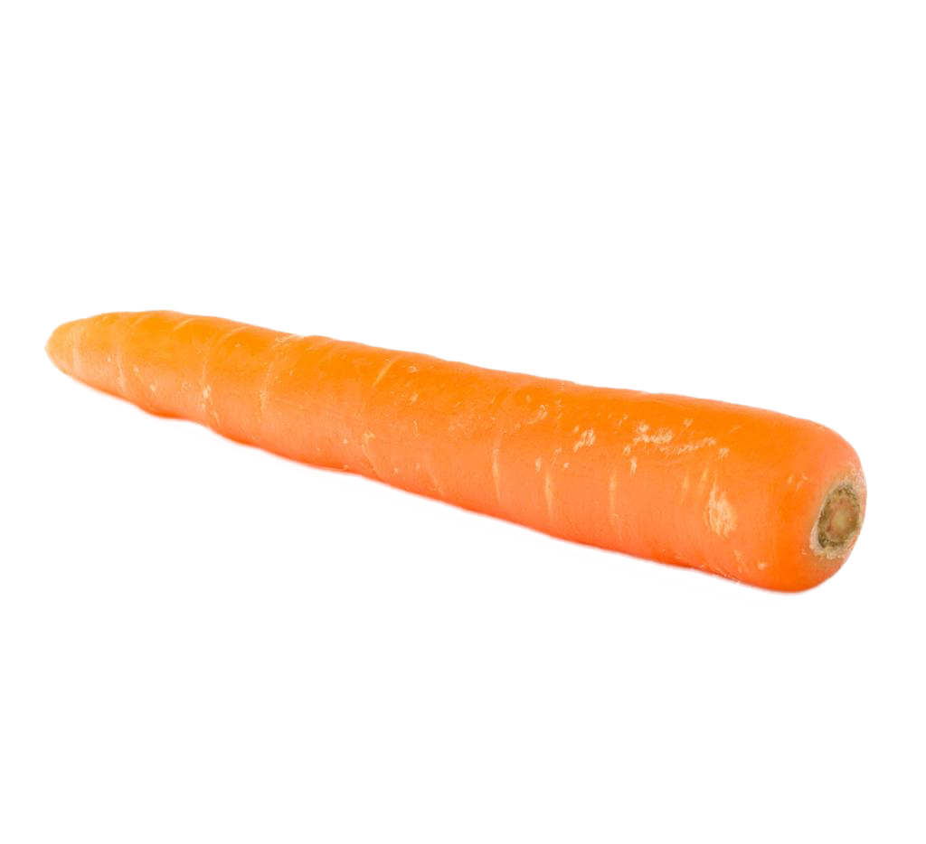
Can Our Ontology Answer a Concrete Question?
CQ1.1: Given the represented properties of a plastic card,
can an ordinary human actor use it to cut a carrot, and why?
Ontology approach
Given the represented properties of the card,
Retrieve the ActionRequirements for Cut.
Compare the properties with the requirements.
Example answer: Feasible under the represented conditions, because the card edge satisfies the relevant cutting requirements.
Represented
object-part properties
Plastic Card
↓
Card Edge
↓
(Thin + sufficient rigidity)
Cut requirements
(target: carrot)
Cut
↓
ActionRequirements
↓
(Thin + sufficient rigidity)

Slide 11
Can We Actually Build This?
A focused ontology supported by curated data
Resource | Role in our project
EPIC-KITCHENS-100 | Kitchen action vocabulary and source context for Cut
Feasibility annotations | Object parts, physical properties, feasible/infeasible examples
Counterfactual annotations | Supporting examples for refining physical requirements
WordNet + Relations Ontology | Terminology normalization and potential reuse of existing relations
Data: A curated Cut-specific subset will supply the object-part properties and feasibility examples.
Implementation: Represent the necessary ontology relations and test our four competency questions.
Main challenge: Formalizing property–requirement compatibility while distinguishing explicit conflict from missing information.

Slide 12
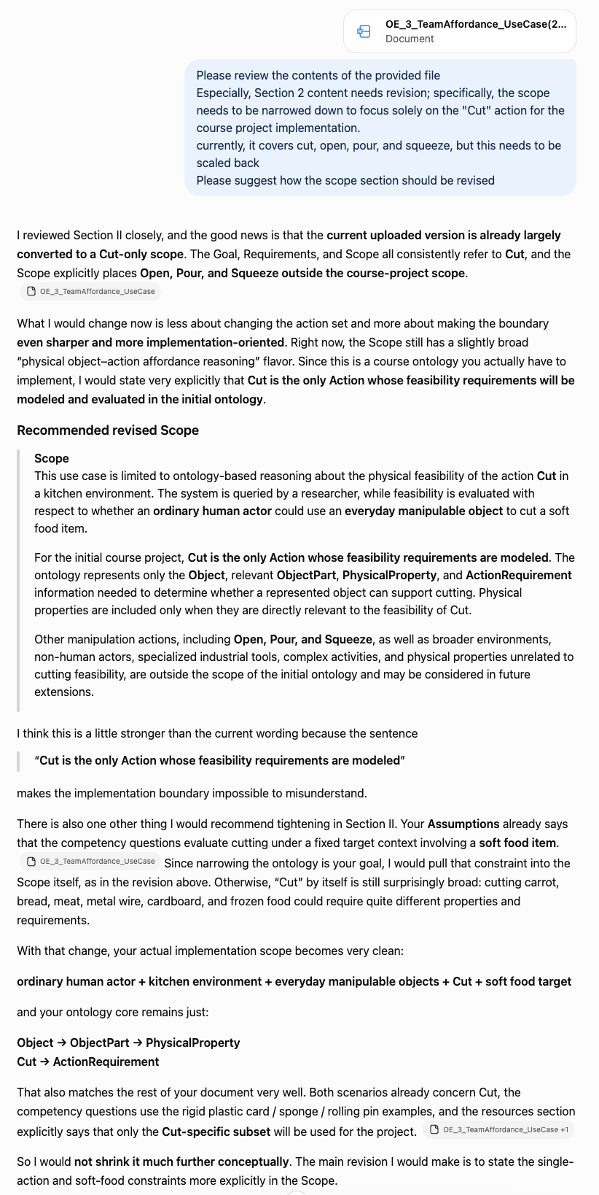
GenAI Use + What Changed
Model: ChatGPT 5.6
GenAI was used to:
  Refine the scope to Cut only.
  Clarify Researcher vs. Ordinary Human Actor.
  Plan the UML activity diagrams.
Further clarification from team discussion:
  Represented physical properties are assumed as input.
  Our ontology evaluates property–requirement compatibility
  rather than identifying properties from raw objects.

