Slide 1
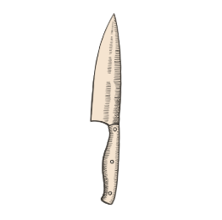

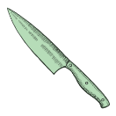
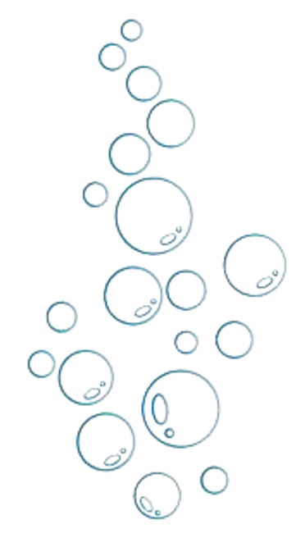
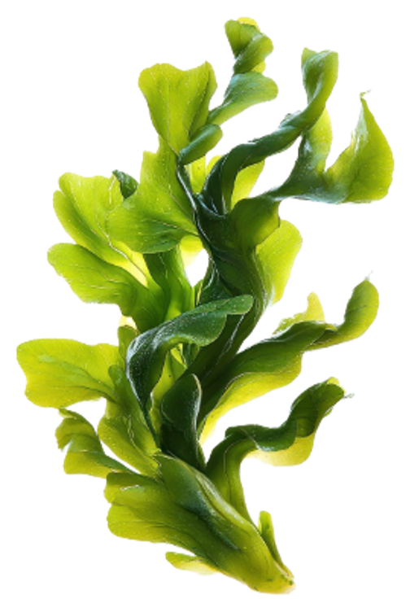
Reasoning About
CUT Feasibility from Physical Properties
Team Affordance
Alex Clark, Hyejin Park, Liangliang Zhang, Xiye Fan

Slide 2
Project Overview
Ontology explains how the physical properties, object parts, and relationships between parts supports or prevents the physical actions or capabilities of a given object
A researcher supplies structured descriptions of candidates—their known properties, relevant parts, and part relationships
Evaluation Rule:
  Feasible – configuration satisfies all requirements of action
  Infeasible – every evaluated configuration of action is blocked by known evidence
  Insufficient Information – No conclusion
The system does not recognize objects, estimate properties from images, or derive capabilities from conventional functions
Scoped to only the CUT action – extend to more actions if time permits
Assumes an ordinary human actor in an everyday kitchen setting

Slide 3
Competency Questions
CQ1.1 — Can a rigid plastic card be used by an ordinary human actor to cut a carrot, and why?
CQ1.2 — Can a typical kitchen sponge be used to cut a carrot, and why or why not?
CQ2.1 — If a conventional cutting tool is unavailable, which of the following available objects could satisfy the represented physical requirements for cutting a carrot: a rigid plastic card, a rolling pin, or a kitchen sponge?
CQ2.2 — Why can a rigid plastic card be returned as a candidate for cutting a carrot while a kitchen sponge is excluded?
CQ3.1 — Can a knife and a pair of scissors both support CUT despite having different relevant part structures and part relationships?

Slide 4
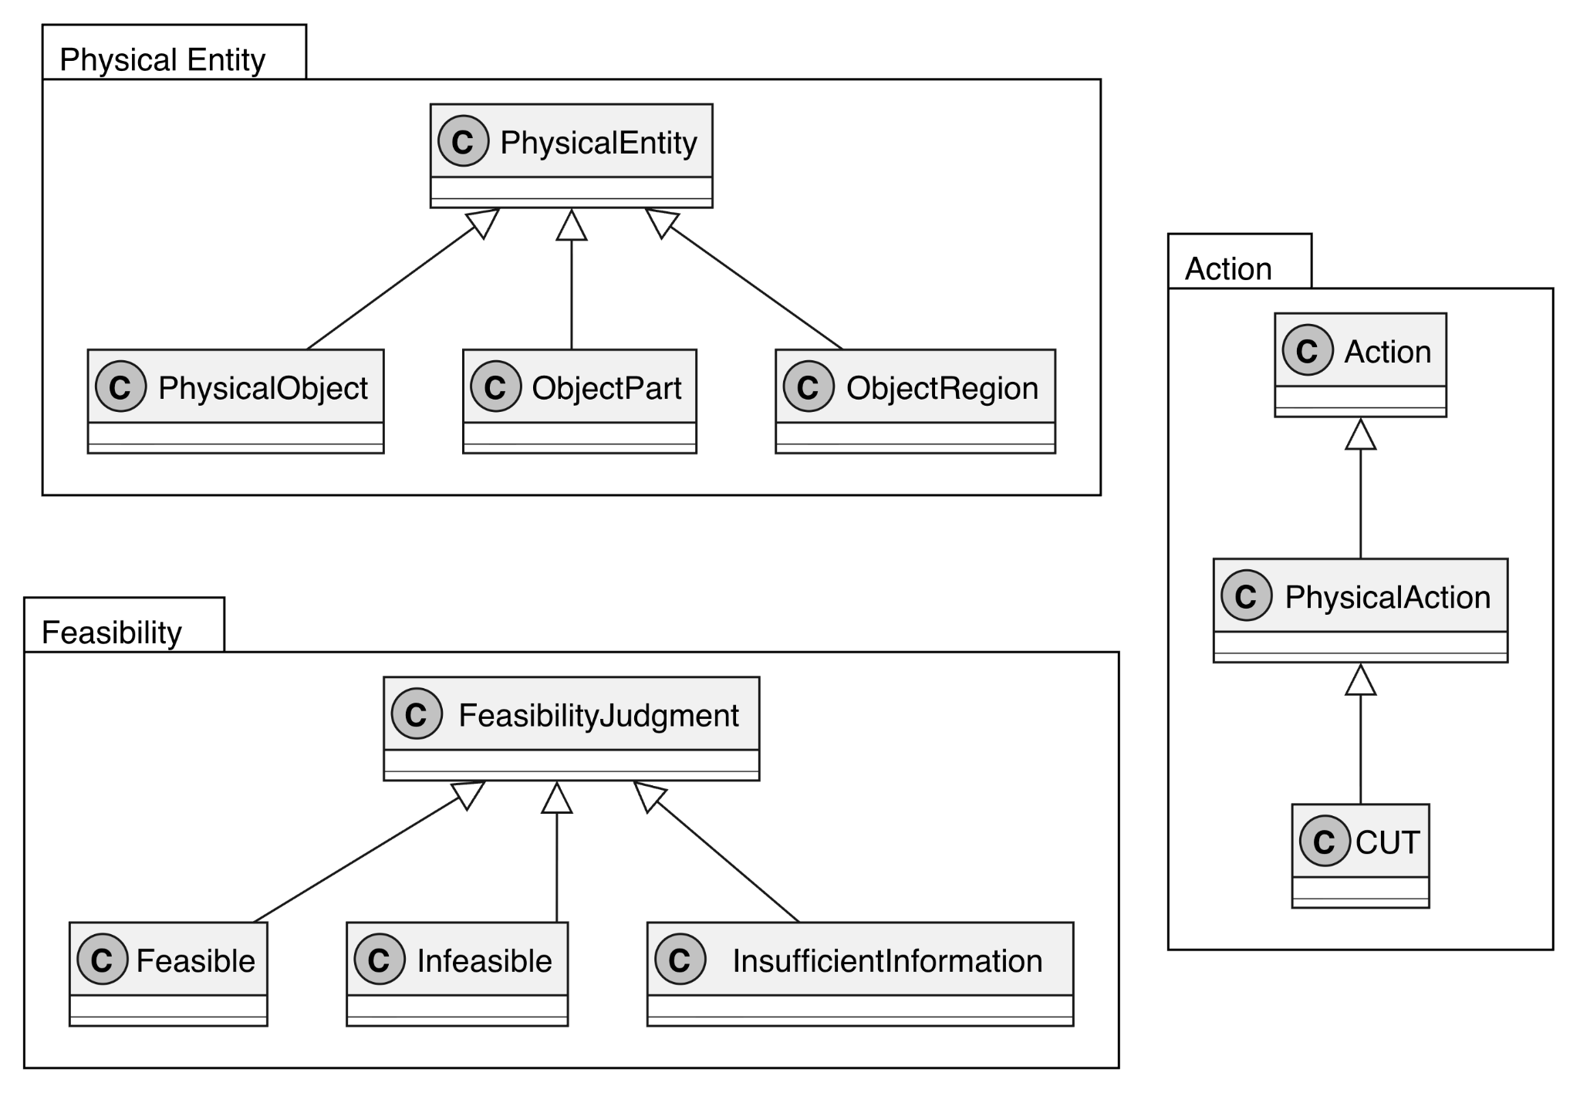
Conceptual Model — Classes
Physical Entity: represents the physical things involved in the task, including PhysicalObject, ObjectPart, and ObjectRegion.
Action: represents the activity being evaluated, with CUT modeled as a specific PhysicalAction.
Feasibility: represents the outcome of the evaluation, with Feasible, Infeasible, and InsufficientInformation as possible judgments.

Slide 5
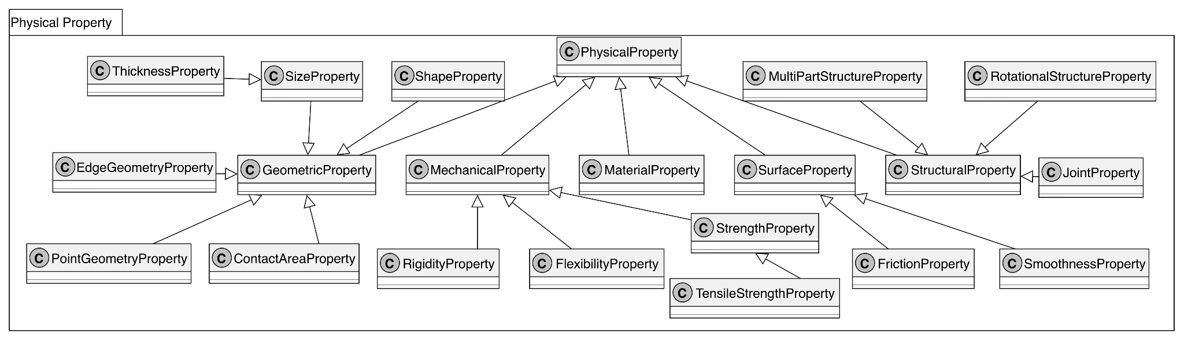
Conceptual Model — Classes
Physical Property: represents the physical characteristics used for feasibility reasoning.
  Geometric properties: capture shape, size, thickness, edge geometry, point geometry, and contact area.
  Mechanical properties: capture rigidity, flexibility, strength, and tensile strength.
  Surface properties: capture friction and smoothness.
  Structural properties: capture joints, rotational structures, and multi-part structures.
  MaterialProperty remains a separate physical-property category for material-related characteristics.

Slide 6
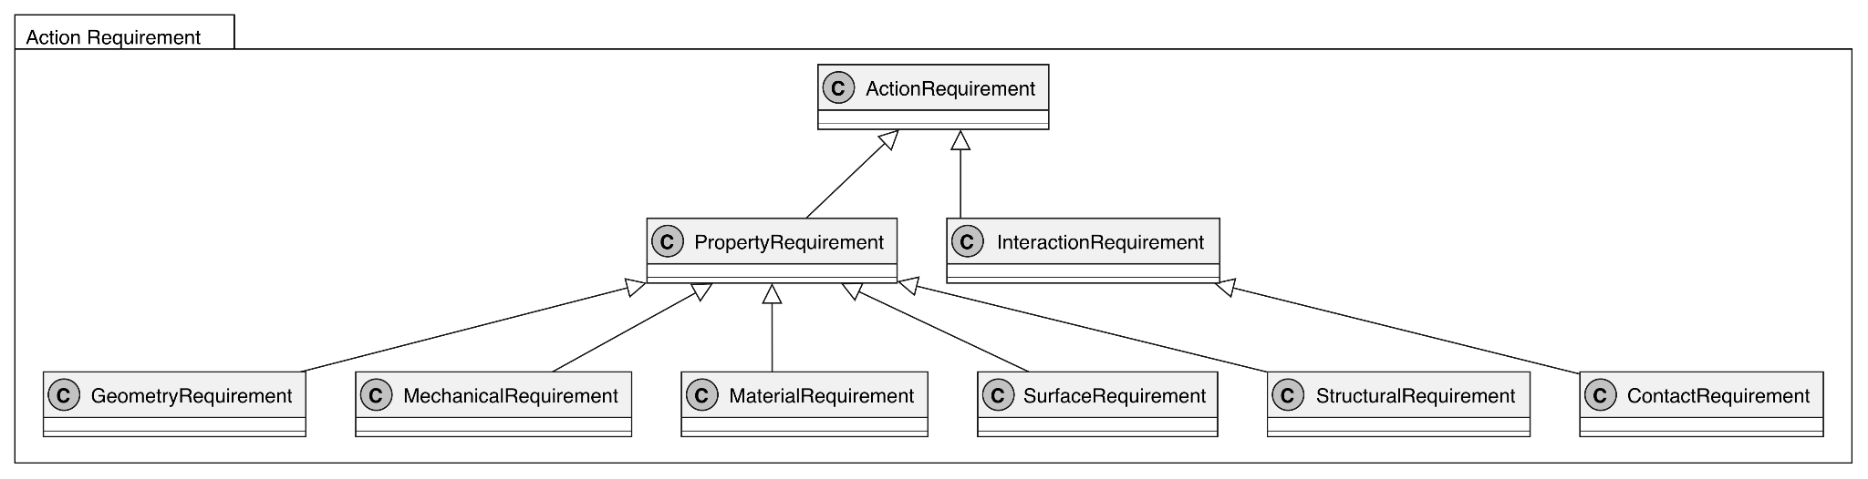
Conceptual Model — Classes
ActionRequirement captures the conditions needed for an action to be feasible.
  PropertyRequirement covers geometry, mechanical, material, surface, and structural conditions.
    6 requirements
  InteractionRequirement captures how the action physically interacts with the object.
    ContactRequirement specializes interaction requirements related to physical contact.

Slide 7
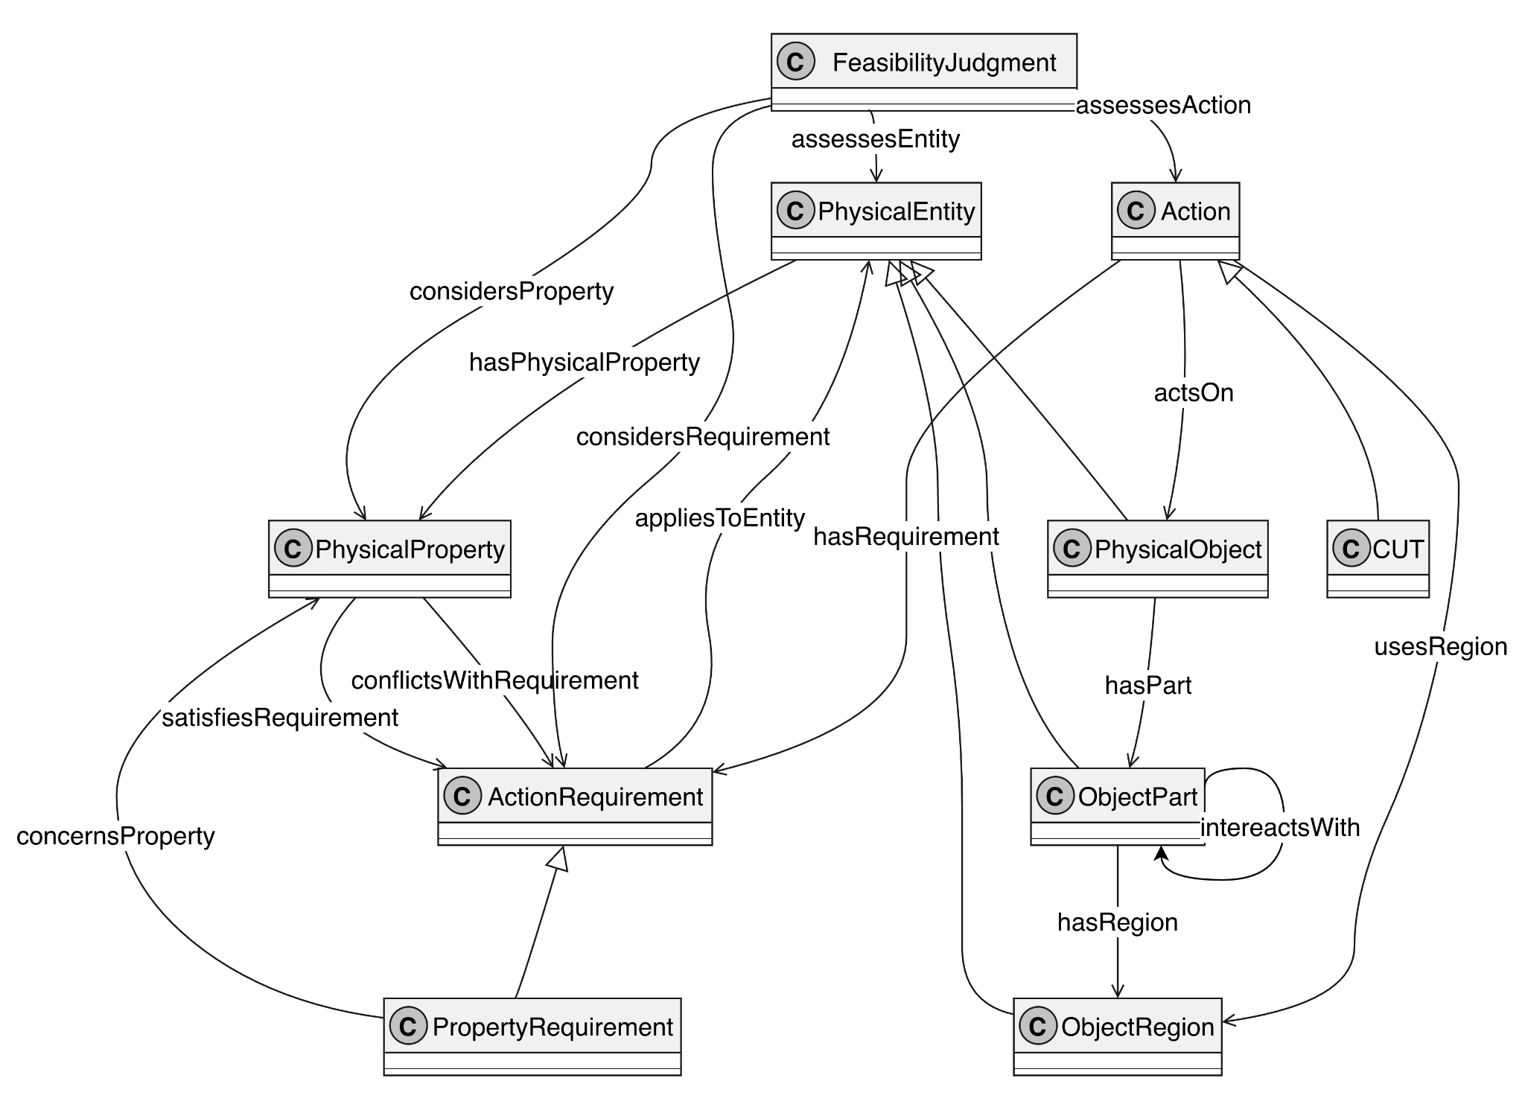
Our SEAWEED Relation Diagram
It may look like seaweed at first,
but every connection has a role in the reasoning!

Slide 8
Idea 1: Find the Relevant Physical Structure
Let’s break the seaweed into three ideas.
①
1. Identify the relevant physical structure
An object may contain multiple parts and regions.
CUT may depend on a specific edge, surface, or interacting part.
Therefore, the ontology reasons about relevant parts rather than the object as a whole.

Slide 9
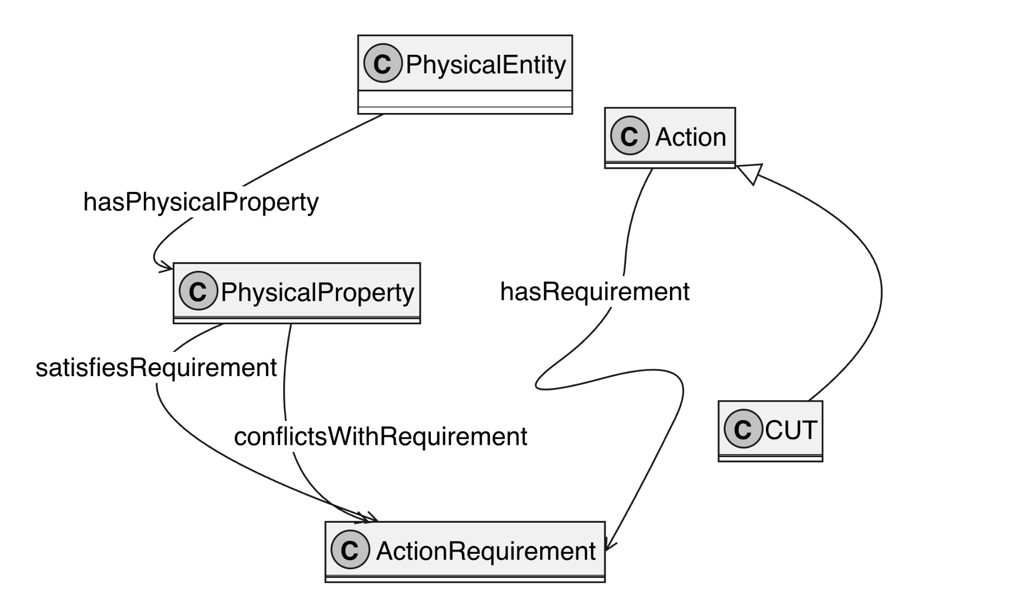
Idea 2: How the comparison works
②
2. Compare physical properties with CUT requirements
CUT is associated with physical requirements.
Candidate properties are evaluated against these requirements.
Properties may satisfy or conflict with a requirement.
Missing information is not automatically treated as a conflict.

Slide 10
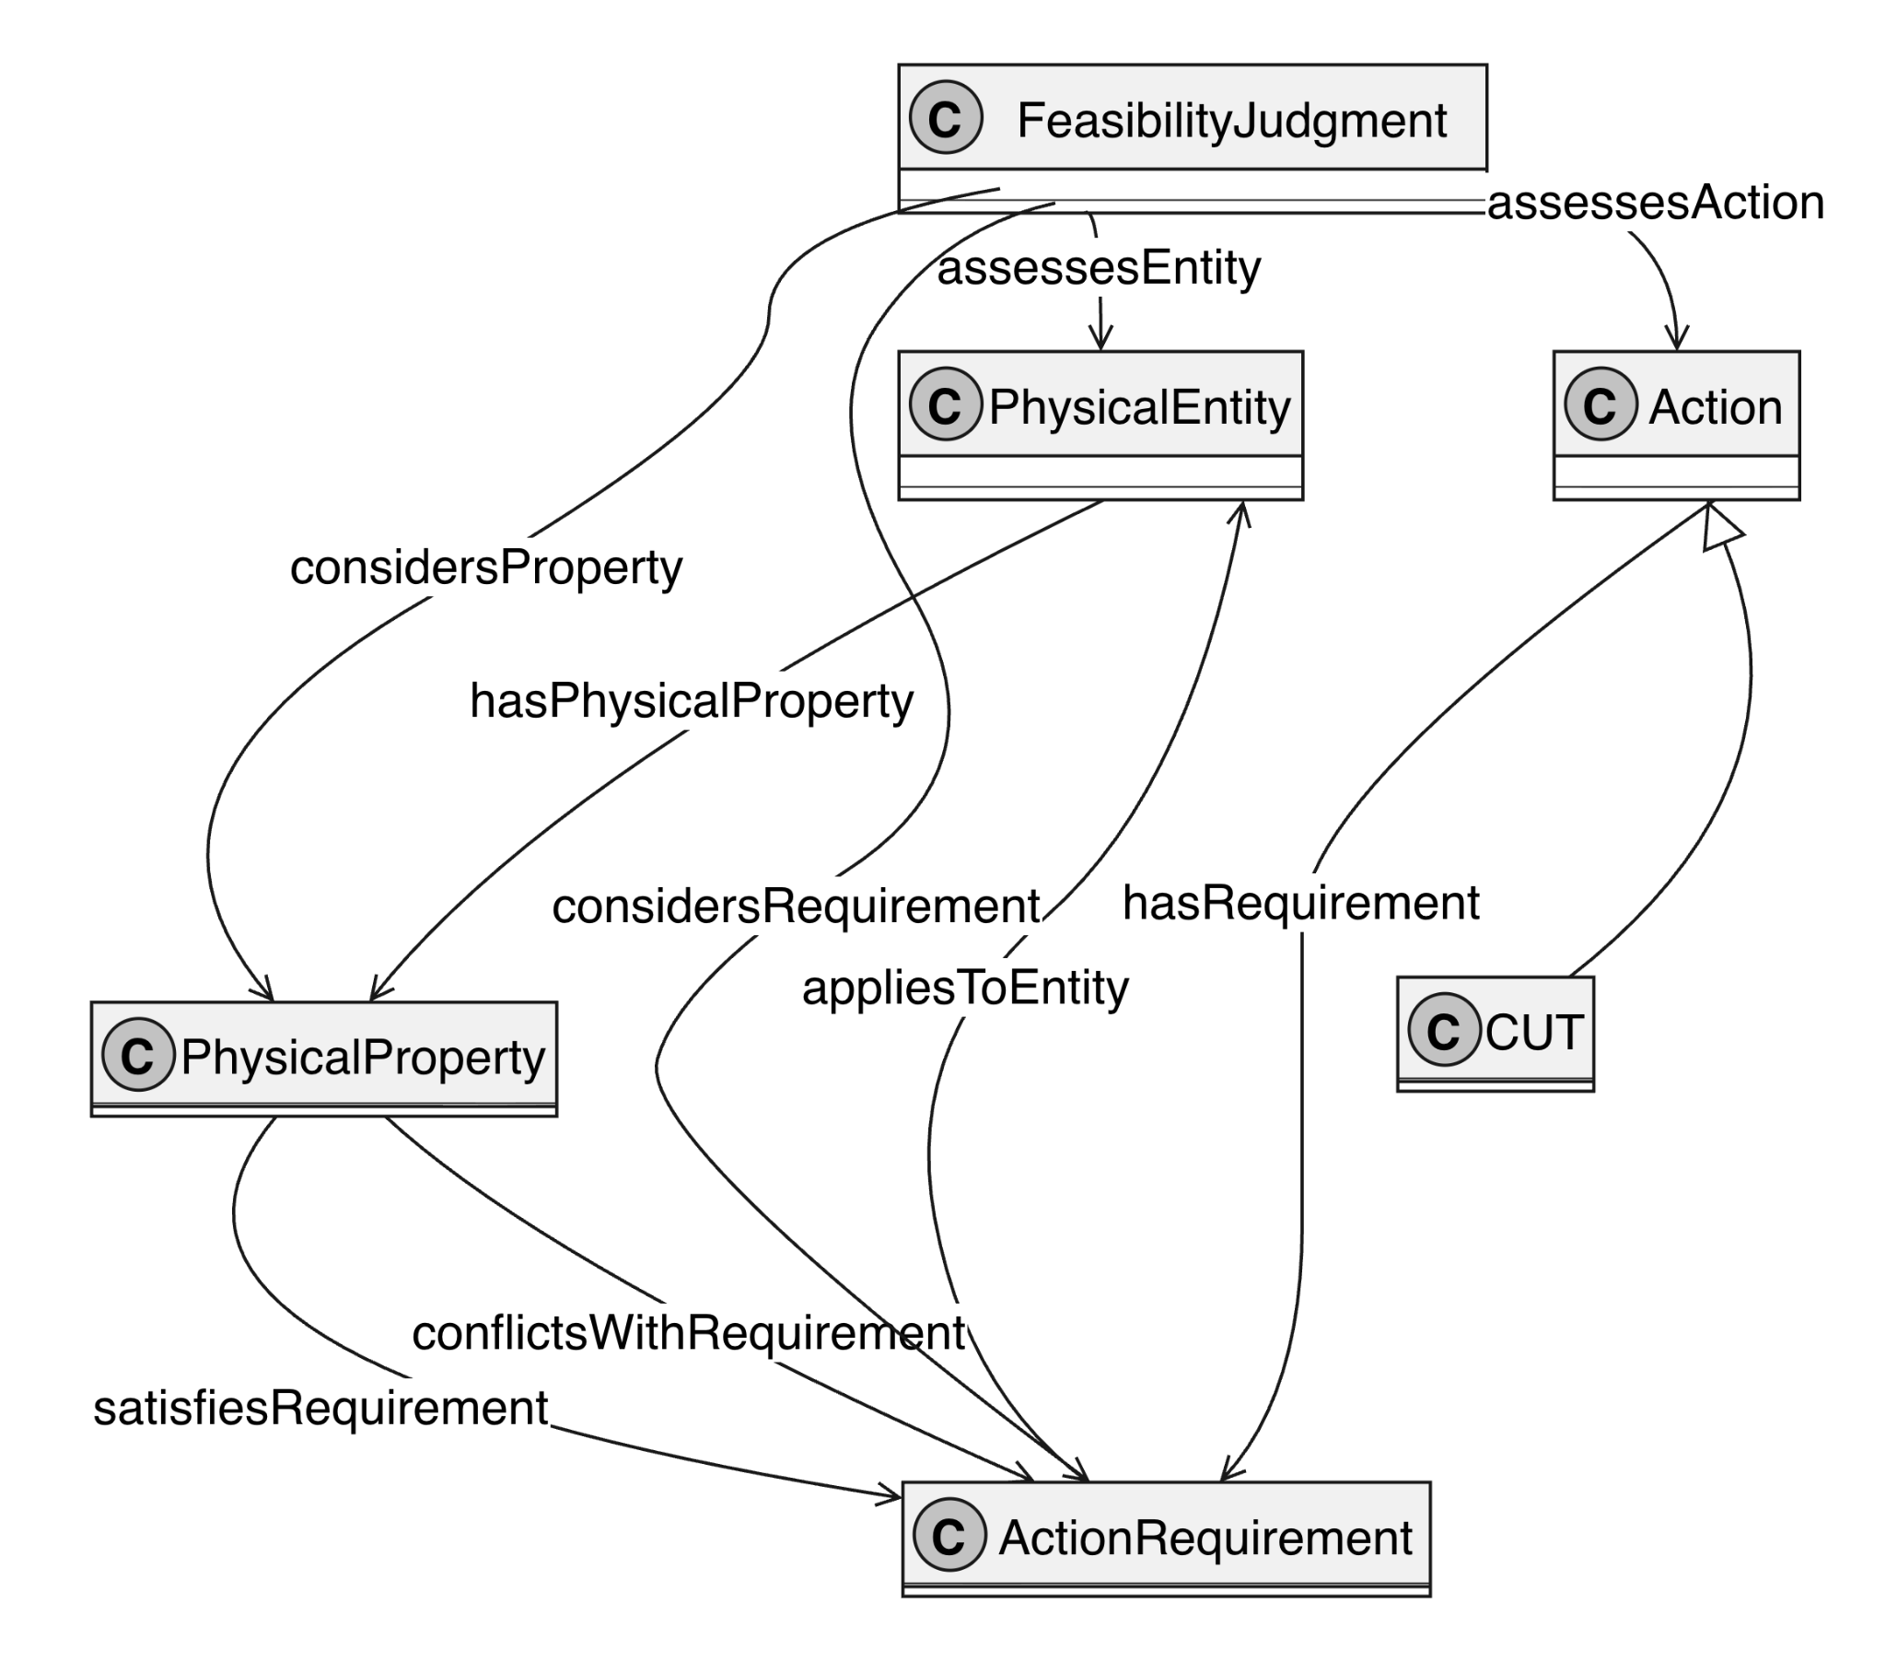
Idea 3: How the final judgment is built
③
3. Produce an explainable feasibility judgment
The judgment considers the candidate physical description
It records the relevant properties and requirements.
Supporting and conflicting evidence can be traced.
This supports feasible, infeasible, or insufficient-information results.

Slide 11
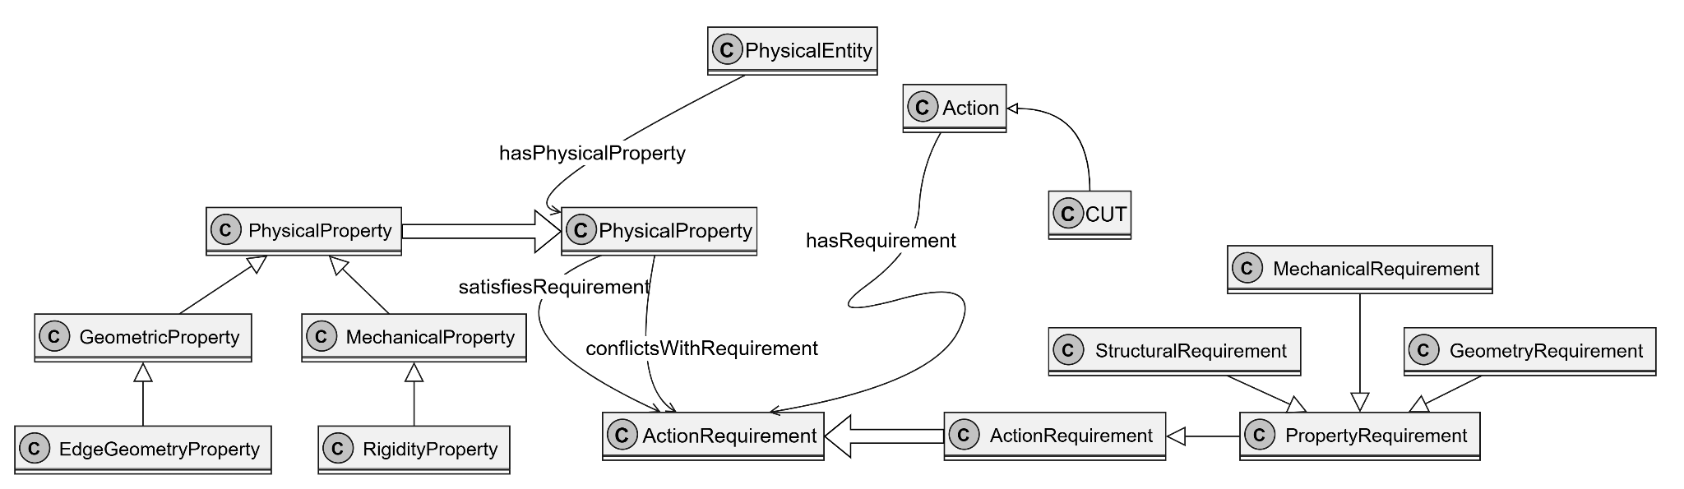
How the Model Addresses the CQs
Example CQ 1.1: Can a rigid plastic card be used by an ordinary human actor to cut a carrot, and why?

Slide 12
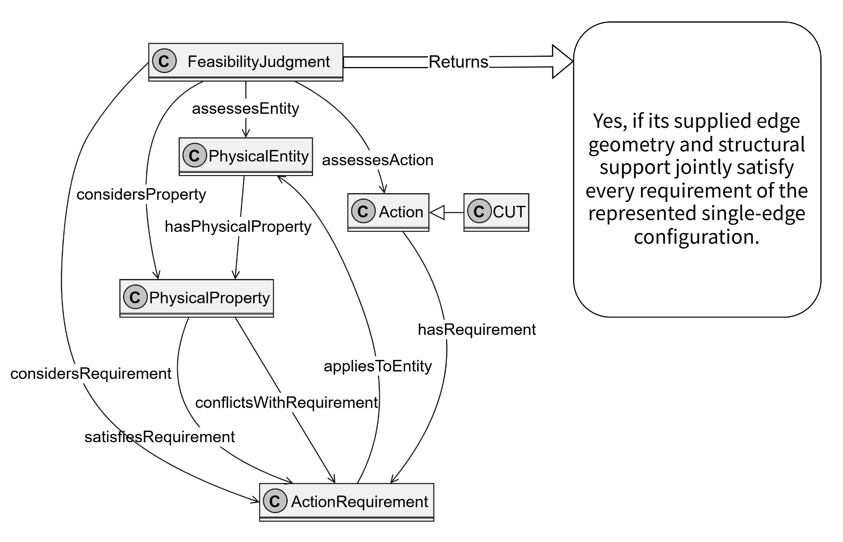
Example CQ 1.1: Can a rigid plastic card be used by an ordinary human actor to cut a carrot, and why?

Slide 13
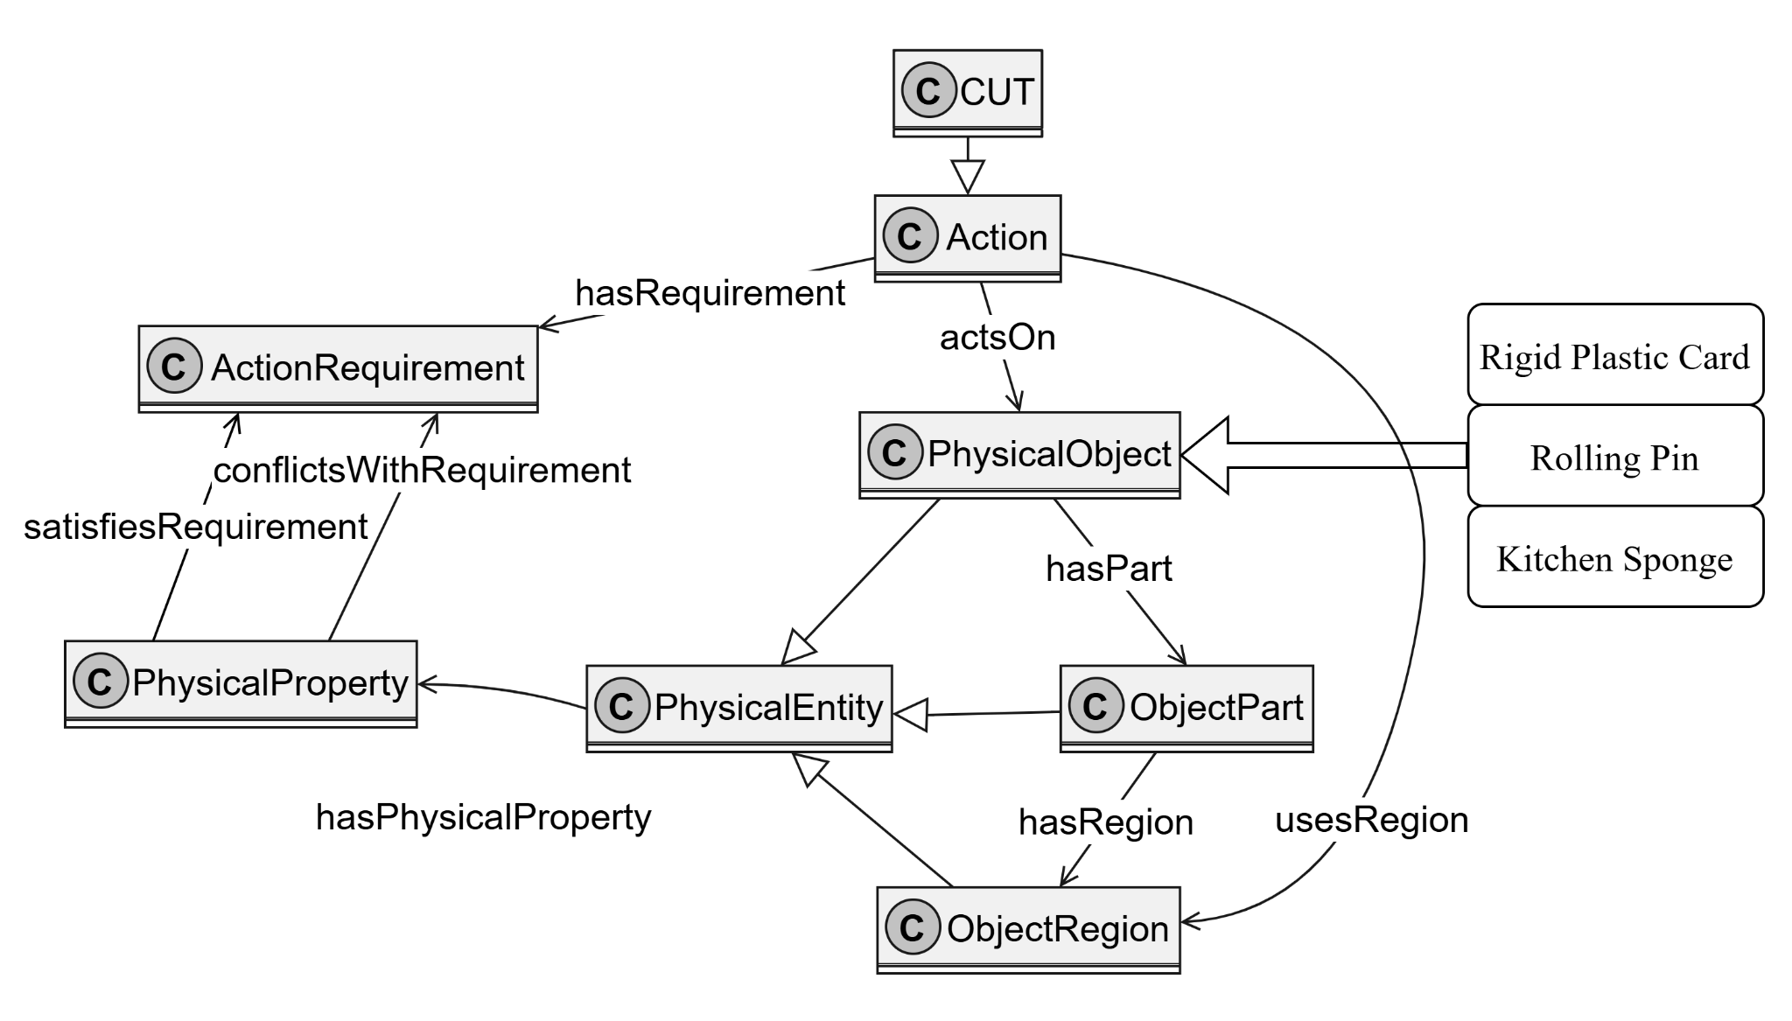
Example CQ 2.1: If a conventional cutting tool is unavailable, which of the following available objects could satisfy the represented physical requirements for cutting a carrot: a rigid plastic card, a rolling pin, or a kitchen sponge?
Individuals

Slide 14
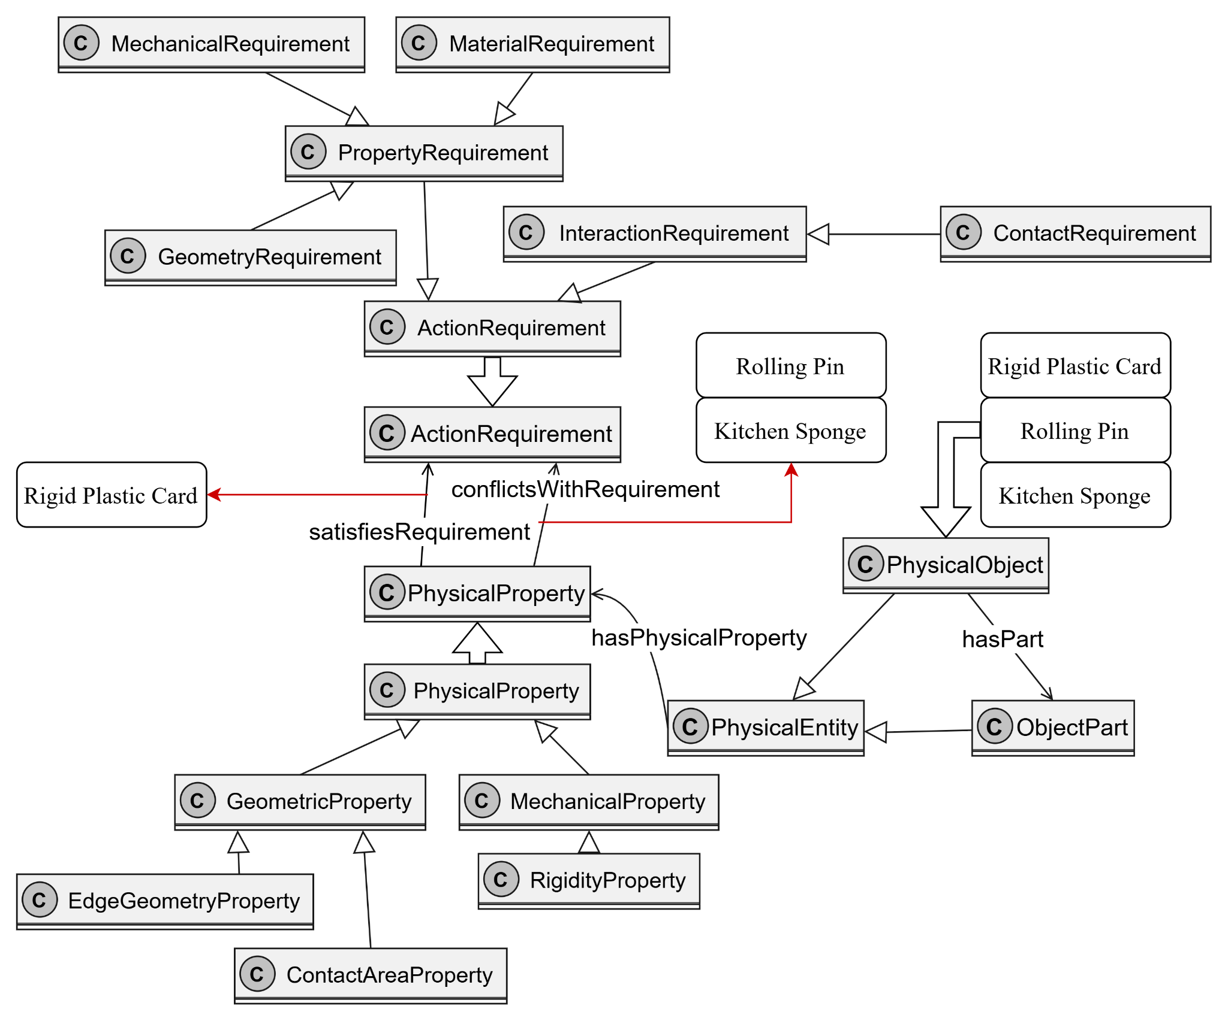
Example CQ 2.1: If a conventional cutting tool is unavailable, which of the following available objects could satisfy the represented physical requirements for cutting a carrot: a rigid plastic card, a rolling pin, or a kitchen sponge?
Under the represented conditions, the rigid plastic card is returned as a candidate because its edge satisfies the modeled geometry and rigidity requirements. The rolling pin and kitchen sponge are excluded because their represented properties conflict with different cutting requirements.
Individuals
Individuals
Individuals

Slide 15
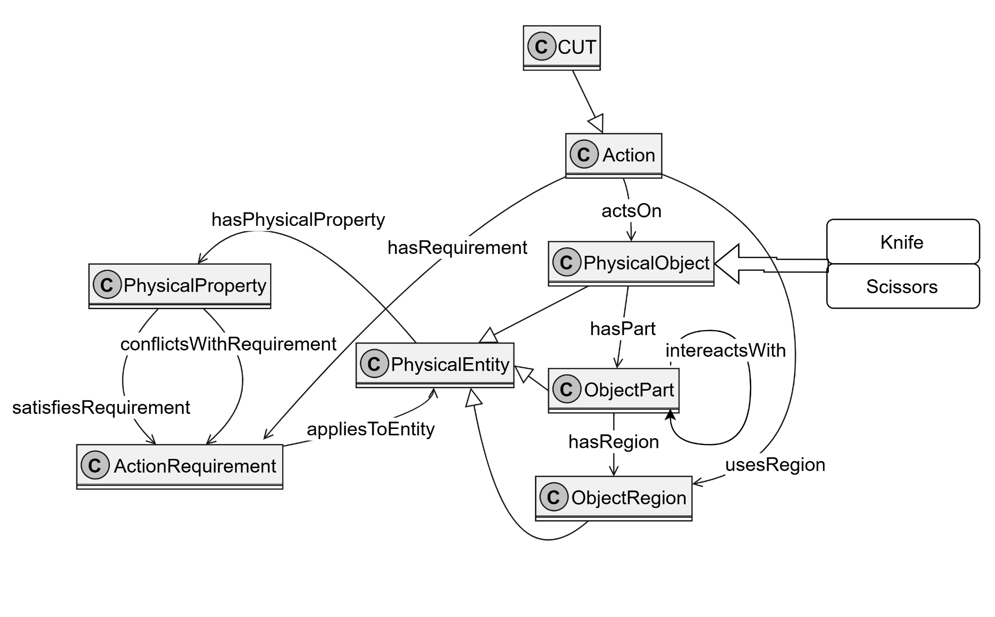
Example CQ 3.1: Can a knife and a pair of scissors both support CUT despite having different relevant part structures and part relationships?
Yes. Both may support CUT through different combinations of relevant physical properties and part relationships. A knife may rely on a single relevant edge with suitable geometry and structural support, while scissors may rely on two relevant parts whose properties and interaction jointly satisfy the applicable CUT requirements.
Mostly Same
Individuals
Different

Slide 16
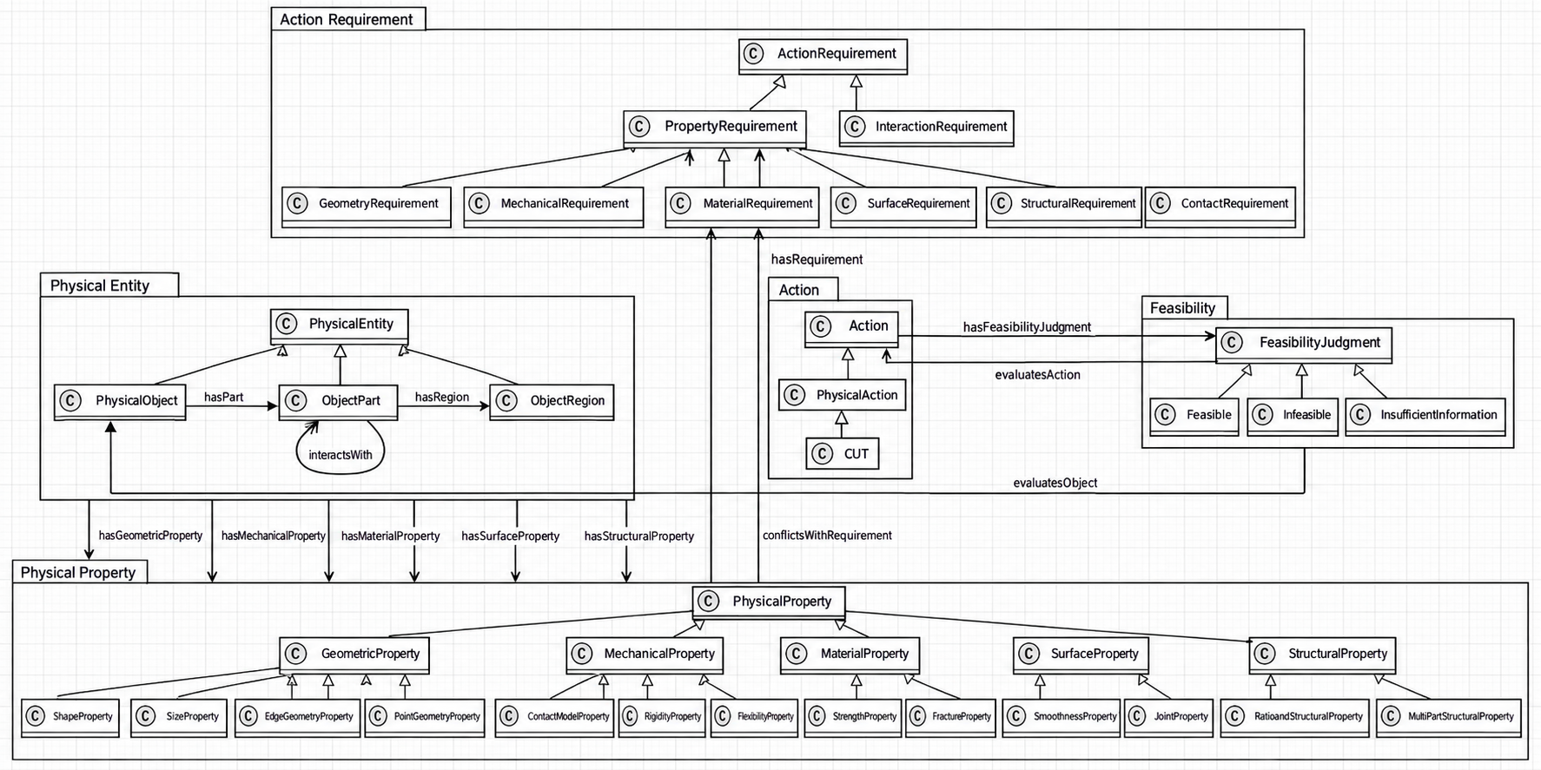
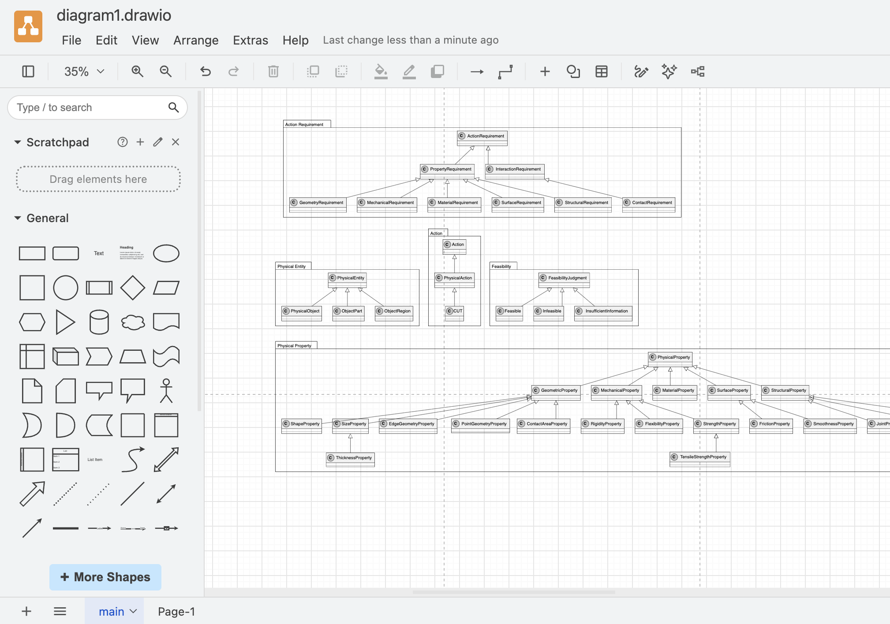
How We Used GenAI for the Conceptual Model
1. We Provided
Revised use case
Curated terminology
Modeling constraints
2. GenAI (ChatGPT) Helped Us Explore
Suggested candidate class and relationship structures
Generated a draft diagram from text/code
Provided ideas for layout and organization
3. We Reviewed & Rebuilt
Checked whether the suggested relationships matched our model
Used the draft mainly as a visual reference
Redrew the conceptual model ourselves in draw.io
PhysicalEntity --> PhysicalProperty : hasPhysicalProperty
CUT --> ActionRequirement : hasRequirement
PhysicalProperty --> ActionRequirement : satisfiesRequirement
…..
Generated
Draft
Manual Redraw

