Slide 1
From Physical Properties to CUT Feasibility
Alex, Hyejin, Liangliang, Xiye
Team Affordance
Nov 2nd, 2026

Slide 2


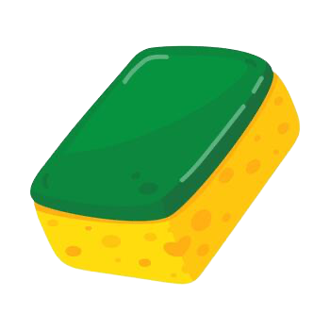
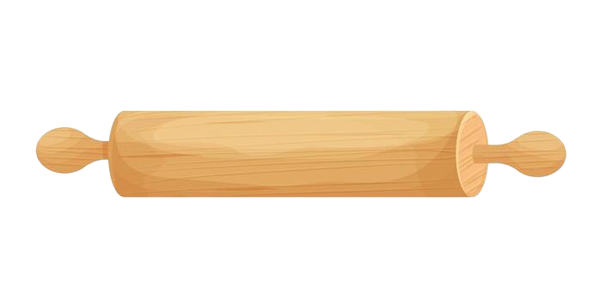
Property-Grounded CUT Affordance Reasoning
Ontological Goal
We evaluate whether a candidate can perform CUT on a target using explicitly represented physical properties, rather than object names or conventional functions.
1. Plastic Card
2. Rolling Pin
3. Sponge
To make this judgment, we first need to represent the relevant physical conditions!

Slide 3
How Our Ontology Represents CUT
An Assessment links a candidate, target, and CUT action.
Physical features describe the objects, while RequirementMappings specify what CUT requires under the target conditions.
Together, they support requirement checking and feasibility judgments.
But how did this model evolve to answer our competency questions?
Assessment
Candidate + Target + CUT
Physical Features
FeatureValue · Parts
CUT Requirements
RequirementMapping
Feasibility Judgment
Feasible / Infeasible / InsufficientInformation

Slide 4
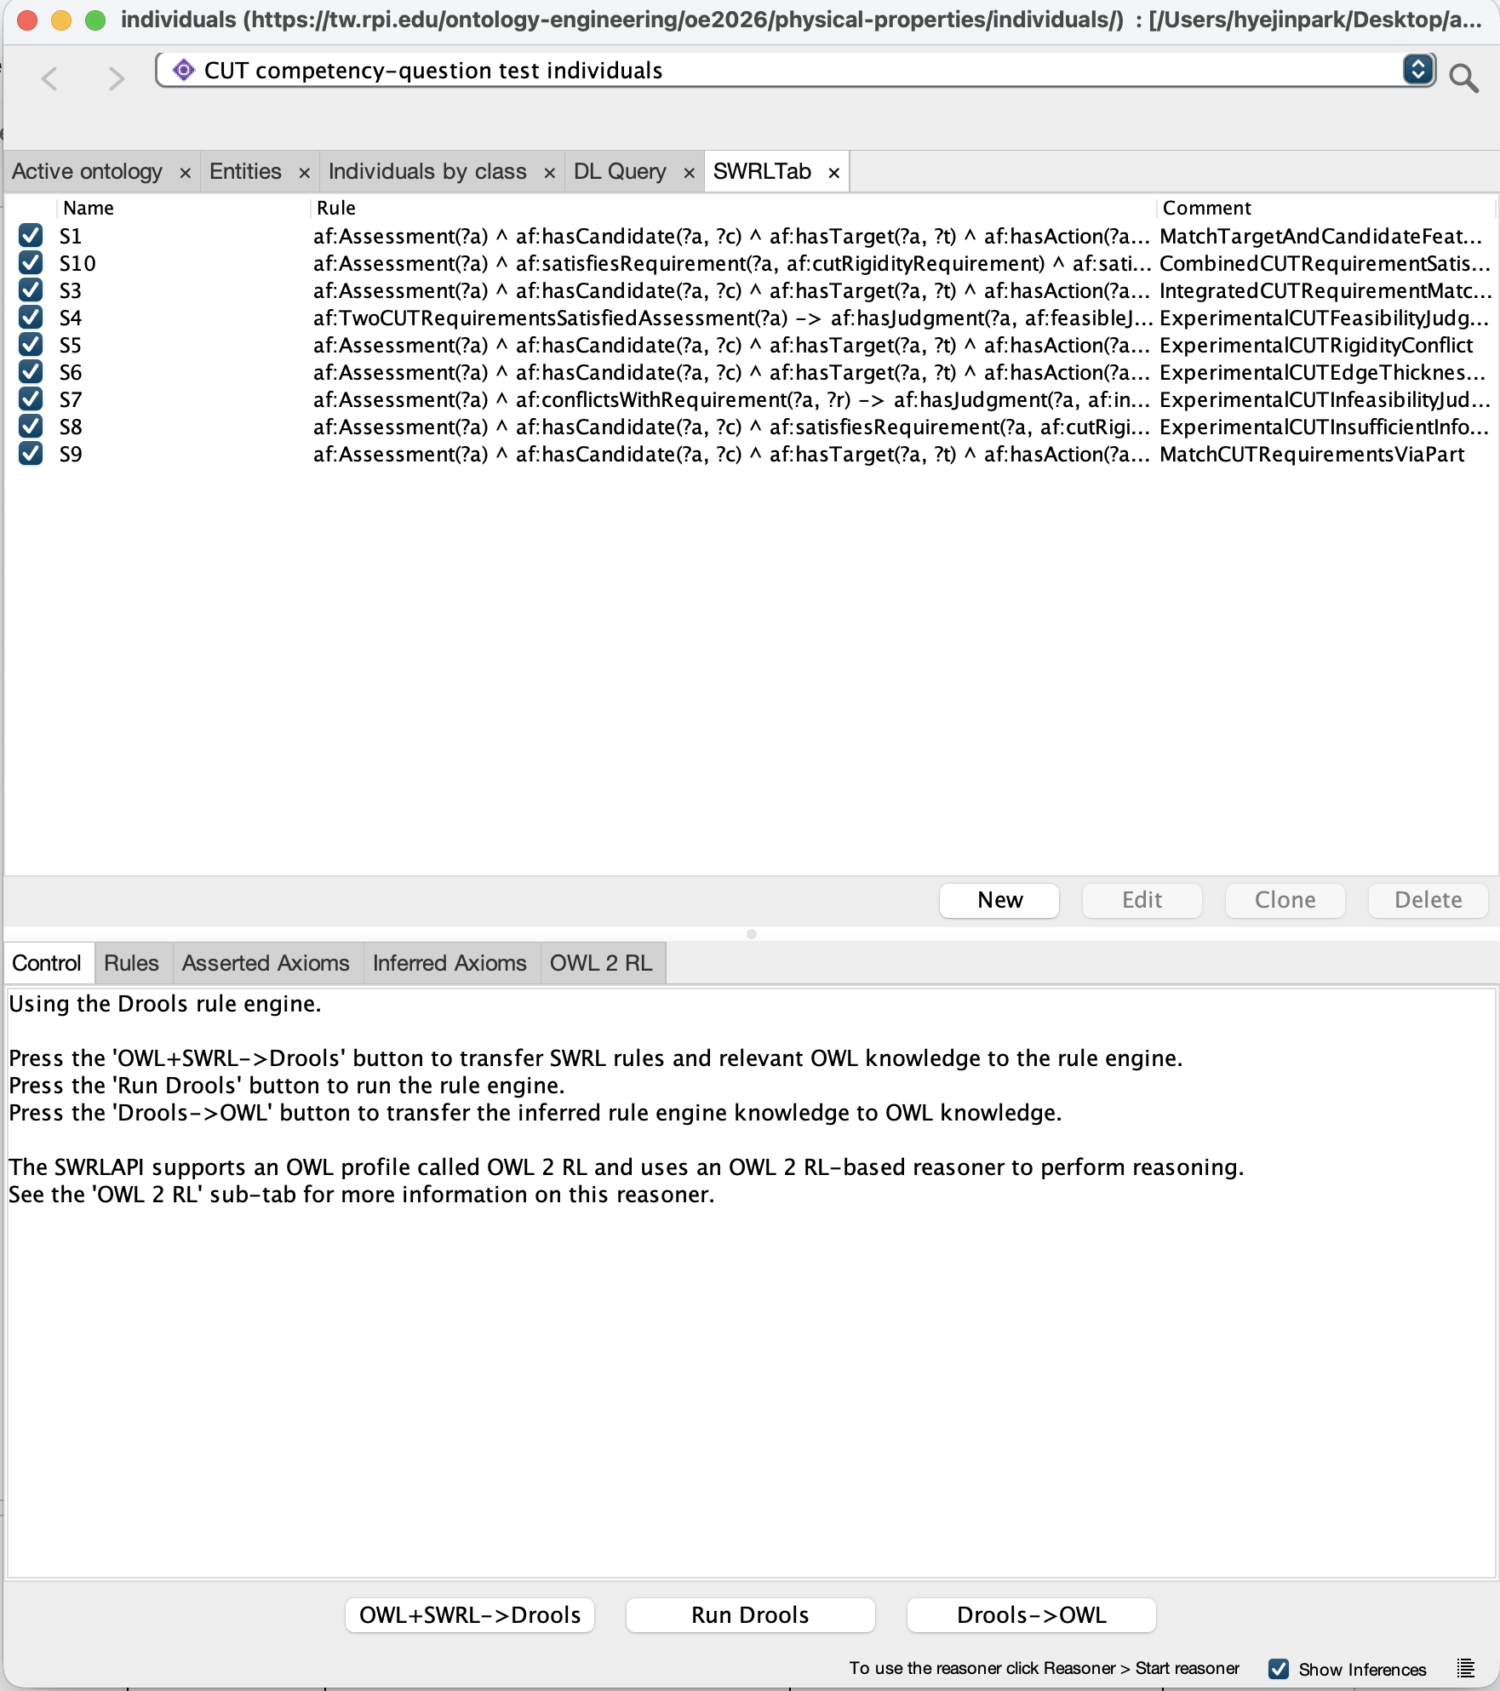
How Our Ontology Evolved
OE9 — Expanded Reasoning
9 SWRL rules
Conflicts & final judgments
Part-based inference
Explicit missing information
OE8 — Foundation
Physical Features & RequirementMappings
Assessment & Part relationships
2 initial SWRL rules
New Requirement:
Answer CQs with SPARQL
OE8: Established the knowledge structure and initial reasoning for requirement satisfaction.
OE9: Extended SWRL from 2 to 9 rules to support queryable judgments, conflicts, and part-level reasoning.
With these extensions in place, we can now examine how the ontology supports answering our CQs through SPARQL

Slide 5
From Reasoning to SPARQL Answers
Example: CUT on a high-hardness carrot For this target, CUT requires high rigidity and low edge thickness.
CQ1 — Can a plastic card cut a carrot,
and why?
Direct comparison of feature levels
CQ2 — SWRL-Inferred Judgment
Which candidate can cut the carrot:
a card, rolling pin, or sponge?
Card | Feasible
Rolling Pin | Infeasible
Sponge | Infeasible
Rigidity | Satisfied
Edge Thickness | Satisfied
CQ1: Using the existing feature values and requirement mappings, SPARQL directly confirms that the card satisfies both CUT requirements.
CQ2: Using the expanded SWRL rules, SPARQL retrieves the inferred judgments: the card is feasible, while the rolling pin and sponge are infeasible.
Cross-validation: A separate SPARQL query directly computes the same three CQ2 judgments from asserted data.
CQ3: Knife vs. Scissors: Compare inferred CUT feasibility and OWL-based part structures.
Next, we'll demonstrate the actual queries and results for each competency question.

Slide 6
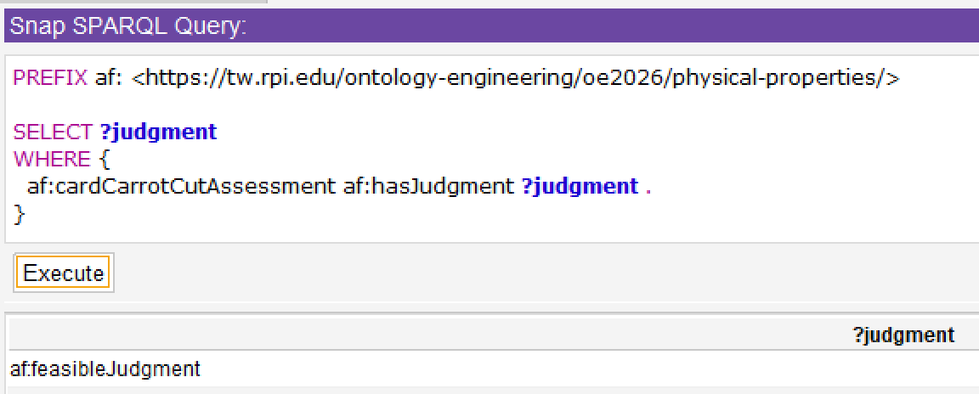
CQ1 - Can a rigid plastic card cut a carrot, and why?
SPARQL:
Result (partial)
PREFIX af: <https://tw.rpi.edu/ontology-engineering/oe2026/physical-properties/>
SELECT ?candidate ?target ?action
?targetFeature ?targetLevel
?requirement ?requiredFeature ?requiredLevel
?candidateLevel ?requirementStatus
WHERE {
VALUES ?assessment { af:cardCarrotCutAssessment }
?assessment af:hasCandidate ?candidate ;
af:hasTarget ?target ;
af:hasAction ?action .
?action af:hasRequirement ?requirement .
?target af:hasFeatureValue ?targetFeatureValue .
?targetFeatureValue af:hasFeatureType ?targetFeature ;
af:hasLevel ?targetLevel .
?mapping a af:RequirementMapping ;
af:usesTargetFeatureType ?targetFeature ;
af:usesTargetLevel ?targetLevel ;
af:affectsRequirement ?requirement ;
af:specifiesRequiredLevel ?requiredLevel .
?requirement af:concernsFeature ?requiredFeature .
candidate | requirement | requiredFeature | requiredLevel | candidateLevel | requirementStatus
card | cutEdgeThicknessRequirement | edgeThickness | low | low | Satisified
card | cutRigidityRequirement | rigidity | high | high | Satisified
OPTIONAL {
?candidate af:hasFeatureValue ?candidateFeatureValue .
?candidateFeatureValue af:hasFeatureType ?requiredFeature ;
af:hasLevel ?candidateLevel .
}
BIND(
IF(!BOUND(?candidateLevel),
"Insufficient information",
IF(?candidateLevel = ?requiredLevel,
"Satisfied",
"NotSatisfied"))
AS ?requirementStatus
)
}
ORDER BY ?requirement
Answer: Yes. A rigid plastic card can cut a carrot. Card can cut a carrot because the required features for cutting a carrot have required levels that match the candidate card’s feature levels.
REASONING: Asserted RDF triples for the comparisons; optional inferred hasJudgment for the feasibilityStatus column.
RUN IN: Standard SPARQL Query tab, SNAP SPARQL Qyery + HermiT Reasoner, with BOTH ontologies loaded.

Slide 7
CQ2 · PRIORITY 2 · USE CASE SCENARIO 2 · ROLE C (LIANGLIANG)
CQ2 · 1/3
CQ2 — Which available object can cut the carrot?
Competency question Given the same carrot, which of a rigid plastic card, a rolling pin, and a kitchen sponge satisfy the CUT requirements?
Scenario A service robot must slice a carrot but no knife is available. It must choose from the objects within reach using their physical features — not their names — and explain its choice.
① WHAT THE ONTOLOGY KNOWS (asserted individuals)
② WHAT CUT REQUIRES FOR A HARD TARGET (main ontology)
Individual | Rigidity | Edge thickness
cardCandidate | high | low
rollingPinCandidate | high | high
spongeCandidate | low | high
carrotTarget | hardness = high | (target)
Requirement mapping | If target has | Candidate needs
cutRigidityMapping | hardness = high | rigidity = high
cutEdgeThicknessMapping | hardness = high | edge thickness = low
③ SHARED EVALUATION RULE (use case §IV)
Per requirement: same level = satisfied · different level = conflict · value marked unspecified = unresolved
One Assessment per object — cardCarrotCutAssessment, rollingPinCarrotCutAssessment, spongeCarrotCutAssessment — each with the same target (carrotTarget) and action (cut).
FEASIBLE
every requirement satisfied
INFEASIBLE
at least one conflict
INSUFFICIENT INFO
unresolved, no conflict
Expected answer Only the card. The rolling pin's edge is too thick; the sponge is neither rigid enough nor thin-edged. Missing information must never be treated as a conflict.
Notes:
INTRO (about 40 s). CQ2 comes from use-case Scenario 2.
A service robot has to slice a carrot, but no knife is available. Its perception module lists three objects within reach: a rigid plastic card, a wooden rolling pin and a kitchen sponge. The planner should not decide from the names; it asks the ontology which object can satisfy the CUT requirements for this carrot.
Left: what the ontology knows. Each object has a rigidity value and an edge-thickness value; the carrot has high hardness. Each object gets its own Assessment with the same target and the same action.
Right: what CUT demands. The two requirement mappings say that for a hard target, CUT needs high rigidity and low edge thickness. Then the shared evaluation rule from the use case: same level = satisfied, different level = conflict, value marked unspecified = unresolved; all satisfied gives Feasible, any conflict gives Infeasible, otherwise Insufficient Information. Before running anything we already expect: only the card.

Slide 8
CQ2 · HOW THE ONTOLOGY ANSWERS IT
CQ2 · 2/3
CQ2 — The answer comes from entailment
INFERENCE CHAIN (SWRL rules, run by HermiT — OWL 2 DL + SWRL)
ASSERTED
Feature levels
carrot hardness = high;
each object's rigidity and
edge thickness; mappings
S1 · S5, S6
Per requirement
satisfiesRequirement
(level = required)
conflictsWithRequirement
(level ≠ required)
S10
Both satisfied?
→ TwoCUTRequirements-
SatisfiedAssessment
S4 · S7 · S8
Final judgment
hasJudgment
feasible / infeasible /
insufficient information
inferred — never asserted in the RDF files
Q2.1 · MAIN CQ2 QUERY
SAME QUERY, TWO WAYS TO RUN IT
PREFIX rdf: <http://www.w3.org/1999/02/22-rdf-syntax-ns#>
PREFIX af: <https://tw.rpi.edu/ontology-engineering/oe2026/physical-properties/>
SELECT ?candidate ?judgment
WHERE {
?assessment rdf:type af:Assessment .
?assessment af:hasTarget af:carrotTarget .
?assessment af:hasAction af:cut .
?assessment af:hasCandidate ?candidate .
?assessment af:hasJudgment ?judgment . # inferred
FILTER (?candidate = af:cardCandidate ||
?candidate = af:rollingPinCandidate || ?candidate = af:spongeCandidate)
} ORDER BY ?candidate
Standard SPARQL Query tab
asserted triples only
→ 0 rows
Snap SPARQL plugin + HermiT
OWL 2 DL entailment incl. SWRL rules
→ 3 rows: the three judgments
Open Individuals .rdf → Reasoner ▸ HermiT ▸ Start → Snap SPARQL tab
Notes:
HOW IT IS ANSWERED (about 50 s). This is our team's entailment query. The important point: the answer is not stored anywhere in the data. satisfiesRequirement, conflictsWithRequirement and hasJudgment are never asserted; the SWRL rules derive them when HermiT runs.
Follow the chain: S1 matches the carrot's hardness to each mapping and infers satisfiesRequirement when the candidate's level equals the required level. S5 and S6 infer conflictsWithRequirement for low rigidity or high edge thickness. S10 classifies an assessment that satisfies both requirements as TwoCUTRequirementsSatisfiedAssessment; S4 then gives it feasibleJudgment, and S7 gives infeasibleJudgment to any assessment with a conflict. S8 handles missing values.
Q2.1 simply asks for the hasJudgment of each of the three assessments. In the standard SPARQL tab, which only sees asserted triples, it returns 0 rows. In the Snap SPARQL plugin with HermiT started, it returns the three judgments. That difference is the entailment.

Slide 9
CQ2 · RESULTS IN PROTÉGÉ AND VALIDATION
CQ2 · 3/3
CQ2 — Results: only the card can cut the carrot
ANSWER Card → Feasible. Rolling pin → Infeasible. Sponge → Infeasible. Matches the expected answer.
Q2.1 + Q2.2 · INFERRED JUDGMENT AND EXPLANATION (Snap SPARQL + HermiT)
VALIDATION
Candidate | satisfies (S1) | conflicts with (S5, S6) | hasJudgment
card | rigidity, edge thickness | — | feasible
rolling pin | rigidity | edge thickness (high) | infeasible
sponge | — | rigidity (low), edge thickness (high) | infeasible
Q2.3 · no reasoner (standard tab)
Recomputes the verdicts from asserted feature levels: FEASIBLE / INFEASIBLE / INFEASIBLE ✓
Q2.4 · all carrot assessments → 8 rows
FEASIBLE card · knife · scissors · testCandidateA
The sponge is a conflict, not missing information: its deformability is represented as low rigidity. Without a reasoner, Q2.1 and Q2.2 return 0 rows.
INFEASIBLE rolling pin · sponge · testCandidateB
INSUFFICIENT INFO testCandidateC (edge thickness unspecified)
LIMITATIONS → NEXT STEPS
• Conflict rules S5/S6 test specific levels — high/medium/low are not declared distinct (fix: owl:AllDifferent + one generic rule).
• Insufficient information needs an explicit hasUnspecifiedFeatureType marker (open-world semantics).
• Requirement mappings cover only high-hardness targets.
Test A/B have the card's / rolling pin's levels under neutral names → same judgments: features decide, not names.
Notes:
RESULTS (about 50 s). Q2.1 in Protégé, Snap SPARQL with HermiT: card feasible, rolling pin and sponge infeasible — exactly the expected answer. Q2.2 gives the explanation the planner reports to the user: the rolling pin satisfies rigidity but conflicts on edge thickness; the sponge conflicts on both. Deformability is represented as low rigidity, so the sponge is a conflict, not missing information.
Two validation checks: Q2.3 computes the same three verdicts directly from the asserted feature levels in the standard SPARQL tab, so the rules and the data agree. Q2.4 runs the judgment query over every carrot assessment: 8 rows covering all three groups of Scenario 2. The neutral-name test candidates A and B get the same judgments as the card and the rolling pin, so the answer depends on features, not names; Test C, whose edge thickness is unspecified, is insufficient information rather than infeasible.
Limitations: the conflict rules are written for specific levels because high/medium/low are not declared distinct; missing values need an explicit hasUnspecifiedFeatureType marker; and mappings exist only for hard targets.

Slide 10
CQ3 Same CUT outcome, different part structures
Can a knife and scissors both meet CUT requirements for the same carrot, and how do their part structures differ?
RESULT Both tools are feasible; scissors have multipart and interacting structure.
EVIDENCE | Verified Q3.6 + Q3.4 results
SPARQL | Q3.6 core query
Candidate | CUT judgment | Structural classes
Knife | Feasible | Neither queried class inferred
Scissors | Feasible | MultiPartObject InteractingPartObject
SELECT ?candidate ?requirement ?judgment
WHERE {
?a a af:Assessment ;
af:hasCandidate ?candidate ;
af:hasTarget af:carrotTarget ;
af:hasAction af:cut ;
af:satisfiesRequirement ?requirement ;
af:hasJudgment ?judgment .
FILTER (?candidate = af:knifeCandidate ||
?candidate = af:scissorsCandidate)
}
Controls: testCandidate3 → multipart;
testCandidate4 → both classes.
4 rows: two satisfied requirements per tool.
Project prefix, full queries and results in notes.
REASONING
High rigidity + low edge thickness → S9 → S10 / S4 → feasible
Distinct parts + interaction → OWL structural classifications
Knife: non-inference does not prove nonmembership. | Snap SPARQL + HermiT; Show Inferences on.
Notes:
TWO-MINUTE SPEAKING PLAN (about 220 words)
0:00–0:20 — Our question asks whether a knife and scissors can meet the same CUT requirements for the same carrot, and how their structures differ. Both assessments are feasible within our two modeled requirements.
0:20–0:50 — Q3.6 returns four rows: each tool satisfies the rigidity and edge-thickness requirements, with feasibleJudgment. Q3.4 separately retrieves structural classes. The scissors have both MultiPartObject and InteractingPartObject; neither class is inferred for the knife. The table summarizes those verified results.
0:50–1:25 — For feasibility, the high-hardness carrot selects requirements of high rigidity and low edge thickness. Those values are attached to the blade parts. S9 matches each part's features, S10 combines the satisfied requirements, and S4 assigns the feasible judgment. Structural classification follows a separate path: two explicitly distinct ObjectPart fillers support MultiPartObject, and a part interaction supports InteractingPartObject.
1:25–1:50 — We added neutral-name controls to test this independently of tool names. Candidate3 has two distinct parts with no asserted interaction and is classified multipart. Candidate4 adds an interaction and receives both classes. Interaction is not currently required for CUT, and different parts may supply different requirements.
1:50–2:00 — Finally, not returning a class is not proof of nonmembership under open-world semantics. We do not claim the knife has exactly one part.
DISPLAY NOTE
The slide shows the Q3.6 core pattern with short variable ?a; it omits PREFIX and ORDER BY for space. Full verified originals follow. Q3.4 returns five rows because it includes testCandidate3/4; Q3.6 returns four. Avoid the OPTIONAL combined query: it triggered a Snap LeftJoin execution error. The mandatory combined query excluded the knife and was not used as the main comparison.
SOURCE QUERIES
https://drive.google.com/file/d/1lVjVKT7o2SVpWCEUAn09a8a7kDAbNkmg/view
Q3.4
PREFIX af: <https://tw.rpi.edu/ontology-engineering/oe2026/physical-properties/>
SELECT DISTINCT ?candidate ?structureClass WHERE {
?candidate a ?structureClass .
FILTER (?structureClass = af:MultiPartObject || ?structureClass = af:InteractingPartObject)
FILTER (?candidate = af:knifeCandidate || ?candidate = af:scissorsCandidate || ?candidate = af:testCandidate3 || ?candidate = af:testCandidate4)
} ORDER BY ?candidate ?structureClass
VERIFIED Q3.4 RESULTS (5)
scissorsCandidate | InteractingPartObject
scissorsCandidate | MultiPartObject
testCandidate3 | MultiPartObject
testCandidate4 | InteractingPartObject
testCandidate4 | MultiPartObject
Q3.6
PREFIX af: <https://tw.rpi.edu/ontology-engineering/oe2026/physical-properties/>
SELECT ?candidate ?assessment ?requirement ?judgment WHERE {
?assessment a af:Assessment ; af:hasCandidate ?candidate ; af:hasTarget af:carrotTarget ; af:hasAction af:cut ; af:satisfiesRequirement ?requirement ; af:hasJudgment ?judgment .
FILTER (?candidate = af:knifeCandidate || ?candidate = af:scissorsCandidate)
} ORDER BY ?candidate ?requirement
VERIFIED Q3.6 RESULTS (4)
knifeCandidate | knifeCarrotCutAssessment | cutEdgeThicknessRequirement | feasibleJudgment
knifeCandidate | knifeCarrotCutAssessment | cutRigidityRequirement | feasibleJudgment
scissorsCandidate | scissorsCarrotCutAssessment | cutEdgeThicknessRequirement | feasibleJudgment
scissorsCandidate | scissorsCarrotCutAssessment | cutRigidityRequirement | feasibleJudgment
Expected standard asserted-only results for Q3.4 and Q3.6: zero rows. Run in Snap SPARQL 6.0.0 with HermiT active and Show Inferences checked. All seven original CQ3 queries were user-verified in Protege. No ontology rules changed. Screenshot evidence is in Report Section 2.3.

Slide 11
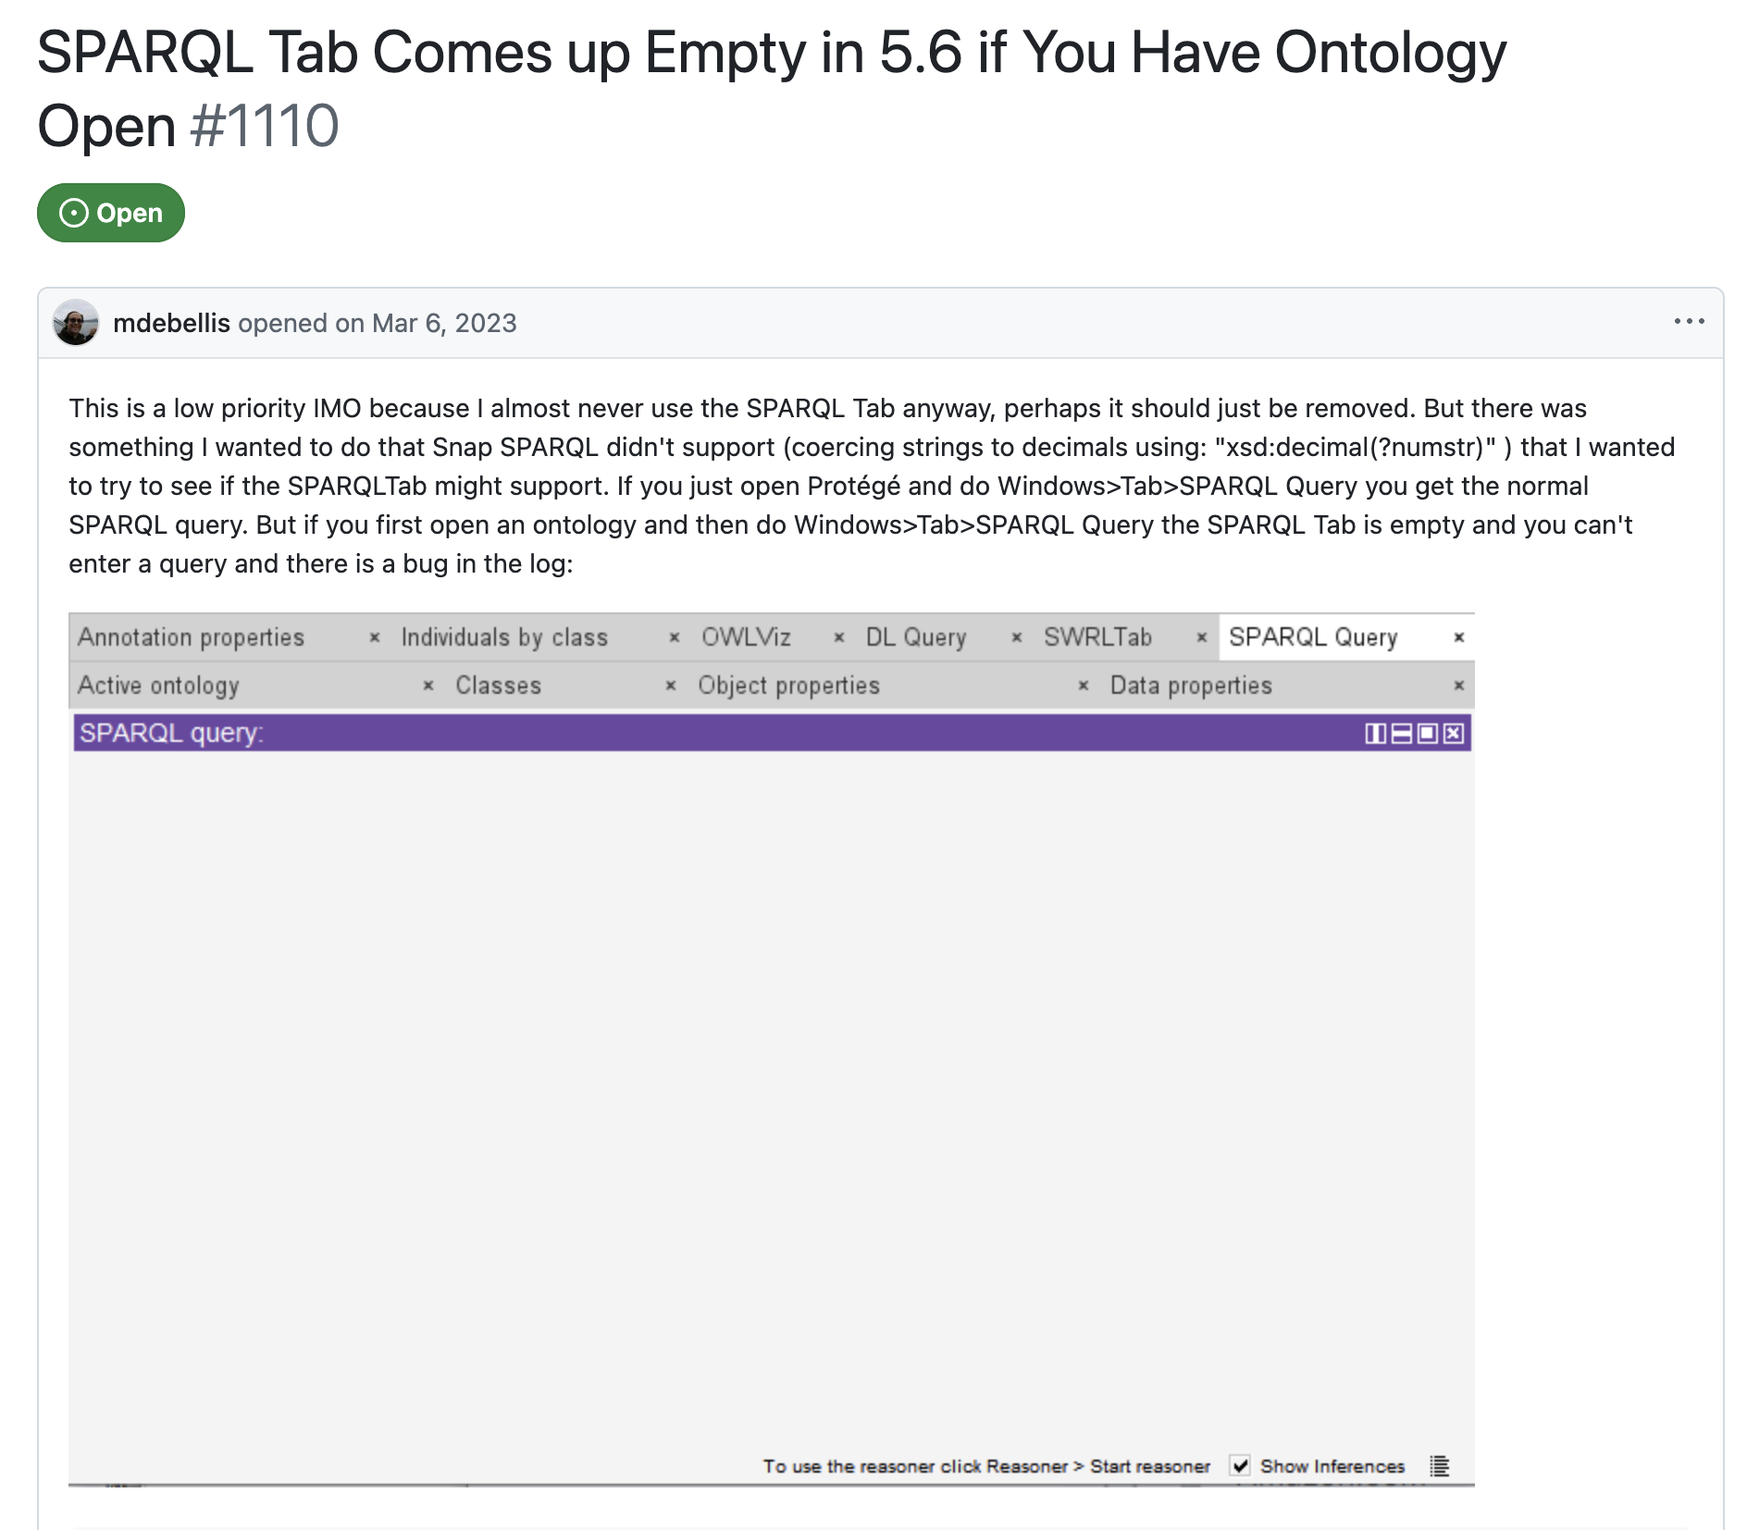
How AI Supported Our Ontology Development
Ontology Modeling & Reasoning — ChatGPT
OWL restrictions, SWRL rules, class relationships, and reasoning behavior review.
Examples: requirement satisfaction, open-world semantics, inconsistent judgments, RDF hygiene.
SPARQL Development & Validation — ChatGPT / Claude
Assisted with query construction, debugging, refinement, and interpretation of results.
Examples: CQ2 query refinement with Claude; CQ3 query troubleshooting and validation discussions with ChatGPT.
Technical Troubleshooting
Investigate a Protégé SPARQL plugin compatibility issue,
evaluate a patched plugin workaround,
and consider Snap SPARQL.
GitHub issue #1110 · Protégé SPARQL tab · Snap SPARQL

Slide 12
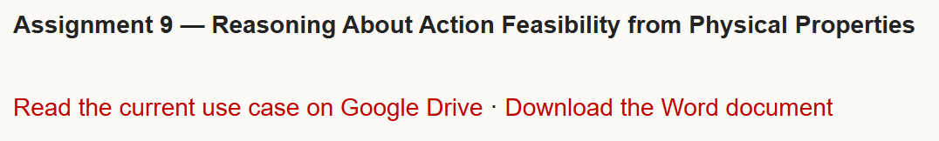
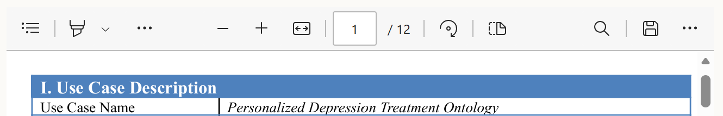
Website Walkthrough
Webpage: About | Action Feasibility from Physical Properties
Current Version:
Downlink for documents has attached;
All files been uploaded;
Other parts like Related Works and Getting Involved will be filled in future weeks.
Goal for the Final Version:
Match with previous years, preview for documents will be available;
Reorganized the structure of some pages to improve readability；
……

