Slide 1
When To Go Where
A Project by Ben Rodgers, Tyler Layton, Annabelle Choi, and Samyuth Sagi
Notes:
Tyler

Slide 2
Purpose
Address the needs of personal preferences for hiking and camping in National Parks
Raising awareness of the vast variety of National Parks
Promoting outdoor exploration and education
Regular camping increased from 26.47 million in 2016 to 38.57 million in 20231 with this growing interest we want:
To encourage and expand this demographic
For hiking follow similar growth patterns
Reduce excuses people have for not pursuing outdoor activities such as camping and hiking
Notes:
https://www.statista.com/statistics/191224/participants-in-camping-in-the-us-since-2006/ Tyler

Slide 3
Data needed from each park
Weather
Terrain
Visitation statistics
Hike statistics
Prices
Wildlife
etc
Notes:
Tyler

Slide 4
Scope
The focus is on 63 U.S. National Parks
Recommendations will be tailored to users, form beginners to experienced adventures, based on preferences for hiking or camping
Might expand later to include forests, lakeshores, and state parks.
Only using publicly available data
Notes:
Ben

Slide 5
Description of the Ontology
Where To Go When will help campers and hikers find the perfect National Park based on things like weather, terrain, how busy it is, hike difficulty, locations, etc.
Actors:
Campers and hikers
People looking for specific parks
The National Park Service
Notes:
Ben

Slide 6
Usage Scenario
John, an experienced hiker, is looking for something new. He has never been to the true midwest of the United States. He is looking for someplace in South Dakota where the weather is typically around 50 degrees in the Fall, is mostly flat land, and where no people show up. He has looked around but can’t seem to find the correct data to point him where he needs to go. He needs specifics in order to satisfy his quench for adventure.
Notes:
Ben

Slide 7
Basic/Normal Flow of Events
(Hiker, UI): A hiker sees that they have the ability to query several fields (e.g. no people, temperature, …) and inputs a query
(System, Public APIs): System refreshes information in ontology with any updated information
(System): System consumes information from the UI and queries the parks on the ontology.
(System): System sorts the results that match the users requests identifying the top three (or fewer)
(UI): Displays the top three (or fewer) parks that match the users requirements

Slide 8
Alternate Flow (Invalid API Access)
(Hiker, UI): A hiker sees that they have the ability to query several fields (e.g. no people, temperature, …) and inputs a query
(System, Public APIs): System fails to connect with some or all of the APIs. Uses preloaded information.
(System): System consumes information from the UI and queries the parks on the ontology.
(System): System sorts the results that match the users requests identifying the top three (or fewer)
(UI): Displays the top three (or fewer) parks that match the users requirements

Slide 9
Alternate Flow (Not Enough Results)
(Hiker, UI): A hiker sees that they have the ability to query several fields (e.g. no people, temperature, …) and inputs a query
(System, Public APIs): System refreshes information in ontology with any updated information
(System): System consumes information from the UI and queries the parks on the ontology.
(System): System can not identify any results that match the user’s query
(UI): System informs the user that there are no parks that match the user’s query

Slide 10
Competency Question
Question:
If I want to go to the northernmost park in the United States that is the least visited in Winter, where should I go?
Answer: “In order to avoid crowds, visiting Arctic Gates National Park in the winter is the optimal solution.”
How was this determined:
The user input their own desires into the system and then the system is able to compare the specific places through a query. Ideally the computer finds the location of the northernmost parks in the United States, once this is done, the computer can compare the visitation statistics for the winter months. The ontology, containing the national parks, is able to easily compare the visitation statistics/month and weather/month, as they will be characteristics attached to the park object.

Slide 11
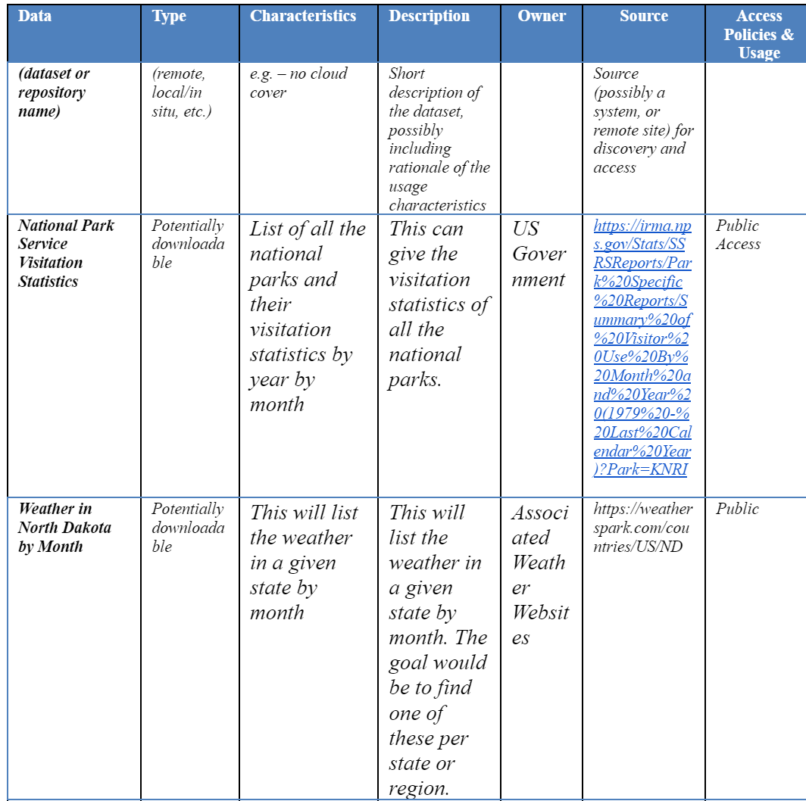
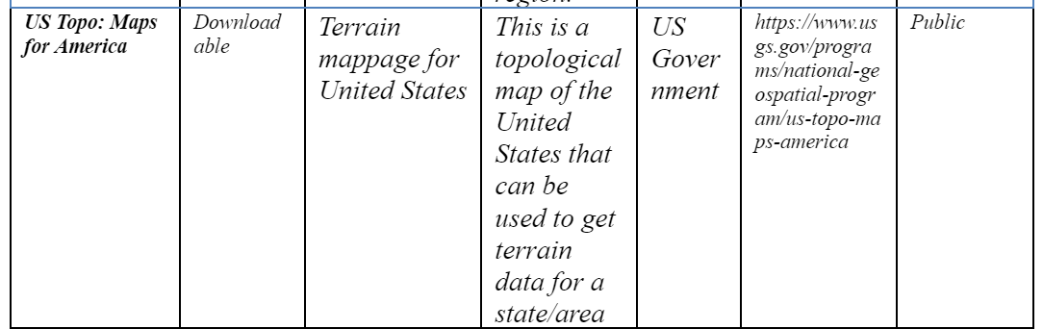
Databases

Slide 12
Questions?

