Slide 1
When To Go Where
A Project by Ben Rodgers, Tyler Layton, Annabelle Choi, and Samyuth Sagi
Notes:
Tyler

Slide 2
Who and Why
Address the needs of personal preferences for hiking and camping in National Parks
Raising awareness of the vast variety of National Parks
Promoting outdoor exploration and education
Regular camping increased from 26.47 million in 2016 to 38.57 million in 20231 with this growing interest we want:
To encourage and expand this demographic
For hiking follow similar growth patterns
Reduce excuses people have for not pursuing outdoor activities such as camping and hiking
Notes:
https://www.statista.com/statistics/191224/participants-in-camping-in-the-us-since-2006/ Tyler

Slide 3
What and How
Where To Go When will help campers and hikers find the perfect National Park based on things like weather, terrain, how busy it is, hike difficulty, locations, etc.
Actors:
Campers and hikers
People looking for specific parks
The National Park Service

Slide 4
Stakeholders
Us who designed the Ontology
The professors helping us in the class
The National park services

Slide 5
Scope
The focus is on 63 U.S. National Parks
Recommendations will be tailored to users, form beginners to experienced adventures, based on preferences for hiking or camping
Might expand later to include forests, lakeshores, and state parks.
Only using publicly available data
Notes:
Ben

Slide 6
Usage Scenario
John, an experienced hiker, is looking for something new. He has never been to the true midwest of the United States. He is looking for someplace in South Dakota where the weather is typically around 50 degrees in the Fall, is mostly flat land, and where no people show up. He has looked around but can’t seem to find the correct data to point him where he needs to go. He needs specifics in order to satisfy his quench for adventure.
Notes:
Ben

Slide 7
Basic/Normal Flow of Events
(Hiker, UI): A hiker sees that they have the ability to query several fields (e.g. no people, temperature, …) and inputs a query
(System, Public APIs): System refreshes information in ontology with any updated information
(System): System consumes information from the UI and queries the parks on the ontology.
(System): System sorts the results that match the users requests identifying the top three (or fewer)
(UI): Displays the top three (or fewer) parks that match the users requirements
Notes:
Ben

Slide 8
Alternate Flow (Invalid API Access)
(Hiker, UI): A hiker sees that they have the ability to query several fields (e.g. no people, temperature, …) and inputs a query
(System, Public APIs): System fails to connect with some or all of the APIs. Uses preloaded information.
(System): System consumes information from the UI and queries the parks on the ontology.
(System): System sorts the results that match the users requests identifying the top three (or fewer)
(UI): Displays the top three (or fewer) parks that match the users requirements

Slide 9
Alternate Flow (Not Enough Results)
(Hiker, UI): A hiker sees that they have the ability to query several fields (e.g. no people, temperature, …) and inputs a query
(System, Public APIs): System refreshes information in ontology with any updated information
(System): System consumes information from the UI and queries the parks on the ontology.
(System): System can not identify any results that match the user’s query
(UI): System informs the user that there are no parks that match the user’s query

Slide 10
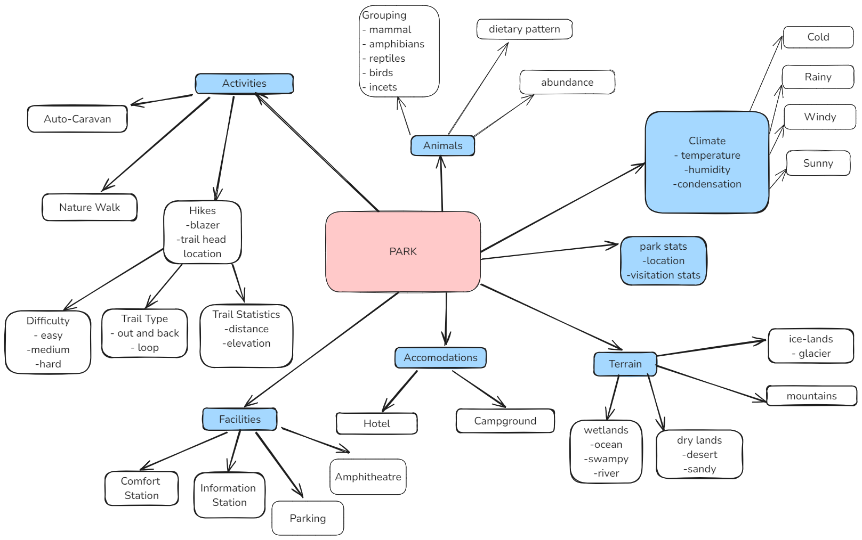
Class Hierarchy
Notes:
Activities: Types of things to do, like auto-caravanning, nature walks, and hikes (with details like difficulty and trail type)
Animals: Information about animals in the park, such as types (mammals, etc.), diets, and how common they are
Climate: Weather details, like temperature, humidity, and conditions (cold, rainy, windy, sunny)
Park Stats: General information, including location and visitation statistics
Terrain: Types of land, like ice fields, mountains, wetlands, and dry areas
Accommodations: Places to stay, like hotels and campgrounds
Facilities: Visitor services, like comfort stations, information stations, parking, and amphitheaters

Slide 11
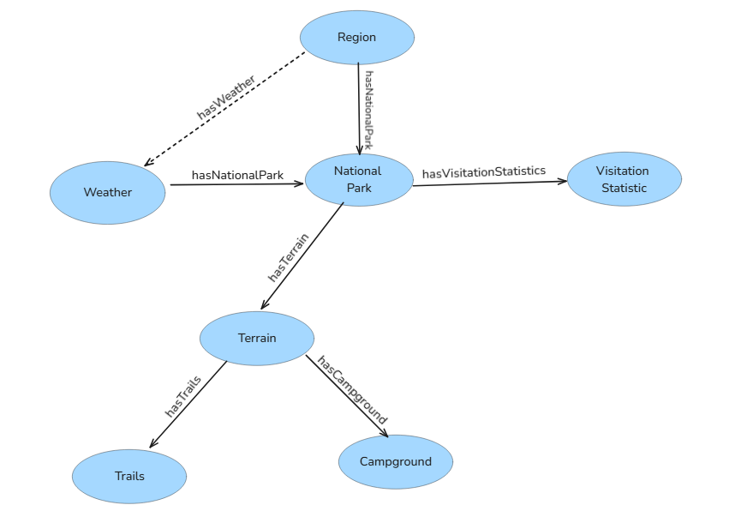

Slide 12
Competency Question
Question:
If I want to go to the northernmost park in the United States that is the least visited in Winter, where should I go?
Answer:
“In order to avoid crowds, visiting Arctic Gates National Park in the winter is the optimal solution.”
How was this determined:
The user input their own desires into the system and then the system is able to compare the specific places through a query. Ideally the computer finds the location of the northernmost parks in the United States, once this is done, the computer can compare the visitation statistics for the winter months. The ontology, containing the national parks, is able to easily compare the visitation statistics/month and weather/month, as they will be characteristics attached to the park object.

Slide 13
Competency Question Pt.2
Question:
“I am in California for a week and I am curious as to what the most popular hike is out of all the National Parks here.”
Answer:
“The Balconies Cave Trail is the most popular hike out of all of the National Parks in California.”
How was this determined:
The ontology would search through all of the National Parks in California putting all of the most popular hikes from each park in a list. Then it would search through that list again finding the most popular hike in the entire state.

Slide 14
Databases
National Park Service Visitation Statistics
Lists all U.S. National Parks
Shows visitation data by year and month
Weather Spark - Climate and Average Weather
Provides year round climate and avg weather data for all U.S. States
US Topo: Maps for America
Provides detailed terrain data for any state or area
From U.S. Geological Survey (USGS)
Most Famous Hikes in Each National Park
Lists the most popular hikes in every U.S. National Park
Provides information about each hike, including difficulty and scenery
Notes:
Annabelle
National Park Service Visitation Statistics:
Lists all U.S. national parks
Shows visitation numbers by year and month
Helps identify busy and less crowded times
Useful for recommending parks based on user preferences for crowds or peak seasons
Weather Spark – Climate and Average Weather
Provides year-round climate and average weather data for all U.S. states
Useful for finding ideal park recommendations based on preferred weather conditions
US Topo: Maps for America
Provides detailed terrain data for any state or area
Sourced from the U.S. Geological Survey (USGS)
Useful for analyzing terrain features for hikers and campers
Most Famous Hikes in Each National Park
Lists the most popular hikes in every U.S. national park
Provides information about each hike, including details on difficulty and scenery
Useful for recommending hiking options based on user preferences

Slide 15
External Ontologies
Bioregistry: “An ontology and inventory of geopolitical entities such as nations and their components (states, provinces, districts, counties) and the actual physical territories over which they have jurisdiction. “
Ontological analysis of terrain data: “ We formalize the properties of each piece of data and its processing history in a geographic ontology, and use declarative Semantic Web Rule Language (SWRL) rules to calculate the errors relative to the real world or to other data.” “The geographic ontology combines knowledge from different areas of expertise, and makes it available for the community to use, critique, and augment.”
Notes:
Annabelle

Slide 16
Questions?

