Slide 1
When To Go Where
A Project by Ben Rodgers, Tyler Layton, Annabelle Choi, and Samyuth Sagi

Slide 2
Quick Overview…
Promote outdoor exploration and education of the 63 National Parks.
Give people a tool that will allow them to search for a specific National Park based on their personal preferences.
Reduce excuses people have for not pursuing outdoor activities such as camping and hiking
Notes:
Annabelle

Slide 3
CQ1
Question 1:
“If I want the coldest temperature park in the midwest during summer, what park should I go to that fits my comfort level?”
Answer 1:
“The coldest park during summer in the midwest would be Theodore Roosevelt National Park located in North Dakota”
Terms used from the Ontology:
temperature, location, park
How was this determined?:
The system would find the locations of all the midwest parks in the United States. After it found these parks, it would then need to access the weather data for the Summer months for those states. Once it finds the lowest overall temperature it can narrow it down to a list of parks that work for the user.
Notes:
Annabelle

Slide 4
Semantics of CQ 1:
Classes in our ontology that need to be checked:
National Park, Climate
Object Properties:
National Park -> hasLocation,National Park -> hasDateValue, Climate -> hasClimate
Restrictions:
∃hasLocation(Midwest) ⊓ ∃hasDateValue(June or July or August) ⊓ ∃hasClimate(cold)

Slide 5
CQ2
Question 2:
If I want to see the rare yellow billed loon bird and I want to see if they are native to any national parks
Answer 2:
“Unfortunately, this animal is not native to any National Park.”
Terms used from the Ontology:
animal, park
How was this determined?:
The system iterates through each national park looking at the animals that are native to each of them. When it cannot find the specific animal that the user is looking for, it returns something along the lines of “cannot find animal”.
Notes:
Identify location: The system would retrieve a list of all National Parks located in the Midwest region of the United States.
Compare Temperatures: By analyzing the average temperature for each park in the summer, the system finds the parks with the coolest climates.
Narrow Down Options: Based on the temperature data, it narrows down the list to parks that best match the user’s preference for cooler conditions, recommending parks with the lowest summer temperatures in the region.

Slide 6
Semantics of CQ2
Classes in our ontology that need to be checked:
National Park, Animal
Object Properties:
National Park -> hasAnimal, Animal -> hasHabitat
Restrictions:
∃hasAnimal (yellow billed loon bird) ⊓ ∃hasHabitat(NationalPark)
The only difference between this one and the previous is that there are less restrictions and the search is less complex. Though the semantics presented help illustrate the logic the ontology would have to have to come up with the proper answer.

Slide 7
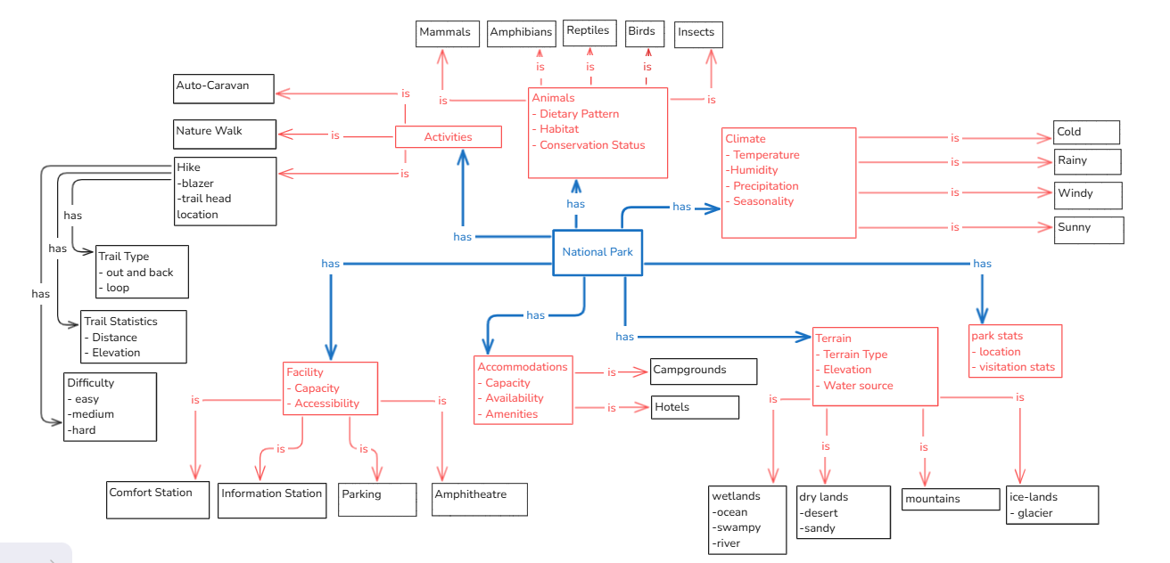
Conceptual Model
Notes:
tyler

Slide 8
First level
Notes:
tyler

Slide 9
Climate
Notes:
tyler

Slide 10
Terrain
Notes:
tyler

Slide 11
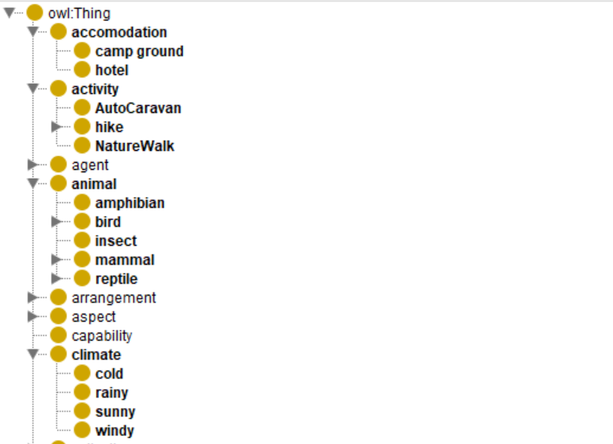
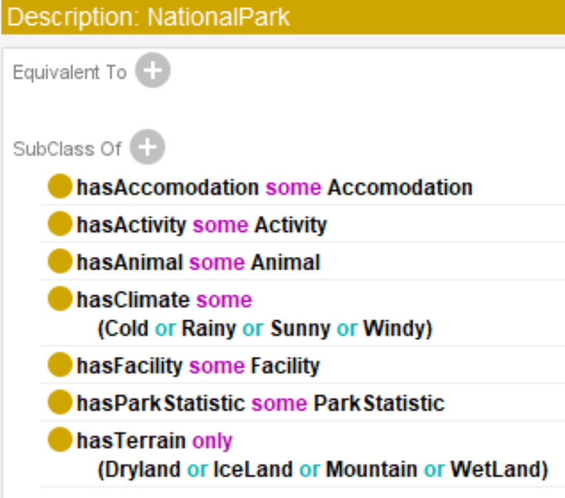
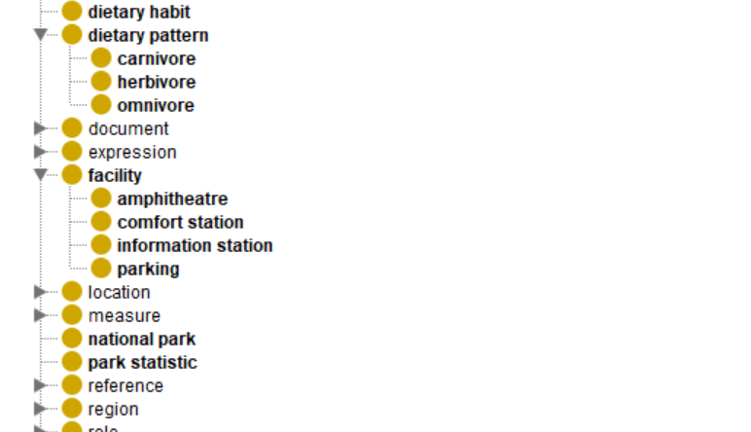
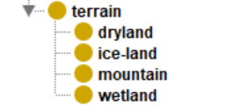
Protege Screenshots (Classes)
________

Slide 12
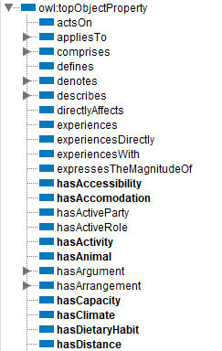
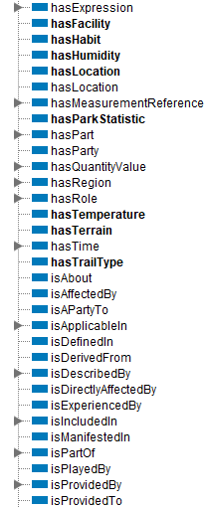
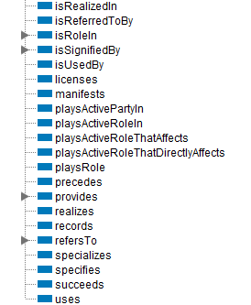
Protege Screenshots (Object Properties)

Slide 13
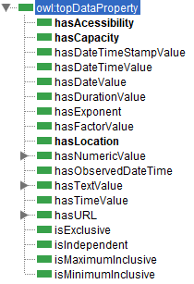
Protege Screenshots (Data Properties)

Slide 14
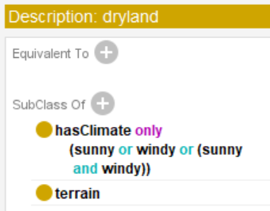
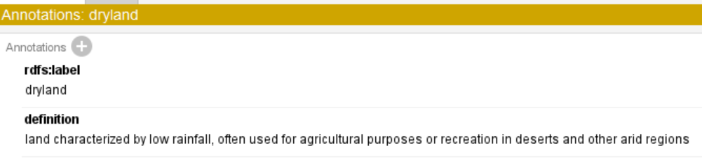
Example of DL constructs
Dryland, Iceland, Mountain, and wetland were defines with specific climate characteristics:
This specifies that DryLand can only have a climate that is either Sunny, Windy, or both.
Other subclasses, like IceLand, Mountain, and Wetland, have their own specific climate properties, which allows for more detailed searches based on the climate of each type of terrain.

Slide 15
Example of its relation to the Conceptual Model
The DL constructs directly relate to the conceptual model by defining the characteristics and constraints of each park type within the ontology. For instance:
Climate and Terrain:
The hasClimate and hasTerrain properties in the DL notation correspond to the attributes of the National Park class in the conceptual model.
Hierarchy of Classes:
The use of subclasses like DryLand, IceLand, etc., supports the model's organization, allowing for detailed classification of parks based on their terrain and climate.

Slide 16
Changes We Made In Second Week
Increased Classes
Added more Data Properties & Object Properties
Organized
Serialized
Properly defined our objects

Slide 17
Current State:
What is going well?
The ontology effectively captures the relationships between parks, their climates, and terrains, making it easier to retrieve relevant data.
The clarity The ontology effectively captures the relationships between parks, their climates, and terrains, making it easier to retrieve relevant data.
What do we still need to work on?
Ensure that all national parks are represented in the ontology with complete data on their climates, terrains, and other relevant properties.

