Slide 1
When To Go Where

Slide 2
Quick Overview…
Promote outdoor exploration and education of the 63 National Parks.
Give people a tool that will allow them to search for a specific National Park based on their personal preferences.
Reduce excuses people have for not pursuing outdoor activities such as camping and hiking
Notes:
Annabelle

Slide 3
Changes made:
(2) how your ontology has evolved due to the addition of needing to answer your competency questions using SPARQL
Included individuals such as:
Parks (e.g., Yellowstone, Yosemite)
States (e.g., Alaska, California)
Seasons
Trails
Difficulty
Distance
Locations

Slide 4
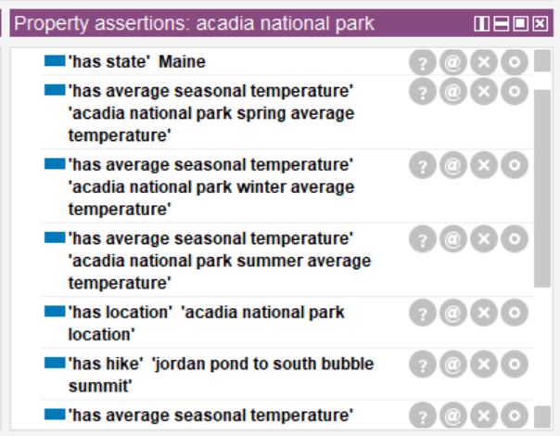
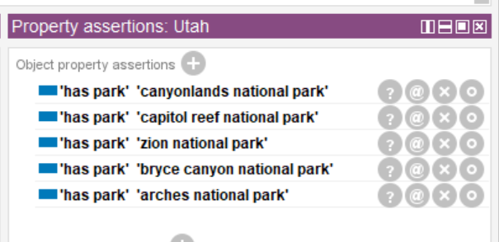
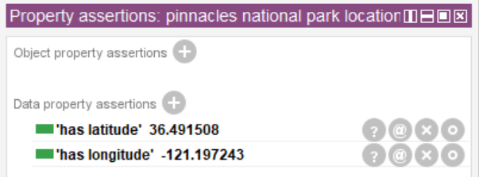
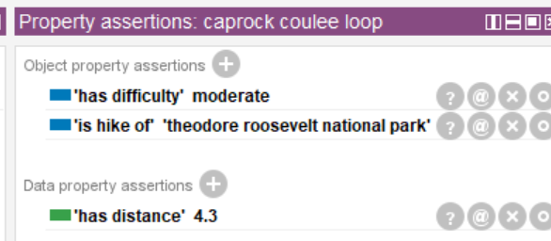
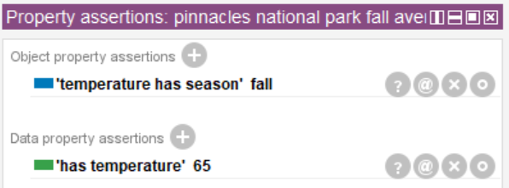
Park:
State:
Location:
Trail:
Temperature:

Slide 5
Competency Question 1:
Question:
If I want the coldest temperature park in the midwest during summer, what park should I go to that fits my comfort level?
Answer:
The coldest park during summer in the midwest would be Rocky Mountain National Park with temperatures of 70.
Terms used from the Ontology:
temperature, location, park

Slide 6
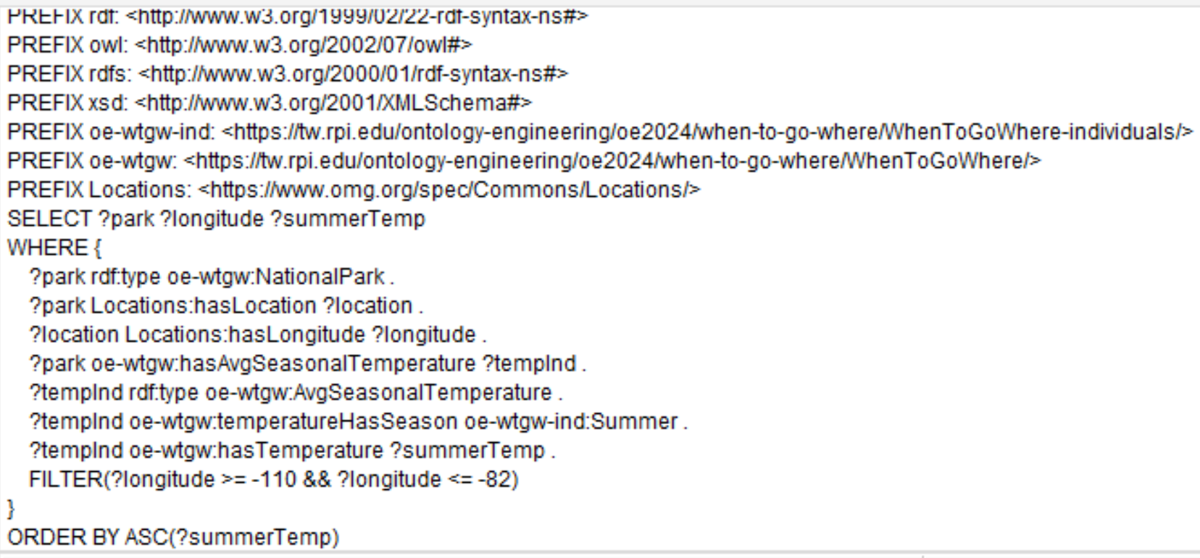
SPARQL Representation:

Slide 7
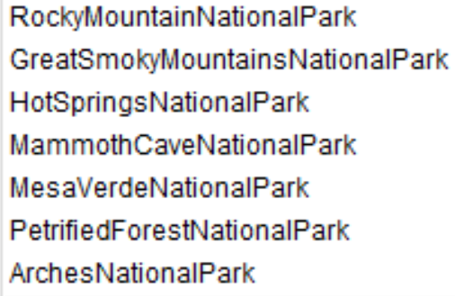
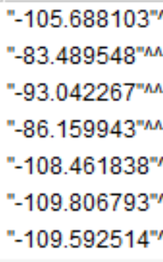

SPARQL Answer:

Slide 8
Competency Question 2:
Question :
I am new to hiking. Which national park has cool summer temperatures and hikes less than 2 miles?
Answer :
Try Crater Lake National Park. The summer highs are about 65°F and the Watchman Peak trail has a distance of 1.7 miles.
Terms used from the Ontology:
Season, temperature, park, hike

Slide 9
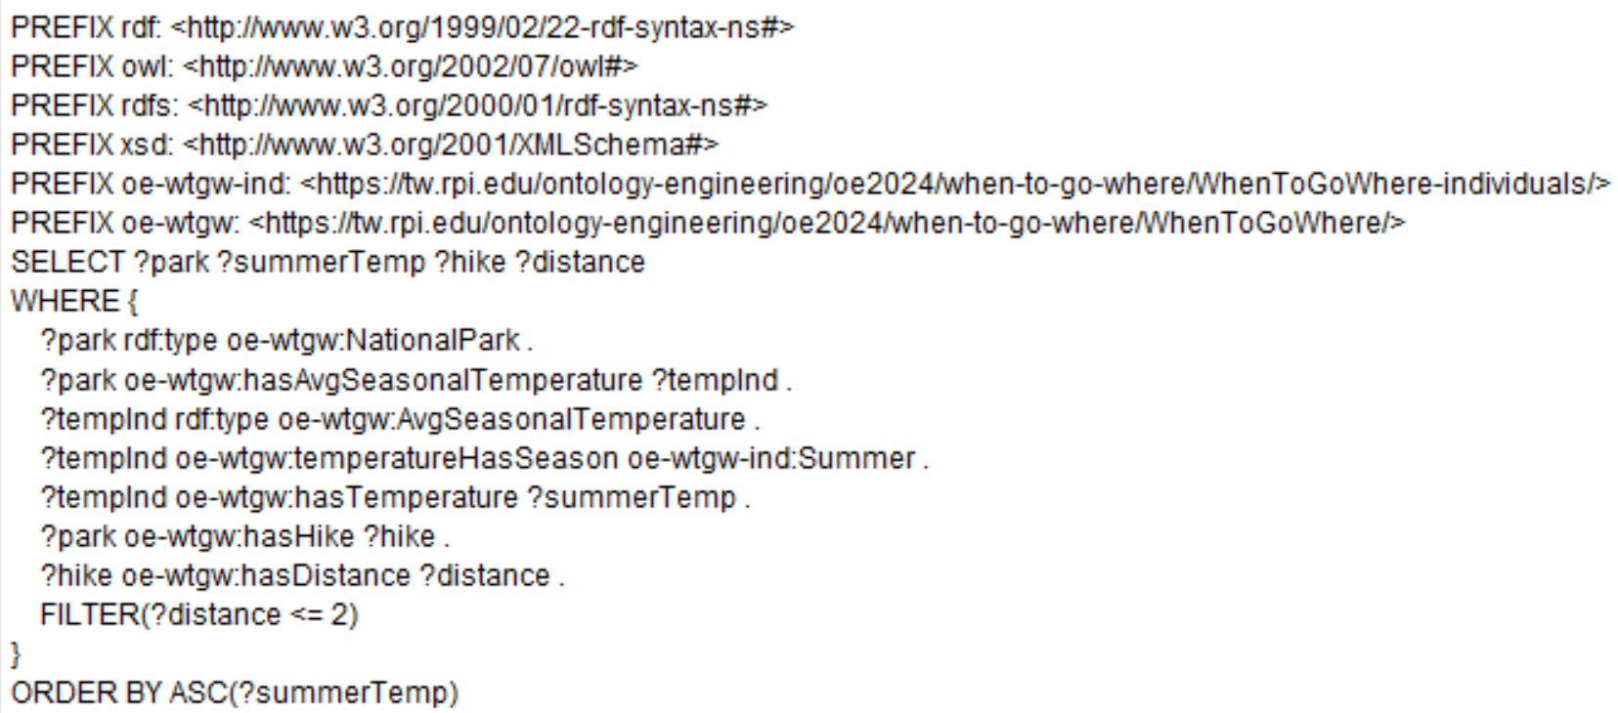
SPARQL Representation:

Slide 10
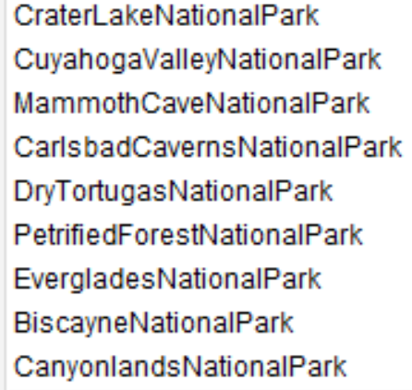

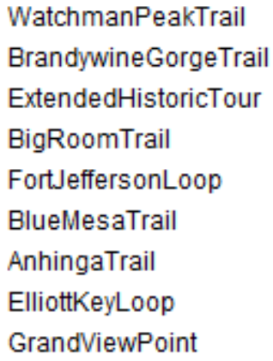

SPARQL Answer:

Slide 11
Competency Question 3:
Q: I am in California for a week and I am curious as to what the longest hikes out of all the National Parks here.
A: The Lakes Trail is the longest hike out of all of the National Parks in California.
Terms used from the Ontology:
location, park, trail
Semantic Processes Involved:
Search California to find longest hike.

Slide 12
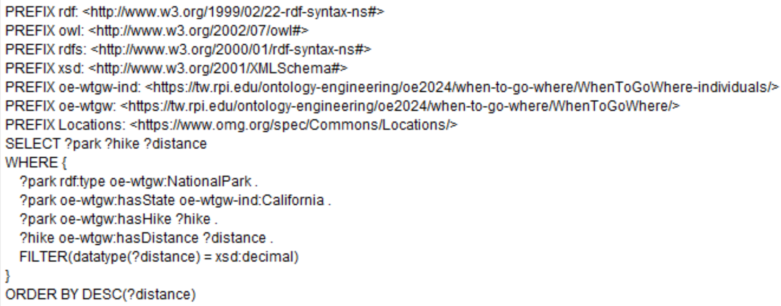
SPARQL Representation:

Slide 13
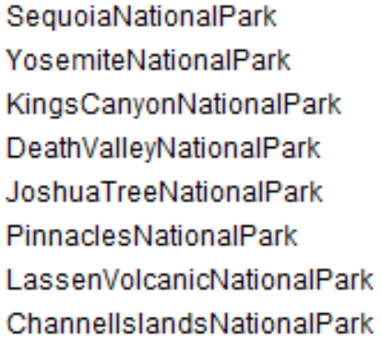
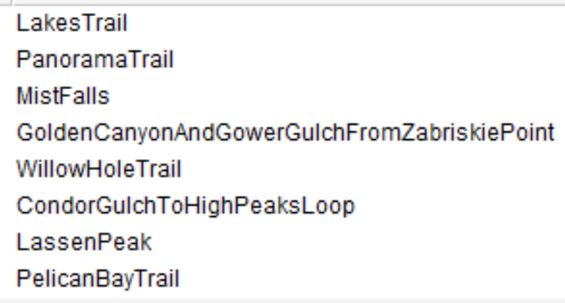
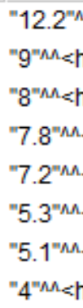
SPARQL Answer:

