Slide 1
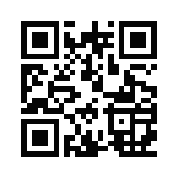


Walking into the Future with PROV Pingback:
An Application to OPeNDAP using Prizms
http://bit.ly/lebo-ipaw-2014
Timothy Lebo, Patrick West, Deborah McGuinness
Tetherless World Constellation
Rensselaer Polytechnic Institute

Slide 2

Outline
Background and Motivation
  Visual Analytics [some challenges with discovery]
Approach
  State of PROV Linked Data [some challenges]
  PROV Pingback [some potential]
  Earth Science LiDAR use case, OPeNDAP
  Situated Computation (à la Prizms)
  Structural vs. Behavioral Provenance
Outstanding Issues: Potential for Abuses
Future Work

Slide 3
Chaos in the
Visual Analytic Process
S. Kandel, A. Paepcke, J. Hellerstein, and J. Heer. Enterprise data analysis and visualization: An interview study. Visualization and Computer Graphics, IEEE Transactions on, 18(12):2917–2926, Dec. 2012.
Among 35 data analysts from 25 commercial organizations:
Discovering and wrangling data is most tedious, time-consuming task
Analytical results are static and shared ad hoc via email, common file
systems, or thumb drives
Difficulties discovering when relevant data becomes available
open information system, where “the user of data may have very little connection with its providers and curators, and where the provenance will ... describe a set of interconnected processes in which we repeatedly find data from one source being used to derive data by a distinct and independent user.”
P. Groth, Y. Gil, J. Cheney, S. Miles. Requirements for Provenance on
the Web. 2012 Int. Journal Digital Curation

Slide 4
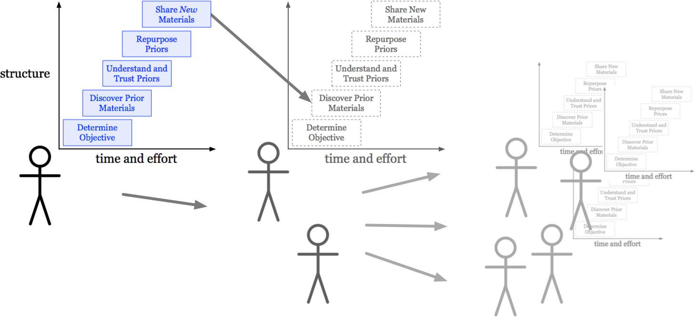
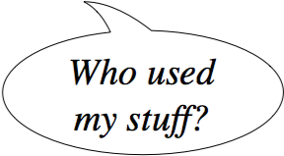
Open Analytical Environments
open information systems:
downstream
downstream
upstream
downstream
P. Pirolli and S. Card The sensemaking process and leverage points for analyst technology as identified through cognitive task analysis. In Proceedings of International Conference on Intelligence Analysis, 2005

Slide 5


Slide 6
Chaos in the
Visual Analytic Process
S. Kandel, A. Paepcke, J. Hellerstein, and J. Heer. Enterprise data analysis and visualization: An interview study. Visualization and Computer Graphics, IEEE Transactions on, 18(12):2917–2926, Dec. 2012.
Among 35 data analysts from 25 commercial organizations:
Discovering and wrangling data is most tedious, time-consuming task
Analytical results are static and shared ad hoc via email, common file
systems, or thumb drives
Difficulties discovering when relevant data becomes available
Our observation:
Data derived from data is related to its antecedents.
So, we can use provenance for discovery.

Slide 7
Outline
Background and Motivation
  Visual Analytics [some challenges with discovery]
Approach
  State of PROV Linked Data [some challenges]
  PROV Pingback [some potential]
  Earth Science LiDAR use case, OPeNDAP
  Situated Computation (à la Prizms)
  Structural vs. Behavioral Provenance
Outstanding Issues: Potential for Abuses
Future Work

Slide 8

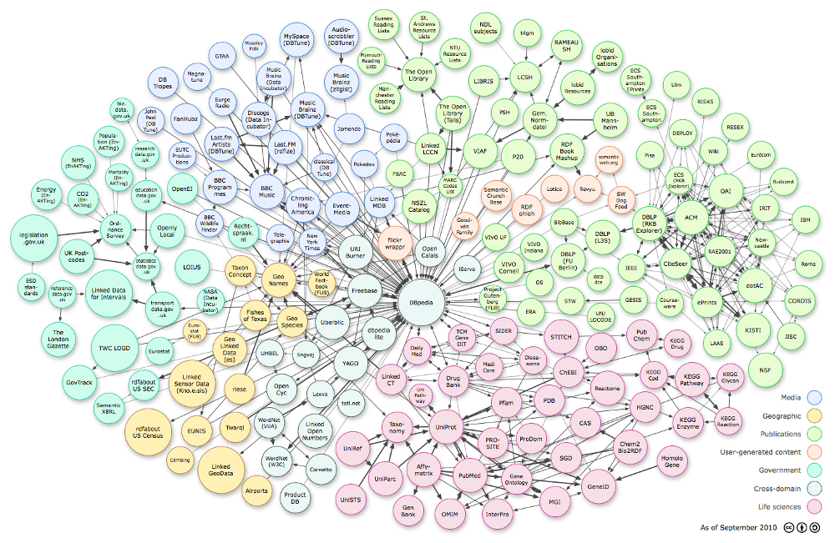
One Year In,
State of the PROV LOD?
?

Slide 9


One Year In,
State of the PROV LOD?
?
1)
2)

Slide 10
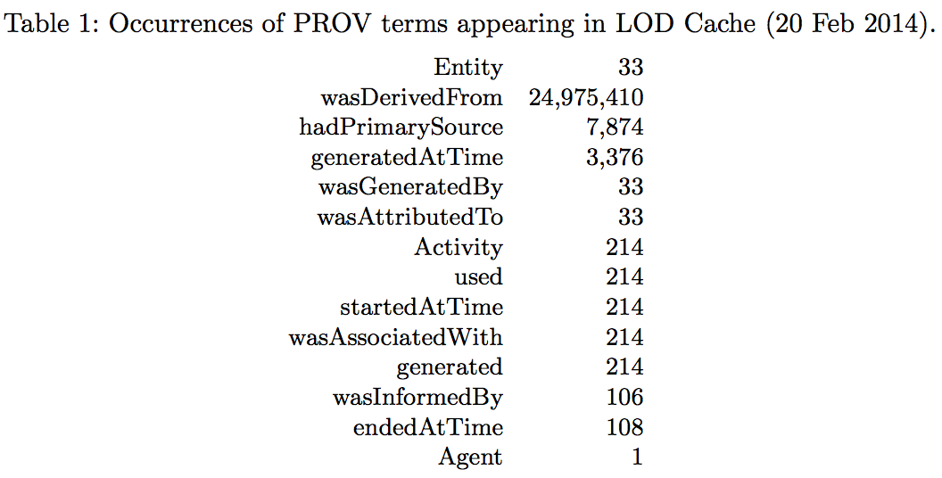
OpenLink Software has not gathered much PROV-O into their “LOD Cache”
Unfortunately, these results do not portray a thriving PROV LOD ecosystem...

Slide 11
Only 15 (now 19) Datasets Listed on datahub.io Report Using PROV
(15 as of Feb, now 19 as of Jun)
dbpedia
imf-linked-data,
bfs-linked-data, fao-linked-data,
oecd-linked-data, ecb-linked-data,
frb-linked-data, uis-linked-data (7, Sarven Capadisli)
provenanceweb, twc-opendap, twc-ieeevis, locv, the-living-lodcloud, twc-hub, twc-healthdata, ichoose, array-express-e-afmx-1, arrayexpress_e-mtab-104
(10, Tim Lebo)
mexico (– Peter Menke)
http://datahub.io/dataset?tags=format-prov
So, a community-based perspective on the use of PROV in LOD does not portray a thriving PROV LOD ecosystem, either...
Notes:
According to the metadata at datahub.io, fifteen datasets use the PROV vocabulary. Nine were created by the authors, so we set those aside. DBPedia is one, but we already saw it through the LOD Cache. That leaves five independent PROV adoptions (imf-linked-data, bfs-linked-data, fao-linked-data, oecd-linked- data, ecb-linked-data), but imf-linked-data can also be seen through the LOD Cache and all five were created by the same author and thus share similar structure.

Slide 12
Outline
Background and Motivation
  Visual Analytics [some challenges with discovery]
Approach
  State of PROV Linked Data [some challenges]
  PROV Pingback [some potential]
  Earth Science LiDAR use case, OPeNDAP
  Situated Computation (à la Prizms)
  Structural vs. Behavioral Provenance
Outstanding Issues: Potential for Abuses
Future Work

Slide 13
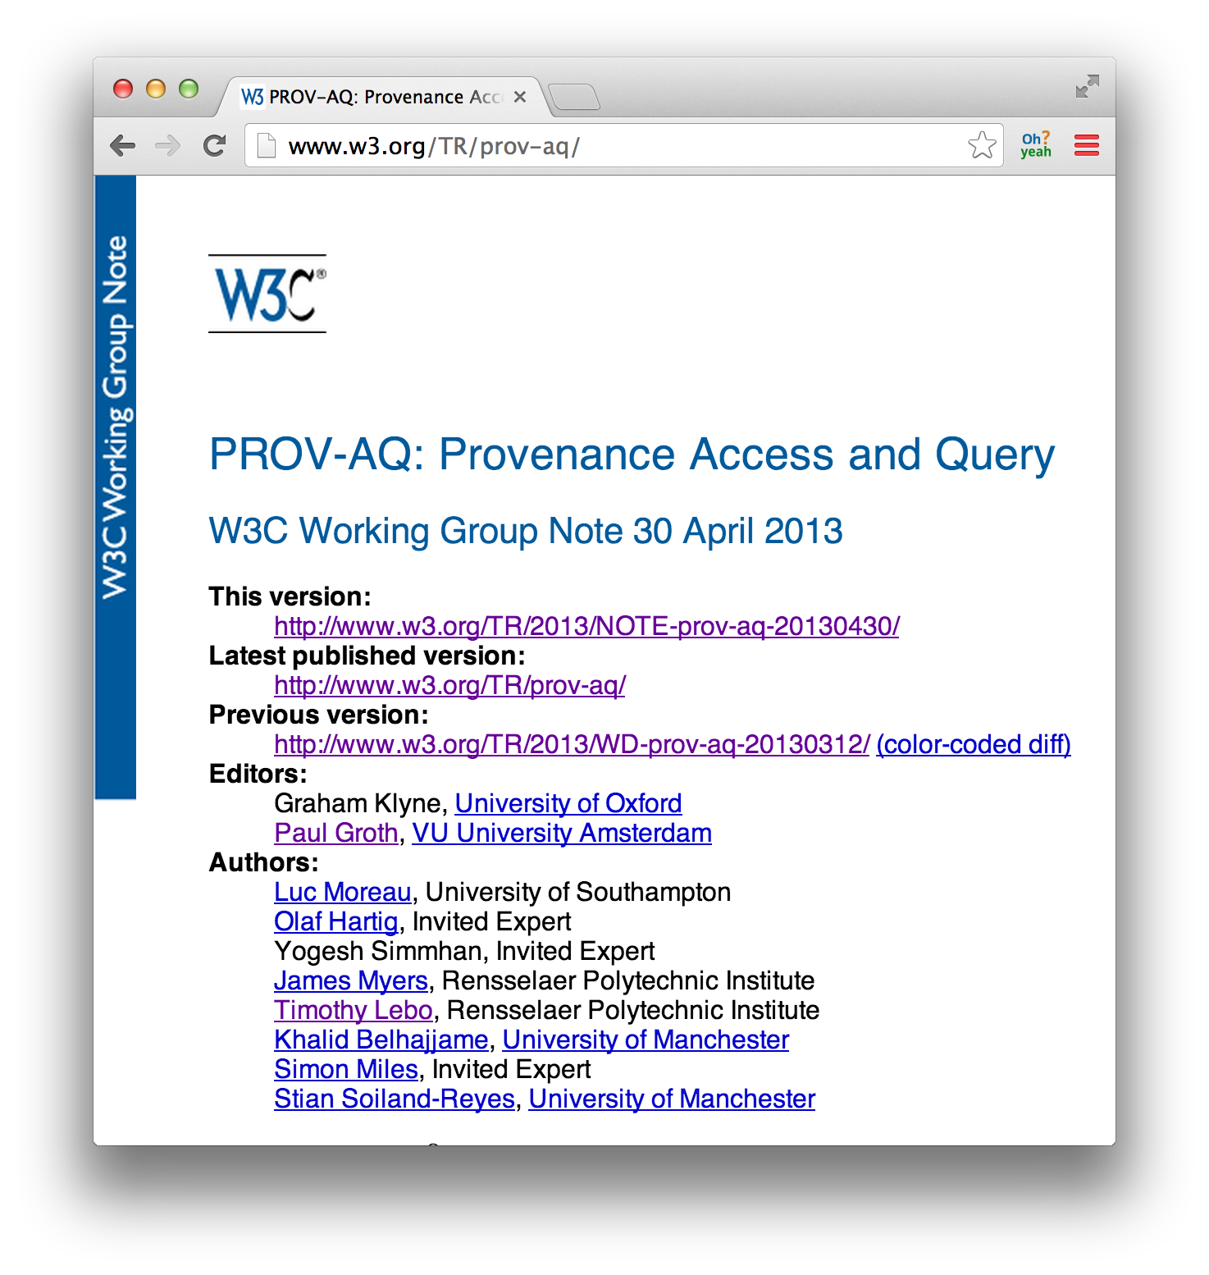
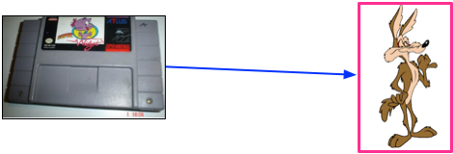
PROV-AQ’s Pingback

Slide 14
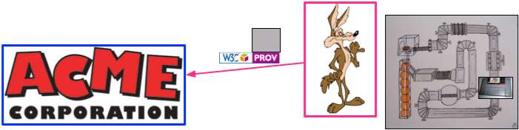
PROV-AQ’s Pingback

Slide 15
Outline
Background and Motivation
  Visual Analytics [some challenges with discovery]
Approach
  State of PROV Linked Data [some challenges]
  PROV Pingback [some potential]
  Earth Science LiDAR use case, OPeNDAP
  Situated Computation (à la Prizms)
  Structural vs. Behavioral Provenance
Outstanding Issues: Potential for Abuses
Future Work

Slide 16
Application
Linked Data is a Good Thing™
  … so, PROV-O for modeling provenance …
  … but a lot of systems don’t do Linked Data!
e.g. OPeNDAP
  a data transport architecture and protocol widely used by earth scientists to access remote data, such as satellite and weather observations.
  It, too, is a Good Thing™ (Peter Fox® says so).
  We demonstrate how a system that does not use Linked Data principles can benefit from publishing its provenance records as Linked Data.

Slide 17
Application for Pingback
LiDAR (Light Detection and Ranging)
  a remote sensing method used to examine the surface of the Earth.
OPeNDAP
  a “data transport architecture and protocol widely used by earth scientists to access remote data, such as satellite and weather observations.”
  It is a Good Thing™ (Peter Fox® says so).
  A good example of how a system that does not use Linked Data principles can benefit from publishing its provenance records as Linked Data.

Slide 18
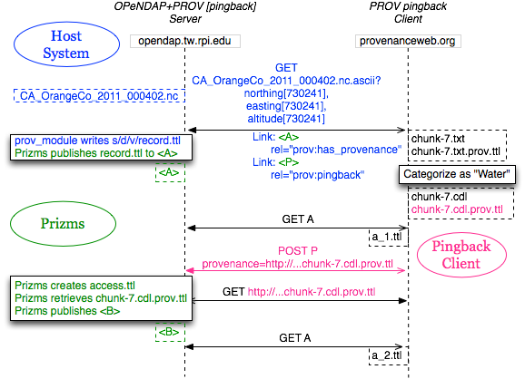
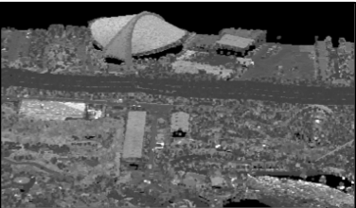
Application for Pingback:
The Sequence

Slide 19
Outline
Background and Motivation
  Visual Analytics [some challenges with discovery]
Approach
  State of PROV Linked Data [some challenges]
  PROV Pingback [some potential]
  Earth Science LiDAR use case, OPeNDAP
  Situated Computation (à la Prizms)
  Structural vs. Behavioral Provenance
Outstanding Issues: Potential for Abuses
Future Work

Slide 20
Prizms’ SDV Organization
The SDV organization principle organizes the many individual Extract-Transform-Load (ETL) processes that constitute a data corpus according to three fundamental provenance aspects:
– Source, the agent (person, organization) providing the dataset.
– Dataset, a logical, abstract portion of the agent’s data.
– Version, a concrete portion of an agent’s abstract dataset.

Slide 21
Prizms’ “Freebies”
@opendap:/home/prizms/prizms/opendap/source/us/opendap-prov/version/20140206-1391/source/opendap-provenance.ttl
https://github.com/timrdf/prizms/wiki
Prizms:
SPARQL endpoint
Conneg URIs
VoID metadata (+= SDV)
PROV-O
HTML views
Linkset analysis
Sindice notification
datahub.io CKAN listing
…

Slide 22
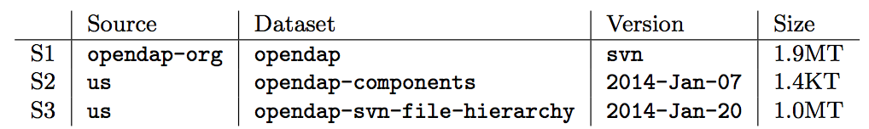
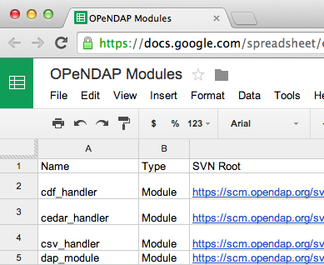

Step 1) Getting Started with OPeNDAP's Structural Provenance
@opendap:/home/prizms/prizms/opendap/source/us/opendap-components/version/2014-Jan-07/
http://opendap.tw.rpi.edu/source/us/dataset/opendap-components/version/2014-Jan-07
OPeNDAP’s Structural Provenance:
svn checkout https://scm.opendap.org/svn/
svn -log -v -xml | svn2prov > svn.ttl

Slide 23
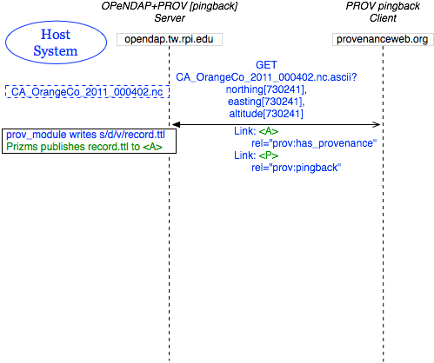
Step 2) Additions to the “host system” - OPeNDAP
Additional behavior:
1) Write PROV-O log
within local SDV directory
2) Include HTTP headers:
prov:has_provenance
prov:pingback
(minimal coupling)
Additional configuration:
  SDV’s base URI, source-id, and dataset-id
  (http://opendap.tw.rpi.edu , us, opendap-prov)
  Data root file path (…/data/source)
  PROV Pingback service URI (/prov-pingback)

Slide 24
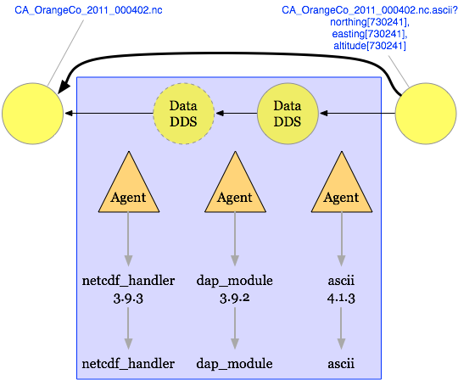
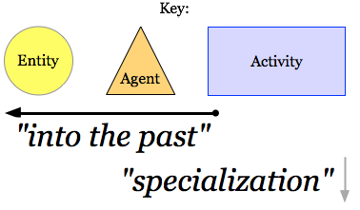
Step 2) What OPeNDAP Captures
Behavioral Provenance:
Structural Provenance

Slide 25

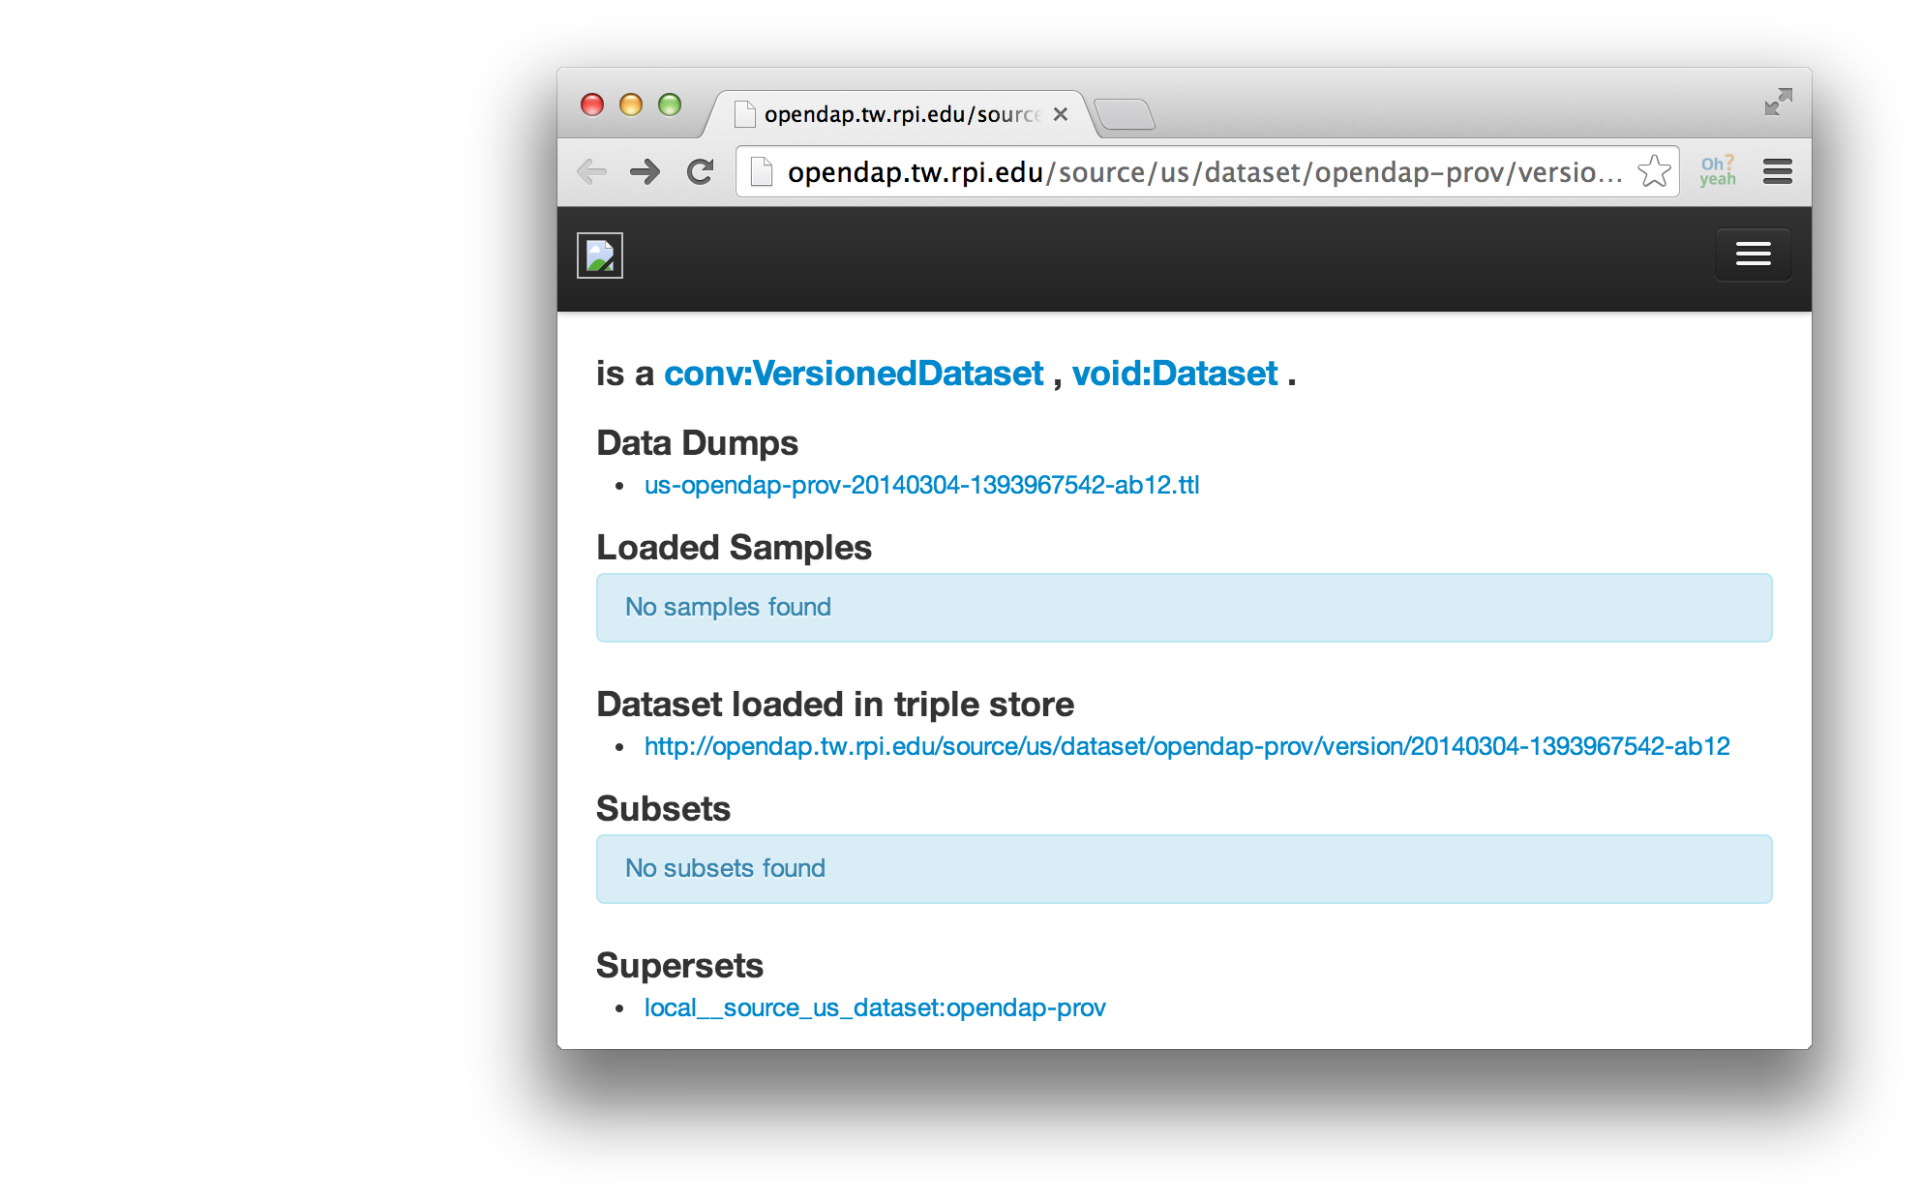
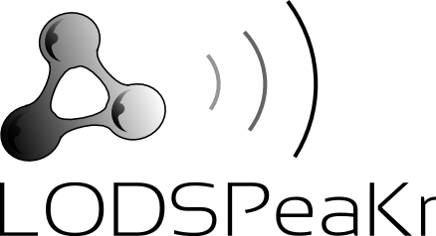
Viewing the PROV “Record”
http://opendap.tw.rpi.edu/source/us/
dataset/opendap-prov/
version/20140206-1391

Slide 26
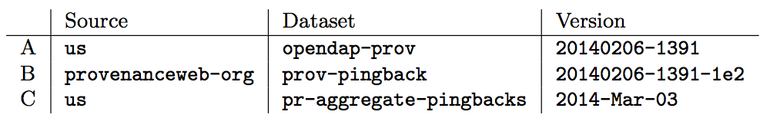
OPeNDAP Provenance
“SDV” Datasets
@opendap:/home/prizms/prizms/opendap/source/us/opendap-components/version/2014-Jan-07/
http://opendap.tw.rpi.edu/source/us/dataset/opendap-components/version/2014-Jan-07
OPeNDAP’s Structural Provenance:
From One PROV Pingback Cycle:

Slide 27
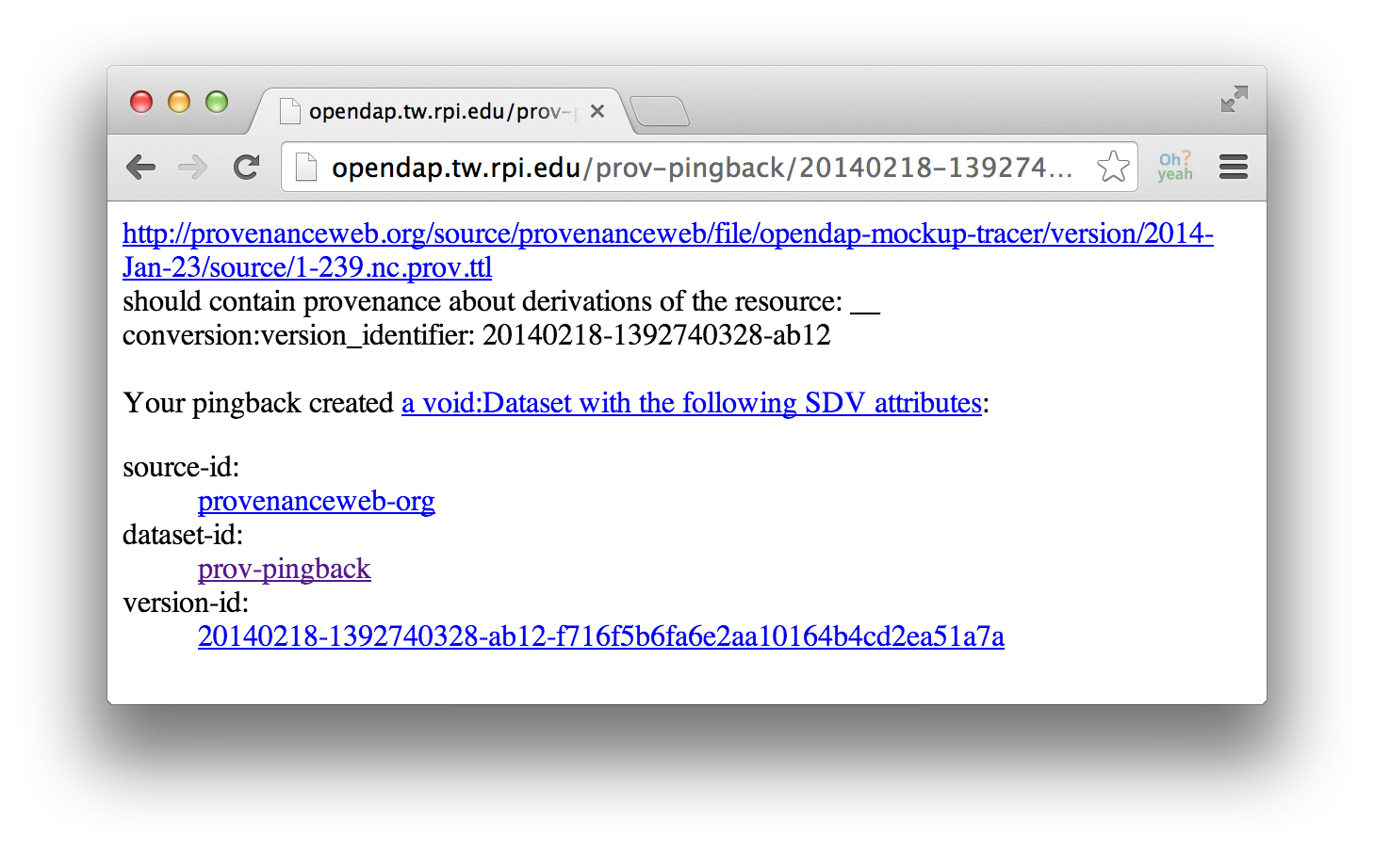
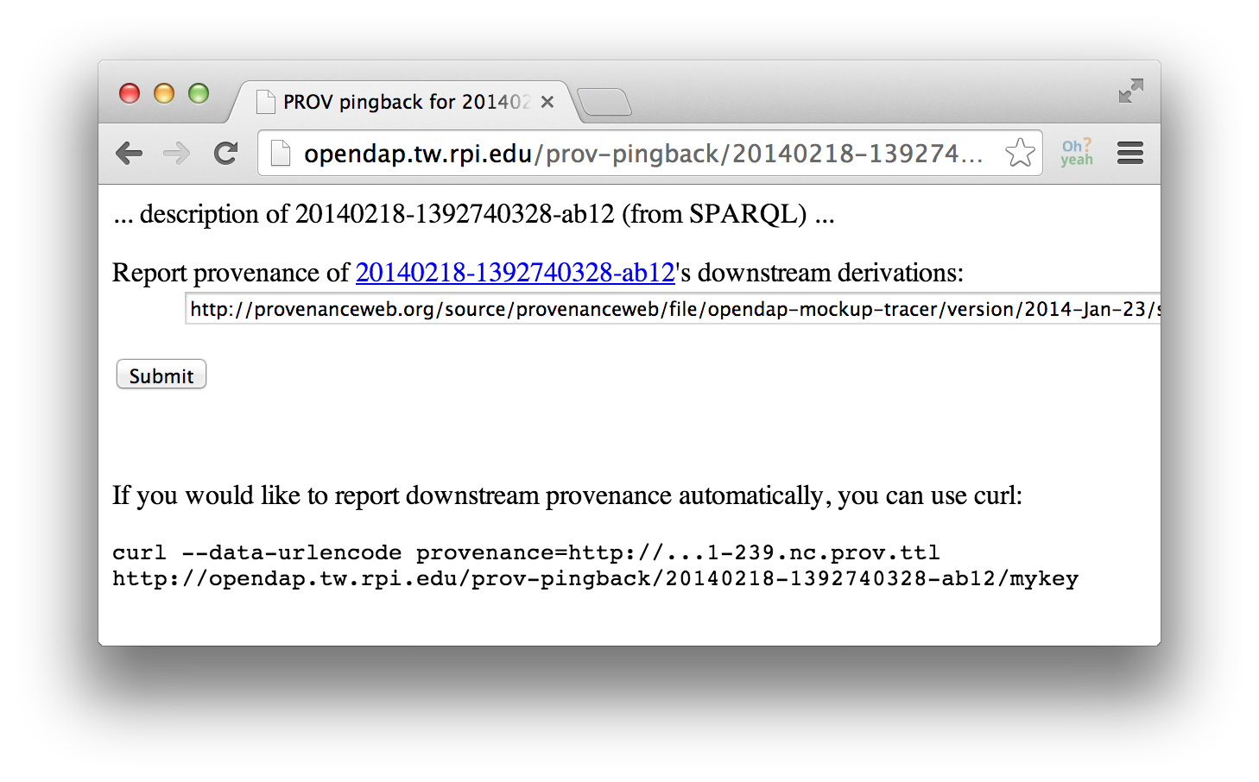
Step 3) Pingback: Accepting Downstream Provenance
http://opendap.tw.rpi.edu/prov-pingback/
20140218-1392740328-ab12/mykey

Slide 28
Step 3) Pingback: Accepting Downstream Provenance
@opendap:~/prizms/opendap/data/source/provenanceweb-org/prov-pingback/version/20140218-1392740328-ab12-f716f5b6fa6e2aa10164b4cd2ea51a7a/access.ttl
<http://opendap.tw.rpi.edu/source/provenanceweb-org/dataset/prov-pingback/version/2014……>
a void:Dataset, dcat:Dataset, conversion:PingbackDataset;
prov:wasDerivedFrom <http://opendap.tw.rpi.edu/source/us/dataset/opendap-prov/…>;
prov:wasDerivedFrom :download_f716f5b6fa6e2aa10164b4cd2ea51a7a; .
:download_f716f5b6fa6e2aa10164b4cd2ea51a7a
a dcat:Distribution;
dcat:downloadURL <http://provenanceweb.org/…/1-239.nc.prov.ttl>; .
From One PROV Pingback Cycle:

Slide 29
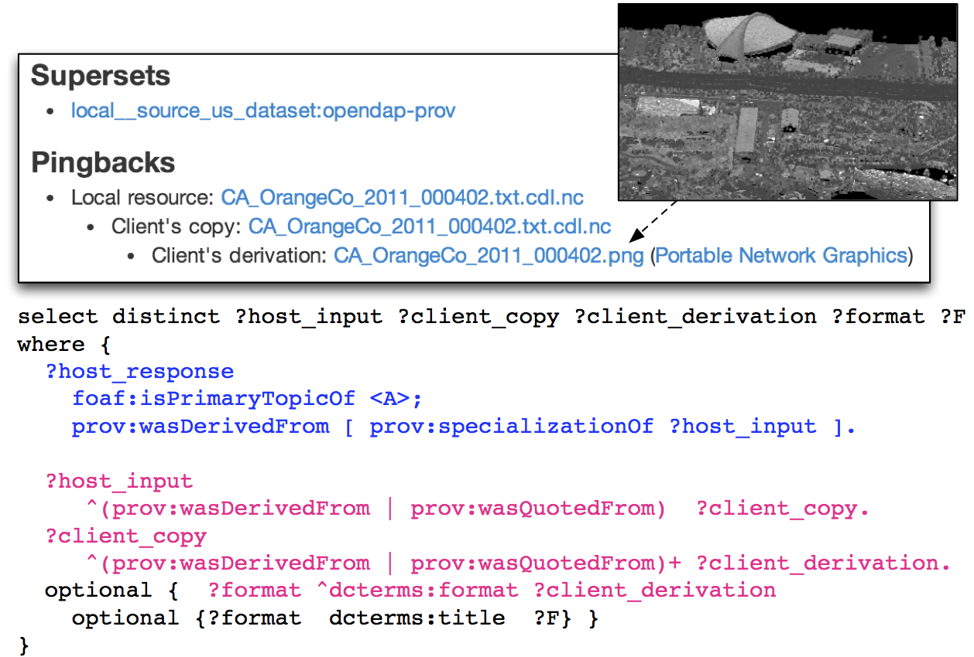
Single Local Query,
All Downstream Derivations
http://opendap.tw.rpi.edu/source/us/dataset/opendap-prov/version/20140304-1393967542-ab12

Slide 30
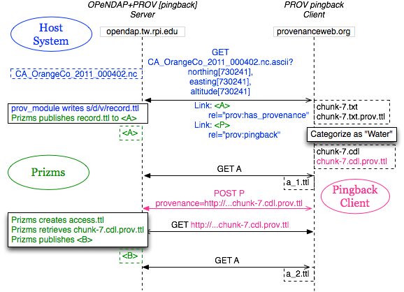
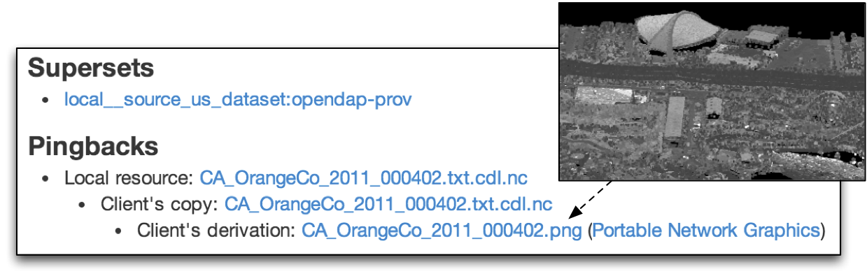
PROV Pingback:
The Sequence

Slide 31
Conclusions
An approach to publish the structural and behavioral provenance of existing host systems
  using minimal coupling to the Prizms platform
  such that provenance records may benefit as Linked Data even if its data cannot
Demonstrated PROV Pingback’s potential to interconnect provenance records that would traditionally sit in isolation

Slide 32
Outstanding Issues:
High Potential for Abuse
Control policies to adjust the tradeoff (discoverability vs. abuse).
Being selective about offering pingback services based on information about the client or its request.
Verify that every pingback submission is worthwhile, either by its
  URL (literally),
  URL contents, or by
  Authenticating the client as a member of a trusted group.
URL blocklists and whitelists can be helpful
  but can become tedious to manage.
URL contents should be handled with caution,
  performing it within a protected space
  aborting it if it does not appear to be in an expected format.

Slide 33
Outstanding Issues:
High Potential for Abuse
Any retrieved provenance should describe at least one derivation of a data product that the host served
  Otherwise, it is not relevant.
Authenticating the submitting client as a member of a trusted
  Not requiring a priori coordination would allow for increased contributions and discoverability.
Any mitigation strategy could also include a manual curation process at each stage.
Some abuse mitigation strategy MUST be established for PROV Pingback to be viable.

Slide 34




Future Work
PVCS – PROVenance for Version Control
pvcs.owl extending prov-o
git2provConverter.js
git2prov.sh
svn2prov.sh
hg2prov.sh

Slide 35
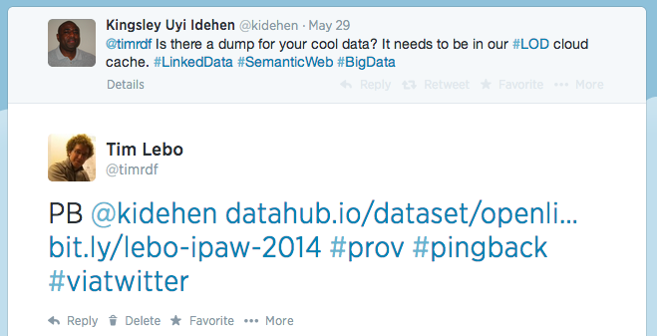
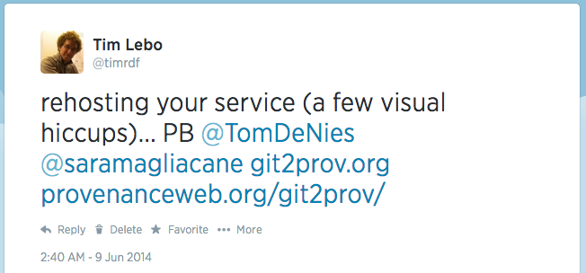
Future Work
@pingback via twitter [1] (… thanks to a reviewer)
[1] http://bit.ly/lebo-ipaw-2014#pingback-on-twitter-pb

Slide 36
Future Work
CALL TO ARMS
  Make your PROVenance more discoverable
  http://www.open-biomed.org.uk/prov-data/csiro.nt
  http://www.provbook.org/provenance
More thorough searches for PROV usage
  foreach ?endpoint in datahub.io:*/sparql
    foreach {prov:?term in ?endpoint}
    foreach {extension:?term in ?endpoint}
  How much PROV will the 2014 Billion Triples Challenge crawl [1] find?
[1] https://github.com/timrdf/DataFAQs/wiki/Billion-Triples-Challenge

Slide 37
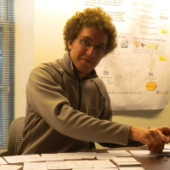



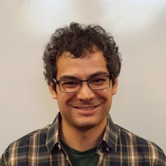


Thanks!
Aaron McVay
(use case)
Tim Lebo (Prizms, pingback, use case)
Patrick West (OPeNDAP++)
Deborah McGuinness (Advisor)
Nick del Rio
(paper feedback)

Slide 38
prefix prov: <http://www.w3.org/ns/prov#>
prefix pml: <http://provenanceweb.org/ns/pml#>
from <>
select *
where {
?question
a pml:Question;
prov:value ?text;
.
filter not exists {
?question prov:wasAttributedTo
<http://www.provbook.org/Luc>
}
}

Slide 39
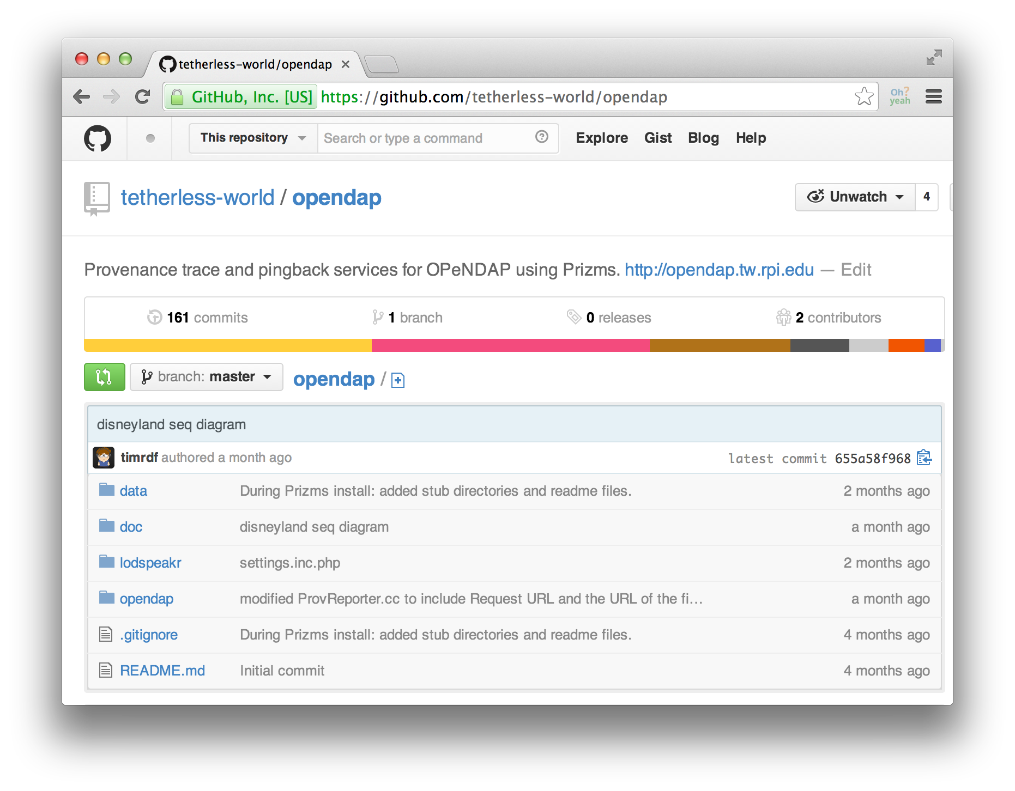
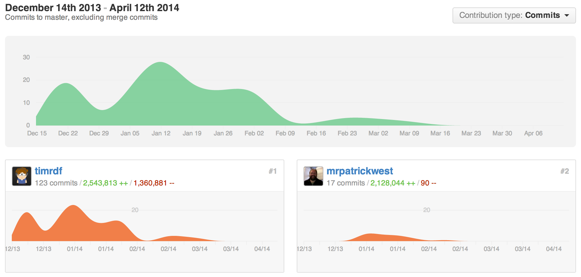
BTW, it’s on GitHub…
IPAW Submission deadline

Slide 40
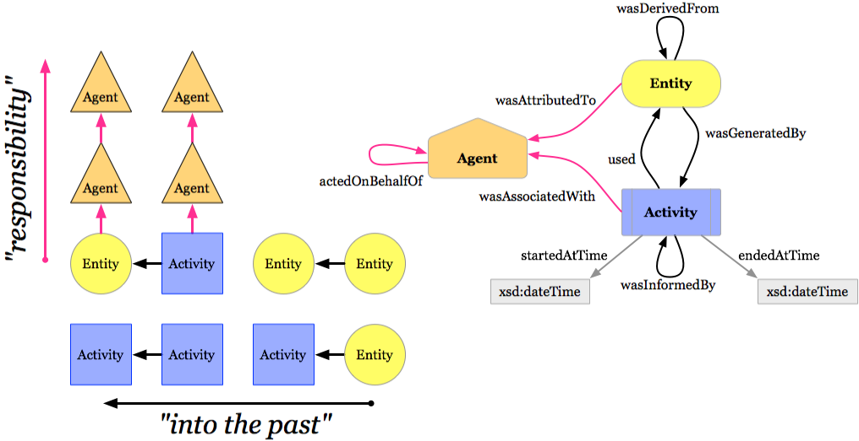
W3C PROVenance
Recommendation 20 Apr 2013
“Provenance is information about entities, activities, and people involved in producing a piece of data or thing, which can be used to form assessments about its quality, reliability or trustworthiness.”
http://www.w3.org/TR/prov-overview

Slide 41
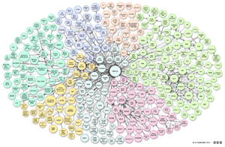

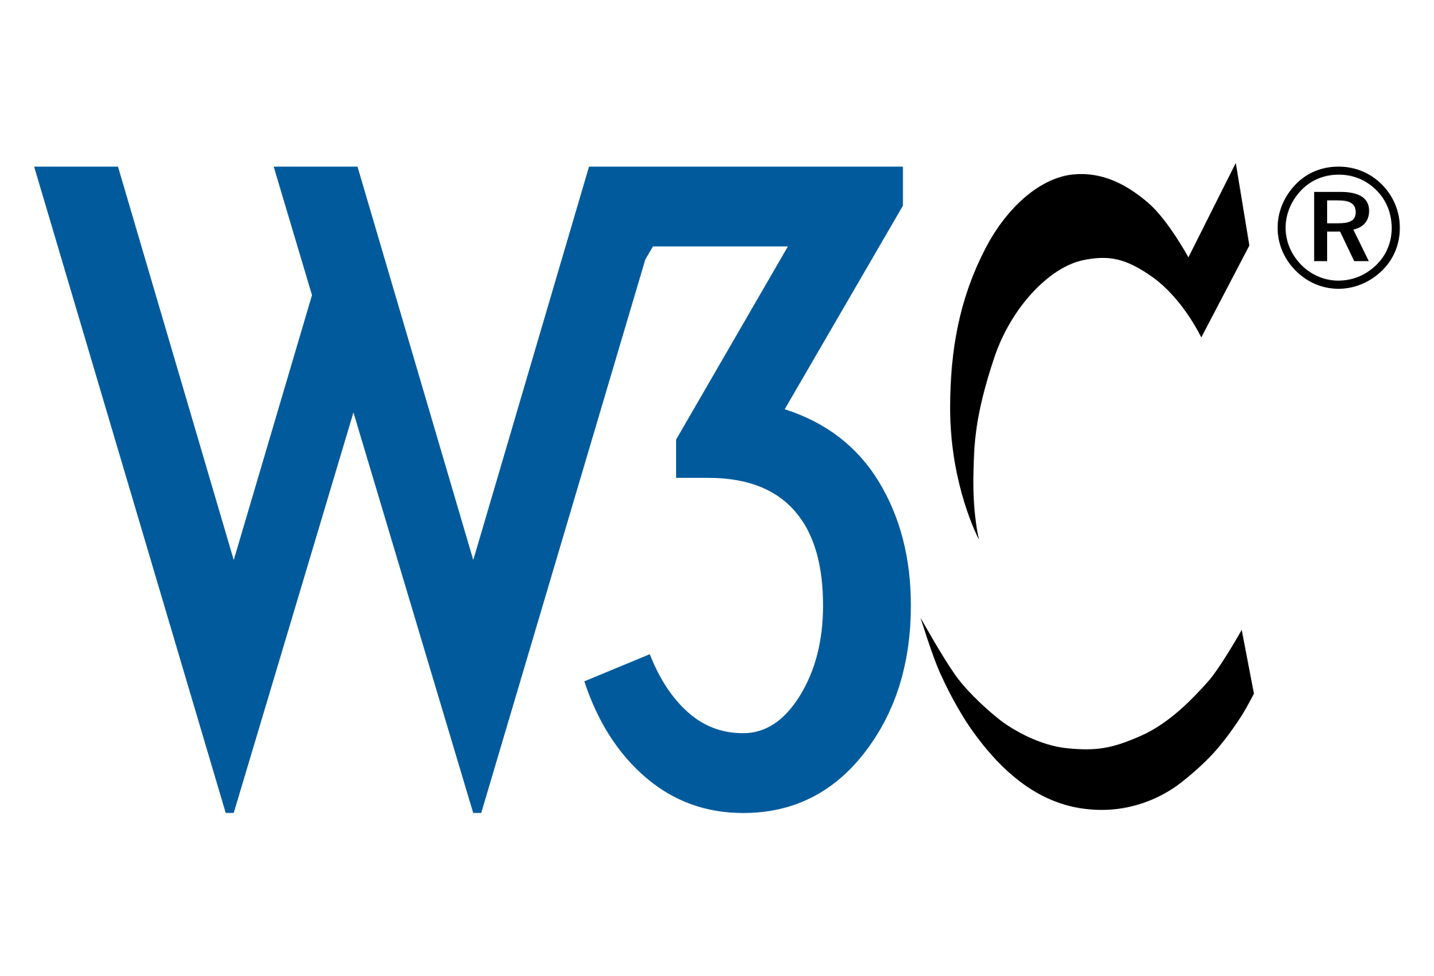

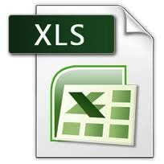

Linked Data
Avoids Archaeological Endeavors
Linked Data offers a huge potential for establishing explicit, understandable connections within and across data sources.
Include links to other URIs, so that people can discover more things.
Use HTTP URIs to name things, so that people can look up those names.
When someone looks up a URI, provide useful information in RDF.
Tim Berners-Lee
w3.org/DesignIssues/LinkedData
Available as non-proprietary format.
(e.g. CSV instead of Excel)
Available as machine-readable structured data. (e.g. Excel instead of image scan of a table)
Available on the web (whatever format) but with an open license.
http://5stardata.info

