Slide 1
DATA TYPES. ARRAYS.
Oleh Ivaniuk

Slide 2
AGENDA
Data types
Type Conversions
Arrays
Arrays methods

Slide 3
Data types

Slide 4
Data types
Data Type | Description
String | represents sequence of characters
Number | represents numeric values
BigInt | represents very large integers (greater than 2 ⁵³)
Boolean | represents boolean value either false or true
Undefined | represents undefined value
Null | represents null
Symbol | represents unique identifier
Object | represents instance through which we can access members
primitive data types
non-primitive data type

Slide 5
Data types. Dynamic (weak) typing
JavaScript is a language with dynamic (weak) typing. This means that variables can dynamically change type at runtime:
let x; // type undefined
console.log(x); // undefined
x = 45; // type number
console.log(x); // 45
x = "45"; // type string
console.log(x); // "45"
Although in the second and third case 45 will be output, but in the second case the variable x will represent the number and in the third case the string

Slide 6
Type Conversions. String
While writing programs, you may need to convert data from one type to another, The three most widely used type conversions are to:
- to String
- to Number
- to Boolean
Convert to string:
Function String()
let a = 20;
let data = String(a);
console.log(data); // "20"
console.log(typeof data); // "string"
Operation + and empty string
let a = 20;
let data = a + "";
console.log(data); // "20"
console.log(typeof data); // "string"

Slide 7
Type Conversions. Number
Convert to Number:
Function Number()
let a = "20";
let num = Number(a);
console.log(num); // 20
console.log(typeof num); // "number"
Unary operation +
let a = "20";
let num = +a;
console.log(num); // 20
console.log(typeof num); // "number"

Slide 8
Type Conversions. Number
Function parseInt() - converts to an integer
console.log(parseInt("7")); // 7
console.log(parseInt("7.5")); // 7
console.log(parseInt("7nm")); // 7
console.log(parseInt("nm")); // NaN
Function parseFloat() - converts to a fractional number
console.log(parseFloat("7")); // 7
console.log(parseFloat("7.125")); // 7.125
console.log(parseFloat("7nm")); // 7
console.log(parseFloat("nm")); // NaN
Function isNaN() - checks if a value represents a number
console.log(isNaN(1)); // false
console.log(isNaN("1")); // false
console.log(isNaN("1m")); // true
console.log(isNaN(null)); // false
console.log(isNaN(undefined)); // true

Slide 9
Type Conversions. Boolean
Boolean conversion:
Function Boolean()
let a = "1";
let bln = Boolean(a);
console.log(bln); // true
console.log(typeof bln); // "boolean"
Double Boolean NOT !!
let a = "1";
let bln = !!a;
console.log(bln); // true
console.log(typeof bln); // "boolean"

Slide 10
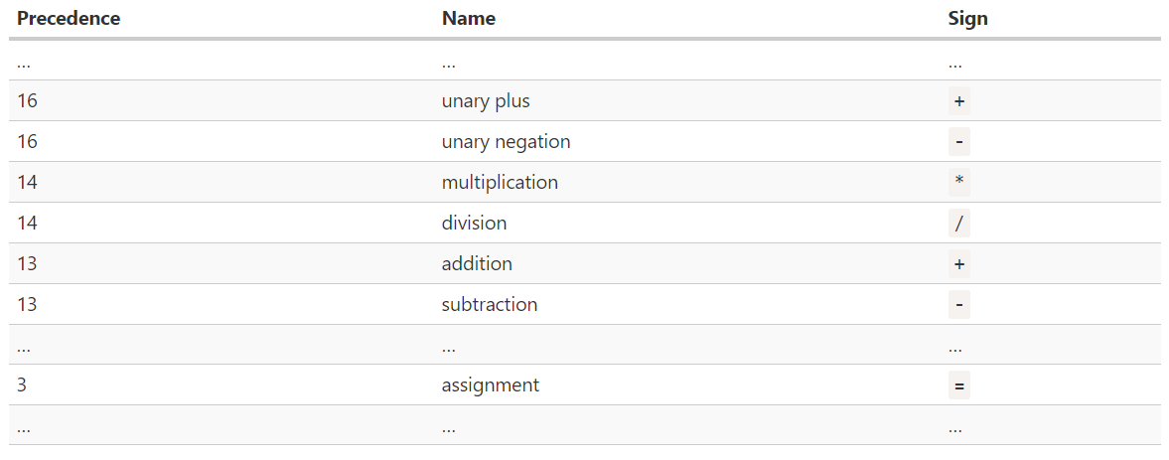
Operator precedence
If an expression has more than one operator, the execution order is defined by their precedence, or, in other words, the default priority order of operators.
To change the standard course of operations, some expressions can be put (taken) in brackets:
console.log(10 - 20 / 5); // 6
console.log(2 ** 4 * 2); // 32
let m = 2;
let n = m * (4 + 2);
console.log(n); // 12
Full
precedence table

Slide 11
Arrays

Slide 12
Arrays. Access by index
There is a special data structure called an array for storing ordered collections. There are 2 ways to create an array:
const arr = [];
const arr = new Array();
In this case, an empty array is created. Also, when created, it can be immediately initialized:
const cities = ["Rome", "Lviv", "Warsaw"];
Elements of the array are numbered starting from zero.
We can get the element by index, indicating its number in square brackets:
console.log(cities[0] ); // Rome
console.log(cities[1] ); // Lviv
console.log(cities[2] ); // Warsaw

Slide 13
Arrays. Add elements. Length property
The index also records/changes values for array elements :
const cities = ["Rome", "Lviv", "Warsaw"];
console.log(cities[0]); // Rome
cities[0] = "Berlin";
console.log(cities[0]); // Berlin
You can add elements (expand the array):
const cities = ["Rome", "Lviv", "Warsaw"];
console.log(cities[5]); // undefined – there are only 3 elements in array
cities[5] = "London";
console.log(cities[5]); // London
You can find out the current size of the array using the length property:
const cities = ["Rome", "Lviv", "Warsaw"];
console.log(cities.length); // 3

Slide 14
Arrays. Loop over an Array
Iterate through the elements of an array using a loop for of :
const cities = ["Rome", "Lviv", "Warsaw"];
for (let i of cities) { // run 3 times
console.log(i); // Rome, Lviv, Warsaw
}
Similar actions can be done with for :
const cities = ["Rome", "Lviv", "Warsaw"];
for (let i = 0; i < cities.length; i++) { // run 3 times
console.log(cities[i]); } // Rome, Lviv, Warsaw
The for construct is more flexible than for of. The for..of loop does not provide access to the current item number, only to its value. In for, you can jump several elements forward depending on the step of the counter and change the elements:
const cities = ["Rome", "Lviv", "Warsaw"];
for (let i = 0; i < cities.length; i += 2) {
cities[i] = cities[i] + "!";
} console.log(cities); // ["Rome!", "Lviv", "Warsaw!"]

Slide 15
Arrays. Arrays methods
Arrays provide many methods:
push(... items) - adds items to the end of the array
pop() - removes the element at the end of the array and returns it.
shift() - removes the element at the beginning of the array and returns it.
unshift(... items) - adds items to the beginning of the array.
slice(start, end) – creates a new array, copying elements from start to end (not including end) into it.
splice(pos, deleteCount, ...items) – starting at the pos index, removes deleteCount items and inserts items.
concat(...items) – returns a new array: copies all members of the current array and adds items to it.
forEach(func) – calls func for each element (enumeration)
map() – creates a new array with the results of calling a function for every array element.
…

Slide 16
Arrays. Arrays methods examples
Consider adding an element to the end of an array by the push() method.
const cities = ["Rome", "Lviv", "Warsaw"];
cities.push("Kyiv");
console.log(cities); // ["Rome", "Lviv", "Warsaw", "Kyiv"]
Consider deleting the first element of the array by the shift() method..
const cities = ["Rome", "Lviv", "Warsaw"];
cities.shift();
console.log(cities); // ["Lviv", "Warsaw"]
You can also delete an element of the array by its index (position) by the splice() method:.
const cities = ["Rome", "Lviv", "Warsaw"];
const deletedElem = cities.splice(0, 1); // Rome
console.log(cities); // ["Lviv", "Warsaw"]

Slide 17
Arrays. Arrays methods examples
The filter() method creates a new array with all the elements tested by the specified function.
const cities = ["Rome", "Lviv", "Warsaw"];
const newArr = cities.filter(function(citie) { return citie.length < 5 });
console.log(newArr); // ["Rome", "Lviv"]
The map() method creates a new array by performing a given function for each element of the array.
const cities = ["Rome", "Lviv", "Warsaw"];
const newArr = cities.map( function(city) { return city + "Capital" }); // ["RomeCapital", // "LvivCapital", "WarsawCapital"]
The reduce() method performs the reducer function you specified for each element of the array and returns a single value.
const data = [2, 4, 6, 8];
function reducer(total, value) { return total + value; }
const sum = data.reduce(reducer); // 20

Slide 18


