Slide 1
NODEJS INTRO
by Kulinskyi Vitalii
updated by Revutska Natalya

Slide 2

AGENDA
What is NodeJS?
Blocking and Non-blocking I/O
REPL Console
NPM & Module System
Global Objects
Filesystem module
HTTP Module

Slide 3
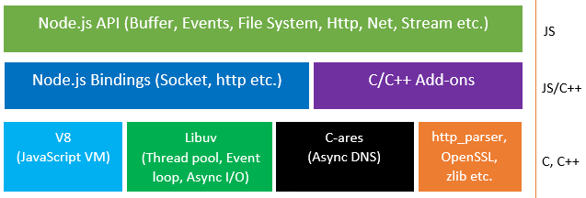
What is NodeJS ?
NodeJS is an open source , cross platform runtime environment for server side and networking applications
It is written in C/C++ & JavaScript and can run on Linux , Mac , Windows
It provides an event driven architecture with non blocking I/O that is optimal for scalability.
It uses Google JavaScript V8 Engine to Execute Code

Slide 4

JAVASCRIPT V8 ENGINE
V8 is an open-source JavaScript engine developed by The Chromium Project for Google Chrome and Chromium web browsers.
V8 compiles JavaScript to native machine code before executing it
V8 can run standalone, or can be embedded into other application

Slide 5
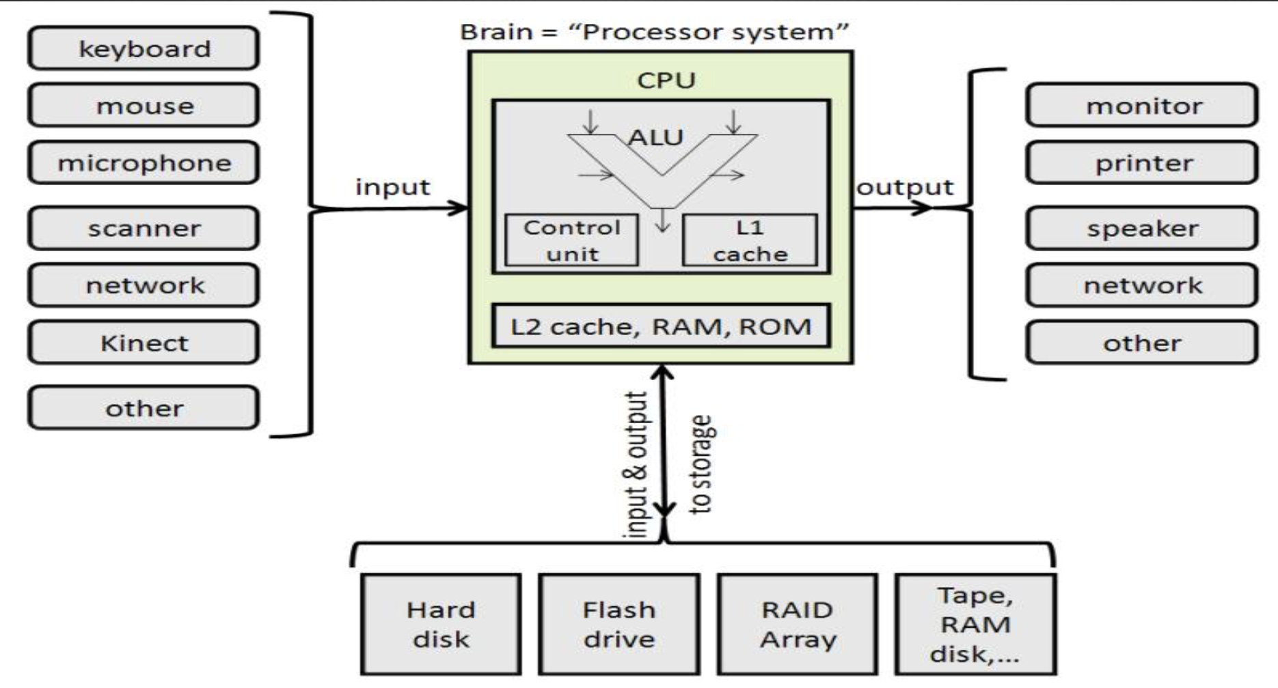
Input/Output (I/O)
Input/Output (I/O) is the communication between an information processing system, such as a computer, and the outside world, possibly a human or another information processing system.
Inputs are the signals or data received by the system
Outputs are the signals or data sent from it.

Slide 6
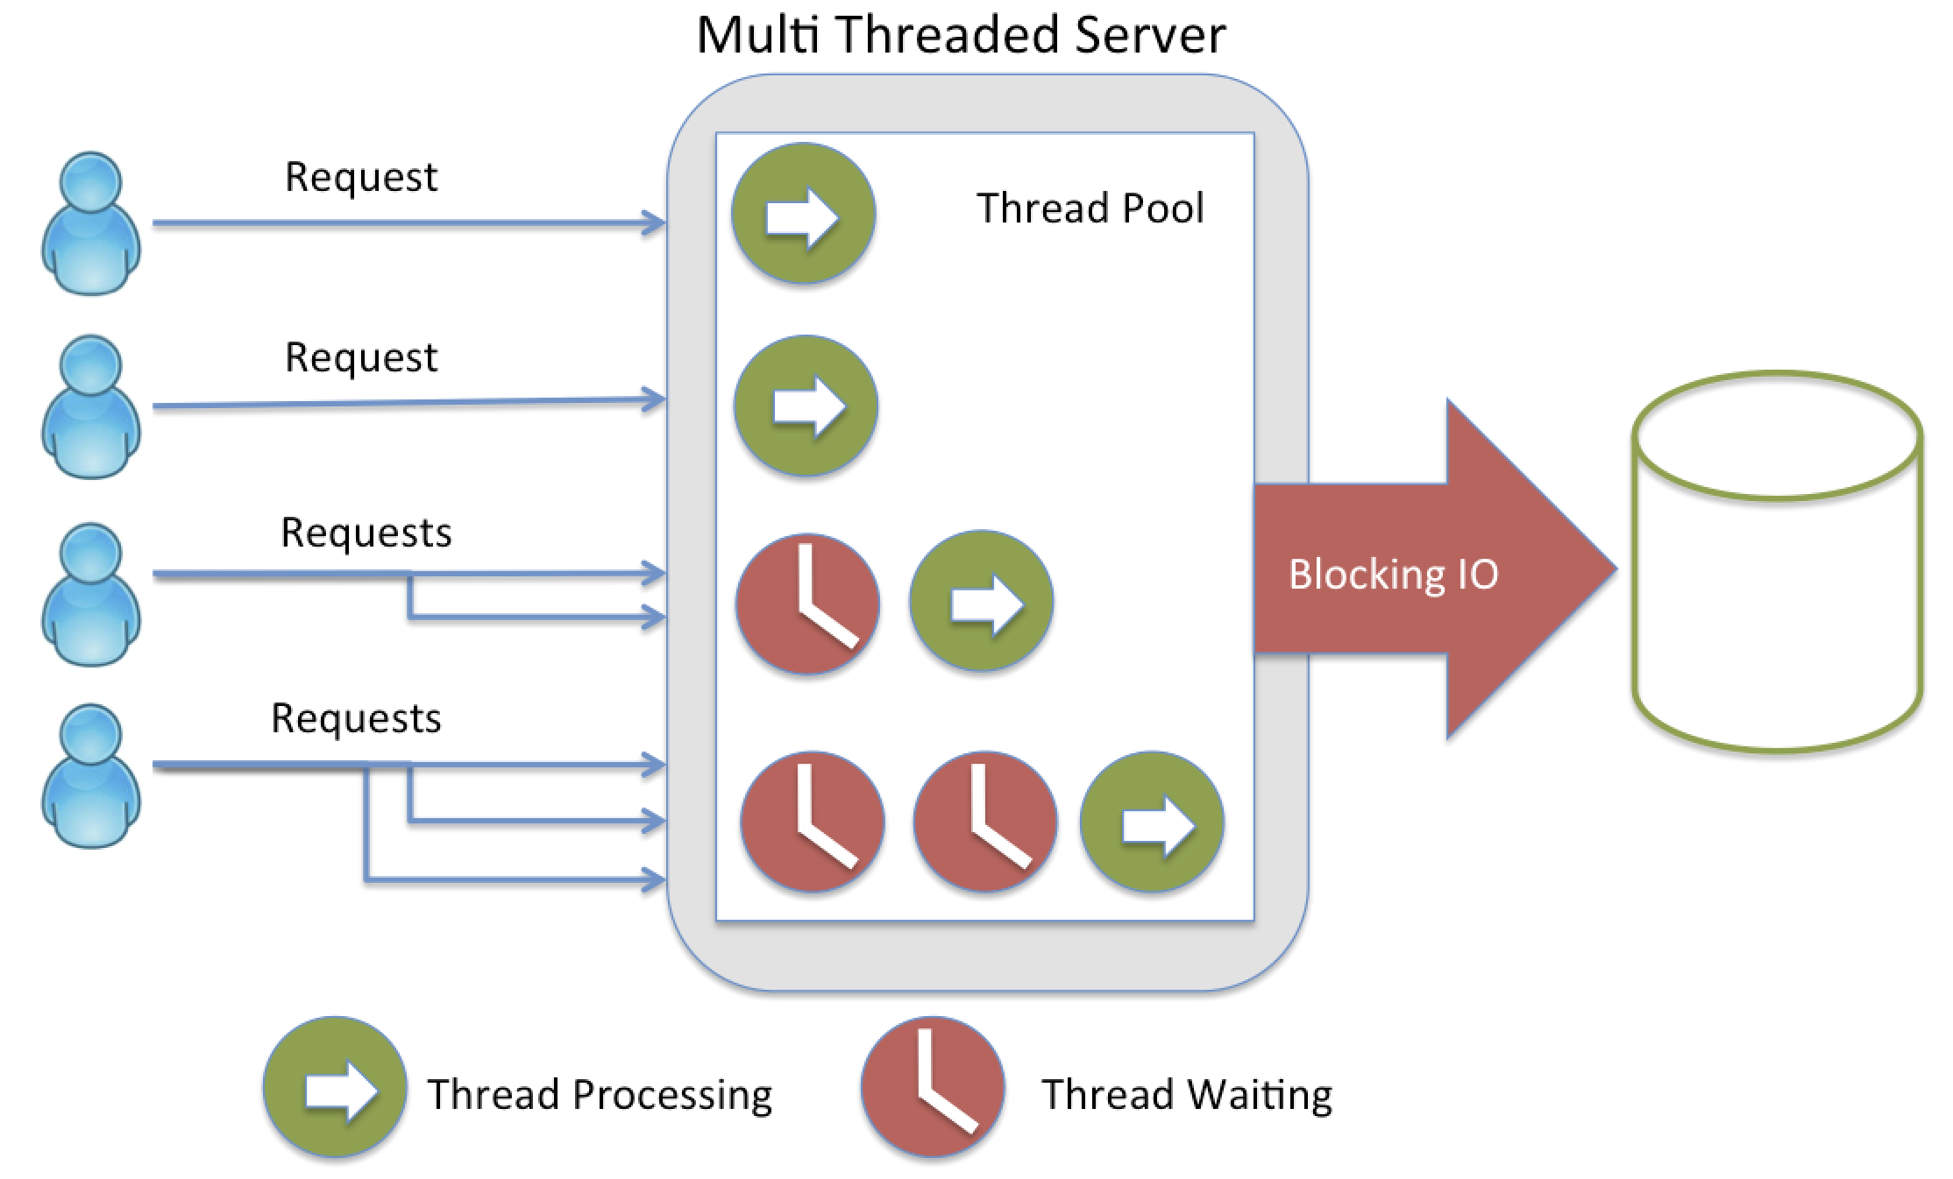
BLOKING I/O
Blocking is when the execution of additional JavaScript in the Node.js process must wait until a non-JavaScript operation completes.

Slide 7
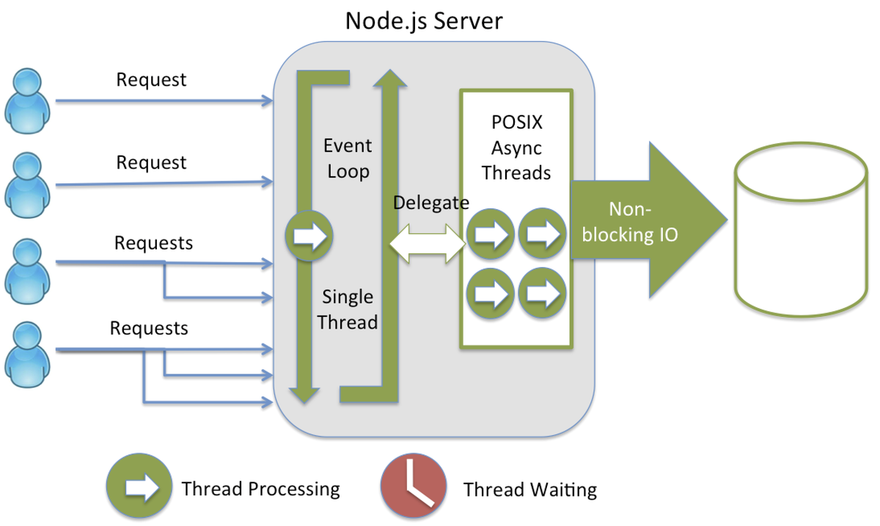
NON-BLOCKING I/O
In Non-blocking I/O once the request is made we continue on to the next line of code before waiting for the time consuming request to finish.

Slide 8
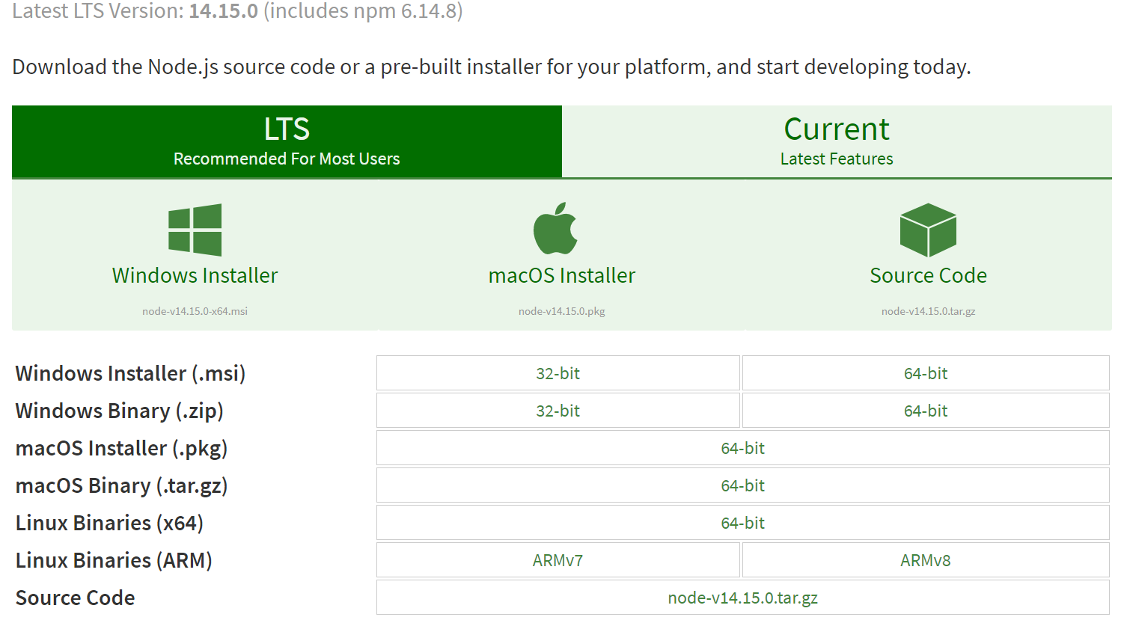
NODEJS SETUP
https://nodejs.org/en/download/

Slide 9
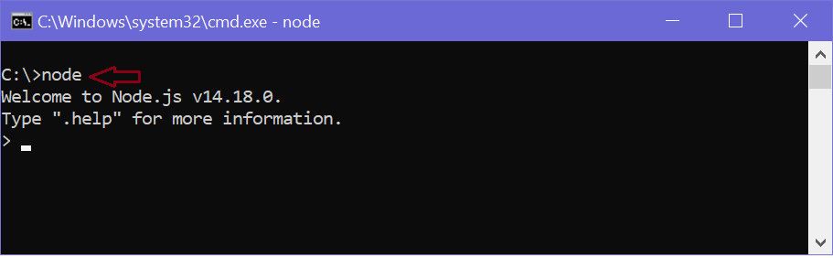
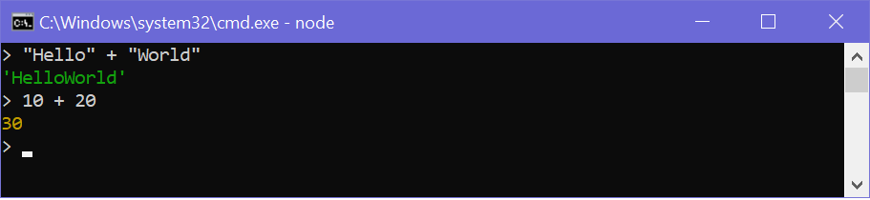
REPL CONSOLE

Slide 10
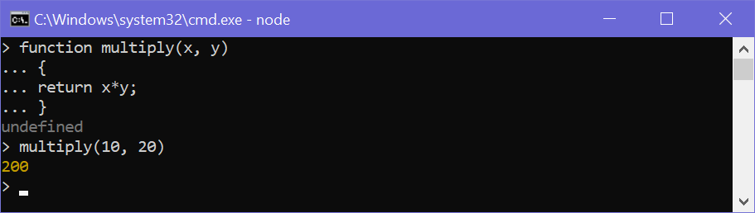
REPL CONSOLE

Slide 11
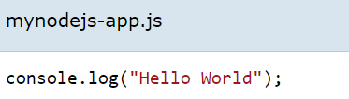
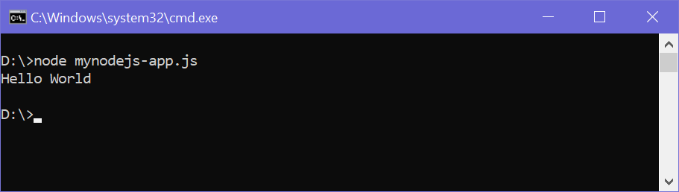
REPL CONSOLE

Slide 12
REPL COMMANDS
REPL Command | Description
.help | Display help on all the commands
tab Keys | Display the list of all commands.
Up/Down Keys | See previous commands applied in REPL.
.save filename | Save current Node REPL session to a file.
.load filename | Load the specified file in the current Node REPL session.
ctrl + c | Terminate the current command.
ctrl + c (twice) | Exit from the REPL.
ctrl + d | Exit from the REPL.
.break | Exit from multiline expression.
.clear | Exit from multiline expression.

Slide 13

NODE PACKAGE MANAGER
Node Package Manager (NPM) is a command line tool that installs, updates or uninstalls Node.js packages in your application. It is also an online repository for open-source Node.js packages. The node community around the world creates useful modules and publishes them as packages in this repository.
https://www.npmjs.com/

Slide 14
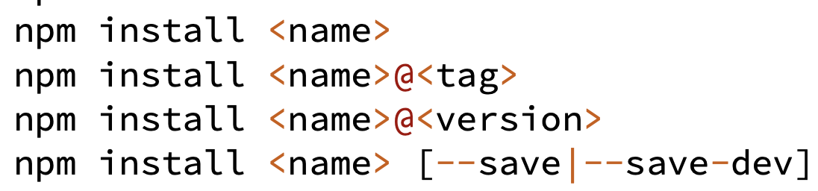
INSTALLING A NPM MODULE
All the modules installed using NPM are installed under node_modules folder.

Slide 15
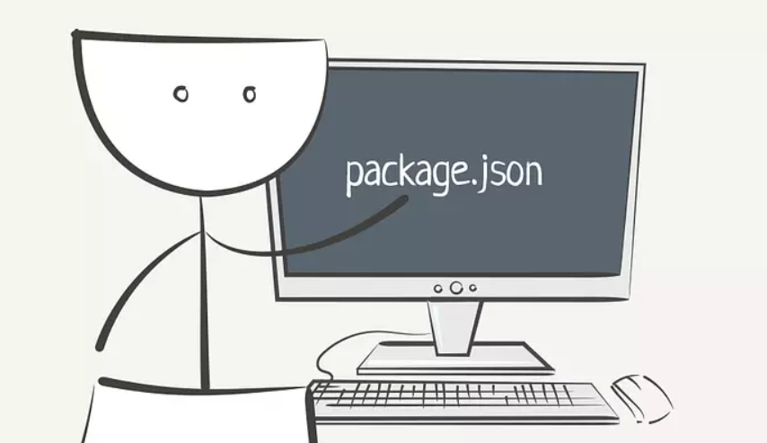
PACKAGE.JSON
The package.json file is kind of a manifest for your project. You can add a it to your package to make it easy for others to manage and install. Packages published to the registry must contain a package.json file.
A package.json file:
lists the packages your project depends on
specifies versions of a package that your project can use
makes your build reproducible, and therefore easier to share with other developers

Slide 16
MODULES IN NODEJS
NodeJS Module system lets developers create a manageable structure of their application
Each module is just a JavaScript file with code (functions, variables, objects, etc.)
In Node, modules are referenced either by file path or by name
Referenced by name modules are either core modules (preinstalled with Node) or third-party modules installed using NPM
Each module exposes public API that the developer can use after the module is imported into the current script

Slide 17
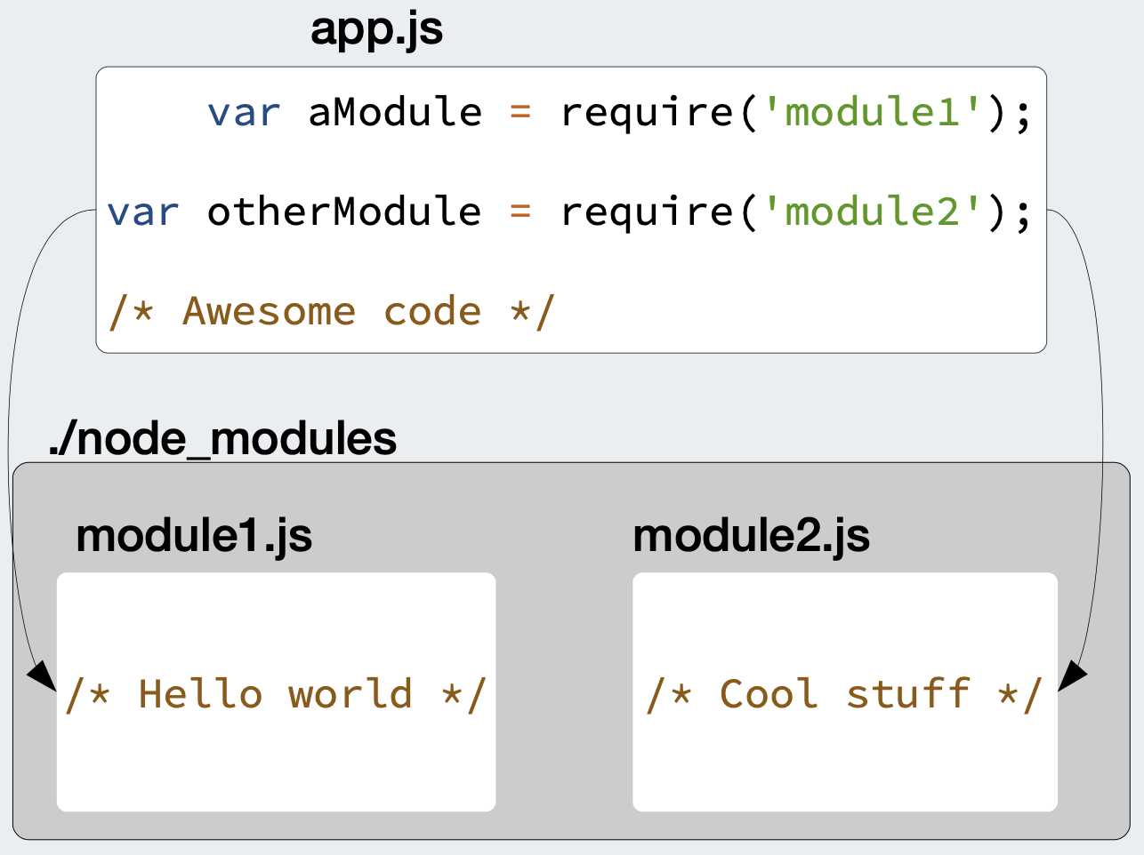
LOADING AND EXPORTING MODULES
To load/import a module, you have to use the require function
The require function returns an object that represents the JavaScript API exposed by the module
Depending on the module, that object can be any JavaScript value — a function, an object with some properties that can be functions, an array, or any other type of JavaScript object

Slide 18
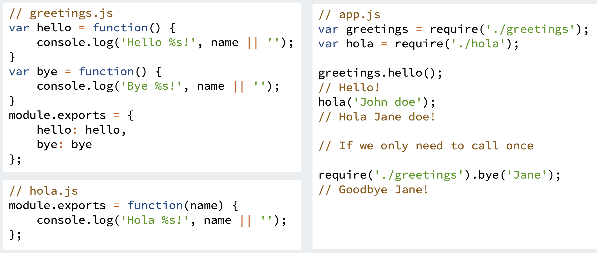
LOADING AND EXPORTING MODULES
To export an object/function/variable from a module, use the module.exports object

Slide 19
GLOBAL OBJECTS
These objects are available in all modules:
process - In computing, a process is an instance of a computer program that is being executed.
console - For printing to stdout and stderr.
require - used to load or import local files, JSON and modules..
__filename – returns the absolute path of the file being executed. It is not available in the Node.js REPL..
__dirname – returns the path of the directory the script is executing in. It is not available in the Node.js REPL.
module.exports is used for defining what a module exports and makes available through require().
setTimeout(cb, ms) – Run callback cb after at least ms milliseconds. The timeout must be in the range of 1-2,147,483,647 cannot span more than 24.8 days.
clearTimeout(t) – Stop a timer that was previously created with setTimeout().
setInterval(cb, ms) – Run callback cb repeatedly every ms milliseconds
clearInterval(t) - Stop a timer that was previously created with setInterval().

Slide 20

FILE SYSTEM MODULE
The fs module provides a lot of very useful functionality to access and interact with the file system.

Slide 21
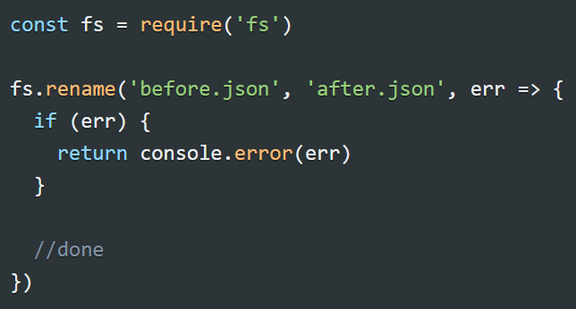
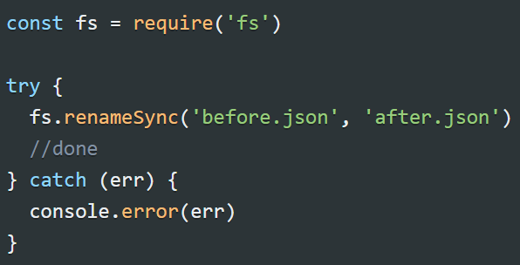
FILE SYSTEM MODULE
For example let's examine the fs.rename() method:
The asynchronous API is used with a callback:
A synchronous API can be used like this, with a try/catch block to handle errors:

Slide 22
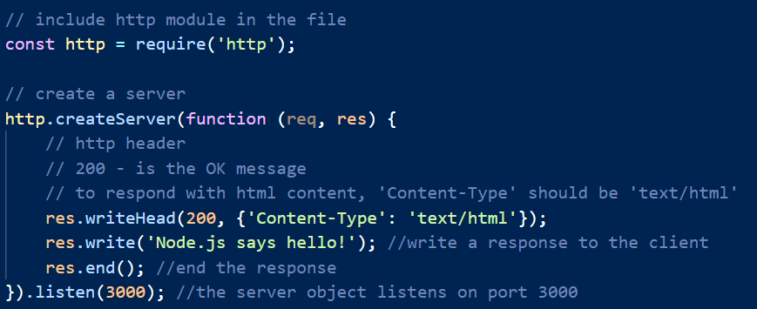
HTTP MODULE
It is easy to create an HTTP server in Node.js. A Node server is typically created using the createServer method of the http module and run this with

Slide 23


